Slide 1

MHK Claims Scoring Predictive Analytics - Update
December, 2017
R1

Slide 2

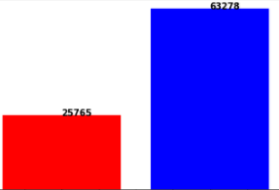


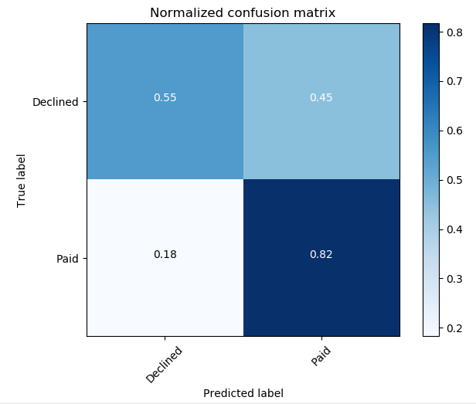

Claim Scoring Prediction - Overview
Data
Method/Procedure
Modeling data: Jan - Oct, 2017
Consider Claims and Sales data
311,490 claim records
31% claims related to quality…89,043
Paid vs. Declined Claims = 71%: 29%
205,765 transactions
35,270 customer records
Modeling data (w.r.t. quality) ... customer ~ 10,000
Data cleaning: missing, imputation, etc.
Data mining: dist. Box, outlier …
5 factors: #claims, #sales, $/claim, $/sale, and $claim/$sale
Data normalization and preprocessing
Machine learning: logistic, GBCT, RF…
Iteratively hierarchical AI modeling
Advanced analytics: Xgboot,NN,ELM,Bayes
Results/Impacts
Next
12 models comparison
Prediction Accuracy: >70%
Continuous improvement
More factors
Online QA
Customer specific modeling
Online Implementation
L1 Logistic
L2 Logistic (OvR)
RBF SVC
Linear SVC
L2 Logistic (Multinomial)
Naïve Bayes
Nearest Neighbors
Decision Tree
Random Forest
Neural Network
AdaBoost
QDA

Slide 3
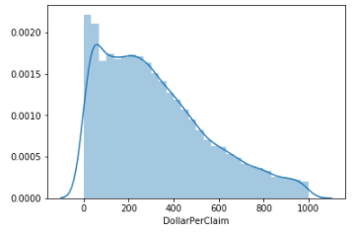
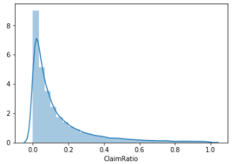
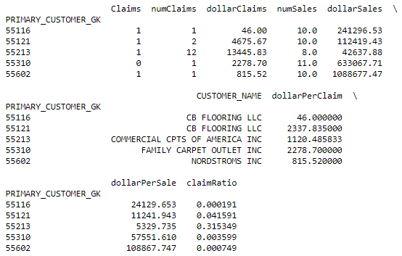
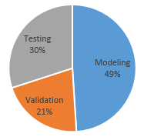
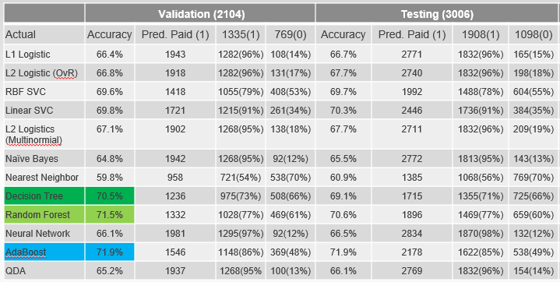
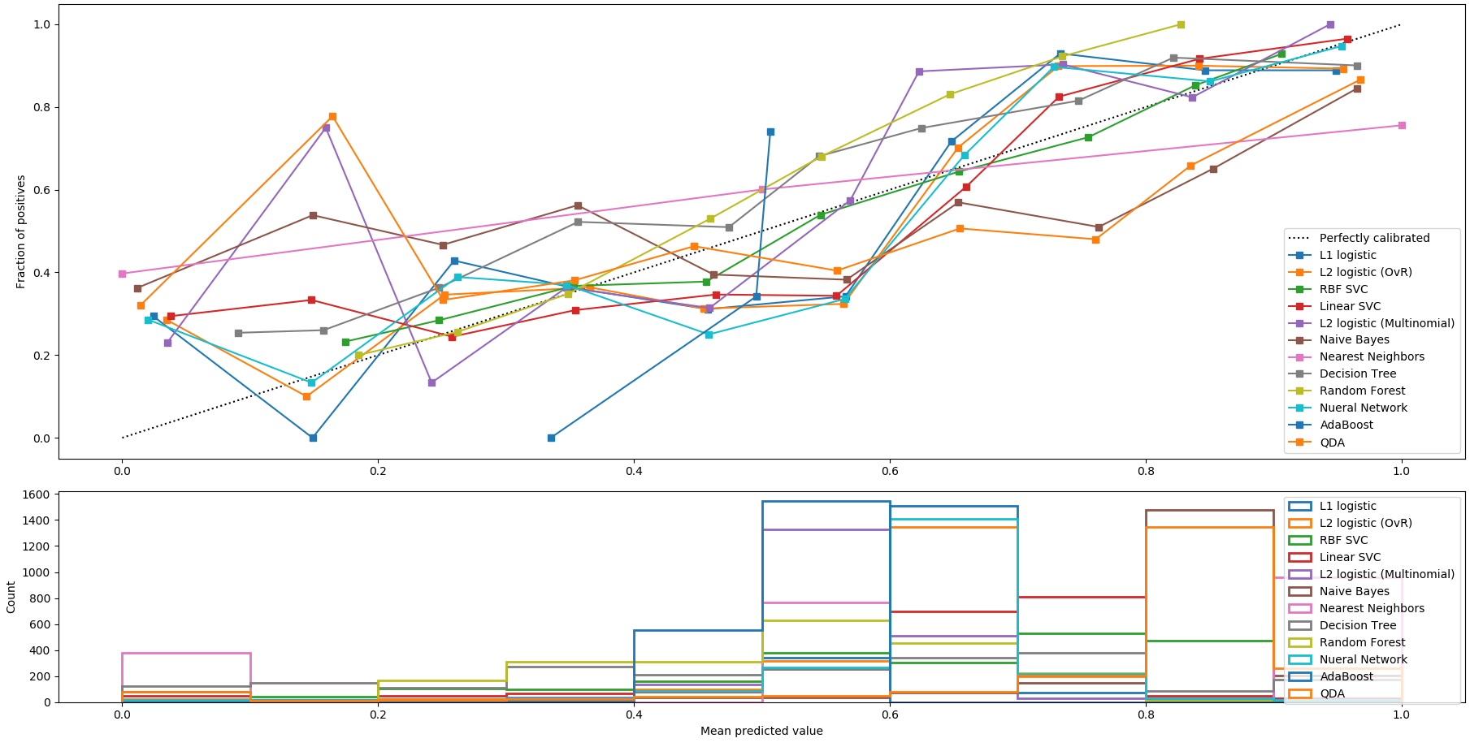
Model
Target: binary classification
Paid (1) vs. Declined (0)
Data Components
1: 63.5%
0: 36.5%
$/Claim
Input Factors
#Claims
#Sales
$/Claim
$/Sale
$Claim/$Sale
Data (~10,000)
Modeling: 4900(49%)
Validation:2100(21%)
Testing:3000(30%)
$Claims/$Sale
12 Methods
L1 Logistic
L2 Logistic (OvR)
RBF SVC
Linear SVC
L2 Logistic (Multinomial)
Naïve Bayes
Nearest Neighbors
Decision Tree
Random Forest
Neural Network
AdaBoost
QDA
Data Normalization
Modeling
Output
Paid (1) or Declined (0)
Confidence (Score)

Slide 4
Results
 | Validation (2104) |  |  |  | Testing (3006) |  |  |  | Comments
Actual | Accuracy | Pred. Paid (1) | 1335(1) | 769(0) | Accuracy | Pred. Paid (1) | 1908(1) | 1098(0)
L1 Logistic | 66.4% | 1943 | 1282(96%) | 108(14%) | 66.7% | 2771 | 1832(96%) | 165(15%) | Prone to Paid, ↑false , reduce $
L2 Logistic (OvR) | 66.8% | 1918 | 1282(96%) | 131(17%) | 67.7% | 2740 | 1832(96%) | 198(18%) | Prone to Paid, ↑false , reduce $
RBF SVC | 69.6% | 1418 | 1055(79%) | 408(53%) | 69.7% | 1992 | 1488(78%) | 604(55%) | Slightly balanced, but ↑false
Linear SVC | 69.8% | 1721 | 1215(91%) | 261(34%) | 70.3% | 2446 | 1736(91%) | 384(35%) | Prone to Paid, ↑false , reduce $
L2 Logistics (Multinormial) | 67.1% | 1902 | 1268(95%) | 138(18%) | 67.7% | 2711 | 1832(96%) | 209(19%) | Prone to Paid, ↑false , reduce $
Naïve Bayes | 64.8% | 1942 | 1268(95%) | 92(12%) | 65.5% | 2772 | 1813(95%) | 143(13%) | Prone to Paid, ↑false , reduce $
Nearest Neighbor | 59.8% | 958 | 721(54%) | 538(70%) | 60.9% | 1385 | 1068(56%) | 769(70%) | Prone to declined, ↑miss, ↓customer
Decision Tree | 70.5% | 1236 | 975(73%) | 508(66%) | 69.1% | 1715 | 1355(71%) | 725(66%) | Balanced prediction results
Random Forest | 71.5% | 1332 | 1028(77%) | 469(61%) | 70.6% | 1896 | 1469(77%) | 659(60%) | Balanced, but slightly prone to Paid
Neural Network | 66.1% | 1981 | 1295(97%) | 92(12%) | 66.5% | 2834 | 1870(98%) | 132(12%) | Prone to Paid, ↑false , reduce $
AdaBoost | 71.9% | 1546 | 1148(86%) | 369(48%) | 71.9% | 2178 | 1622(85%) | 538(49%) | Prone to Paid, ↑false , reduce $
QDA | 65.2% | 1937 | 1268(95% | 100(13%) | 66.1% | 2769 | 1832(96%) | 154(14%) | Prone to Paid, ↑false , reduce $
Voting(RF, DT, SVC) | 72.4% | 1440 | 1095(82%) | 423(55%) | 72.1% | 2045 | 1565(82%) | 615(56%) | Prone to Paid
Recommend two models: Decision Tree and Random Forest
Both balance the paid and declined prediction, particularly DT method
Voting method is strongly recommended if possible, as it is robust after integrating different individual models

Slide 5
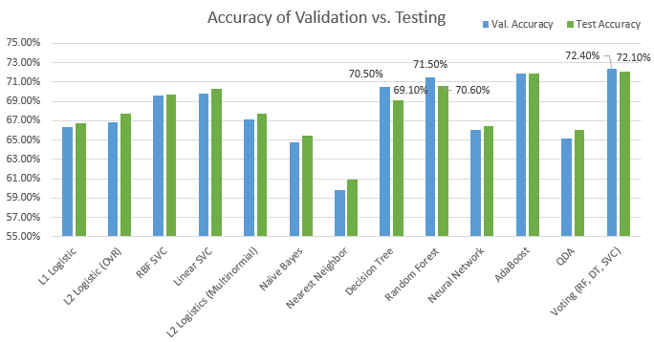
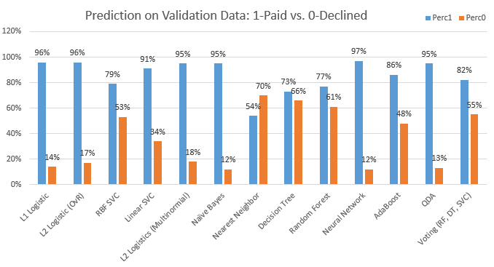
Method Comparison
Prone to predict the “Paid” claims, company will loss benefits
NN method: Prone to predict the “Declined” claims, customer will not be happy
DT, RF & Voting methods have the testing accuracy lower than validation ones, which makes sense
Other methods may be overfitting for ‘Paid”…need to be improved for business purpose
Voting method: Balance the accuracy and bias of prediction.
DT & RF: Balance the binary prediction.

Slide 6
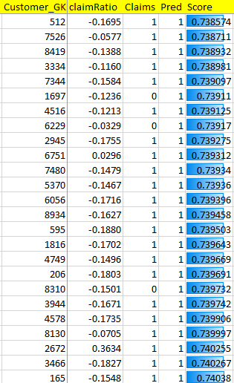
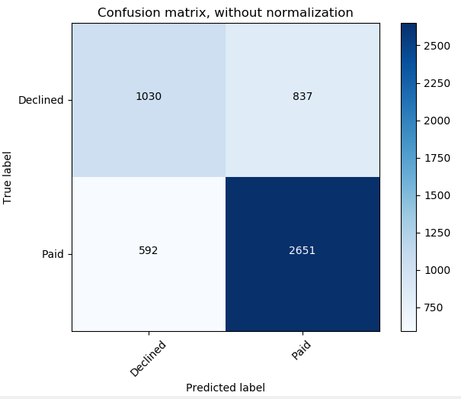
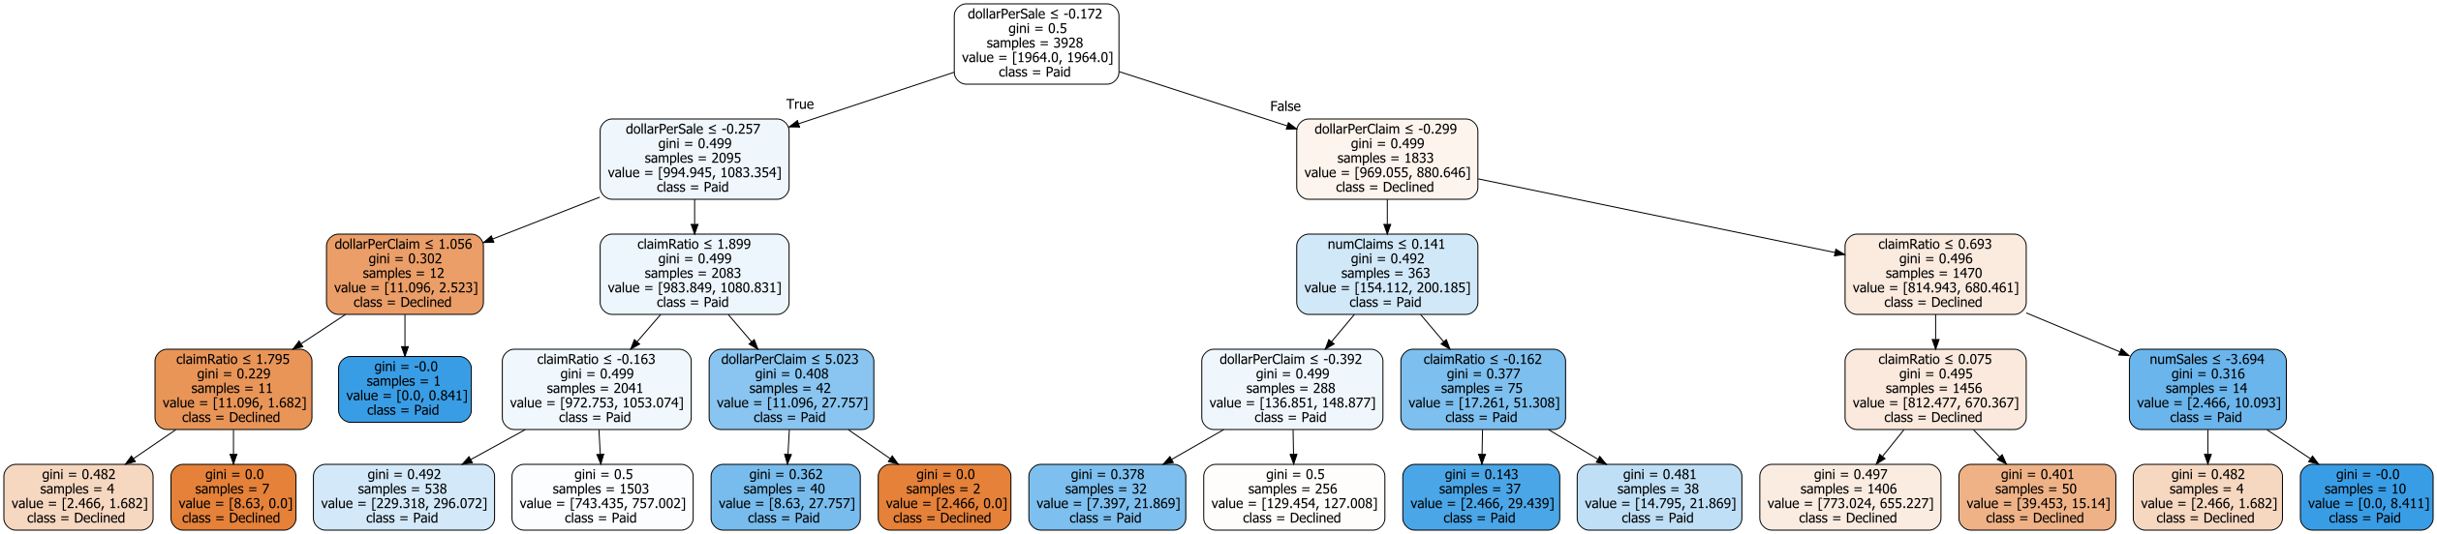
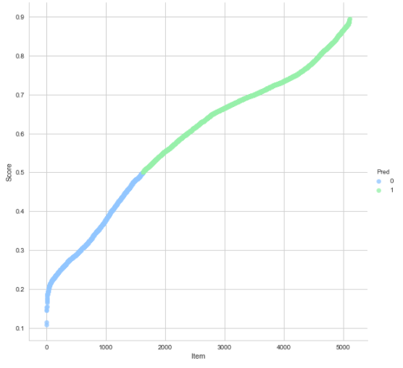
Visualization Results
1867
Scorecard
3243
Decision Tree

Slide 7
Thanks

Slide 8
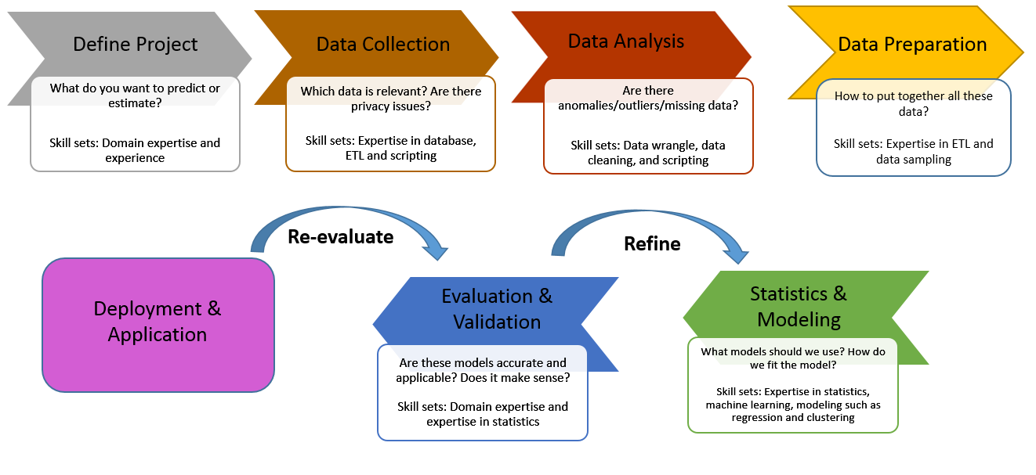
Modeling Process

