Slide 1

MHK Claims AI Scoring Predictive Analytics - Update
Xiaomo Jiang
Yatkwai Kee
Richard Yan
Deepak Jhamta
Jithendra Koduru
February, 2018
R4.1

Slide 2
Version Control
Ver | Description | Date
1 | Preliminary modeling Customer historical pattern … Sales + Claims Jan-Oct 2017 Voting model (RF, DT, SVC) … 70% accuracy | 12/10/2017
2 | Customer pattern (Sales, Claims) + Product Attributes (Size, Style, Color & Backing) Online application w/ dashboard update on 1/10/2018 Review with Operation team on 1/26/2018 Model accuracy … 72% | 1/10/2018
3 | Add ML/AI slides & online implementation flowchart Compare models w/ or w/o PCA Segmentation: Highly likely (>60%)..>80% accuracy, unsure, highly unlikely (<40%) Review it in Lunch & Learn | 2/2/2018
4 | Add product historical issues via rolls New data set with cleaning in SQL script .. Jan 2017 – Feb 2018 Explore more classification methods Updated model accuracy … 83% Segmentation: Highly likely (>75%)-->92%, unsure, highly unlikely (<25%)--~88% … cover 67% claims | 2/22/2018

Slide 3
Analytics … Turn Data into Decision
Descriptive What has happened?
Diagnostic Why did it happen?
Prescriptive
What should I do about it?
Predictive What is likely to happen in future?
Automation
Intelligence
Optimization
Rules
Robustness
Simulation
Modeling
Text Mining
Prediction
Data Insight Decision
Statistics
Detection
Easy intermediate Hard
Business Value
Machine Learning
Forecasting
Analytics Efforts
Data Mining
Probability
Scoring
Recommendation
Expert Inputs to Decision
OLAP
Visualization
Dashboard
Planning
BI
Reporting
Analytics Focus
Past Present Future

Slide 4
Predictive Modeling … Iterative Procedure
Project Definition
Data
Collection
Data Analysis
Validation/ Testing
Data Preparation
Predictive Modeling
Deployment/ Application
Are there any roadblocks for application?
What do we want to predict or estimate?
AI
Are these models accurate and applicable? Does it make sense physically?
What data is available? Is there any data restriction?
Analytics
Business Value
Big Data
What models should we use to trade-off the complexity and accuracy?
Are there any anomalies/outliers/ missing/imbalance?
How to put together all data from different sources? Do we need dimension reduction?

Slide 5

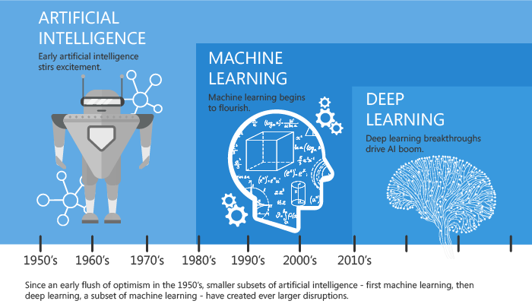
Analytics Techniques …AI, Machine Learning & Deep Learning
Artificial Intelligence
Any technique which enables computers to mimic human behavior
Machine Learning
Subset of AI techniques which enables machines intelligent
Deep Learning
Subset of ML which makes the computation of complicated multi-layer neural networks feasible
Big Data
Complexity
High Performance Computation
Cloud technology
High speed internet
Analytics & Data Science
http://blog.devitpl.com/learning-machine-learning/

Slide 6
Claim AI Scoring Improve Claim Process Speed and Accuracy
Business Objective | Improve claim processing speed and accuracy, reduce cost of claims and improve customer satisfaction
Use Case Capability Description | Develop claim recommendation score to identify potential predictors of claims. Recommendation engine is based on customer claim history, claim to sales %, product and product claim history.
Use Case Sponsor | Claim Analysis
Value Drivers | Costs – Claims spending
Current Challenges | Analytics Insights & Solution Approach
100% of claims submitted require manual evaluation and high percentage of them require further inspection before decision is made Claim analysis reps spend a lot of time in navigating across multiple systems with incomplete information to investigate factors that determine validity of a claim Incorrect classification on a claim causing both unnecessary spend and efforts and impacting customer satisfaction Back log in claim processing due to need of manual evaluation in all claims | Insights: Identify customer, product, manufacturing process attributes that are predictors of claims Provide timely and simple recommendation score on claims Identify shifts in production variables over time Potential modeling approach: Propensity of false claims based on product and customer data, physical inspection is required. Propensity of valid claims with auto approval potential. Impact on current processes: Reduce yearly claim spend with more insightful analysis on products, customers, and manufacturing history attributes while improving customer service through more timely processing of claims Reduce spend on claim processing with more accuracy, effectiveness and efficiency
Data Sources | Customer Sales, Customer claims Product profile, Product sales and claim history Manufacturing profile

Slide 7




Claim AI Scoring - Overview
Data
Method/Procedure
Modeling data: Jan 2017 - Feb, 2018
Customer + Product + Roll
12 input factors
30,128 customer records for modeling
Only claims related to quality
Paid vs. Declined Claims = 71%: 29%
Data cleaning: missing, imputation, etc.
Data mining: dist. Box, outlier …
Data normalization and preprocessing
Machine learning: logistic, decision tree…
Advanced analytics: Neural Network, Bayes, Deep Learning
Results/Impacts
Next
Prediction Accuracy:
Overall: >83% (vs. 70% last model)
Highly likely: ~92% (vs. 80%)
Highly Unlikely: ~88% (vs. 75%)
Potential reduction of claim processing effort by 60%+ (vs. 40%)
Improve timeliness and accuracy in claim processing (hours/days to minutes)
Solution implementation/integration.
Continuous model accuracy improvement
Customer specific modeling

Slide 8
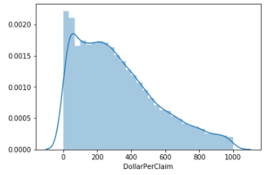
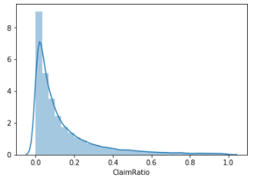
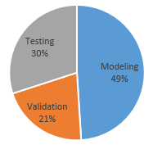
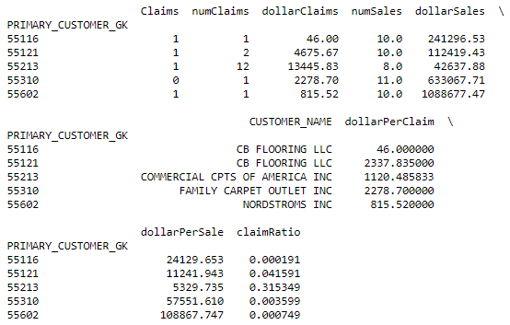
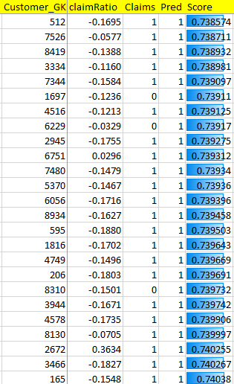
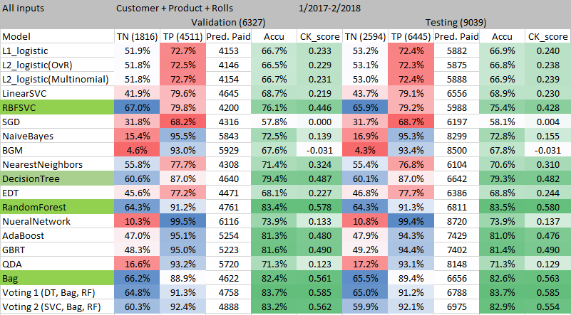
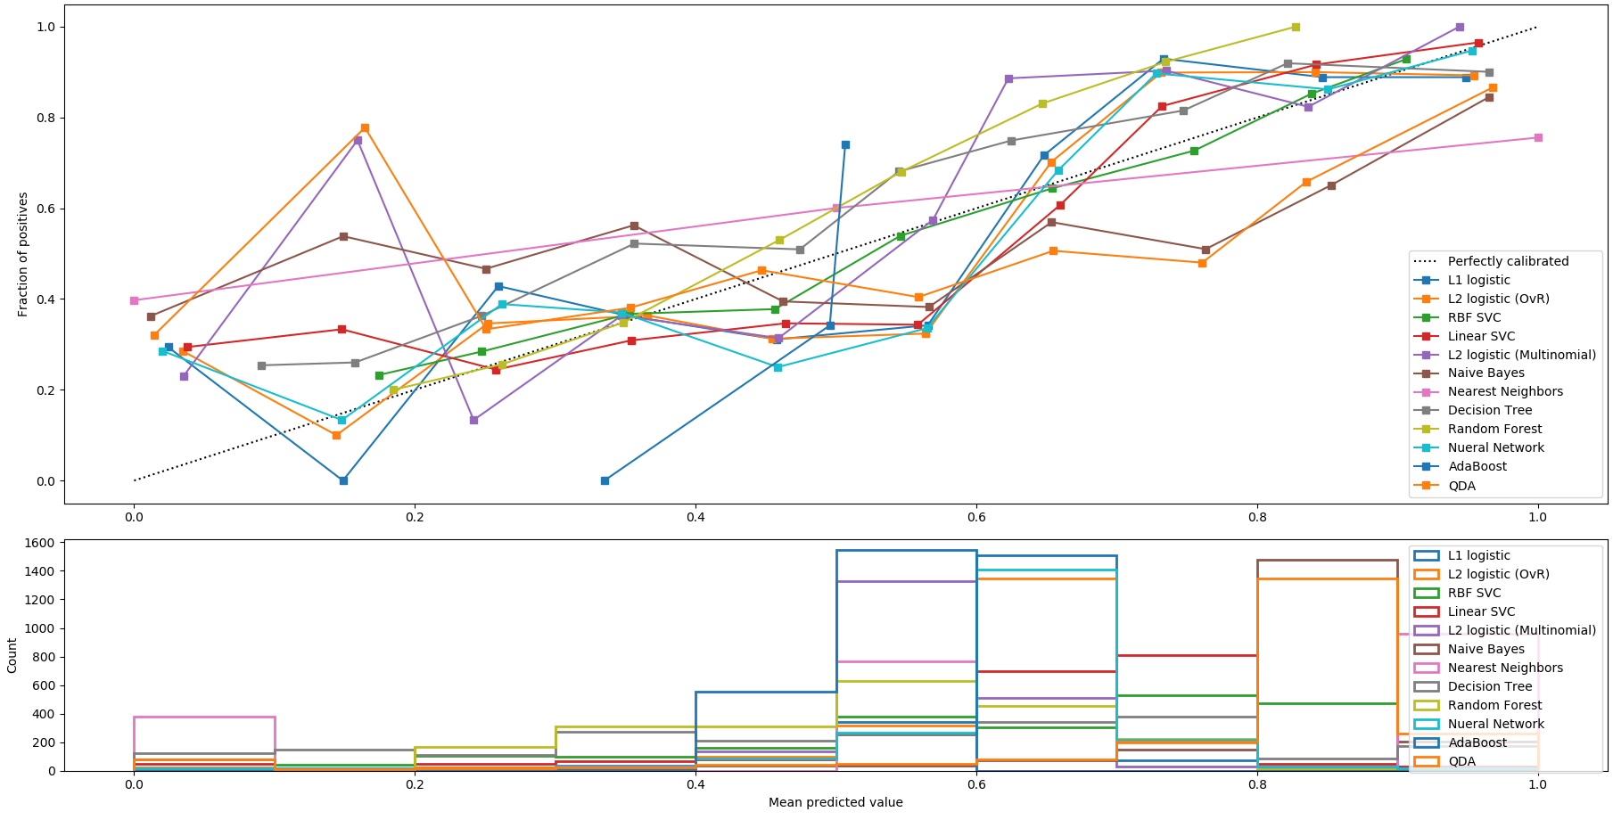
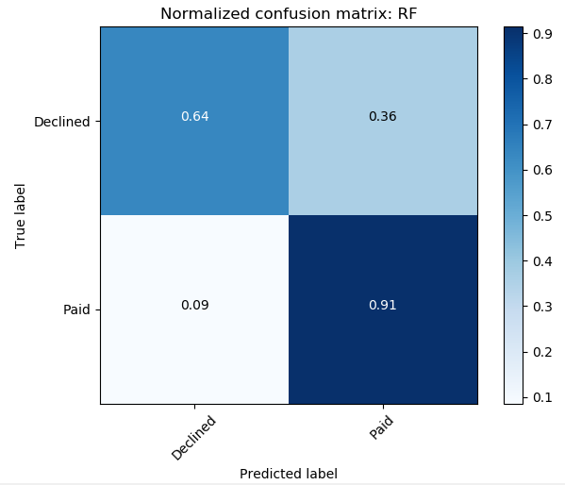
Modeling
Input Factors
#Claims
#Sales
$Claim
$/Sale
$Claim/$Sale
Product Style
Product Size
Product Back
Product Color
F1ROLL
F1GROL
F1DLOT
Target: binary classification
Paid (1) vs. Declined (0)
Data Components
Paid: 71.3%
Declined: 28.7%
$/Claim
Data (30128)
Modeling: 14,762(49%)
Validation:6,327(21%)
Testing:9,019(30%)
$Claims/$Sale
17 Methods
L1 Logistic
L2 Logistic (OvR)
RBF SVC
Linear SVC
L2 Logistic (Multinomial)
Naïve Bayes
Nearest Neighbors
Decision Tree
Random Forest
Neural Network
AdaBoost
QDA
Extra Decision Tree
SGD
QDA
Bag
BGM
Sample data
Data Normalization
AI Modeling
Output
Paid (1) or Declined (0)
Confidence (Score)
Model comparison

Slide 9
Results – Customer + Product + Rolls
Recommend models: RBF-SVC, Decision Tree, Random Forest & Bag, balancing positive & negative true with balanced classification
SVC requires tuning up the parameters C and gamma
Voting method may not be needed as individual models perform well already

Slide 10
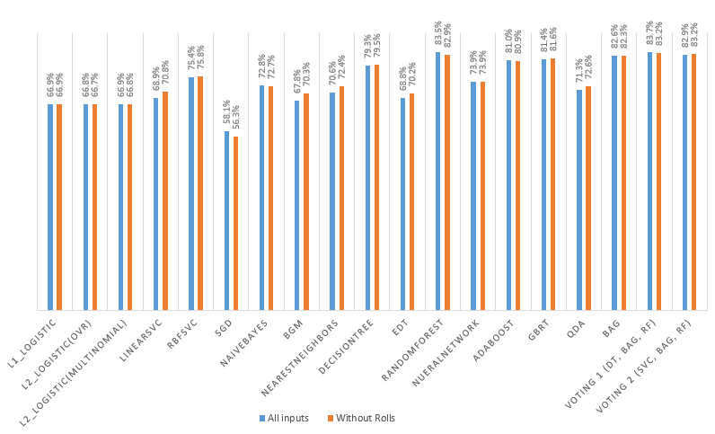
Model Accuracy Comparison (w/o Rolls)
Model Overall Accuracy
The impact of historical issues of a roll on the overall accuracy is Not significant

Slide 11
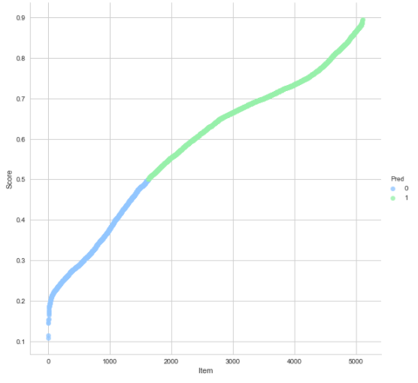
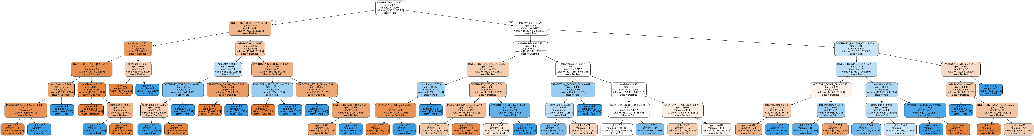
Results
Scoring Decision Logic
Level 1
dollarPerClaim ≤ -0.473
Level 2
INVENTORY_COLOR ≤ -0.038
dollarPerSale ≤ 1.679
Level 3
numSales ≤ 0.831
dollarPerClaim ≤ -0.475
dollarPerSale ≤ -0.358
INVENTORY_BACKING ≤ 1.439
Level 4
INVENTORY_STYLE ≤ -0.572
claimRatio ≤ -0.081
numSales ≤ 0.831
INVENTORY_COLOR ≤ 0.079
INVENTORY_COLOR ≤ -1.666
dollarPerSale ≤ -0.357
INVENTORY_STYLE ≤ -0.851
INVENTORY_STYLE ≤ 2.12
Level 5
numSales ≤ 0.249
numClaims ≤ 2.636
INVENTORY_STYLE ≤ -0.884
INVENTORY_COLOR ≤ 0.787
INVENTORY_STYLE ≤ -1.055
INVENTORY_STYLE ≤ -1.331
…
Level 6
dollarPerSale ≤ -0.285
INVENTORY_SIZE ≤ 2.964
INVENTORY_STYLE ≤ 2.232
…
Confusion Matrix
AI Scoring
(0, 1)
2594
Highly likely to pay
(90%+ conf.)
>0.75
Uncertain
Highly likely to decline (84%+ conf.)
<0.25
6445
Decision Tree

Slide 12
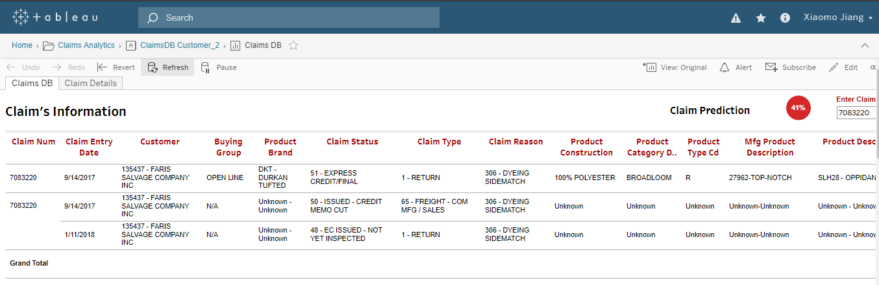
AI Score in Dashboard
Declined (< 50% prob. to pay)
To be updated
Next…
Solution implementation/integration…dashboard update
Continuous model accuracy improvement
Customer specific modeling

Slide 13
Thanks

Slide 14
Online Application

Slide 15
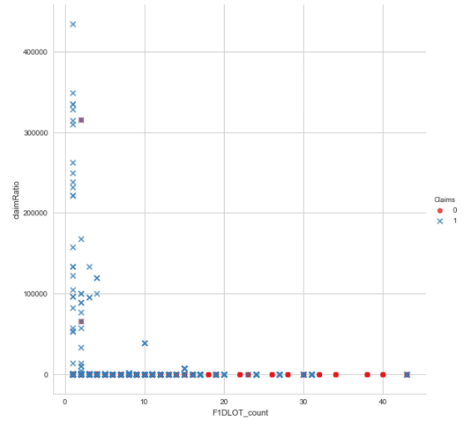
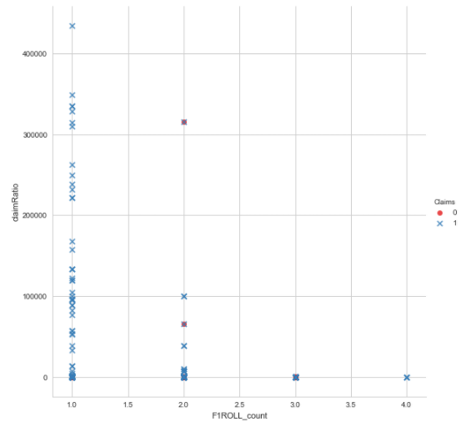
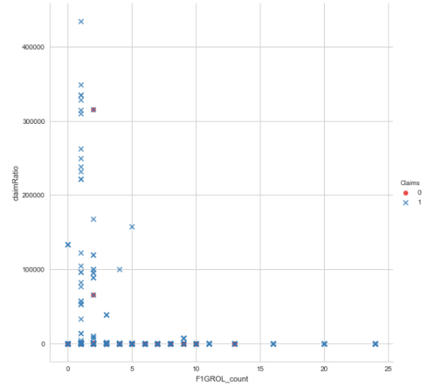
Influencing Factors for Claims (30,000+)
F1DLOT count
F1ROLL count
F1GROL count
4849 F1DLOTs have >1 claims
(16% data)
1372 F1ROLLs have >1 claims
(4.6% data)
3951 F1GROLs have >1 claims
(13% data)

Slide 16
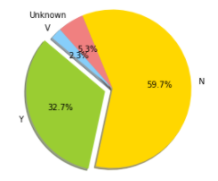
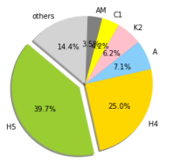
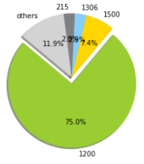
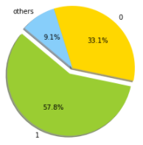
Influencing Factors for Claims
6 Backing types: 85%+
…total 89 backs
73978 rolls
Y = Quality issue: 33%
1 = Paid, 0=Declined
4 Sizes: 88%+
Total 166
24488
42782

Slide 17
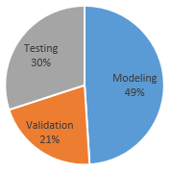
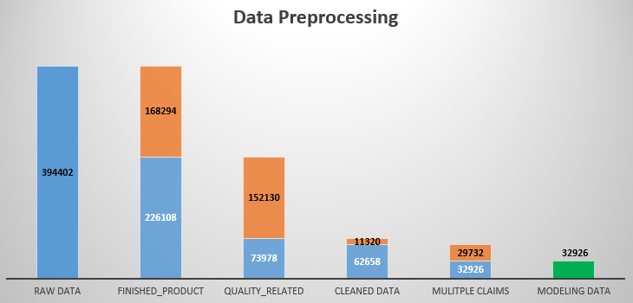
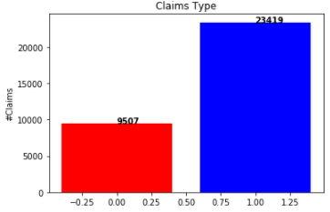
Modeling Data (old)
Records
394,402 raw records with product info
~16% (62,658) raw data used for modeling
32,926 modeling data points
Non-Product, e.g., misc., handling
Modeling | 16133
Validation | 6915
Testing | 9878
42.7%
Claims
Non-quality, i.e., rebate
Product
38.6%
Unfeasible, i.e., claim $<0
57.3%
18.8%
15.9%
Paid 71%
Declined 29%

Slide 18
Results (R2) – PCA vs. Raw
 | Validation (6915) |  |  |  | Testing (9878) |  |  |  | Comments
Actual | Accuracy | Pred. Paid (1) | 4918(1) | 1997(0) | Accuracy | Pred. Paid (1) | 7026(1) | 2852(0)
L1 Logistic | 71.8%/72.1% | 6598/6651 | 97%/98% | 9%/8% | 72.1%/72.3% | 9482/9537 | 98%/98% | 9%/8% | Prone to Paid, ↑false , reduce $
L2 Logistic (OvR) | 71.8%72.2% | 6597/6603 | 97%/98% | 9%/10% | 72.1%/72.4% | 9482/9469 | 98%/98% | 9%/9% | Prone to Paid, ↑false , reduce $
RBF SVC | 66.4%/66.3% | 4581/4671 | 73%/74% | 50%/48% | 65.7%/66.0% | 6518/6653 | 72%/73% | 49%/48% | Slightly balanced, but ↑false
Linear SVC | 65.8%/67.4% | 4920/5256 | 76/80% | 41%/35% | 66.0%/67.9% | 6931/7422 | 75%/80% | 43%/38% | Prone to Paid, ↑false , reduce $
L2 Logistics (Multinormial) | 71.8%/72.2% | 6597/6581 | 97%/95% | 9%/10% | 72.1%/72.4% | 9482/9437 | 98%/98% | 9%/10% | Prone to Paid, ↑false , reduce $
Naïve Bayes | 69.1%/70.0% | 6170/6252 | 91%/92% | 15%/15% | 69.3%/70.8% | 8781/8932 | 91%/93% | 16%/16% | Prone to Paid, ↑false , reduce $
Nearest Neighbor | 64.8%/57.3% | 4679/3718 | 73%/58% | 45%/56% | 64.3%/57.3% | 6644/5287 | 72%/58% | 45%/57% | Prone to declined, ↑miss, ↓customer
Decision Tree | 59.5%/66.1% | 3650/4275 | 59%/70% | 62%/57% | 60.1%/66.4% | 5215/6067 | 59%/70% | 63%/59% | Balanced prediction results
Random Forest | 66.1%/65.0% | 4949/4781 | 77%/74% | 41%/43% | 66.2%/65.1% | 7009/6721 | 76%/73% | 42%/45% | Balanced, but slightly prone to Paid
Neural Network | 71.6%/71.8% | 6784/6735 | 99%/99% | 4%/6% | 71.6%/71.9% | 9723/9656 | 99%/99% | 3%/5% | Prone to Paid, ↑false , reduce $
AdaBoost | 72.1%/72.6% | 6471/6358 | 96%/95% | 13%/17% | 72.0%/72.9% | 9297/9038 | 96%/95% | 12%/18% | Prone to Paid, ↑false , reduce $
QDA | 70.0%/70.7% | 6301/6366 | 93%/94% | 13%/13% | 70.5%/71.2% | 9009/9074 | 93%/94% | 14%/14% | Prone to Paid, ↑false , reduce $
Voting(RF, BLAG, SVC) | 70.0%69.3% | 5529/5155 | 85%/81% | 33%/41% | 70.1%/70.5% | 7839/7314 | 85%/(81% | 34%/44% | Prone to Paid
PCA/Raw shown
PCA with 95% info – 5 PCAs considered, vs. 9 raw factors
No significant improvement observed from PCA process

Slide 19
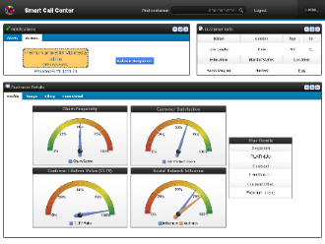
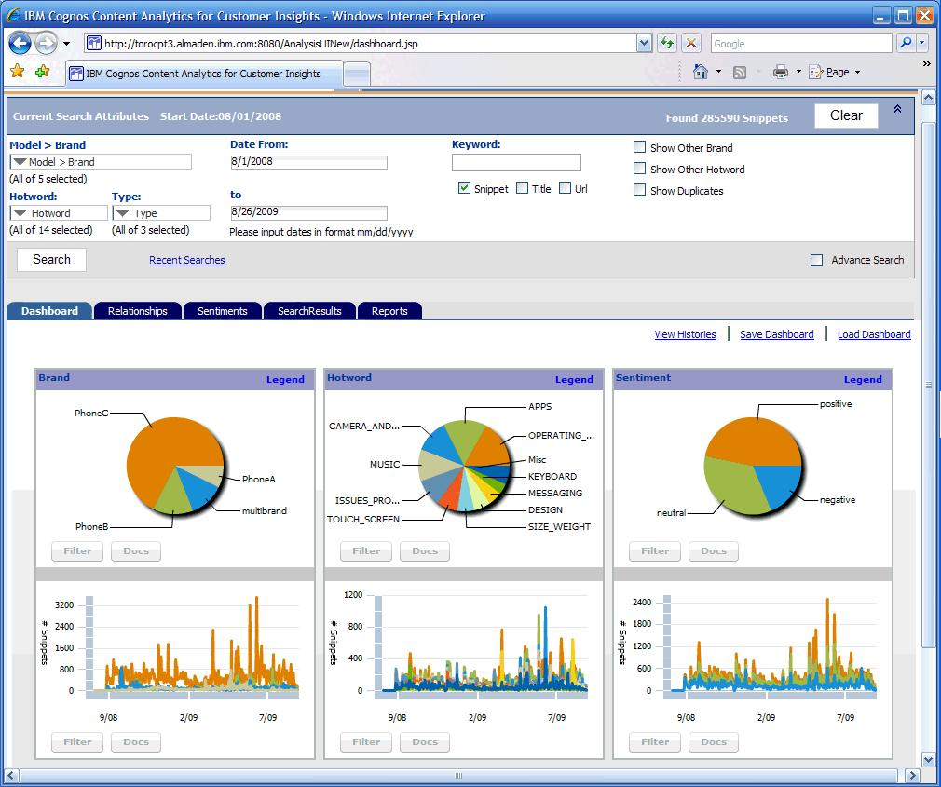
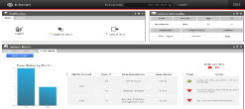
Claim Scoring (Proposal)
Customer
KPI, Dashboards
Customer Analytics
Product
Behavioral
Segmentation
Propensity
To Buy
Transactions
Order – Ship - Bill
Worksheets
Customer
Claims
Customer sales
Claims
Claims / Sales Pattern
Claims / Product Pattern
External
Market, Consumer, Competitor
Operational
Systems
Campaigns
Social
Industry Reviews, Trends
Scoring
Sales Mgmt
Recommendation
Retail Portal
Customer Service

Slide 20
Claim AI Scoring Analytics Roadmap
Implementation
AI Model
QA Testing
Improved Analytics
Business Review
Preliminary Analytics
Advanced AI Development
Team Review II
Revised AI Modelling
Recommended Use Cases Prioritized
Product Data Retrieval
Team Review of Claim Scoring
Preliminary AI Modelling
Claims Data Retrieval
Project Initiation
Roadmap

Slide 21
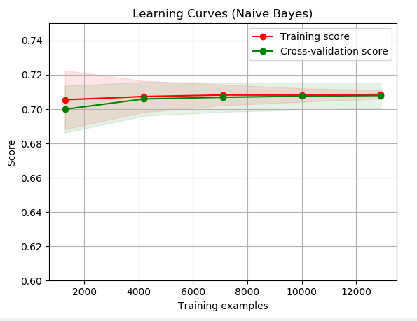
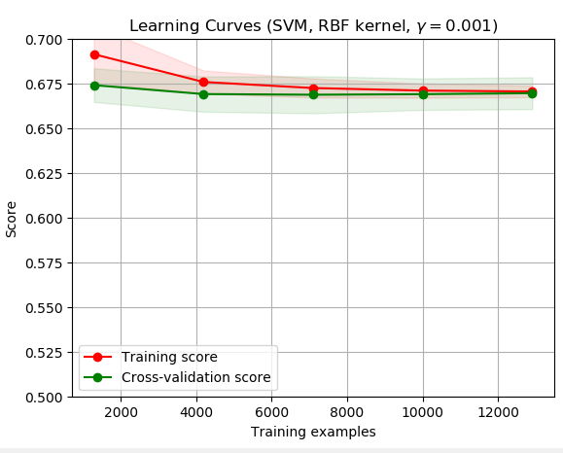
Learning Curves
Fewer samples needed for Naïve Bayes method

Slide 22
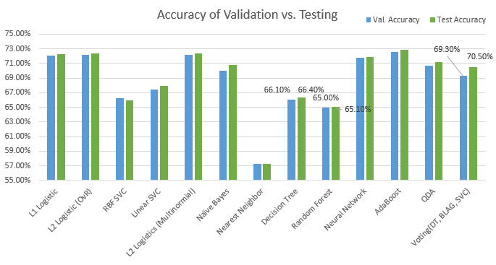
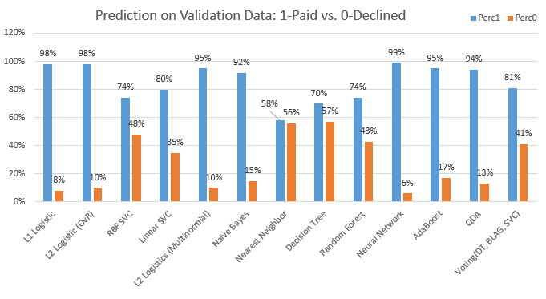
Method Comparison (R2)
In favor of predicting the “Paid” claims, company will loss benefits
No significant improvement is obtained by adding product features
Except for SVC, all other methods seem to have the testing accuracy larger than validation ones, which indicates that the models may be overfitting for ‘Paid”…need to be further improved for business purpose
Voting method: Balance the accuracy and bias of prediction.
SVC, NN, DT & RF: Balance the binary prediction.

Slide 23
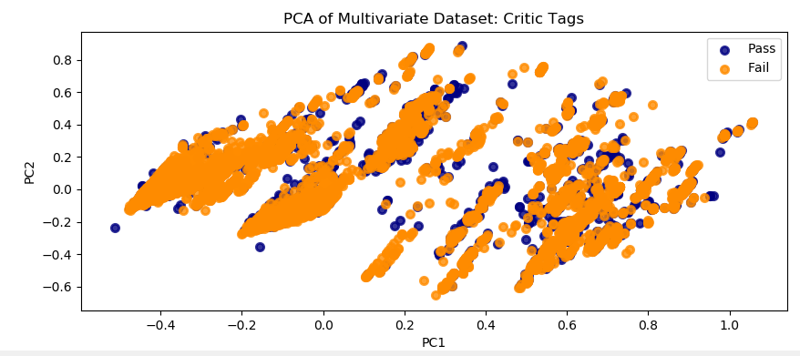
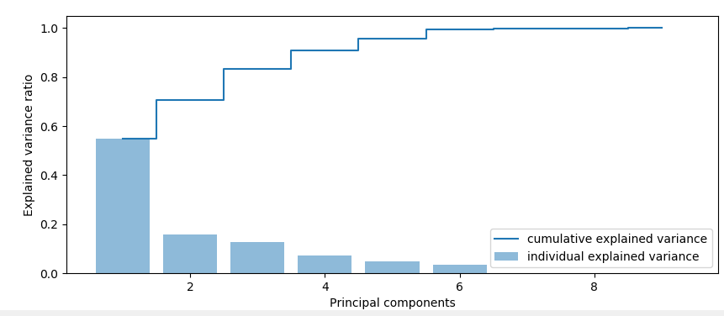
PCA
PC/Standard deviation/Proportion of Variance/Cumulative Proportion
PC1 0.367471 0.549483 0.549483
PC2 0.196869 0.157711 0.707194
PC3 0.176534 0.126814 0.834008
PC4 0.135046 0.074211 0.908219
PC5 0.110978 0.050117 0.958336
PC6 0.095005 0.036728 0.995065
PC7 0.022163 0.001999 0.997063
PC8 0.021798 0.001934 0.998997
PC9 0.015701 0.001003 1.000000
No clear clusters
5 PCAs with 95% info

Slide 24
Results (R1) – Customer data only
 | Validation (2104) |  |  |  | Testing (3006) |  |  |  | Comments
Actual | Accuracy | Pred. Paid (1) | 1335(1) | 769(0) | Accuracy | Pred. Paid (1) | 1908(1) | 1098(0)
L1 Logistic | 66.4% | 1943 | 1282(96%) | 108(14%) | 66.7% | 2771 | 1832(96%) | 165(15%) | Prone to Paid, ↑false , reduce $
L2 Logistic (OvR) | 66.8% | 1918 | 1282(96%) | 131(17%) | 67.7% | 2740 | 1832(96%) | 198(18%) | Prone to Paid, ↑false , reduce $
RBF SVC | 69.6% | 1418 | 1055(79%) | 408(53%) | 69.7% | 1992 | 1488(78%) | 604(55%) | Slightly balanced, but ↑false
Linear SVC | 69.8% | 1721 | 1215(91%) | 261(34%) | 70.3% | 2446 | 1736(91%) | 384(35%) | Prone to Paid, ↑false , reduce $
L2 Logistics (Multinormial) | 67.1% | 1902 | 1268(95%) | 138(18%) | 67.7% | 2711 | 1832(96%) | 209(19%) | Prone to Paid, ↑false , reduce $
Naïve Bayes | 64.8% | 1942 | 1268(95%) | 92(12%) | 65.5% | 2772 | 1813(95%) | 143(13%) | Prone to Paid, ↑false , reduce $
Nearest Neighbor | 59.8% | 958 | 721(54%) | 538(70%) | 60.9% | 1385 | 1068(56%) | 769(70%) | Prone to declined, ↑miss, ↓customer
Decision Tree | 70.5% | 1236 | 975(73%) | 508(66%) | 69.1% | 1715 | 1355(71%) | 725(66%) | Balanced prediction results
Random Forest | 71.5% | 1332 | 1028(77%) | 469(61%) | 70.6% | 1896 | 1469(77%) | 659(60%) | Balanced, but slightly prone to Paid
Neural Network | 66.1% | 1981 | 1295(97%) | 92(12%) | 66.5% | 2834 | 1870(98%) | 132(12%) | Prone to Paid, ↑false , reduce $
AdaBoost | 71.9% | 1546 | 1148(86%) | 369(48%) | 71.9% | 2178 | 1622(85%) | 538(49%) | Prone to Paid, ↑false , reduce $
QDA | 65.2% | 1937 | 1268(95% | 100(13%) | 66.1% | 2769 | 1832(96%) | 154(14%) | Prone to Paid, ↑false , reduce $
Voting(RF, DT, SVC) | 72.4% | 1440 | 1095(82%) | 423(55%) | 72.1% | 2045 | 1565(82%) | 615(56%) | Prone to Paid
Recommend two models: Decision Tree and Random Forest
Both balance the paid and declined prediction, particularly DT method
Voting method is strongly recommended if possible, as it is robust after integrating different individual models

Slide 25
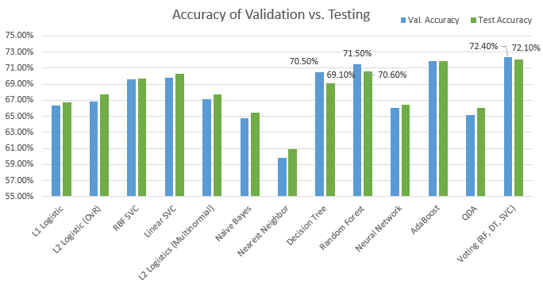
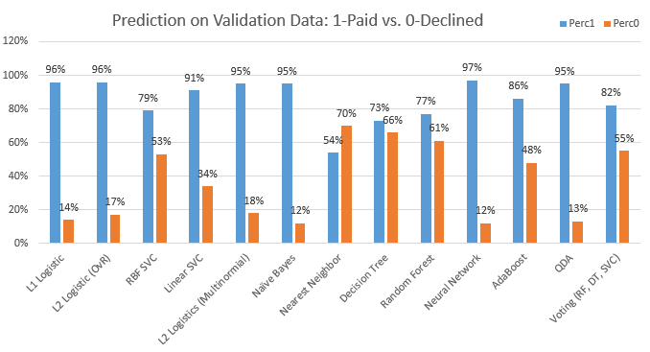
Method Comparison (R1) – Customer Data Only
Prone to predict the “Paid” claims, company will loss benefits
NN method: Prone to predict the “Declined” claims, customer will not be happy
DT, RF & Voting methods have the testing accuracy lower than validation ones, which makes sense
Other methods may be overfitting for ‘Paid”…need to be improved for business purpose
Voting method: Balance the accuracy and bias of prediction.
DT & RF: Balance the binary prediction.

Slide 26
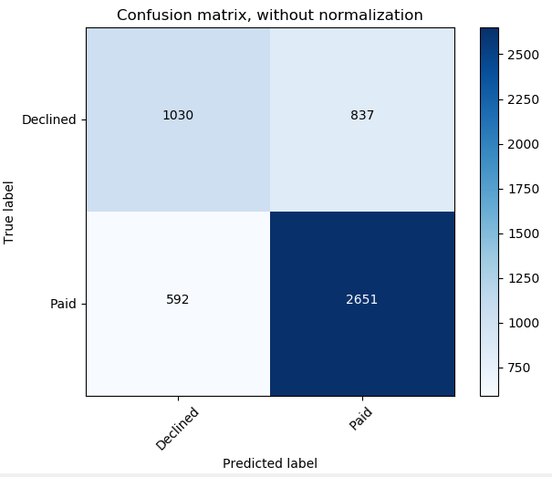
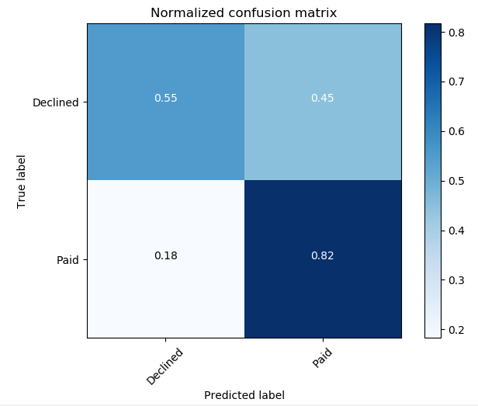
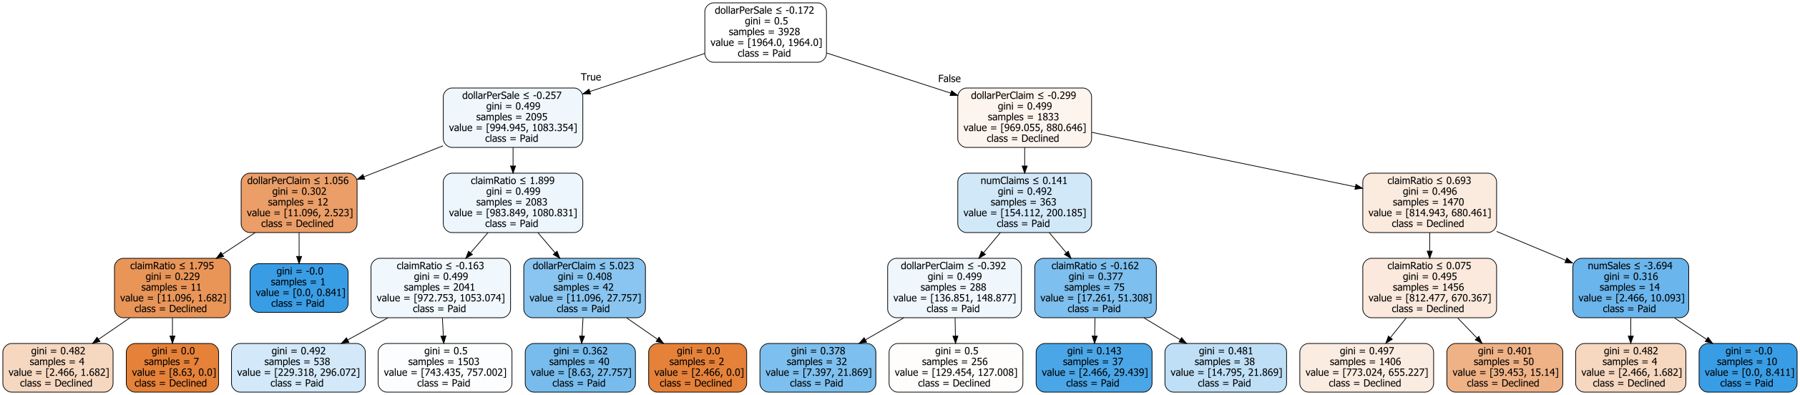
Visualization (R1) – Customer Data
1867
Scorecard
3243
Decision Tree

Slide 27
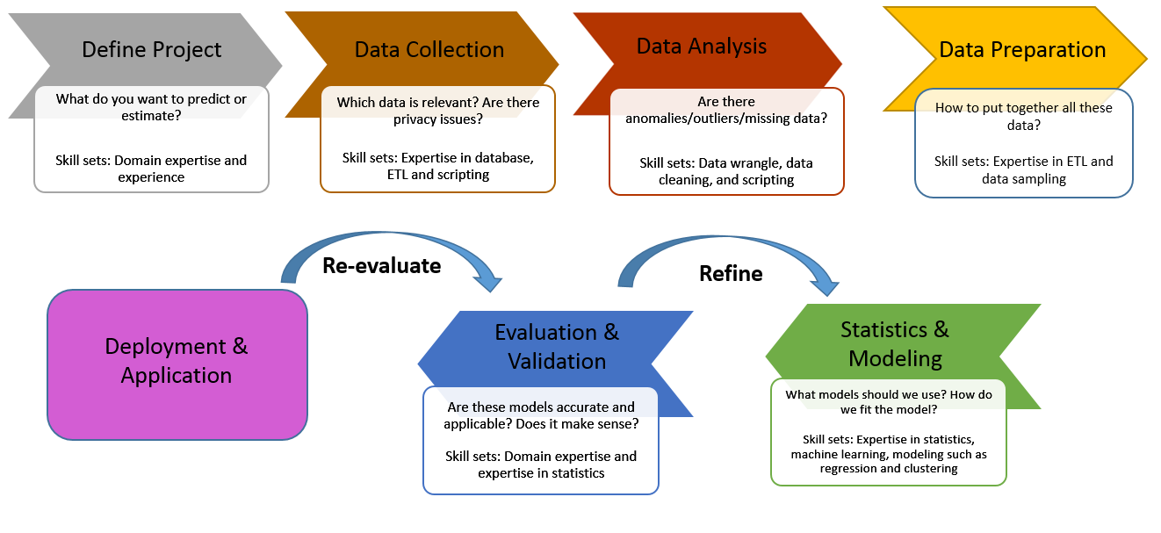
Modeling Process

Slide 28
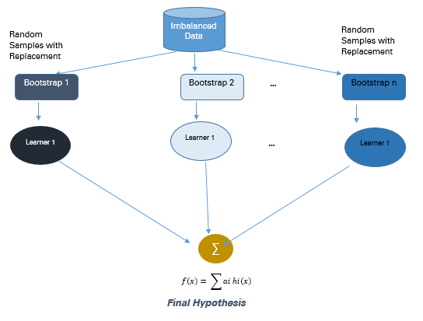
Bagging
Bagging is an abbreviation of Bootstrap Aggregating. The conventional bagging algorithm involves generating ‘n’ different bootstrap training samples with replacement, training the algorithm on each bootstrapped algorithm separately and then aggregating the predictions at the end. Bagging is used for reducing Overfitting in order to create strong learners for generating accurate predictions. Unlike boosting, bagging allows replacement in the bootstrapped sample.

Slide 29
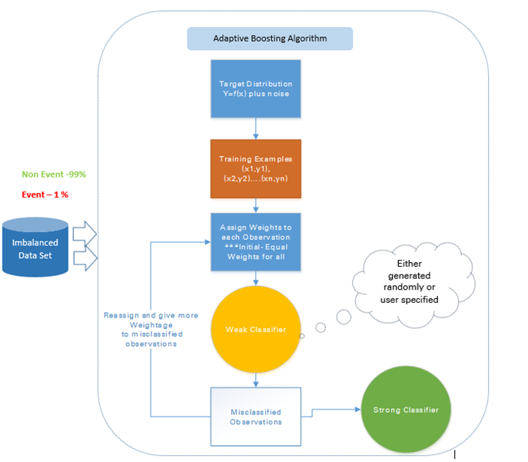
Adaptive Boosting – AdaBoost
Ada Boost is the first original boosting technique which creates a highly accurate prediction rule by combining many weak and inaccurate rules. Each classifier is serially trained with the goal of correctly classifying examples in every round that were incorrectly classified in the previous round.
For a learned classifier to make strong predictions it should follow the following three conditions:
The rules should be simple
Classifier should have been trained on sufficient number of training examples
The Classifier should have low training error for the training instances
Each of the weak hypothesis has an accuracy slightly better than random guessing i.e. Error Term € (t) should be slightly more than ½-β where β >0. This is the fundamental assumption of this boosting algorithm which can produce a final hypothesis with a small error
After each round, it gives more focus to examples that are harder to classify. The quantity of focus is measured by a weight, which initially is equal for all instances. After each iteration, the weights of misclassified instances are increased and the weights of correctly classified instances are decreased.
Advantages
Very Simple to implement
Good generalization- suited for any kind of classification problem
Not prone to overfitting
Disadvantages
Sensitive to noisy data and outliers

Slide 30
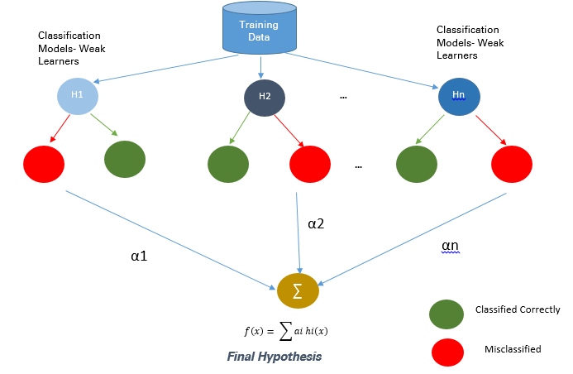
Boosting-based
Boosting is an ensemble technique to combine weak learners to create a strong learner that can make accurate predictions. Boosting starts out with a base classifier / weak classifier that is prepared on the training data. The base learners / Classifiers are weak learners i.e. the prediction accuracy is only slightly better than average. A classifier learning algorithm is said to be weak when small changes in data induce big changes in the classification model.
In the next iteration, the new classifier focuses on or places more weight to those cases which were incorrectly classified in the last round.

Slide 31
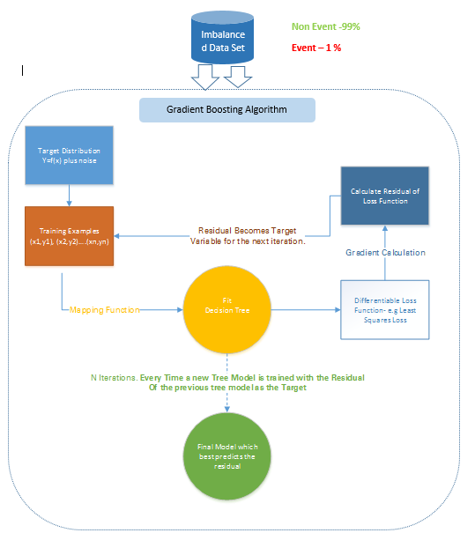
Gradient Tree Boosting
In Gradient Boosting many models are trained sequentially. It is a numerical optimization algorithm where each model minimizes the loss function, y = ax+b+e, using the Gradient Descent Method.
Decision Trees are used as weak learners in Gradient Boosting.
While both Adaboost and Gradient Boosting work on weak learners / classifiers. And try to boost them into a strong learner, there are some fundamental differences in the two methodologies. Adaboost either requires the users to specify a set of weak learners or randomly generates the weak learners before the actual learning process. The weight of each learner is adjusted at every step depending on whether it predicts a sample correctly.
On the other hand, Gradient Boosting builds the first learner on the training dataset to predict the samples, calculates the loss (Difference between real value and output of the first learner). And use this loss to build an improved learner in the second stage.
At every step, the residual of the loss function is calculated using the Gradient Descent Method and the new residual becomes a target variable for the subsequent iteration.
Disadvantages
Gradient Boosted trees are harder to fit than random forests
Gradient Boosting Algorithms generally have 3 parameters which can be fine-tuned, Shrinkage parameter, depth of the tree, the number of trees. Proper training of each of these parameters is needed for a good fit. If parameters are not tuned correctly it may result in over-fitting.

Slide 32
XGBoost
XGBoost (Extreme Gradient Boosting) is an advanced and more efficient implementation of Gradient Boosting Algorithm discussed in the previous section.
Advantages over Other Boosting Techniques
It is 10 times faster than the normal Gradient Boosting as it implements parallel processing. It is highly flexible as users can define custom optimization objectives and evaluation criteria, has an inbuilt mechanism to handle missing values.
Unlike gradient boosting which stops splitting a node as soon as it encounters a negative loss, XG Boost splits up to the maximum depth specified and prunes the tree backward and removes splits beyond which there is an only negative loss.
Extreme gradient boosting can be done using the XGBoost package in R and Python

Slide 33
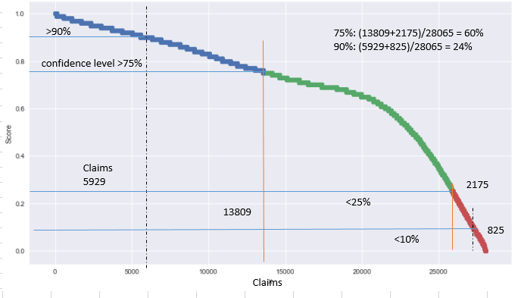
Random Forest Classifier
A random forest is a meta estimator that fits a number of decision tree classifiers on various sub-samples of the dataset and use averaging to improve the predictive accuracy and control over-fitting. The sub-sample size is always the same as the original input sample size but the samples are drawn with replacement if bootstrap=True (default).

