Slide 1
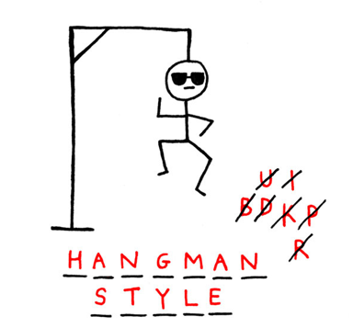
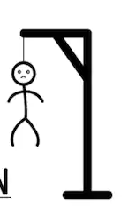
Hangman
Janabelle

Slide 2




List, Strings, For loops
Last week we talked about what lists are
  Similar to what you use in essays
  Collection of objects
This week we will be using lists and for loops again!
We will also be using strings

Slide 3

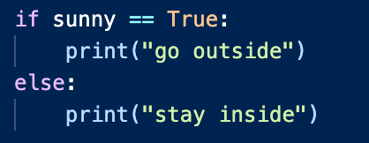
if/else
They are conditional statements that help you decided what which code to execute
Example: I want go outside, but only if it is sunny. If it is not sunny, then I want to stay inside.

Slide 4
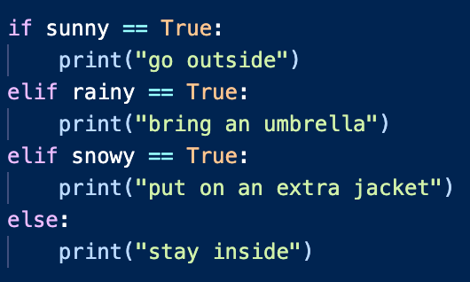
ELIF
Very similar to if/else, but now we have more choices

Slide 5

get_word()
Gets a word from the list of possible words to guess
How to store these words?
  With a list!
How do we create a list? With words: cat, dog, python, monkey, snake
We don’t want the user to know that ‘cat’ is always the first word, so we want to randomize the word to guess

Slide 6
While Loops
Very similar to for loops
  In for loops we always know how many number of times we loop/iterate through
While loops only stop when the while loop condition fails
What are the while loop conditions for our hangman?
  We want to be able to keep guessing when
    Word has not been guessed
    Still have number of tries left

Slide 7
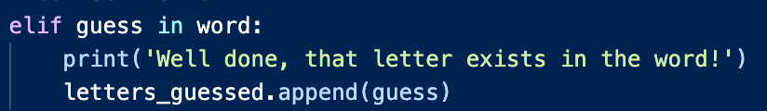
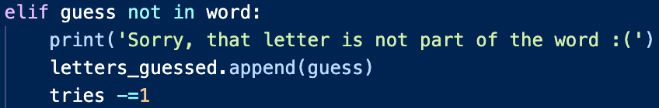
play_game()
This function is very long
Use while loops to keep guessing letters
We have a lot of if/else statements to check user inputs
What are some possible inputs that user might type?
  A letter that exists in the word, “cat”
  A letter not in the word, “cat”
Notice: tries = tries - 1

Slide 8

Play_game() cont.
The input is not in the alphabet, “abcdefg…”
The input was already guess before
Notice: letters_guessed, how do we keep track of letters we have guessed already

Slide 9


play_again()
Function to ask if you want to play again with a different word
Simple if/else statement
If the user types ‘y’ or ‘yes’ or ‘yeah’, then play again
If user types anything else, quit the game

Slide 10
Inputs
How do we keep track of this
answer = input(‘any string you want’)

Slide 11
For HW
We will give you a version of this game, that does not have the play_again() function
Add play_again() to the code!

Slide 12
Questions
If you guess a correct letter, do we take off one of out 10 guesses?
Can you guess a partial word? What happens when you do?
How do you quit the program at anytime? (type in ‘no’)
  import sys
  sys.exit(0)
Notes:
If you guess a correct letter, does it take off one of the 10 guesses?
Can you guess partial word? What’s the result
Add "yeah" as valid response
How do you quit the program (type in ‘no’) at any time?
import sys
sys.exit(0)

