Slide 1
Tic-Tac-Toe
Janabelle

Slide 2
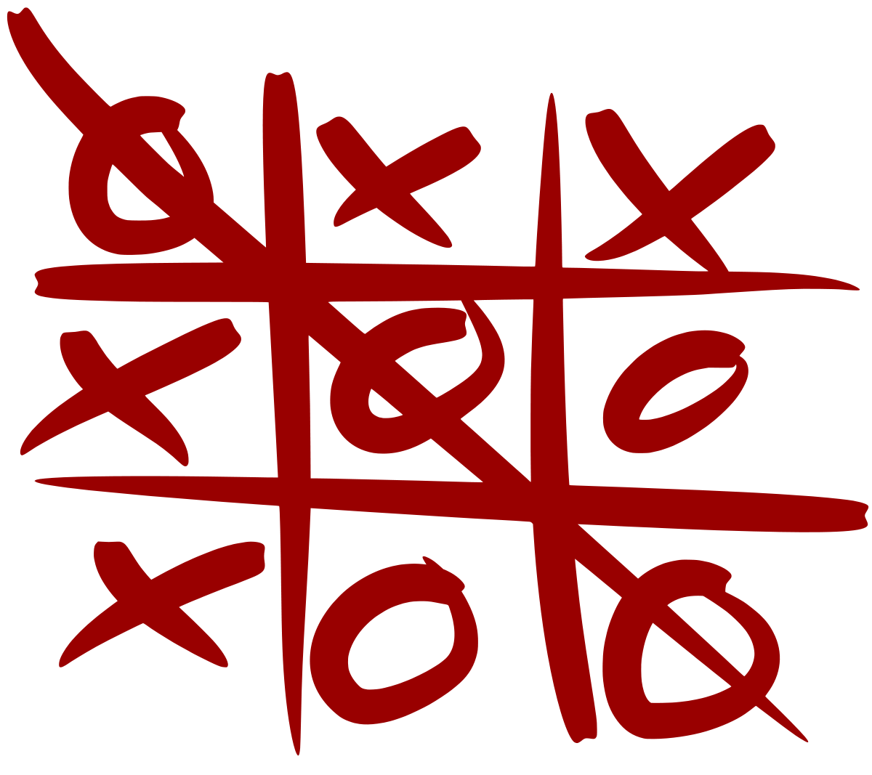
Demo!

Slide 3
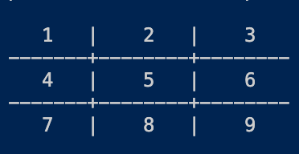
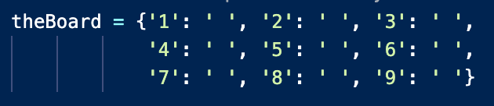
Global Variable
A variable available to all your functions
Be careful because any function can change it
So keep track of when you are changing it
The tic-tac-toe board
Uses a dictionary
The numbers are the keys and X and O are the values

Slide 4
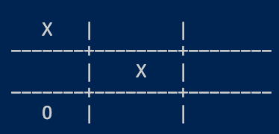
instruction()
display_board()
The instruction for the board
Tells you each box number and that’s the numbers you put in when you choose a position
Prints the board out the current status of the board

Slide 5
check_winner()
A bunch of if-elif-else statements to check if there is a winner
What are all the possibilities for a win?
How to check the status of the board?
We learned that to get the value for a key theBoard[‘1’]

Slide 6
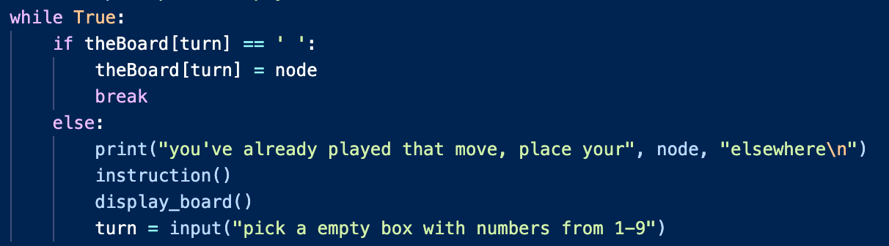
play()
Has a for loop that’s loops 9 times
There can ever be 9 different turns
Calls instruction() and display_board()
Each turn instructions remind the players and board is updated
While loop to loop until valid input
break: jumps out of the loop immediately

Slide 7

play() cont.
After the players put in a valid number, call check_winner() to check if we have a winner
If yes, then break
If no, then change to the next player
If we played the whole board and still no winner, then we know its a tie

