Slide 1
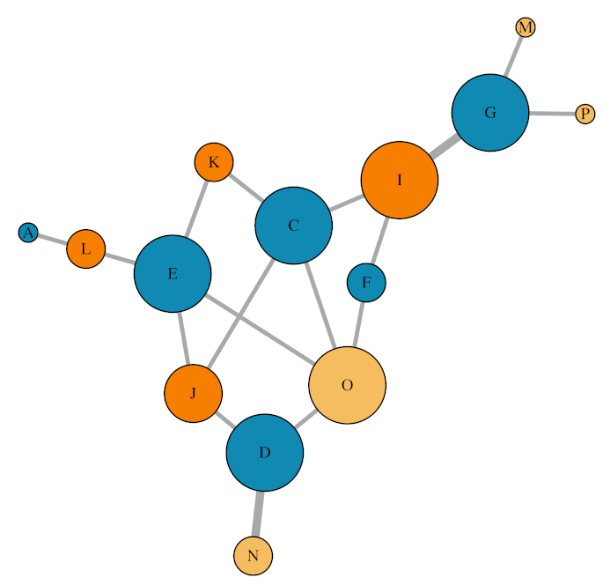
Replicate 1: Insemination network
Isolated female Social female Male

Slide 2
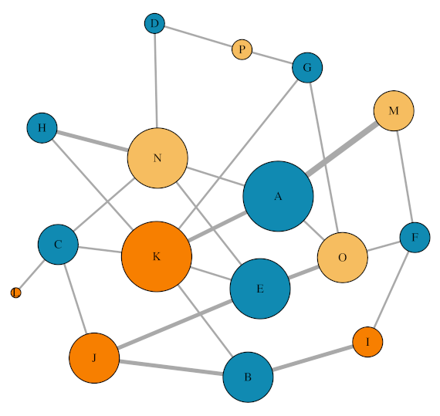
Replicate 2: Insemination network
Isolated female Social female Male

Slide 3
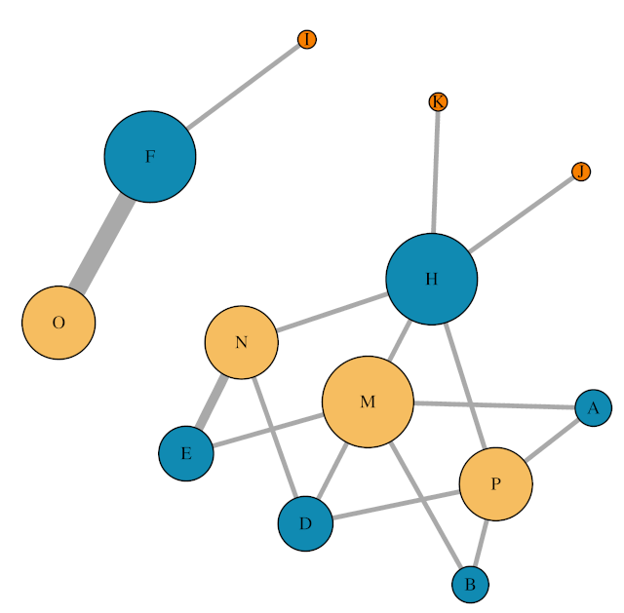
Replicate 3: Insemination network
Isolated female Social female Male

Slide 4
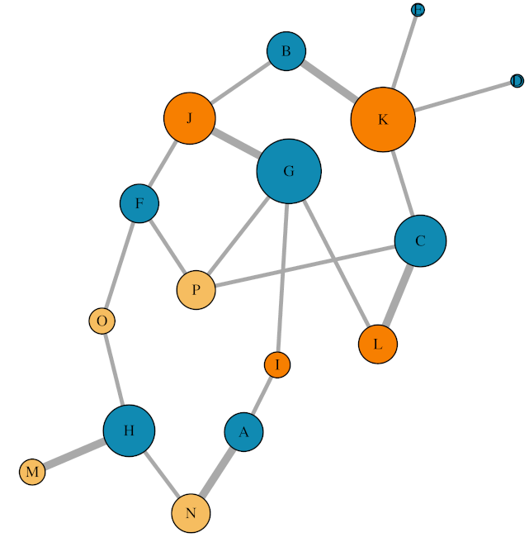
Replicate 4: Insemination network
Isolated female Social female Male

Slide 5
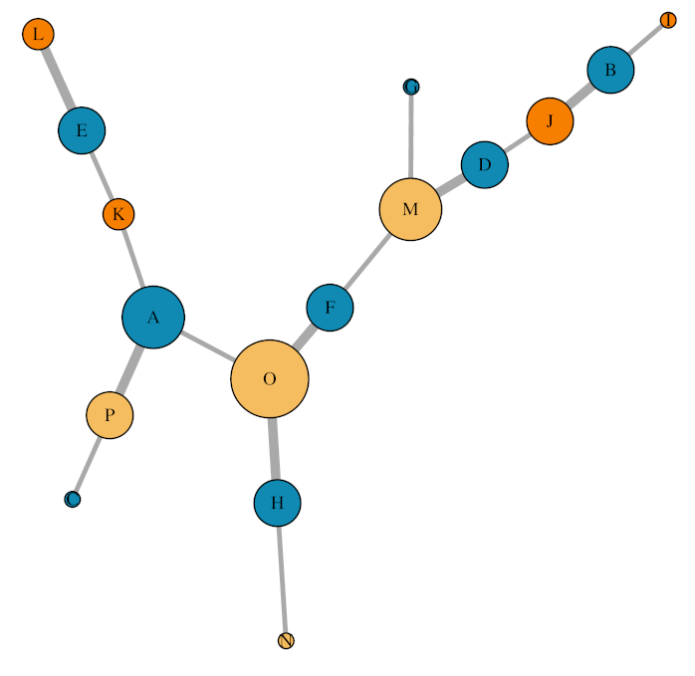
Replicate 5: Insemination network
Isolated female Social female Male

Slide 6
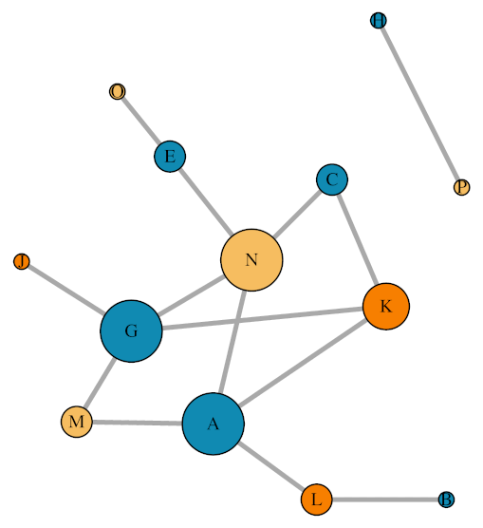
Replicate 6: Insemination network
Isolated female Social female Male

Slide 7
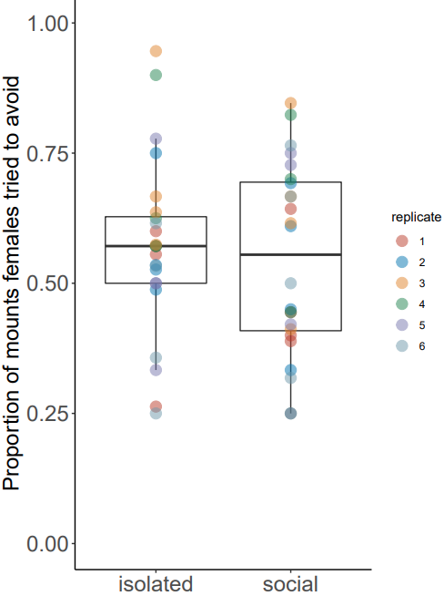
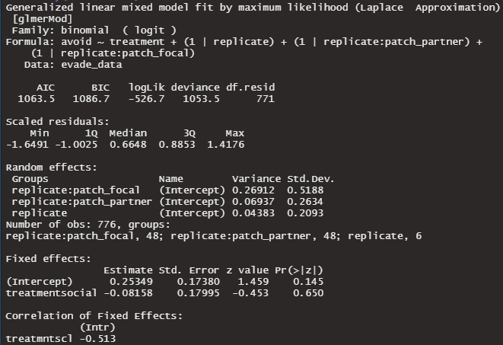

Slide 8
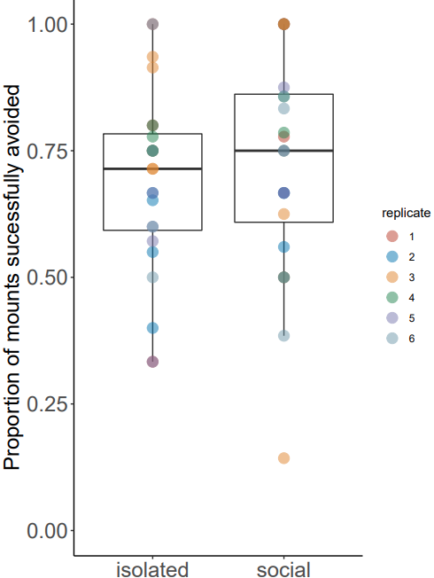
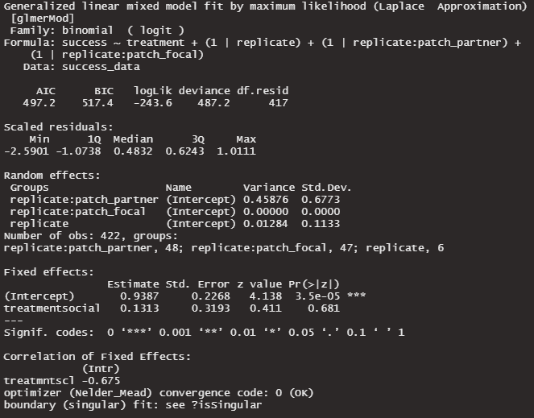

Slide 9
