Slide 1
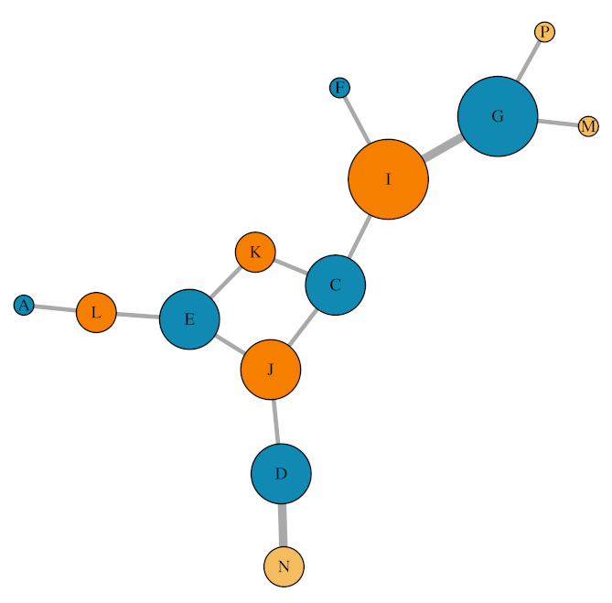
Replicate 1: Insemination network
Isolated female Social female Male

Slide 2
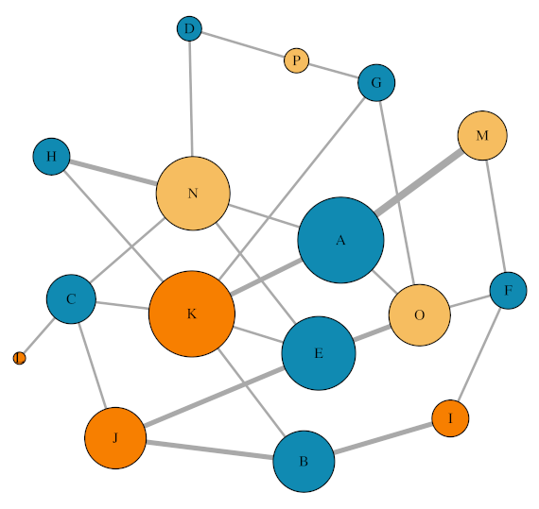
Replicate 2: Insemination network
Isolated female Social female Male

Slide 3
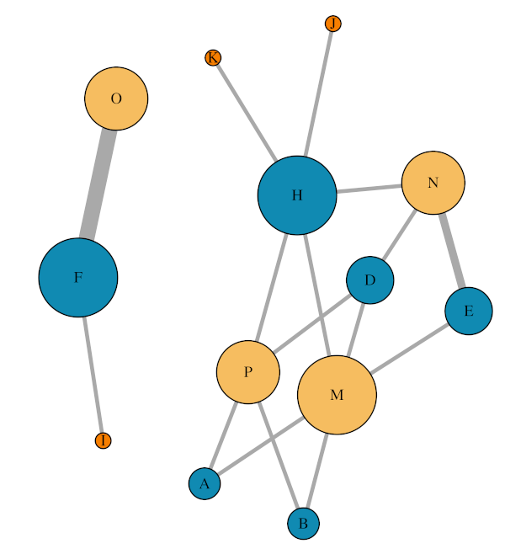
Replicate 3: Insemination network
Isolated female Social female Male

