Slide 1
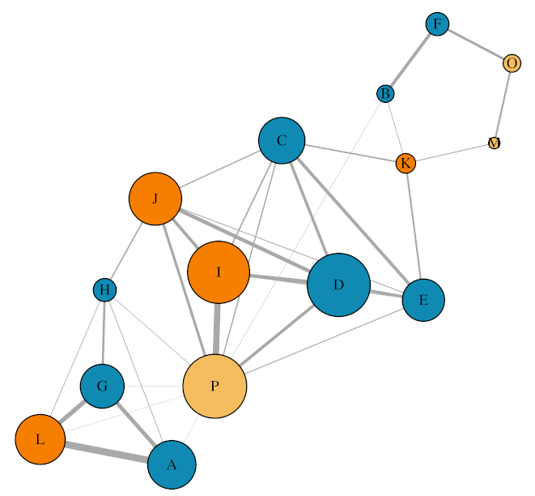
Rep 1 aggregation network
Isolated female Social female Male

Slide 2
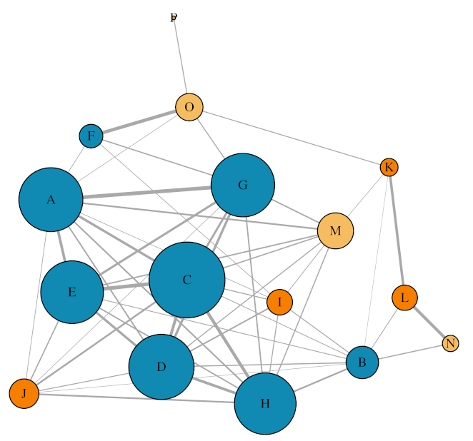
Rep 2 aggregation network
Isolated female Social female Male

Slide 3
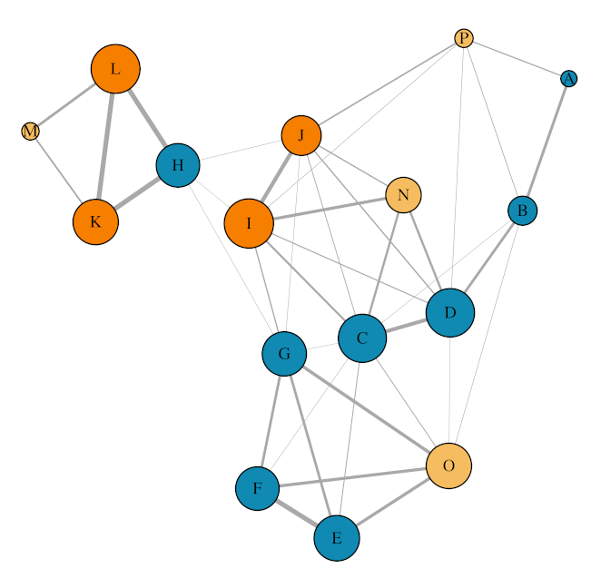
Rep 3 aggregation network
Isolated female Social female Male

Slide 4
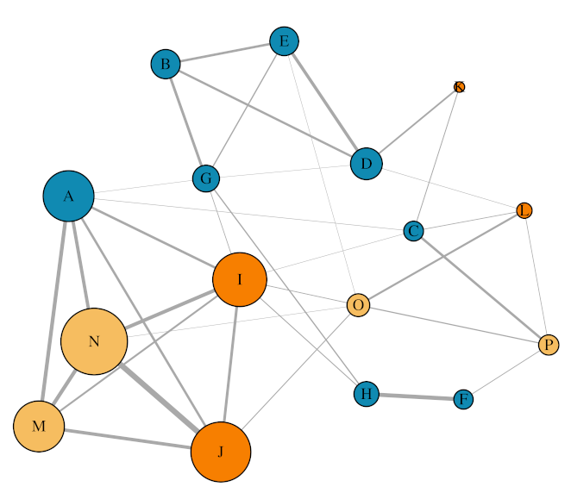
Rep 4 aggregation network
Isolated female Social female Male

Slide 5
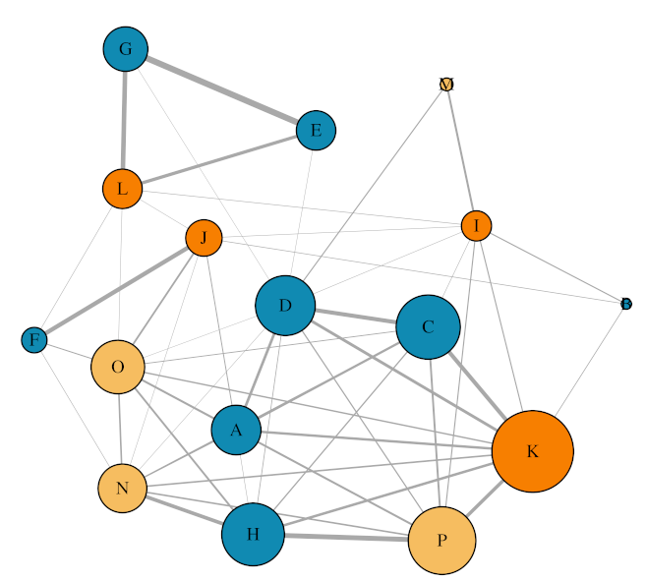
Rep 5 aggregation network
Isolated female Social female Male

Slide 6
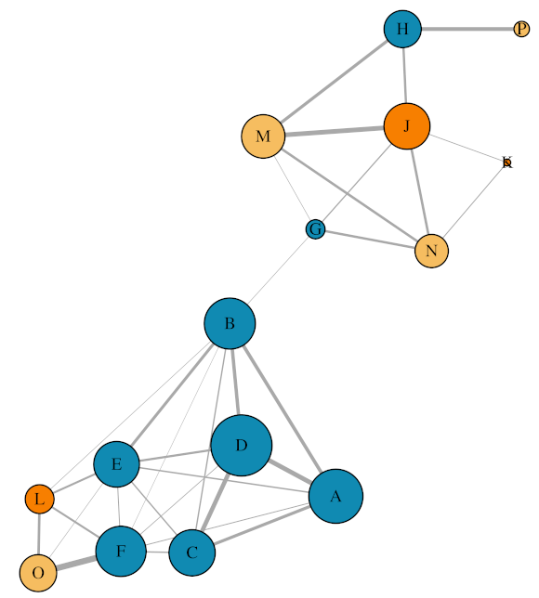
Rep 6 aggregation network
Isolated female Social female Male

