Slide 1
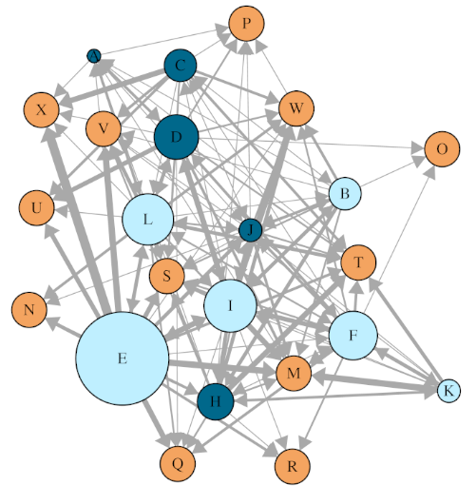
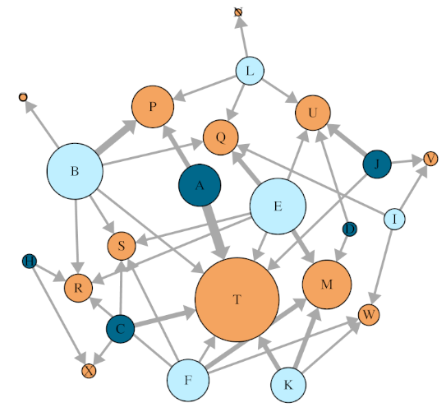
Replicate 1 networks (all days)
Isolated male
Experienced male
Female
Directed mount network Node size: Out-strength for males;
Constant for females
Directed insemination network Node size: Out-strength for males; In-strength for females

Slide 2
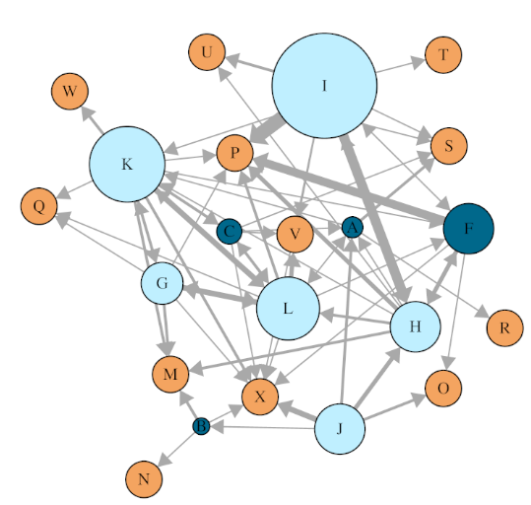
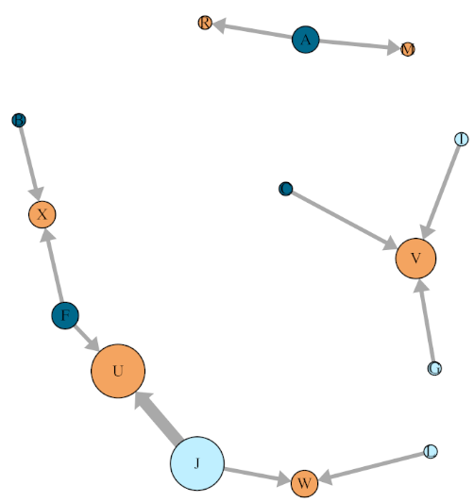
Replicate 2 networks (all days)
Isolated male
Experienced male
Female
Directed mount network Node size: Out-strength for males;
Constant for females
Directed insemination network Node size: Out-strength for males; In-strength for females

Slide 3
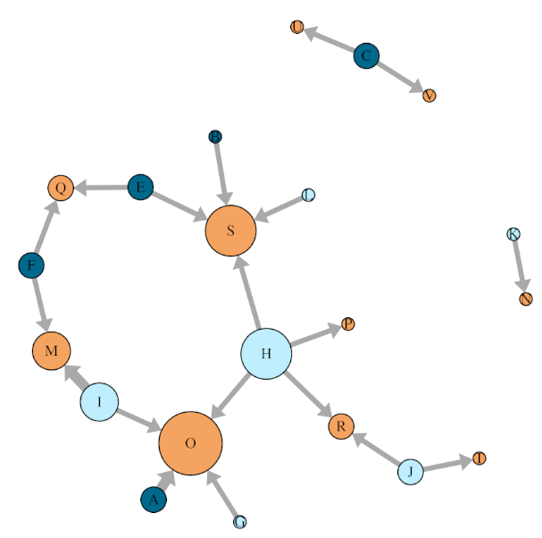
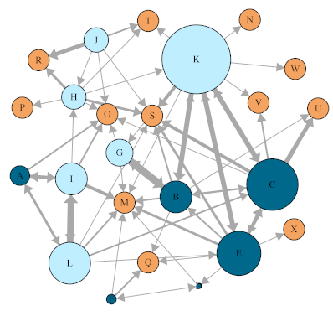
Replicate 3 networks (all days)
Isolated male
Experienced male
Female
Directed mount network Node size: Out-strength for males;
Constant for females
Directed insemination network Node size: Out-strength for males; In-strength for females

Slide 4
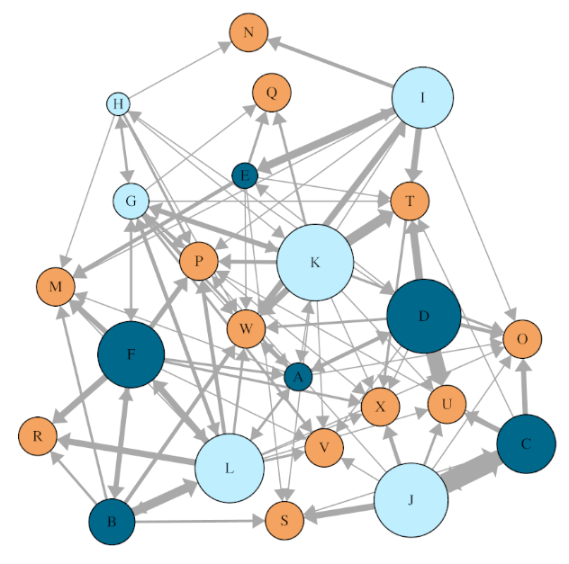
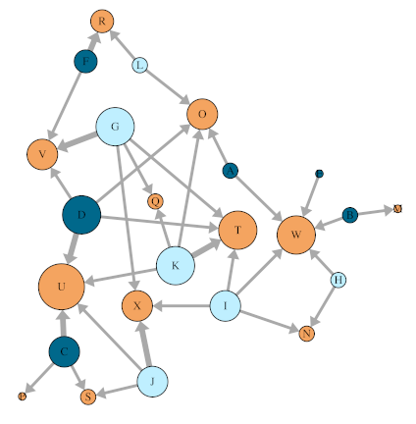
Replicate 4 networks (all days)
Isolated male
Experienced male
Female
Directed mount network Node size: Out-strength for males;
Constant for females
Directed insemination network Node size: Out-strength for males; In-strength for females

Slide 5
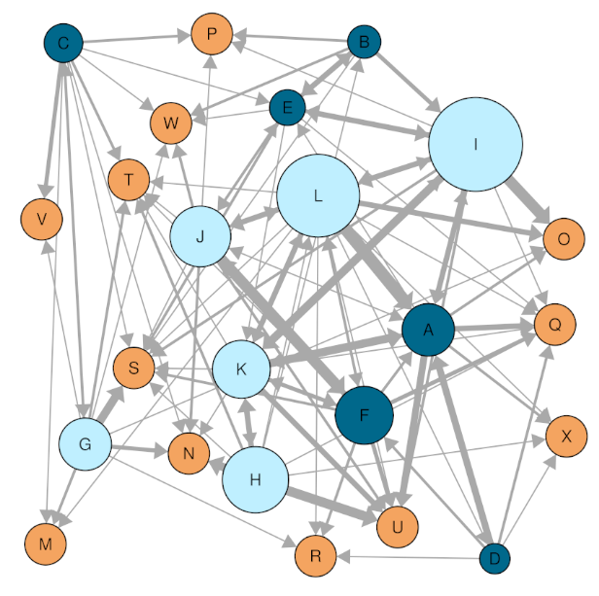
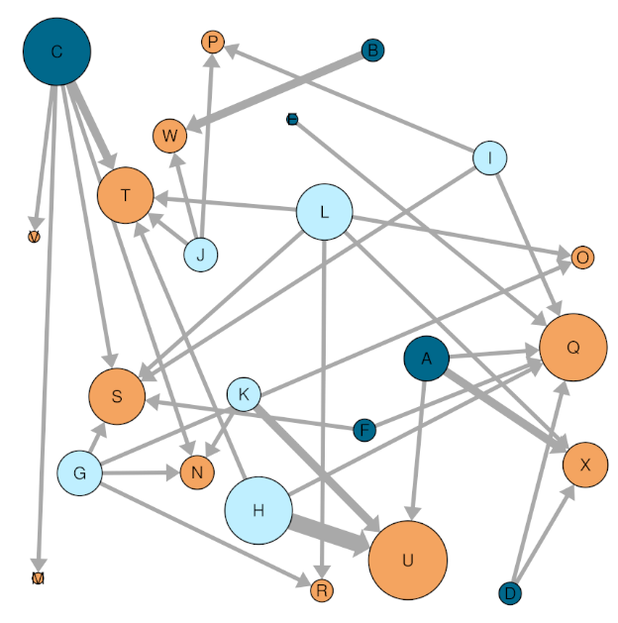
Replicate 5 networks (all days)
Isolated male
Experienced male
Female
Directed mount network Node size: Out-strength for males;
Constant for females
Directed insemination network Node size: Out-strength for males; In-strength for females

Slide 6
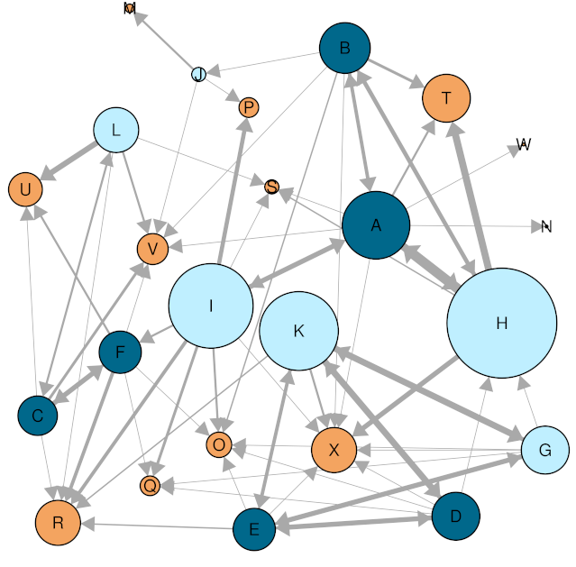
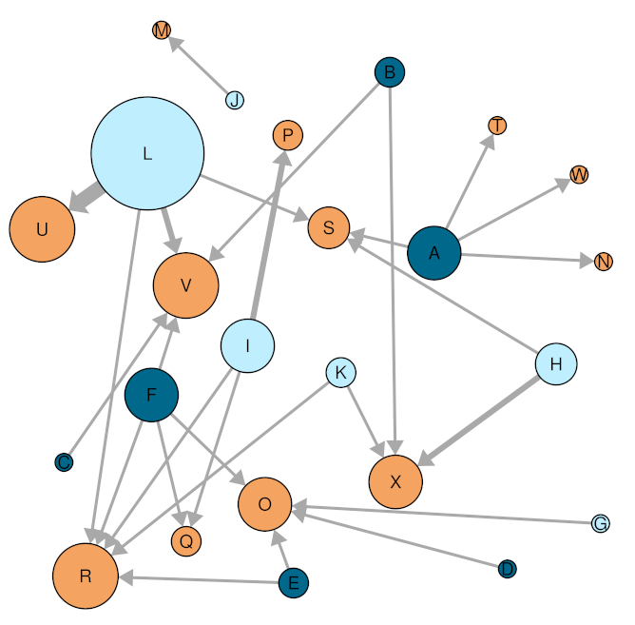
Replicate 6 networks (all days)
Isolated male
Experienced male
Female
Directed mount network Node size: Out-strength for males;
In-strength for females
Directed insemination network Node size: Out-strength for males; In-strength for females

Slide 7
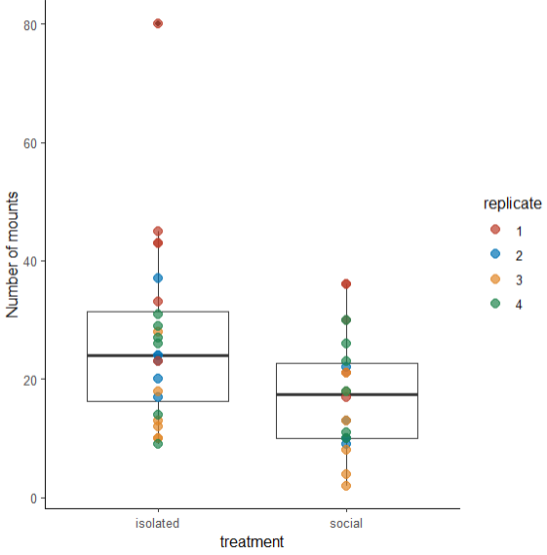
Total mounts performed

Slide 8
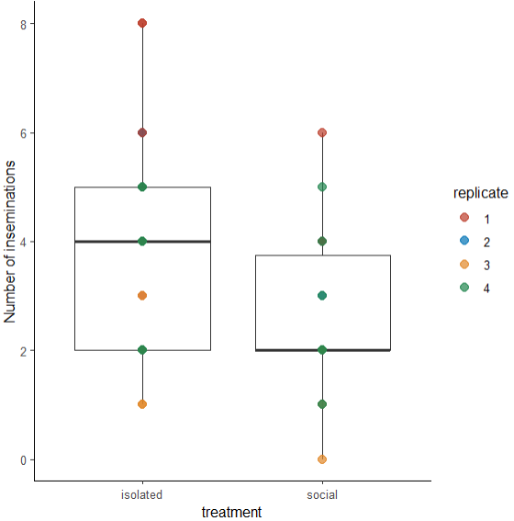
Total inseminations

Slide 9
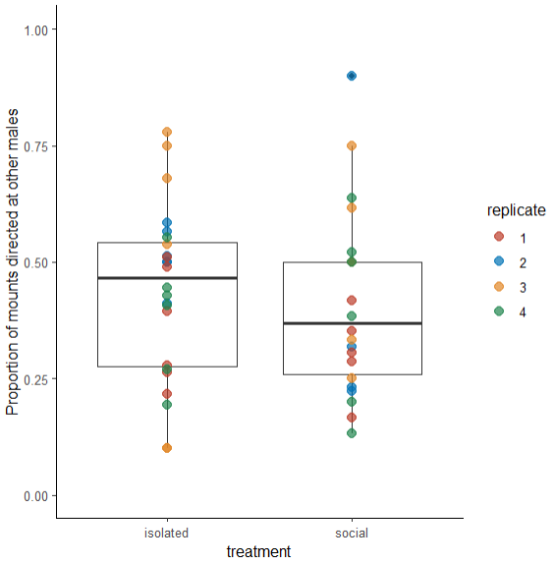
Proportion of mounts directed at other males

Slide 10
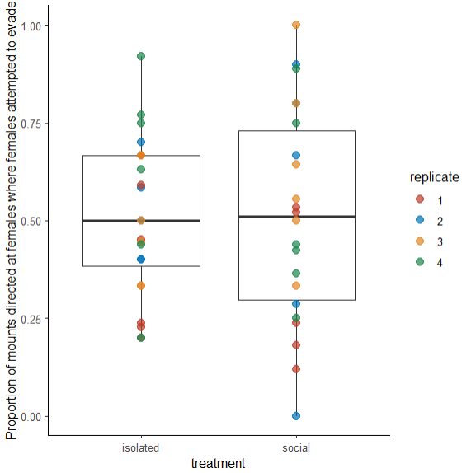
Proportion of mounts directed at females where females tried to evade

Slide 11
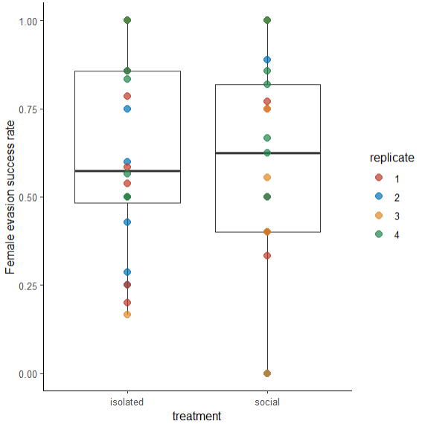
Proportion of mounts where females attempted to avoid that were successful

Slide 12
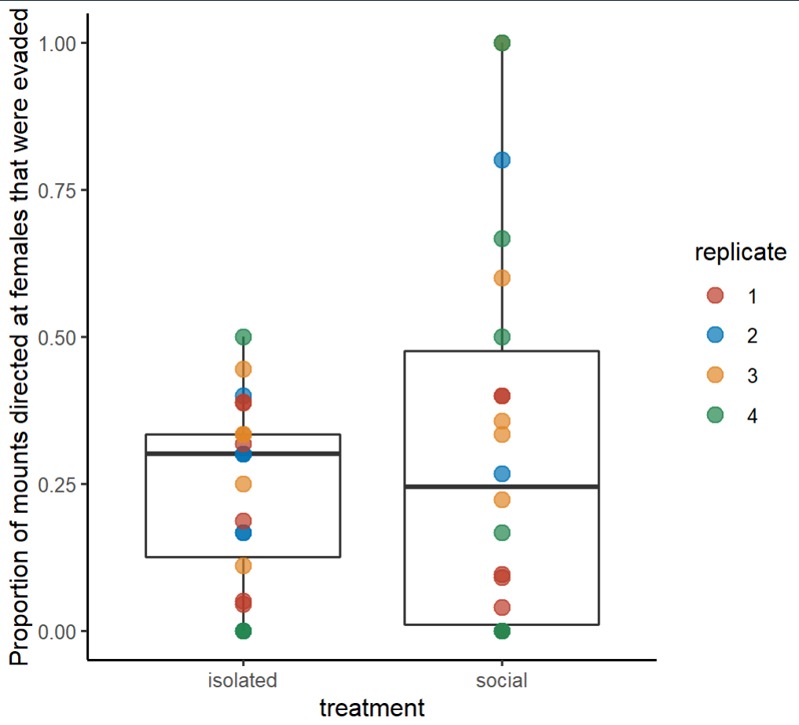
Proportion of mounts directed at females that were evaded

Slide 13
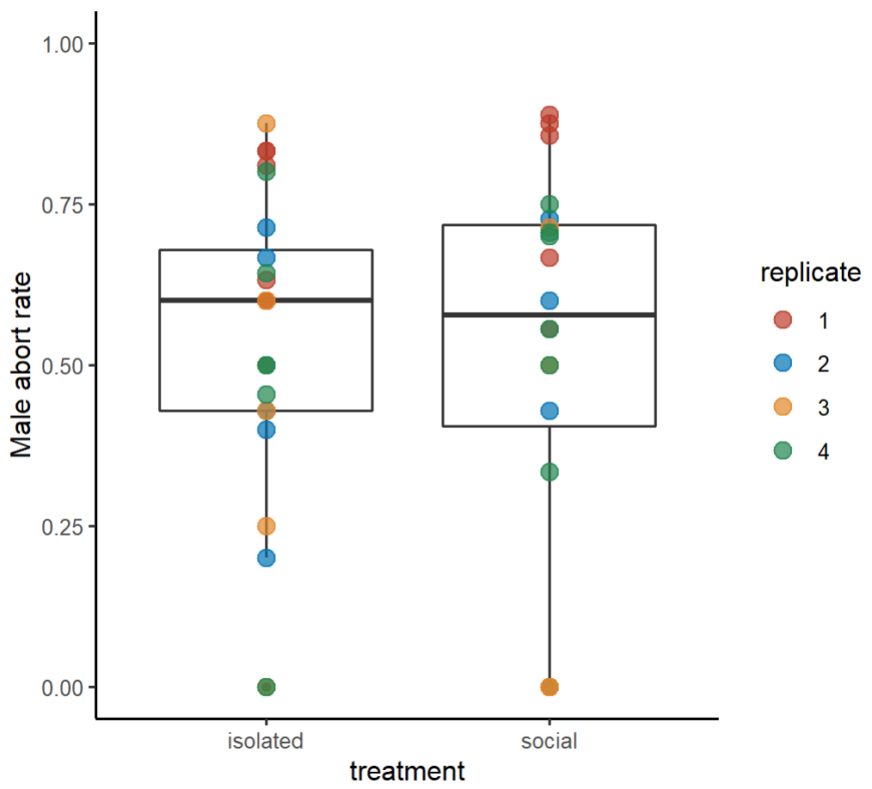
Proportion of mounts aborted where males had the choice to abort

Slide 14
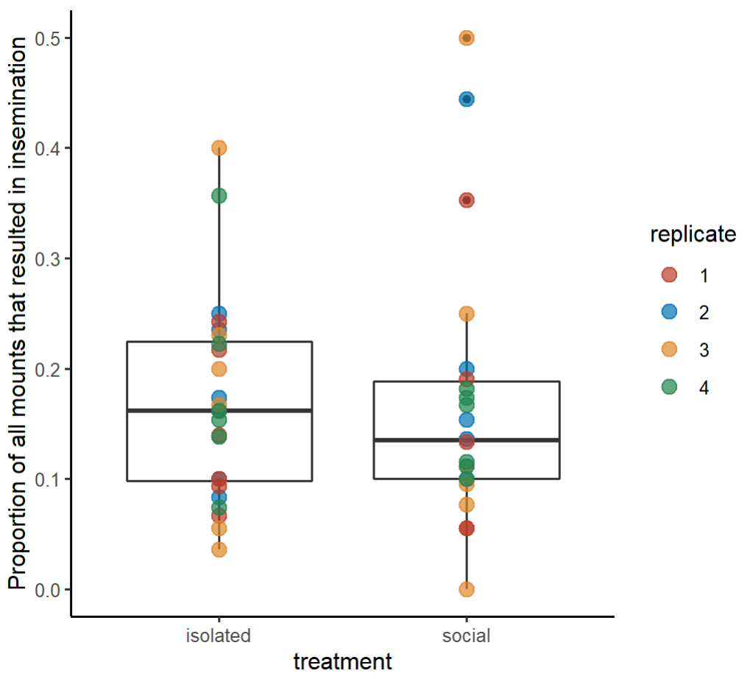
Proportion of all mounts that resulted in insemination

Slide 15
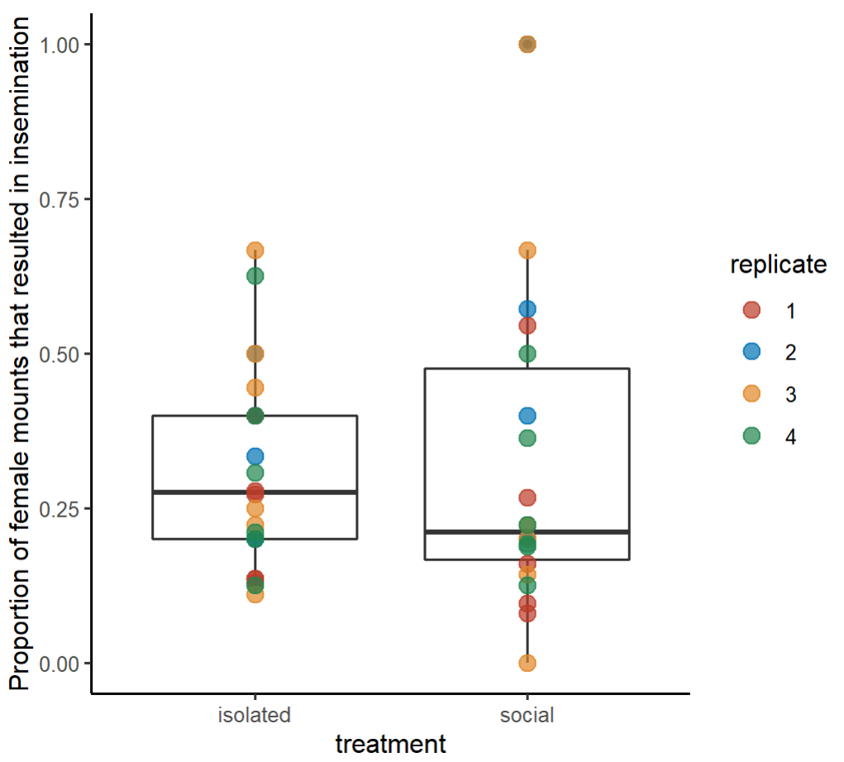
Proportion of mounts directed at females that resulted in insemination

Slide 16
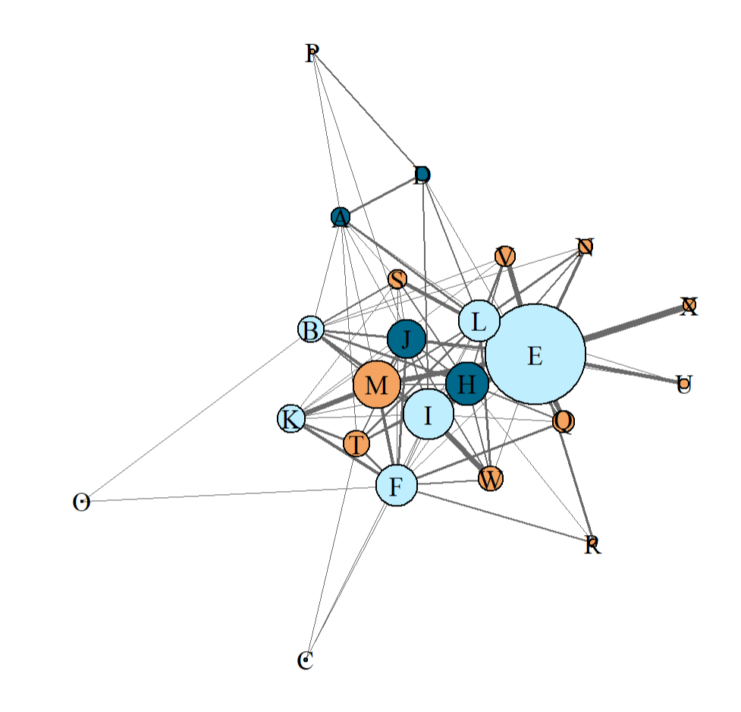
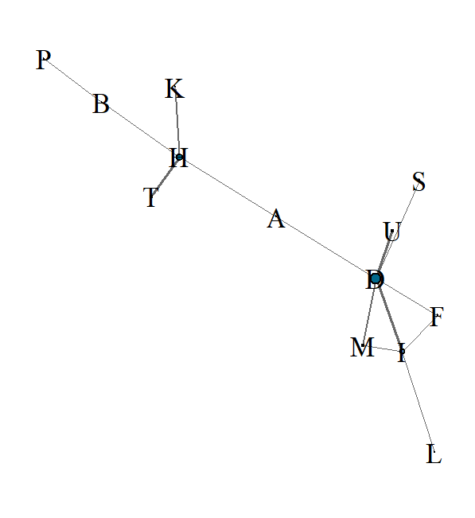
Replicate 1 mount networks
Day 1
Day 2
Isolated male
Experienced male
Female

Slide 17
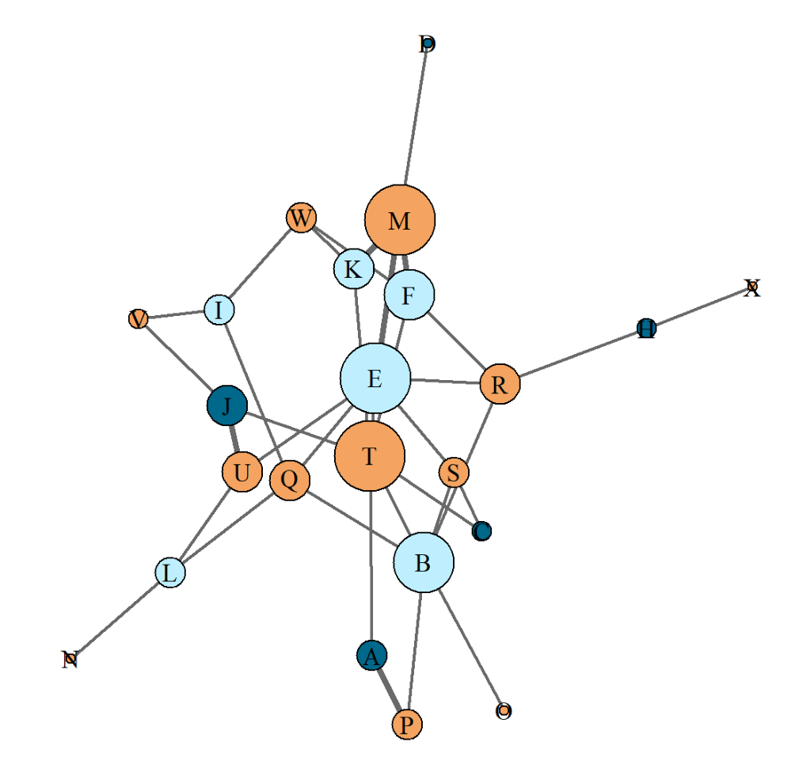
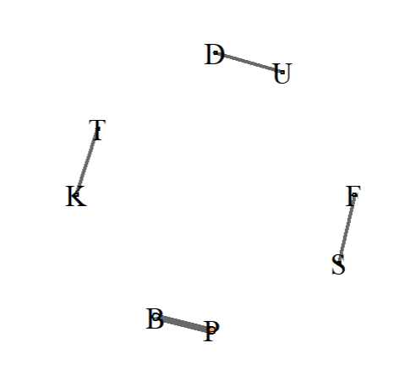
Replicate 1 insemination networks
Day 1
Day 2
Isolated male
Experienced male
Female

Slide 18
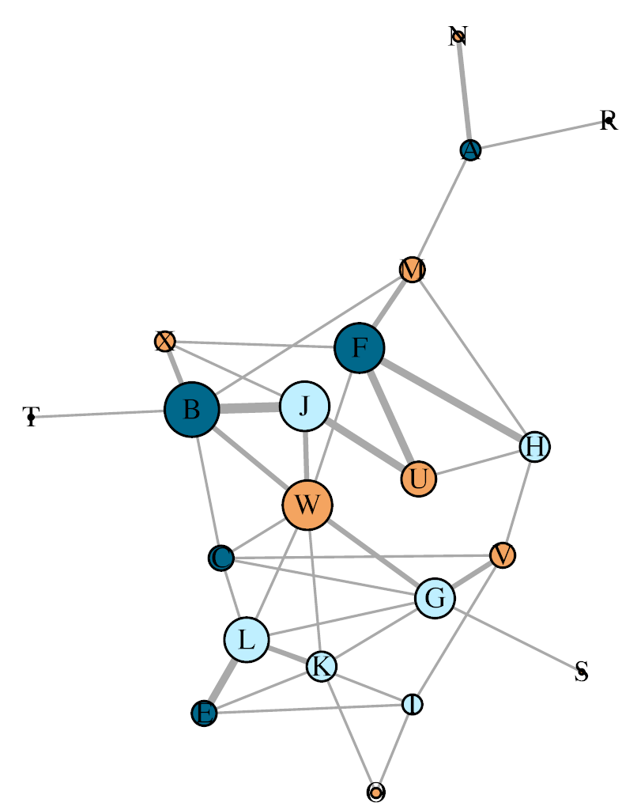
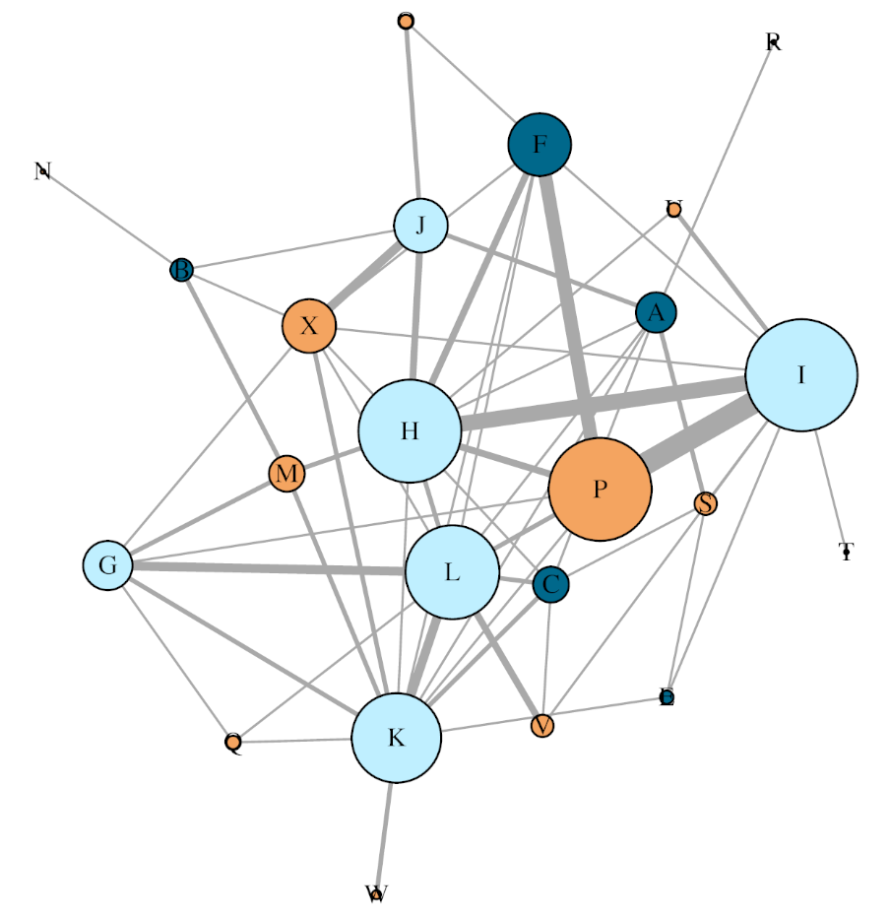
Replicate 2 mount networks
Day 1
Day 2
Isolated male
Experienced male
Female

Slide 19
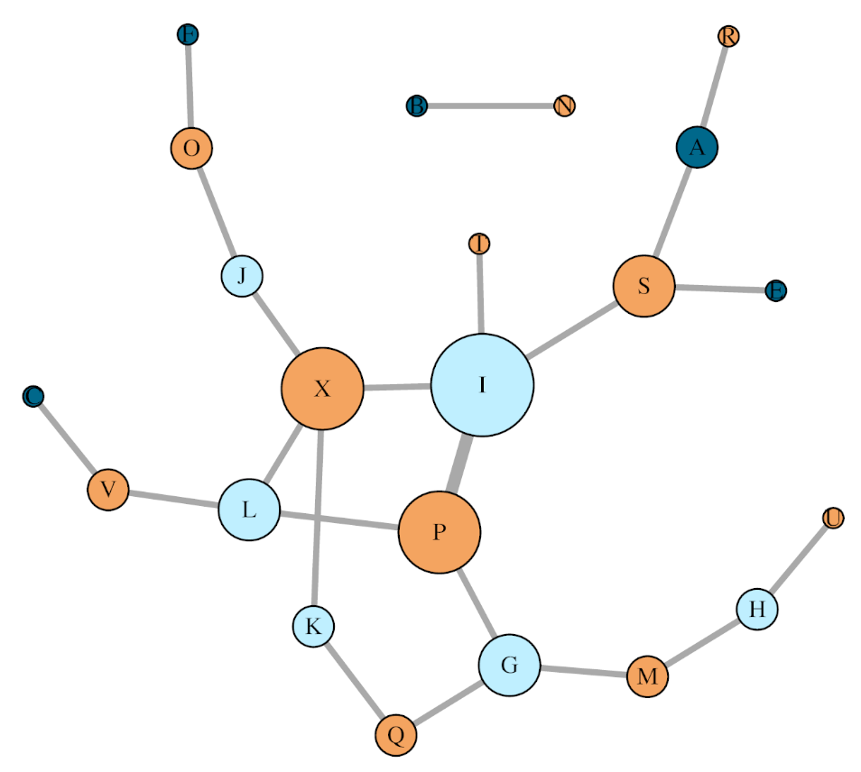
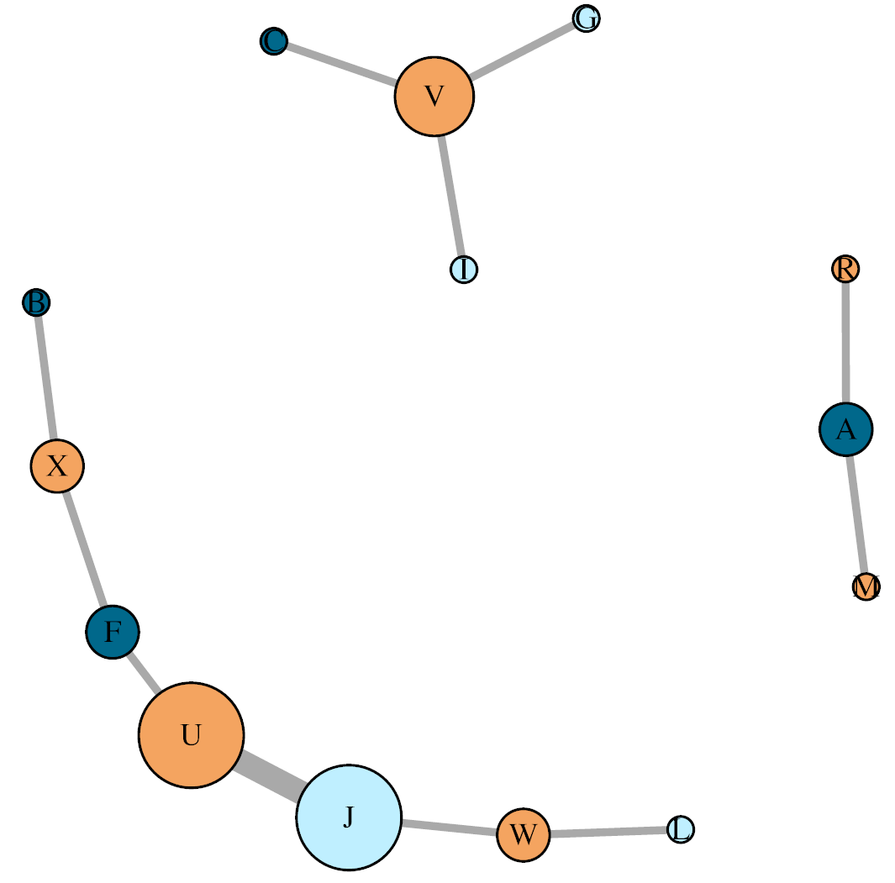
Replicate 2 Insemination networks
Day 1
Day 2
Isolated male
Experienced male
Female

