Slide 1
ID key for first male social experience experiment (Fall 2022)

Slide 2
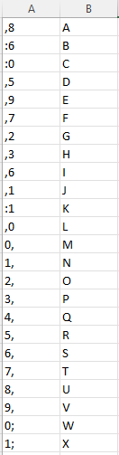
Rep 1

Slide 3
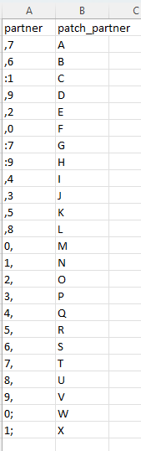
Rep 2

Slide 4
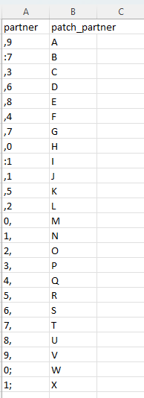
Rep 3

Slide 5
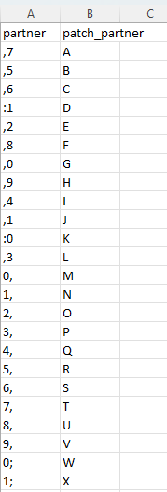
Rep 4

Slide 6
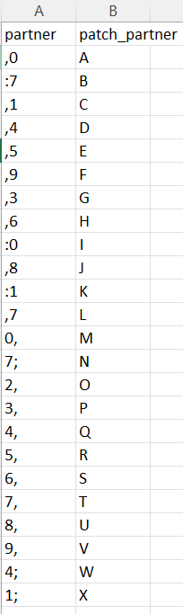
Rep 5

Slide 7
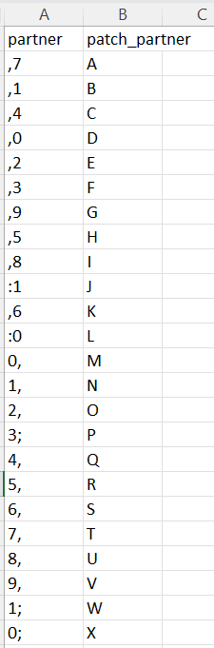
Rep 6

