Slide 1
Mating rate per fly (based on # of matings over 32 representing the 32-day window of when we conducted mating trials. If a female died during those four weeks, I changed the denominator to number of days they were alive during that 32 day window)
Notes:
Figure 2.

Slide 2

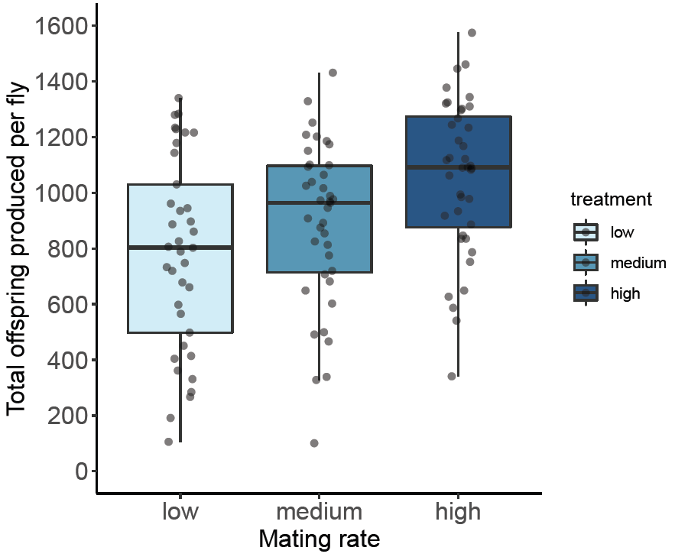
Total lifetime offspring produced (R1 and R2 combined except for the last batch of R2 offspring)
***
*

Slide 3
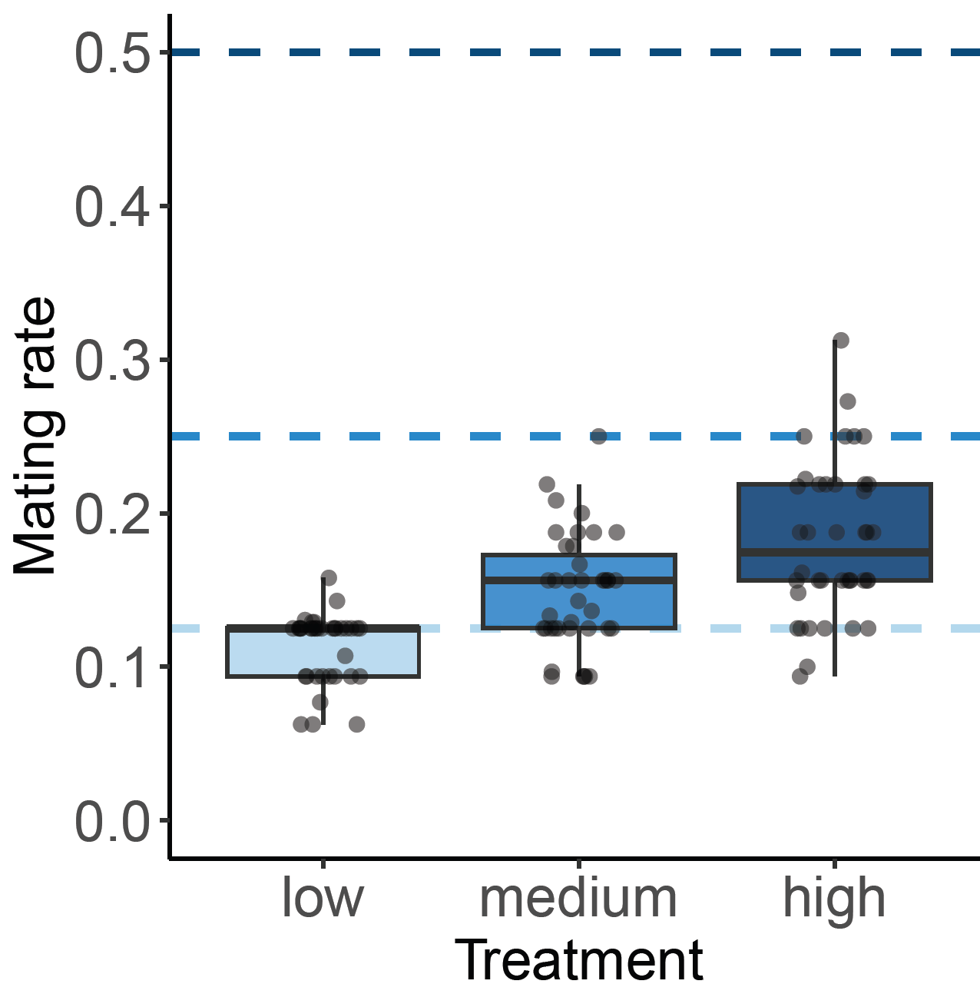
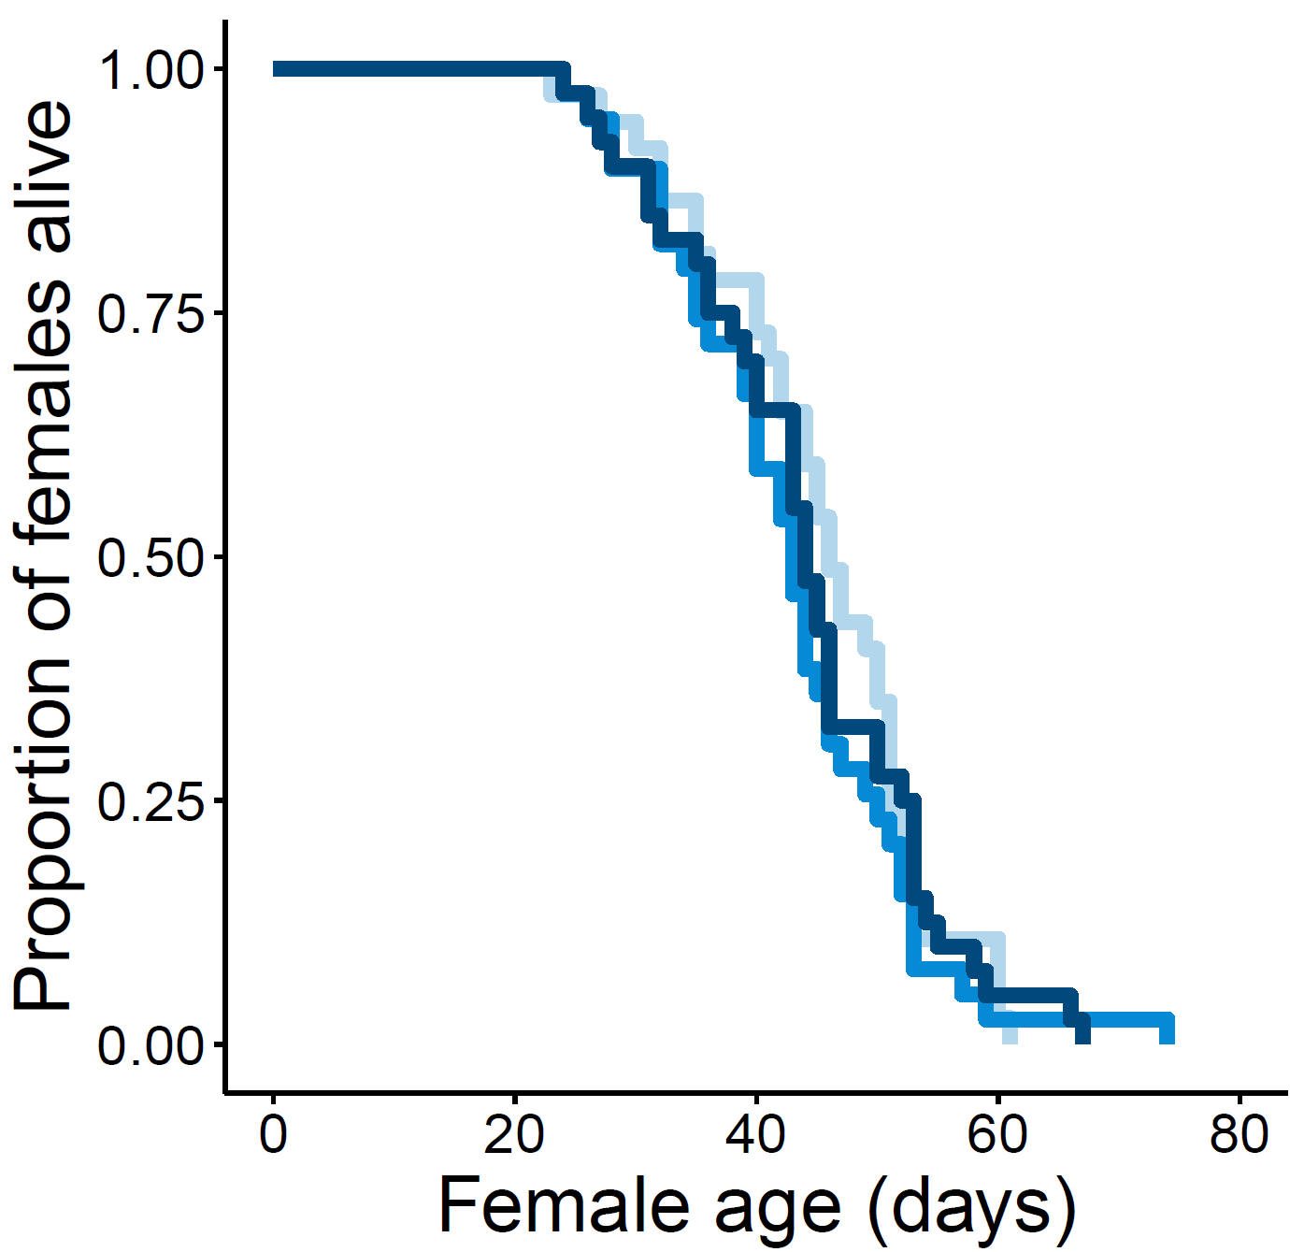
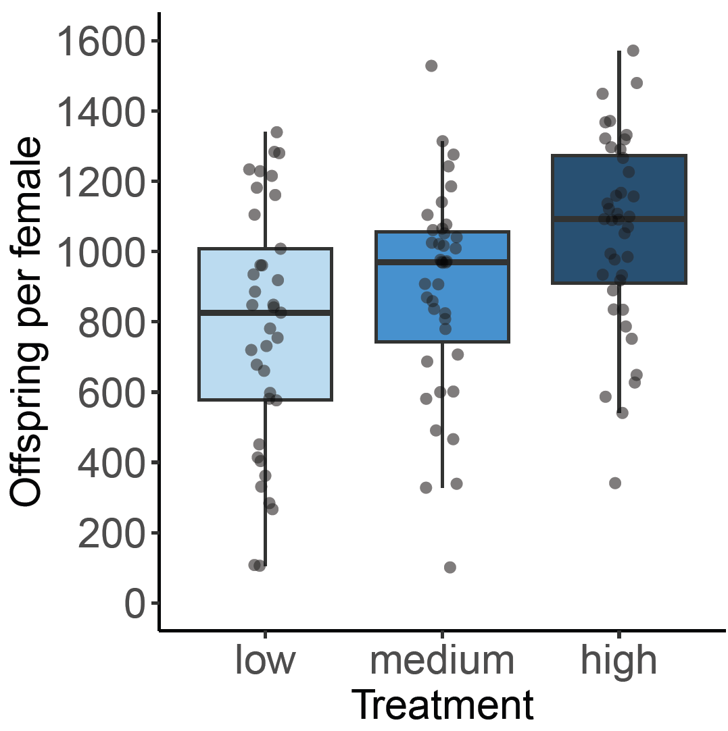

a)
b)
c)

Slide 4
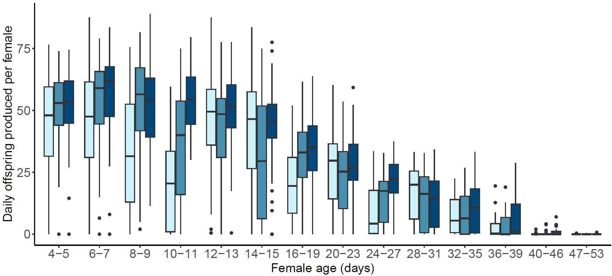
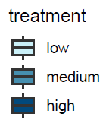

Slide 5
