Slide 1
What are the true effect sizes of winner and loser effects?: A meta-analysis comparing self-selection and random assignment protocols

Slide 2
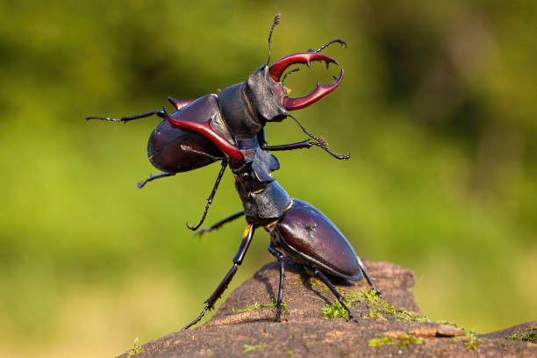
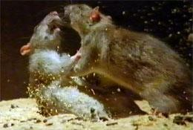
Winner effect: When prior winning experiences increase the probability of winning subsequent contests
Loser effect: When prior losing experiences increase the probability of losing subsequent contests

Slide 3
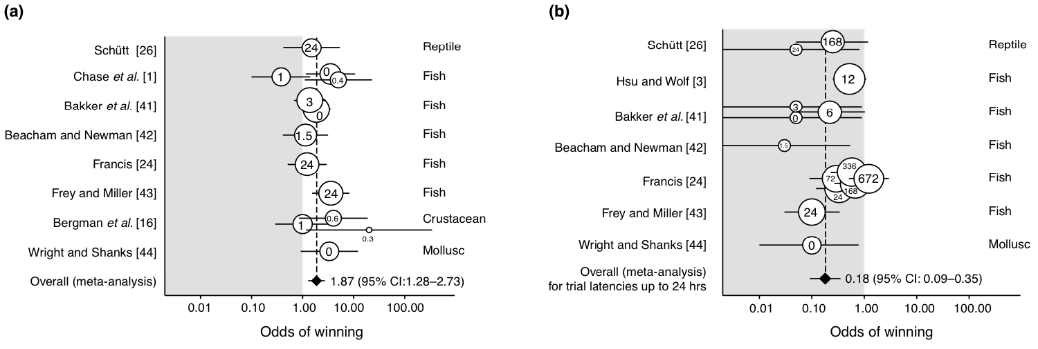
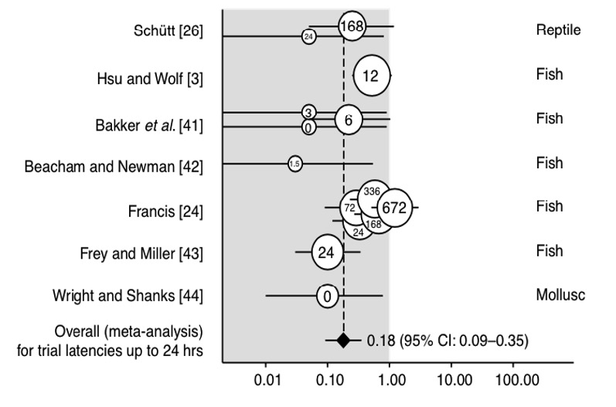
Cross-taxa evidence of winner and loser effects
Winner effect
Loser effect
Odds of winning a contest after winning an initial contest
Odds of losing a contest after losing an initial contest
Rutte et al. (2006). Trends in Ecology and Evolution.

Slide 4
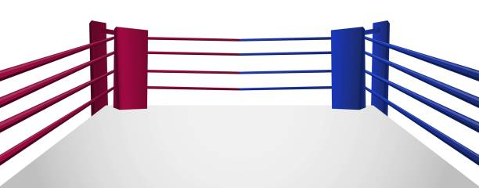
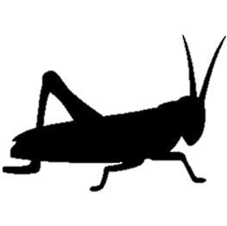
Self-selection protocols
Winner
Loser
Fight against size-matched, naïve opponent to test the Winner effect
Fight against size-matched, naïve opponent to test the Loser effect

Slide 5
Random assignment protocols
Randomly-assigned winner
Randomly-assigned loser
Fight against size-matched, naïve opponent to test the Winner effect
Fight against size-matched, naïve opponent to test the Loser effect

Slide 6
Our research questions:
1. What are the magnitudes of winner and loser effects across various taxa? Can the sign of their effects be estimated confidently?
2. Is the magnitude of the loser effect higher than that of the winner effects (as previously suggested by Bakker et al. (1989)?
3. Is the magnitude of winner and loser effects lower in experiments using random assignment than in studies that commit selection bias?
4. What is the proportion of studies on winner and loser effects that use random assignment protocols instead of self-selection? Has it increased over time?

Slide 7
Search criteria
Empirical studies that assessed the effect of prior contest wins or losses on subsequent contest outcomes
We excluded studies that:
Did not match individuals to naïve, unfamiliar competitors in the test phase
Did not quantify contest outcome as a response variable (some studies only measure aggression or physiological measures)
We found 37 eligible studies that produced 168 total comparisons

Slide 8
From each study, we extracted:
Protocol type (self-selection or random assignment)
2) Initial contest experience (win or loss)
3) Sample size
4) Outcome of test contest (Measured by # of wins and # of losses)
5) Type of study animals
6) Study publication year

Slide 9
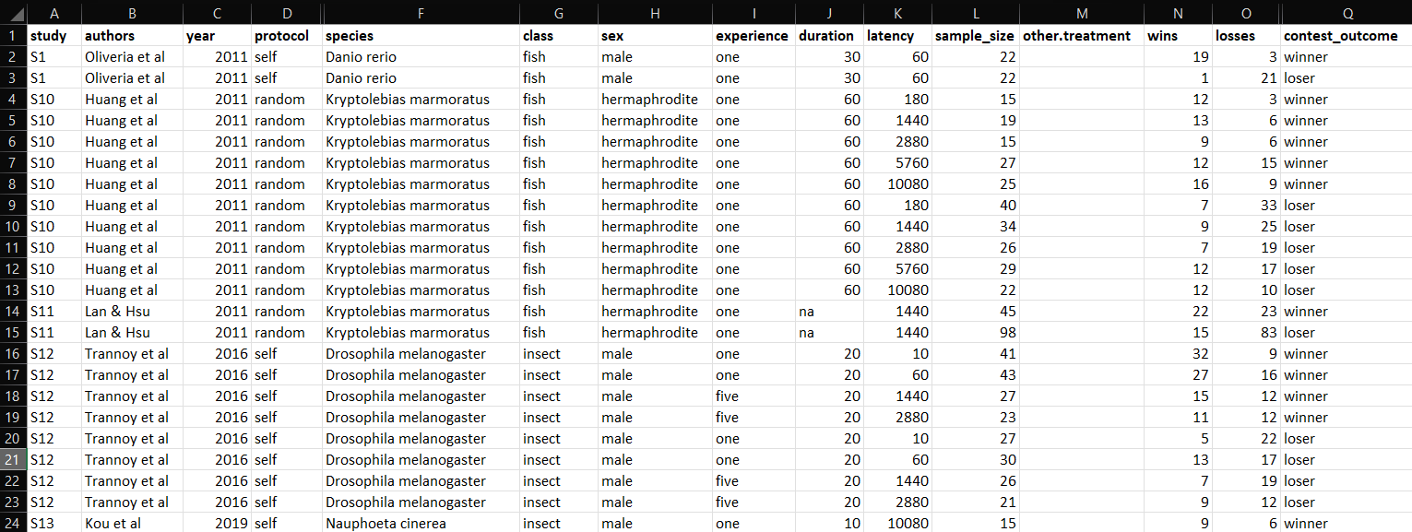
The data:

Slide 10
Calculating effect sizes
Used the metafor package in R
Used the escalc() function with the “PLO” measure to calculate effect size in log-odds (logit transformed proportion)
all_data <- escalc(data = all_data, xi = ifelse(contest_outcome == "winner", wins, losses),
ni = sample_size,
measure = "PLO",
append = TRUE)
xi = the number of individuals experiencing the event of interest
(wins for prior winners and losses for prior losers)

Slide 11
Generating the meta-analysis model
Used the rma.mv() function to generate a meta regression model with the effect sizes calculated earlier
met_mod_all <-rma.mv(data = all_data, yi, vi, mods = ~ contest_outcome + protocol,
random = ~ (1|study/experiment),
method="ML")
Contest outcome (prior winner or prior loser) and protocol type (selection bias or random assignment) were moderators
Experiment nested within study ID as a random effect

Slide 12
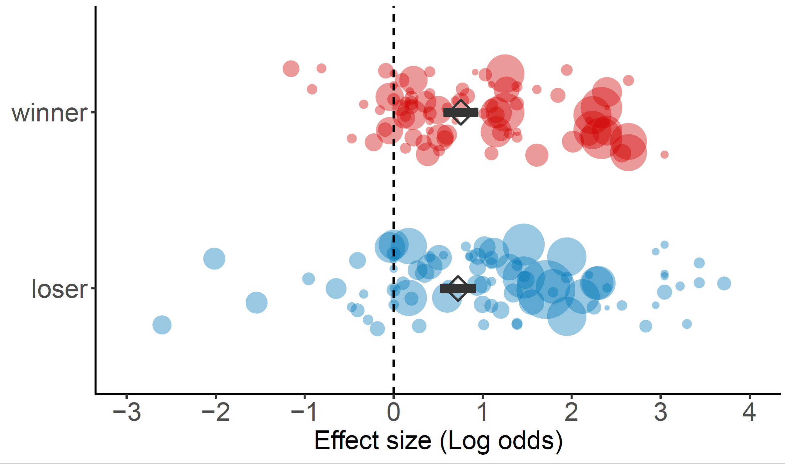
The pooled log-odds of winning a contest for prior winners was 0.76 (95% CI: 0.56 – 0.95; p < 0.0001)
The pooled log-odds of losing a contest for prior losers was 0.72 (95% CI: 0.52 – 0.92; p < 0.0001)

Slide 13
We did not detect significant differences in the magnitude of winner effects vs. loser effects (Qm₁ = 0.18; 95% CI: -0.11 – 0.18; p = 0.67)
Notes:
The QM statistic tests whether the moderator variable significantly influences the mean effect size “I do think you should report the estimated difference between winner and loser effects, with CIs; these are log-odds/odds as well.”

Slide 14
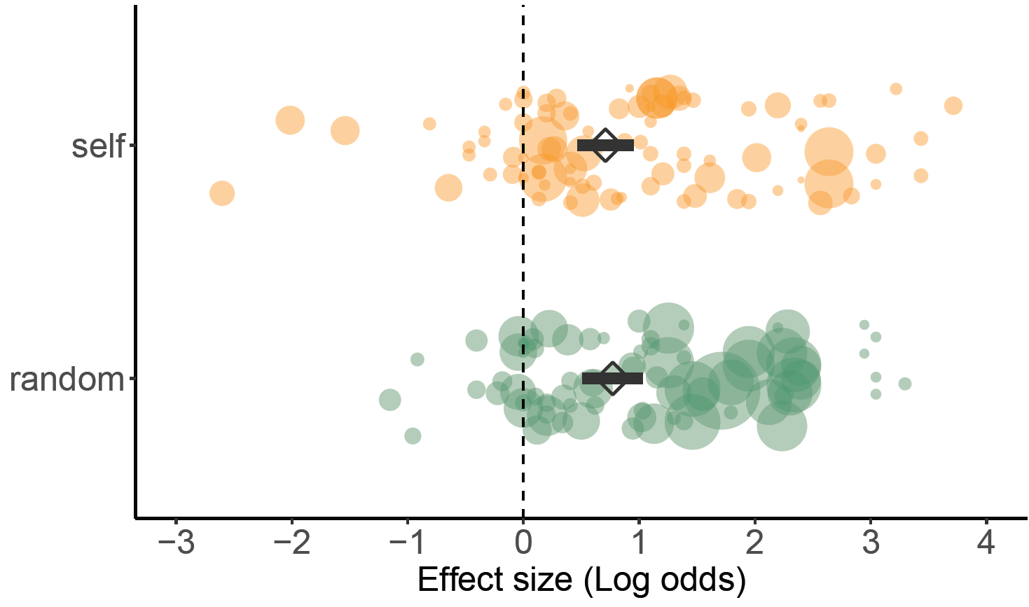
We did not detect significant differences in the magnitude of winner and loser effects between self-selection and random assignment studies (Qm₁ = 0.12; 95% CI:-0.41 – 0.29; p = 0.72)
Notes:
The QM statistic tests whether the moderator variable significantly influences the mean effect size

Slide 15
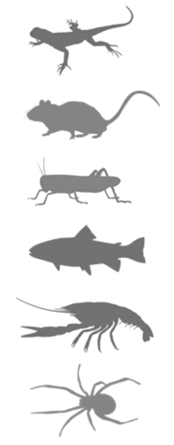
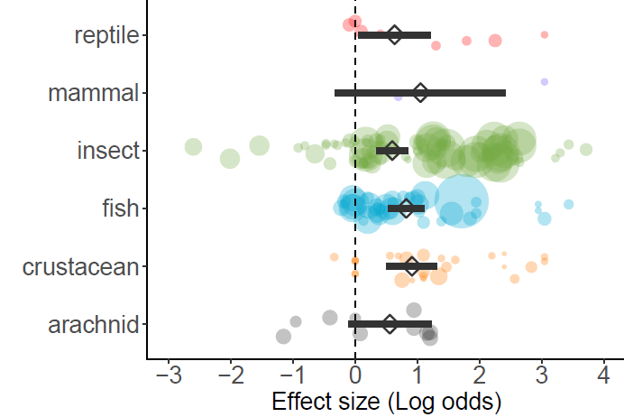
The effects of prior wins and losses did not differ by taxa (Qm₆ =; 95% CI: _________; p = 0.70)

Slide 16
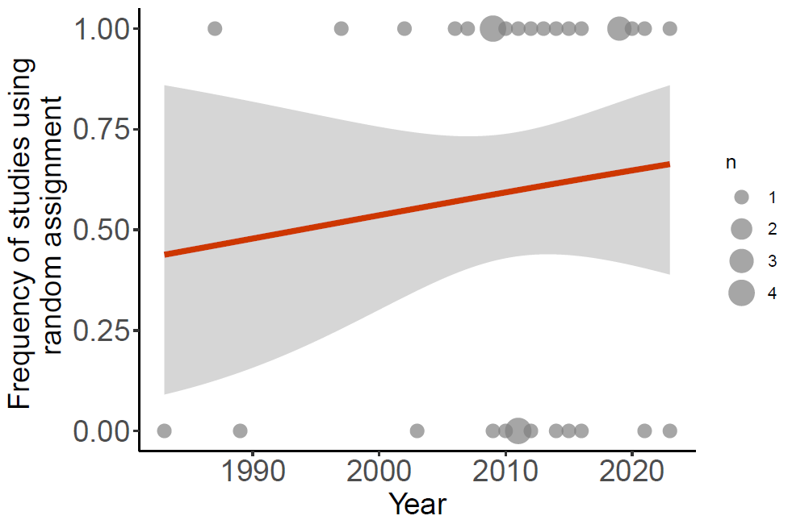
We found a non-statistically significant trend of random assignment being used more frequently than self-selection over time (GLM: Wald χ² = 0.40; 95% CI = -0.05 – 0.09; p = 0.53)
year_mod <- glm(data = study_info, protocol ~ year, family = binomial())

Slide 17
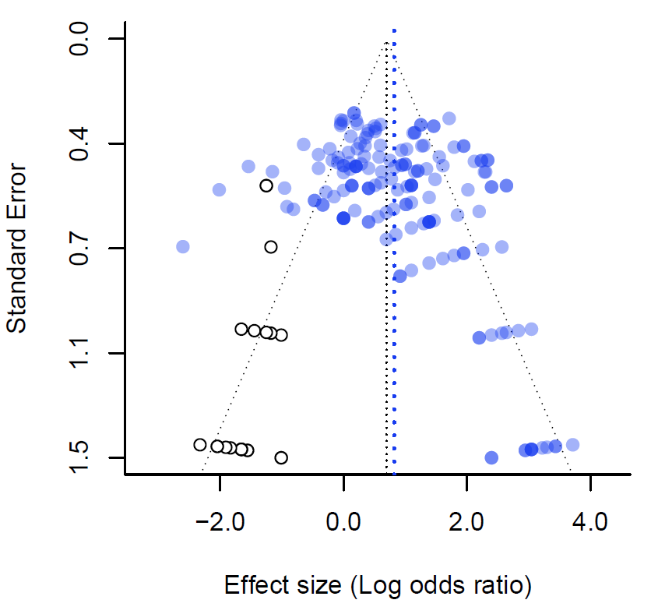
Publication bias

