Slide 1
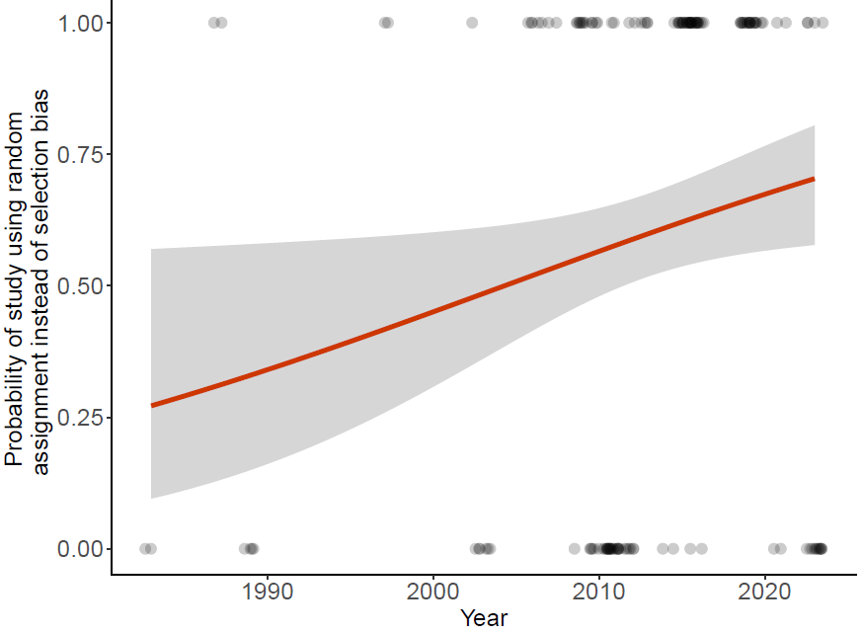
Fig 1. The use of random assignment has increased over time but still, ~25% of recent studies commit selection bias

Slide 2
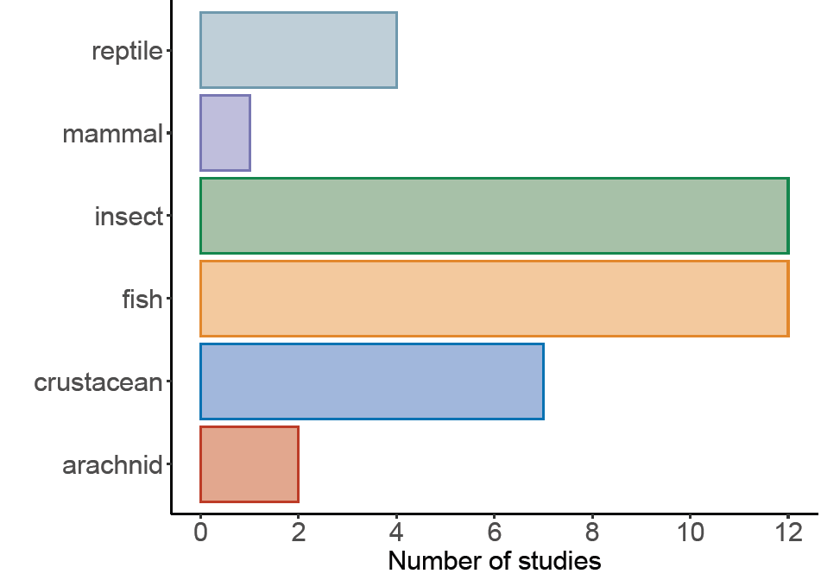






Fig 2.

