Slide 1
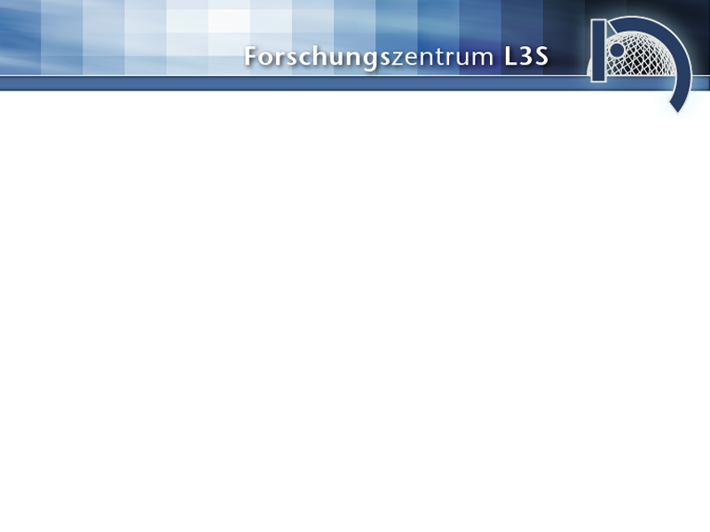
Extending the XML web development framework
COCOON
into a complete web service for the registration of scientific primary data
RegServ v1.0
Jan Hinzmann
Universität Hannover
B.Sc. Colloquium
06.07.2005 Hannover

Slide 2
Overview
  History
    since 2003: project CoData
    2005 bachelorthesis
  RegServ: Architecture
    cocoon
    corelibrary
    interfaces
  Further Work
    database for metadata
    searchinterface

Slide 3
History
2003
  project CoData was founded
2004
  simple browserinterface to register a Data-DOI in the handlesystem
  the browserinterface was then extended by the
  registerCitationDOI-method
end 2004
  customers have registered over 6.000 Data-DOIs

Slide 4
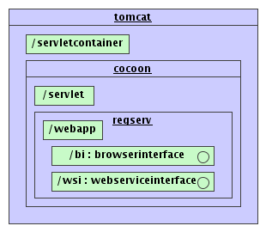
RegServ: Architecture
The web application has the following architecture:
  servletcontainer: tomcat
    https, authentification
  servlet: cocoon
    SoC/MVC2
  webapp: RegServ
    core-library: regserv.jar
      tasks
      commands
    browserinterface
    webserviceinterface

Slide 5
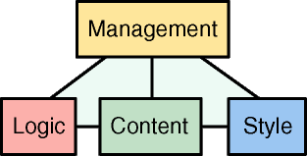
Cocoon: Web Development Framework
SoC – Separation of Concerns MVC2
  sitemap.xmap
  flowscript.js
  content.xml
  style.xsl
source: http://cocoon.apache.org/2.1/introduction.html

Slide 6
Cocoon: webapp
  http://localhost/cocoon/myWebapp/index.html
tomcat
cocoon
myWebapp
sitemap
matcher

Slide 7
Cocoon: sitemap
  http://localhost/cocoon/myWebapp/index.html
index.xml
Sitemap
<map:match pattern="index.html">
<map:generate src="index.xml"/>
<map:transform src="xml2html.xsl"/>
<map:serialize type="html"/>
</map:match>
xml2html.xsl
index.html
html,xhtml
pdf
postscript
xml
xls (Excel)
zip
...

Slide 8
Cocoon: flowscript
  http://localhost/cocoon/myWebapp/index.html
Sitemap
<map:match pattern="index.html">
<map:call function="hello"/>
</map:match>
<map:match pattern="helloWorld">
<map:generate src="index.xml"/>
<map:transform src="index.xsl">
<map:parameter name="foo" value="{flow-attribute:foo}"/>
</map:transform>
<map:serialize type="html"/>
</map:match>
flow.js
function hello(){
var value = "Hello World!";
var foo = {"foo":value};
cocoon.sendPage("helloWorld", foo);
}
index.html
<html>
<body>
<p>Hello World!</p>
</body>
</html>

Slide 9
Overview
  History
    since 2003: project CoData
    2005 bachelorthesis
  RegServ: Architecture
    cocoon
    corelibrary
    interfaces
  Further Work
    database for metadata
    searchinterface

Slide 10
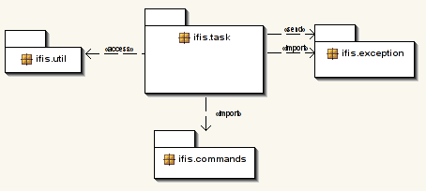
Core: packages
task
  collect commands and execute them
commands
  provide corefunctionality
util
  logging
  timestamp
  checksum (URN)
exception
  errorhandling

Slide 11
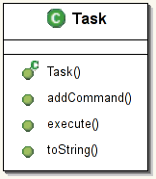
Core: tasks
the following tasks have been determined:
  registerCitationDOI
  registerDataDOI
  updateURL
  updateCitationDOI
  transformData2CitationDOI
    Each task consists of one or more commands.
    When a task is executed, all its commands are executed.

Slide 12
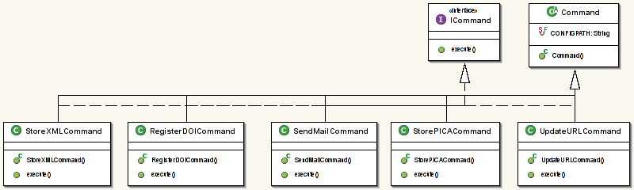
Core: commands
For the tasks we need the following commands:
  storeXML -- DB
  registerDOI -- IDF
  sendMail -- DDB
  storePICA -- GBV
  updateURL -- IDF

Slide 13
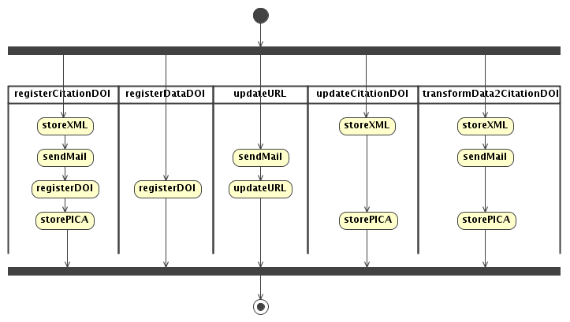
Core: putting it all together

Slide 14
Core: usage
How do I use the library?
  get an instance of ifis.task.Task
  get instances of ifis.commands.*
  add your commands to the task
  execute the task
How to get parameters in order to instantiate these commands?
  use an interface
    browserinterface
    webserviceinterface
    (formularinterface)

Slide 15
Overview
  History
    since 2003: project CoData
    2005 bachelorthesis
  RegServ: Architecture
    cocoon
    corelibrary
    interfaces
  Further Work
    database for metadata
    searchinterface

Slide 16
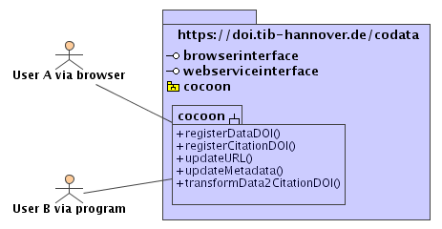
Browserinterface
application flow
  select task
  provide parameter
  see preview
  get resumé

Slide 17
Browserinterface: http://beethoven.kbs.uni-hannover.de:8080/cocoon/regserv/browserinterface/
Service-Request
1
Cocoon
task?
2
3
sitemap
flowscript
DB
parameter?
preview
DDB
5
4
Service-Response
corelibrary
IDF
GBV

Slide 18
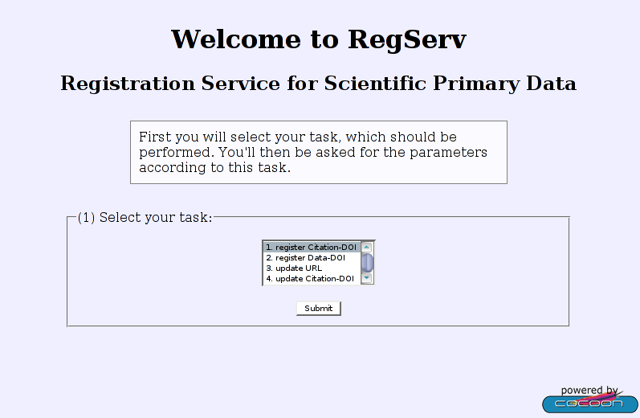
Browserinterface: task

Slide 19
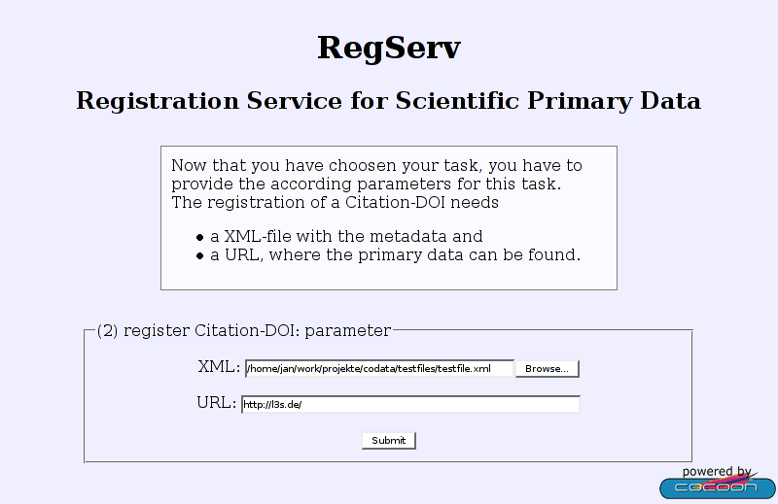
Browserinterface: parameter

Slide 20
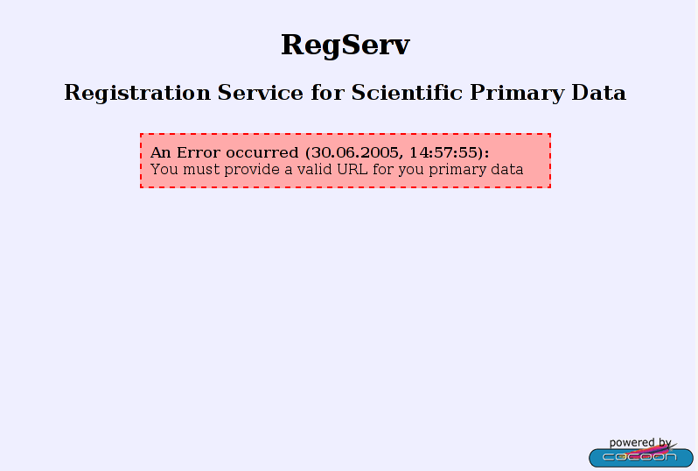
Browserinterface: error

Slide 21
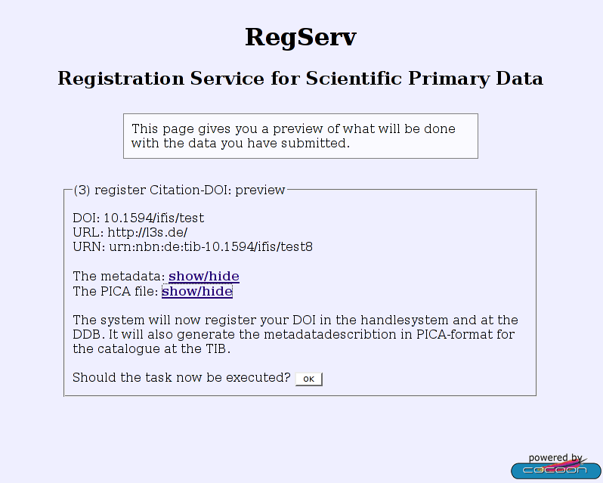
Browserinterface: preview

Slide 22
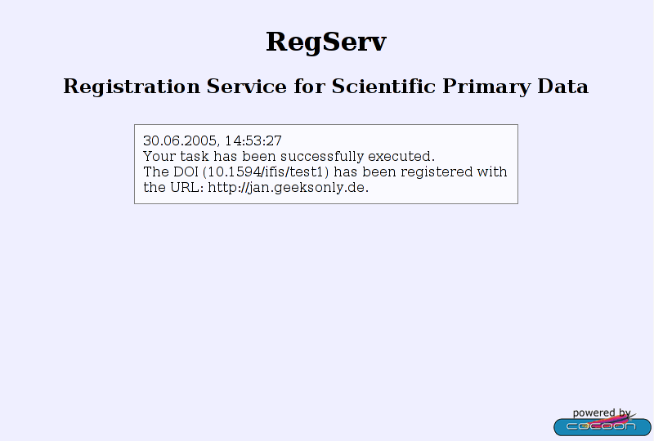
Browserinterface: resumé

Slide 23
Webserviceinterface
2005: new requirements
  "We need a (soap)webserviceinterface."
  cocoon has an integrated axis-component
application flow
  send a SOAP:Envelope
  get a SOAP:Response

Slide 24
Webserviceinterface: the doubled code
Cocoon
browserinterface
sitemap
flowscript
DB
webserviceinterface
axisproxy
javascript
DDB
same code
IDF
cannot call
processPipelineTo()
=> compute XSLT ...
Axis
corelibrary
java
GBV

Slide 25
Webserviceinterface: thesis
Thesis:
  make Cocoon interpret soap-messages to skip the axis-component!
Thoughts:
  The soapEnvelope is xml
  it contains all necessary data
  the name of the first node after the bodynode is the methodname
  the parameters are provided in a well-defined order
Idea:
  generate the soapEnvelope with a StreamGenerator and store it for later use in a flowscriptvariable ('soapData')
  extract the methodname
  as soon as the methodname is known, extract the parameters
  execute the method and send the answer

Slide 26
Webserviceinterface: what do we get?
<?xml version=”1.0”?>
<soapenv:Envelope
xmlns:soapenv="http://schemas.xmlsoap.org/soap/envelope/"
xmlns:xsd="http://www.w3.org/2001/XMLSchema"
xmlns:xsi="http://www.w3.org/2001/XMLSchema-instance">
<soapenv:Body>
<ns1:registerDataDOI
soapenv:encodingStyle="http://schemas.xmlsoap.org/soap/encoding/"
xmlns:ns1="CodataWS">
<ns1:arg0 xsi:type="xsd:string">10.1594/ifis/test1</ns1:arg0>
<ns1:arg1 xsi:type="xsd:string">http://jan.geeksonly.de</ns1:arg1>
</ns1:registerDataDOI>
</soapenv:Body>
</soapenv:Envelope>
methodname
parameter

Slide 27
Webserviceinterface: what should we send?
<?xml version=”1.0”?>
<soapenv:Envelope
xmlns:soapenv=”http://schemas.xmlsoap.org/soap/envelope/”
xmlns:xsd=”http://www.w3.org/2001/XMLSchema”
xmlns:xsi=”http://www.w3.org/2001/XMLSchema−instance”>
<soapenv:Body>
<ns1:registerDataDOIResponse
soapenv: encodingStyl e=”http://schemas.xmlsoap.org/soap/encoding/”
xmlns:ns1=”CodataWS”>
<ns1:registerDataDOIReturn xsi:type=”xsd:string”>OK
</ns1:registerDataDOIReturn>
</ns1:registerDataDOIResponse>
</soapenv:Body>
</soapenv:Envelope>
answer
message

Slide 28
Webserviceinterface: solution
Cocoon
sitemap
flowscript
Matcher
main()
XML soapData;
//assign soapData:
processPipelineTo(soapData);
Generator (Stream)
String soapMethod;
//assign soapMethod:
processPipelineTo(soapMethod);
Generator
Parameter soapParameter;
//assign soapParameter:
processPipelineTo(URL/DOI/...);
Generator
/*call corelibrary and execute the task.*/
String soapAnswer;
//sending answer:
sendPage("answer", answer);
answer
corelibrary

Slide 29
Webserviceinterface: solution
SOAP-Request
1
Cocoon
2
4
sitemap
flowscript
DB
SOAP-Response
3
DDB
corelibrary
DOI.org
GBV

Slide 30
Conclusion
2005 within the context of the bachelorthesis:
  refactorings made the use of Axis obsolet: only single code! :o)
  a general solution for a web service with cocoon has been found
  this was possible without any performanceloss
  the application has become more modular
  all tasks have been implemented for both interfaces
June 2005
  customers have registered over 200.000 DOIs

Slide 31
Further Work
  implement Databaseconnection to store the incoming metadata
  implement a searchinterface on the metadata
  gain performance in the implementation towards the handlesystem
  implement look-up-methods to answer questions like
    "How many handle are registered atm?"
    "Is a DOI already in the handlesystem?"
    "What is the URL according to this DOI?"
  implement a formularinterface
  many other usefull things ...

Slide 32
Thank you!
- end -

