Slide 1


OpenGL - Fruit Bars
PSET: FRUIT DATA
FROM GACHORORO
ICS 2311 Computer Graphics
Computer Science ,
CS 3.2 - April 10, 2025
Group 7

Slide 2

OPENGL DEVELOPERS
Jany Muong
Joram Kireki
Akech Atem
Josphat Waweru
SCT211-0848/2018
SCT211-0079/2022
SCT211-0535/2022
SCT211-0003/2022
Group 7

Slide 3
OPENGL PSET
A survey was carried out in Gachororo about youth preference on fruits. 170 youth were interviewed about their fruits of preference as follows Fruit: Ovacad o Orange Banana Kiwifruit Mango s Grapes People: 36 41 19 28 30 16 a) Write an OpenGL program that displays the bar chart. Input to the program is to include the data points and the labeling required for the x and y axes. The data points are to be scaled by the program so that the graph is displayed across the full area of a display window. (reading Chapter on Graphics Output Primitives in the book will help) i. Ensure that each bar has the color that closely resembles the ripe fruit under consideration ii. label your x axis as well in black and Y axis in Red b) Suppose we wish to start the graph at point (5,5) on the display window, demonstrate how this would be achieved using your question case example
Group 7

Slide 4
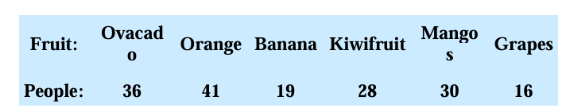
OPENGL PSET
Survey Background
A survey was conducted in Gachororo on youth fruit preferences
150 youth were interviewed about their preferred fruits
Results showed varying preferences across 6 different fruits
Group 7

Slide 5
OVERVIEW OF CONCEPTS
OpenGL: create basic 2D visualizations using OpenGL, coordinate systems and transformations, output primitives (lines, rectangles, text)
Miscellaneous: creating accurate bar charts from raw data, proper scaling of data to fit display window, effective labeling of chart elements
Our Solution:
part (a): scaling of data points to fill display area, color mapping (bars colored to match actual fruits), axis labeling with specific color requirements (x-axis black, y-axis red)
part (b): coordinate system manipulation, translate/offset graphical elements, maintaining all chart functionality while changing origin point.
Group 7

Slide 6
OPENGL WRAPPERS
C: opengl + freeglut + glew
Python: PyOpenGL PyOpenGL_accelerate PyGLM
pip install pyopengl pyopengl_accelarte pyglm
Group 7

Slide 7
WHAT WAS DONE
Based on These Objectives:
Create an OpenGL program displaying a bar chart of the survey data
Scale data points to use the full display window area
Color each bar to match the actual fruit it represents
Label the X axis in black and Y axis in red
Implement a second version with graph starting at point (5,5)
Technical Challenges:
Data scaling for different window sizes
Matching colors to actual fruits
Text rotation for readability
Coordinate system transformation
Group 7

Slide 8


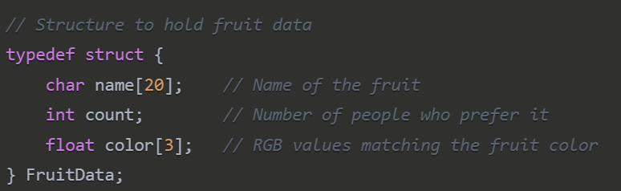
DATA STRUCTURES
Fruit Color Mapping
RGB
Struct
To Capture Fruit Data
Avocado: Dark green {0.34, 0.51, 0.01}
Orange: Orange {1.00, 0.65, 0.00}
Banana: Yellow {0.89, 0.81, 0.34}
Kiwifruit: Kiwi green {0.62, 0.89, 0.31}
Mangos: Mango orange {1.00, 0.78, 0.25}
Grapes: Purple {0.50, 0.19, 0.58}

Slide 9
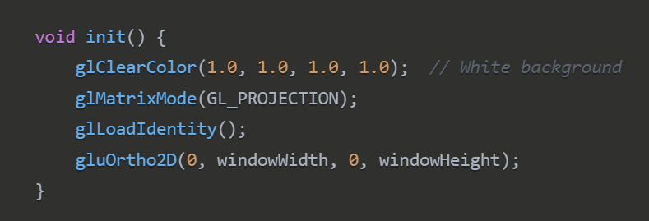
OPENGL - PART A
Initialization & Setup

Slide 10
INITIALIZATION - INTERPRETATION
init() function – Prepares the OpenGL environment:
glClearColor(1.0, 1.0, 1.0, 1.0) – Sets the background color to white.
glMatrixMode(GL_PROJECTION) – Switches to projection matrix mode for setting up the view.
glLoadIdentity() – Resets the matrix to identity.
gluOrtho2D(0, windowWidth, 0, windowHeight) – Establishes a 2D orthographic projection that matches the window dimensions.
This ensures that the coordinate system aligns with the pixel dimensions of the window.

Slide 11
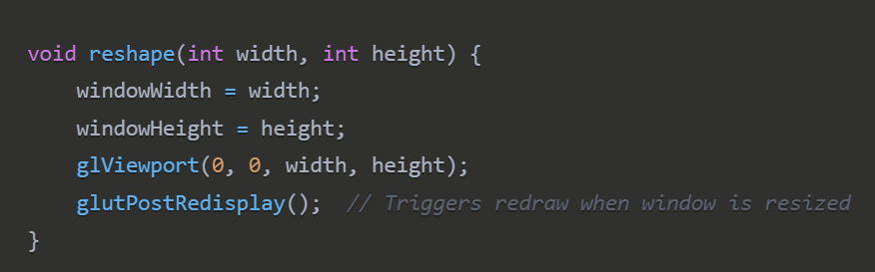
OPENGL - PART A
Window
Resizing
Handler

Slide 12
WINDOW RESIZING/SCALING
reshape() function – handles window resizing:
updates windowWidth and windowHeight to the new size.
glViewport(0, 0, width, height) – Maps the OpenGL rendering area to the new window size.
glutPostRedisplay() – requests a redraw to reflect the updated layout.
Keeps the chart responsive when the window is resized.

Slide 13
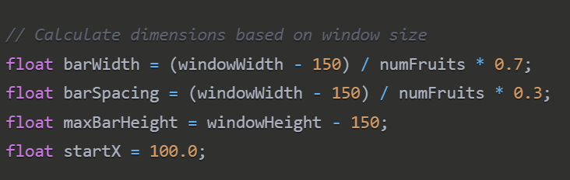
OPENGL - PART A
Rendering the Bar Chart

Slide 14
RENDERIN CHART
Calculating bar dimensions dynamically:
barWidth – width of each bar (70% of space per fruit).
barSpacing – space between bars (30% of space per fruit).
maxBarHeight – maximum bar height, leaving space at the top and bottom.
startX = 100.0 – starting x-coordinate for the first bar.
This layout adapts the bars to fit nicely in the window regardless of its size.

Slide 15
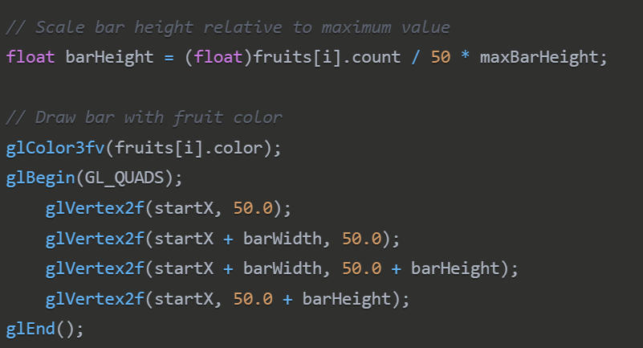
OPENGL - PART A
Drawing Individual Bars

Slide 16
RENDERIN INDIVIDUAL BARS
barHeight = (float)fruits[i].count / 50 * maxBarHeight – Scales bar height based on fruit count (assuming max 50).
glColor3fv(fruits[i].color) – uses the RGB color associated with the fruit.
glBegin(GL_QUADS) ... glEnd() – draws a rectangle representing the bar.
starts at (startX, 50.0) and extends upward to show count visually.

Slide 17
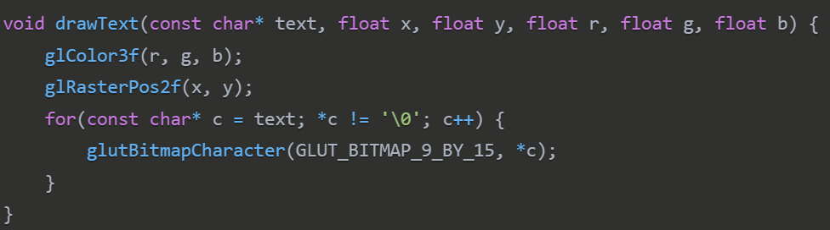
OPENGL - PART A
Text Rendering Function

Slide 18
RENDERIN TEXT
drawText() function – renders text at specified position:
sets text color using glColor3f(r, g, b).
glRasterPos2f(x, y) – positions the text origin.
loops through each character and renders it using glutBitmapCharacter.
used for labels, titles, or numerical values on the chart.

Slide 19
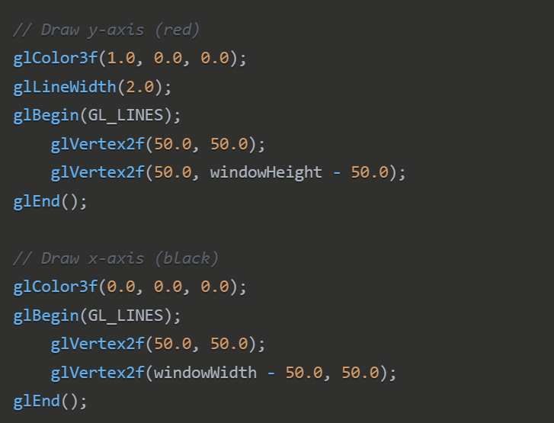
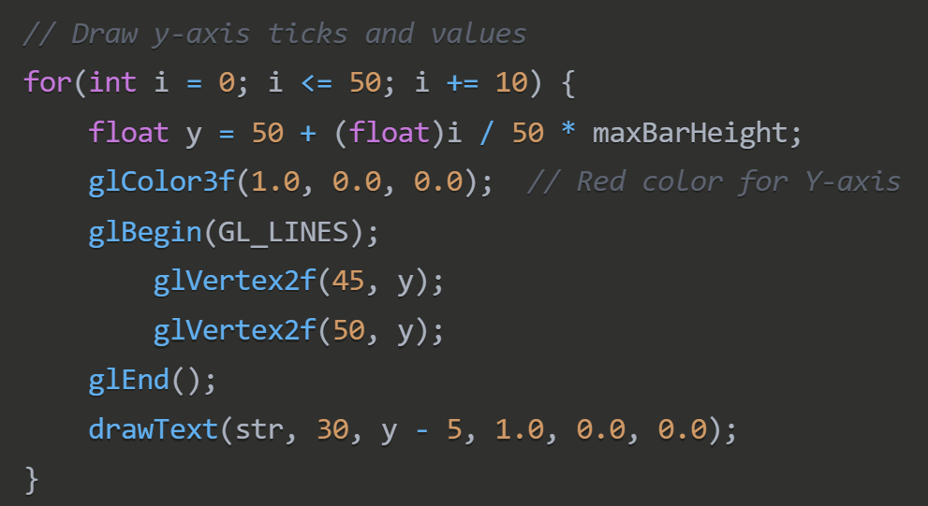
OPENGL - PART A
Coordinate System & Axes

Slide 20
RENDERIN TEXT
Rotated text labels for fruit names:
glPushMatrix() / glPopMatrix() – Preserves the transformation state.
glTranslatef(startX + barWidth/2, 30, 0) – Moves origin to label position below each bar.
glRotatef(45, 0, 0, 1) – Rotates the label by 45° for better spacing.
drawText(...) – Draws the fruit name in black.
Improves readability of closely spaced labels below bars.
Slide 7: Coordinate Axes
Y-axis (red):
glColor3f(1.0, 0.0, 0.0) – Sets color to red.
glLineWidth(2.0) – Thicker line for emphasis.
Line drawn from (50.0, 50.0) to (50.0, windowHeight - 50.0) – Vertical axis from bottom to near top.
X-axis (black):
glColor3f(0.0, 0.0, 0.0) – Sets color to black.
Line drawn from (50.0, 50.0) to (windowWidth - 50.0, 50.0) – Horizontal axis across the bottom.
The axes establish a visual frame for the chart.
Y-axis ticks and labels:
Loop draws ticks every 10 units up to 50.
Each tick is a short red line from (45, y) to (50, y).
drawText(str, 30, y - 5, 1.0, 0.0, 0.0) – Draws the value label left of the tick.
Helps viewers interpret bar heights in terms of quantity.

Slide 21
OPENGL - PART B
Create a bar chart starting at coordinate (5,5) instead of default origin
Demonstrate understanding of coordinate system transformations
Maintain proper scaling and visibility
Define offset constants: xOffset = 5.0, yOffset = 5.0
Create a base coordinate system display to show (5,5) location
Draw chart axes starting from that point
Position all elements relative to the new origin

Slide 22
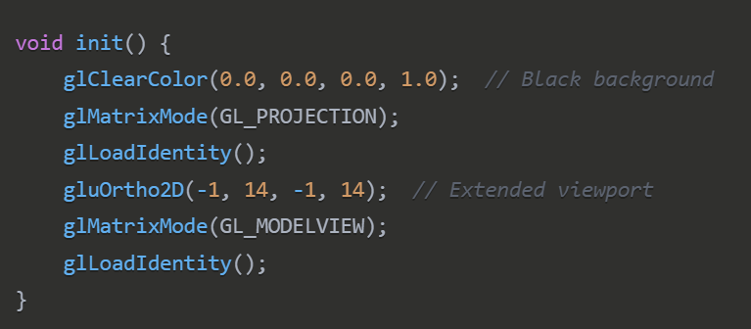
OPENGL - PART B
Setting Up the Viewing Volume

Slide 23
INITIALIZATION - INTERPRETATION
This function initializes the OpenGL rendering environment:
glClearColor(0.0, 0.0, 0.0, 1.0) - Sets the background color to black (RGB values 0,0,0 with alpha 1.0 for full opacity).
glMatrixMode(GL_PROJECTION) - Switches to modifying the projection matrix, which controls how 3D coordinates are projected onto the 2D screen.
glLoadIdentity() - Resets the current matrix to the identity matrix, essentially starting from a clean slate.
gluOrtho2D(-1, 14, -1, 14) - This is the critical part. It sets up a 2D orthographic projection where:
The x-coordinates range from -1 to 14
The y-coordinates range from -1 to 14
This creates a "viewing volume" that extends beyond the point (5,5) in all directions. The range was deliberately chosen to:
Allow space for the world coordinate system display
Include negative coordinates (-1) to show the full coordinate grid
Extend to 14 to provide room for the bars and labels
Unlike Part A where the viewport was automatically scaled to the window size, here we're explicitly defining a coordinate system that makes (5,5) visible within our viewport.
glMatrixMode(GL_MODELVIEW) - Switches back to the modelview matrix, which will be used for positioning objects in the scene.
glLoadIdentity() - Resets the modelview matrix to the identity matrix.

Slide 24
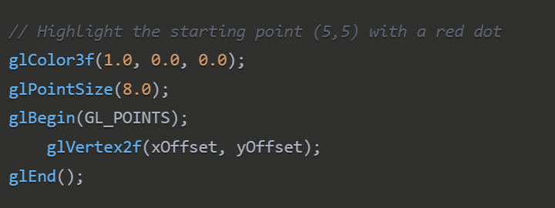
OPENGL - PART B
Visualizing the
World Coordinates

Slide 25
WOLD CORDINATES
glColor3f(1.0, 0.0, 0.0) - sets the drawing color to red.
glPointSize(8.0) - makes the point larger (8 pixels wide) for better visibility.
glBegin(GL_POINTS) and glEnd() - these functions enclose the point drawing commands.
glVertex2f(xOffset, yOffset) - places a point at coordinates (xOffset, yOffset), which is (5,5) since those are the values of these variables.
This red dot serves as a visual indicator showing exactly where the point (5,5) is located in the coordinate system, making it clear where the chart will begin.

Slide 26
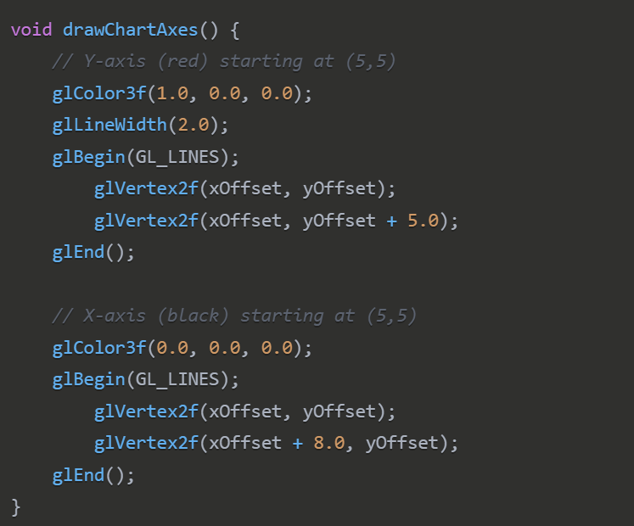
OPENGL - PART B
Visualizing the
Bar Chart

Slide 27
BAR CHART
This function draws the chart's axes originating from point (5,5):
Y-axis (red):
glColor3f(1.0, 0.0, 0.0) - Sets the color to red as specified in the requirements.
glLineWidth(2.0) - Makes the line thicker (2 pixels).
The line is drawn from point (5,5) up to point (5,10), creating a vertical axis 5 units tall.
glVertex2f(xOffset, yOffset) - Starting point at (5,5).
glVertex2f(xOffset, yOffset + 5.0) - Ending point at (5,10).
X-axis (black):
glColor3f(0.0, 0.0, 0.0) - Sets the color to black as specified.
The line is drawn from point (5,5) to point (13,5), creating a horizontal axis 8 units wide.
glVertex2f(xOffset, yOffset) - Starting point at (5,5).
glVertex2f(xOffset + 8.0, yOffset) - Ending point at (13,5).
The axes create the base frame of reference for the chart, with both axes originating from (5,5) rather than from the edge of the window as in Part A.

Slide 28
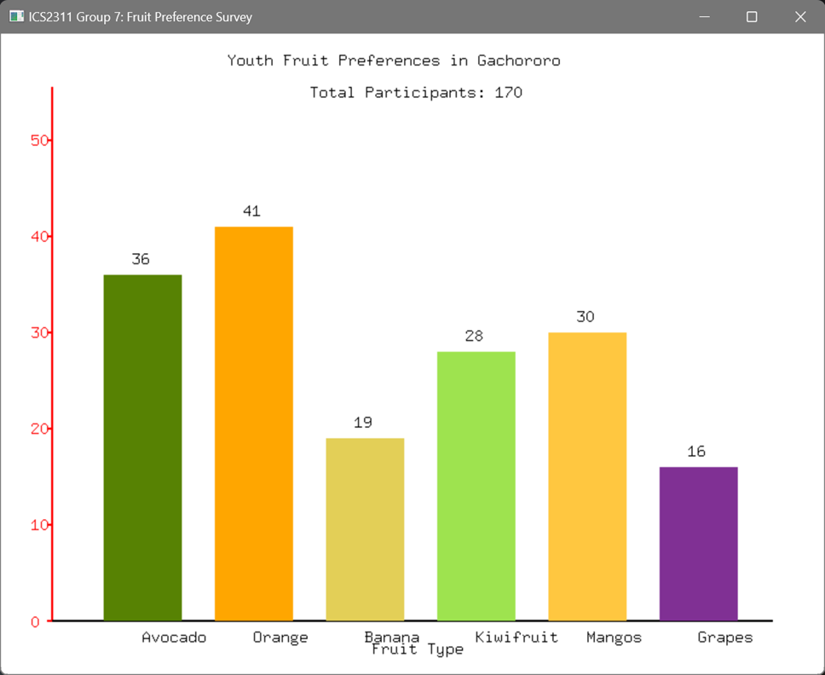
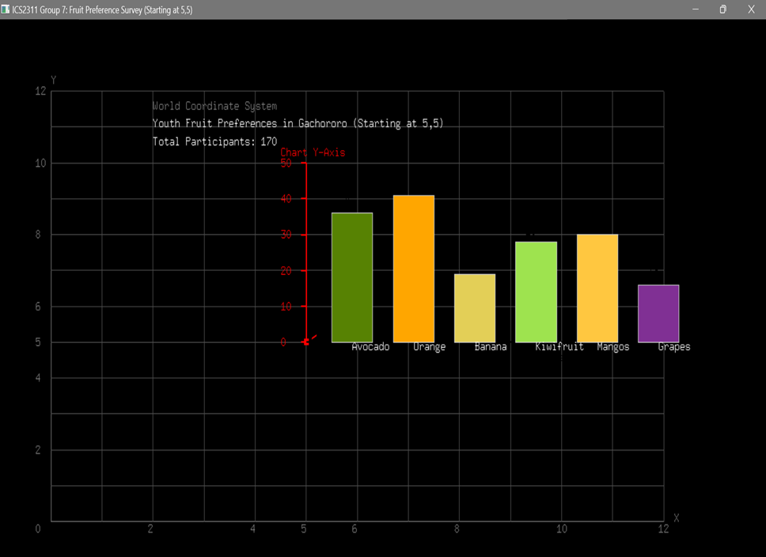
OPENGL - DIFF

Slide 29
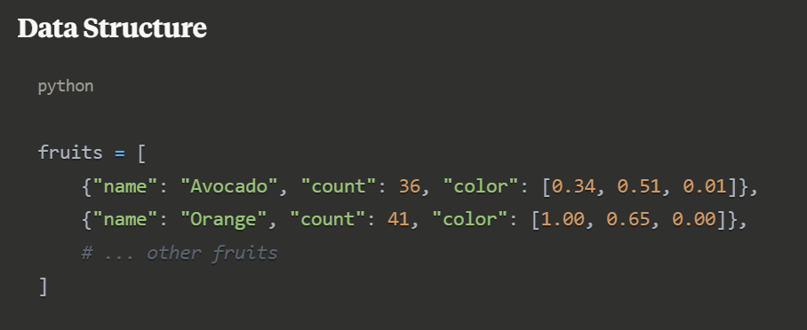
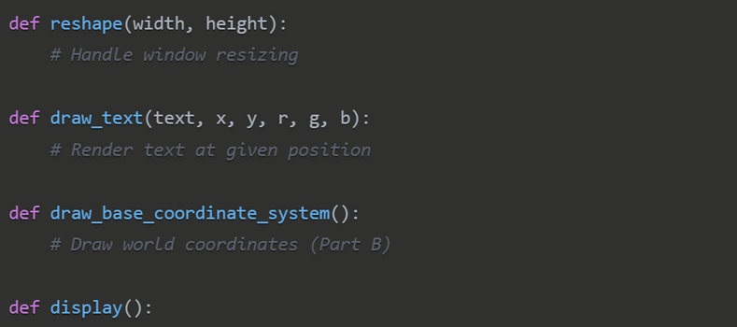
OPENGL - PYTHON
C to Python
Libraries
Installation
Run Python
All the Python code is a direct translation of C to the Python equivalents. The code basically works the same way in either language
PyOpenGL PyOpenGL_accelerate PyGLM as replacement for Freeglut and Glew
pip install pyopengl pyopengl_accelarte pyglm
./a_fruit_bars.py
./b_fruit_bras.py

Slide 30
Thank you!
Group 7

