Slide 1

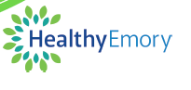
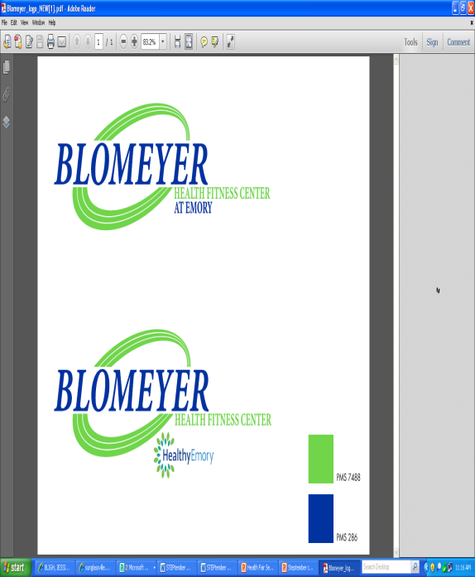
The Blomeyer Health Fair
Open to all Emory faculty/staff!
September 18th
4-7pm
Building 1525, 5th floor
Featuring!
Big Peach Running Co.
Sam’s Club
Teeth Whitening (Only $79!)
Liberty Mutual
Salad Master
Barnes N Noble
Emory Worklife Resources
Emory FSAP
Winship Cancer Institute
Emory Dermatology
Emory Physical Therapy
Fresh Market Shopping
Healthy Cooking Samples
AND MORE!
Call 404-727-4600 to sign up for:
FREE Chair Massages, $25 Body Wraps, & $79 Teeth Whitening!
Membership Special:
NO MONEY DOWN!

