Slide 1







Tech Trends and Annual salary of data analysts in the proposed database
Jaime Olarte
26/09/2022

Slide 2



OUTLINE
Executive Summary
Introduction
Methodology
Results
Visualization – Charts
Dashboard
Discussion
Findings & Implications
Conclusion
Appendix

Slide 3

EXECUTIVE SUMMARY
It’s necessary to distinguish between trends data and demographic data since they operate from different logics
Tech trend data is clear and allows for a clear picture of comparison between current behavior and trends in the tech market
ConvertedComp has an excessively positively skewed distribution
The demographic data have sampling problems.
Technology trends tell us about the labor market and market trends
Demographic data tells us about the common characteristics of developers that exist in the job market.
The database has practical deficiencies for the detailed analysis of the annual salary; however, it has consistencies in other fields.
Almost 10% of the salary is explained by age and experience.
Data was taken from IBM Data Analyst professional certificated

Slide 4

INTRODUCTION
The main objective of this work is to describe the objective conditions necessary to be successful as a data analyst.
The thesis statement of this project is that the annual salary of a person is scarcely linked to the data provided and that therefore it is essential to be aligned with the domain of the technologies of the moment.
To meet the general objective, it is necessary to meet two specific objectives.
It is necessary to understand what are the technological elements that data analysts use and what are the ones that will possibly be used in the future.
It is also important to understand what are the demographic characteristics that frame a successful career in terms of salary, since this variable is directly linked to purchasing power.

Slide 5

METHODOLOGY
searched for duplicate data rows
Replaced NAN values (by mean and mode)
For data analysis, repeated records of the technology df were eliminated. For graphical analysis they were kept.
The variables that expressed years by means of text were changed, replacing the text values by the lowest value of each column. Then they were transformed into integers.
Outliers in the "ConvertedComp" and "Age" columns were removed
Relevant text variables were converted from text to integers or dummy variables.
Visualizations were created
Two data frames were concatenated, from the resulting data frame the numerical values were selected, and correlation were made. (Pearson, Spearman and Kendall)
The variables most related to annual salary were selected.
A linear regression model was made with each one and another with all of them together.
Data Cleaning
Data Normalization
Data Analysis

Slide 6
RESULTS
As can be seen in the attached table, the values manage to explain 10% of the behavior of this variable, therefore, although coding time and age exert a scarce but certain influence with respect to the Salary of a Developer.
On the other hand, the annual salary of a data analyst depends on variables other than those proposed in these databases. More research is needed on this. Soft skills could be a good start.
Regression Element | R^2 Train | R^2 Test
YearCode | 0.0858 | 0.0834
YearCodePro | 0.0889 | 0.0964
Age | 0.0825 | 0.0909
Together | 0.1003 | 0.1067

Slide 7
PROGRAMMING LANGUAGE TRENDS
Current Year
Next Year
JavaScript
8687
JavaScript
6630
HTML/CSS
7830
HTML/CSS
5328
SQL
7106
Python
5239
Bash/Shell/PowerShell
4642
SQL
5012
Python
4542
TypeScript
4088
0
1000
2000
3000
4000
5000
6000
7000
8000
9000 10.000
0
500 1000 1500 2000 2500 3000 3500 4000 4500 5000 5500 6000 6500 7000
LanguageWorkedWith (Recuento)
Language Desaire (Recuento)

Slide 8
PROGRAMMING LANGUAGE TRENDS - FINDINGS & IMPLICATIONS
Findings
Except for "Bash/Shell/PowerShell" and "TypeScript" the most popular programming languages today and the trends for the coming year are the same.
The first two records match on both variables.
There are two languages that tend to increase their relevance in the framework of the labor market, these are Python and TypeScript.
Findings
Except for "Bash/Shell/PowerShell" and "TypeScript" the most popular programming languages today and the trends for the coming year are the same.
The first two records match on both variables.
There are two languages that tend to increase their relevance in the framework of the labor market, these are Python and TypeScript.

Slide 9
DATABASE TRENDS
Current Year
Next Year
5000
6000
4328
5469
5000
4000
3649
4110
4097
3331
3281
4000
3000
2856
3248
3016
3000
2000
2000
1000
1000
0
0
MySQL
Microsoft SQL Server
PostgreSQL
SQLite
MongoDB
PostgreSQL
MongoDB
Redis
MySQL
Elasticsearch
DatabaseWorkedWith
DatabaseDesireNextYear

Slide 10
DATABASE TRENDS - FINDINGS & IMPLICATIONS
Findings
Three of the five data platforms are repeated in the current moment and in the trends
There are new platforms that have increased their relevance as useful tools for data management.
"SQL Server" and "SQLite" no longer arouse the same interest for the near future, which allowed them to be in the 5 most used databases.
Implications
A relative stability is maintained, however, there is more volatility with respect to technologies related to databases.
"Elasticsearch" and "Mongo DB" are emerging as the most recognized tools on the market.
Despite the relative stability in the framework of database technologies, this field has more mobility with respect to programming languages.

Slide 11

DASHBOARD
https://sa1.ca.analytics.ibm.com/bi/?perspective=dashboard&pathRef=.my_folders%2FFINAL%2BTASK&action=view&mode=dashboard&subView=model0000018362bfaf77_00000001

Slide 12
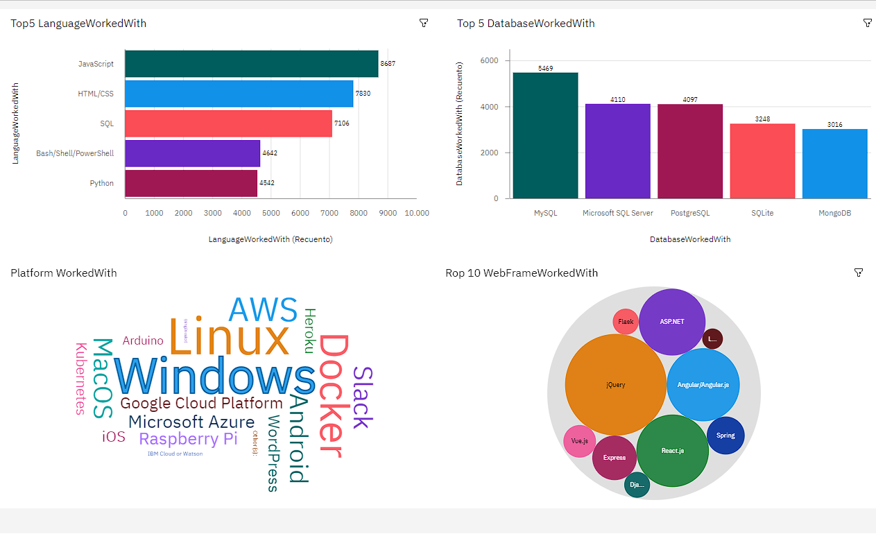
DASHBOARD TAB 1

Slide 13
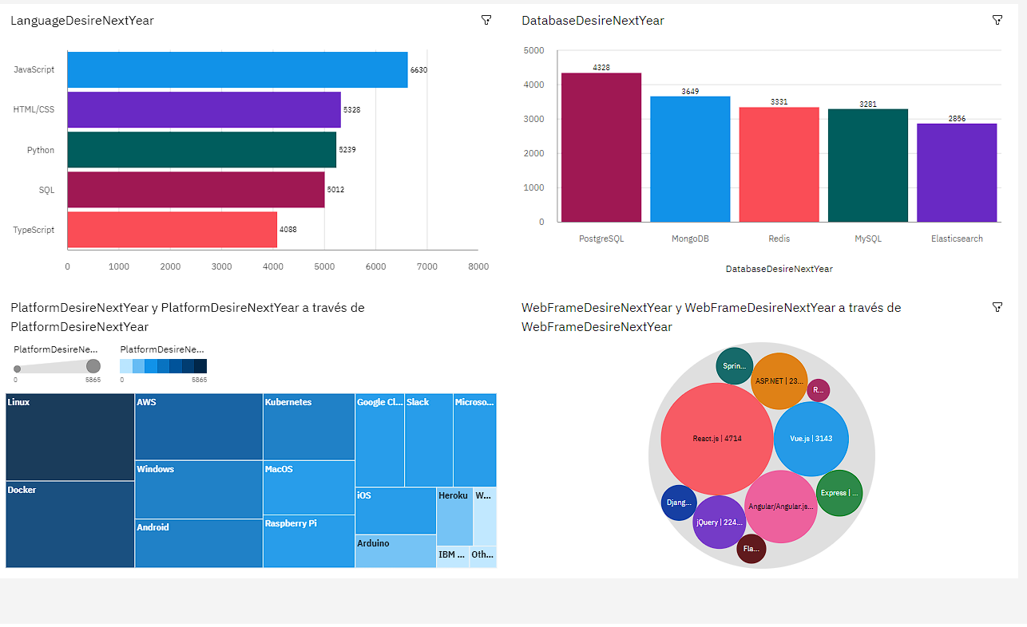
DASHBOARD TAB 2

Slide 14
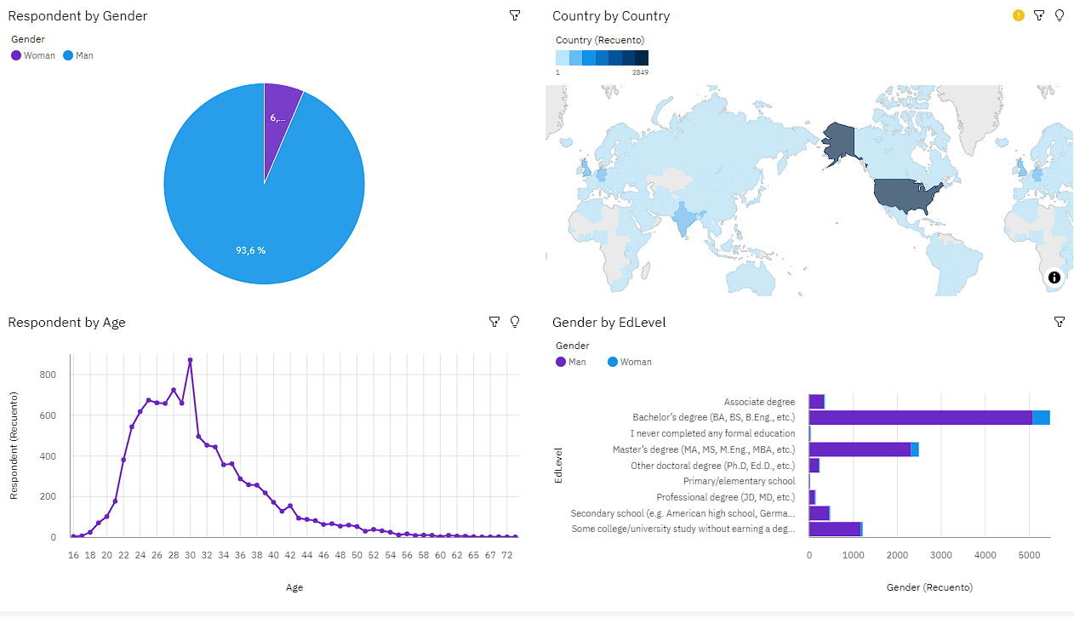
DASHBOARD TAB 3

Slide 15
DISCUSSION
In order to explain annual salary, it is probably better to research the number of contacts and the social circle since there is no explanatory element within the data that can do this.
However, given the representativeness of the sample, it is not possible to extend any conclusion outside the United States, even within America it is not representative of the entire population since there are also biases framed in the gender and ethnicity of the population. Therefore, the study is only representative for Caucasian men from the United States.

Slide 16
OVERALL FINDINGS & IMPLICATIONS
Findings
There are no explanatory elements to explain the skewed distribution of the data with respect to salary.
In terms of technology, there is a relative stability that maintains the trend of the most usual technologies with relative consistency.
There are no elements of the technology base that bear any relationship to annual salary, so only age, years of coding experience, and professional experience have 10% explanatory power. Elements such as academic level or level of comfort with the job have no practical use.
Implications
If the salary is not based on age, working time, the technologies that an analyst is capable of handling, the analyst's education or the pleasure with which he does his job and sees his career, there are elements outside of the study that have not been considered to explain them or are only explained by chance.
The management of the latest technology is a fundamental requirement to have a successful career in data analysis, however, it operates as a key to access the field since it does not have salary implications.

Slide 17

CONCLUSION
There is a relative stability in the framework of the technologies used, in this sense, the technological market provides clear elements of the technologies necessary for work in the field of data analysis.
On the other hand, in terms of salary, the only elements slightly related to better salaries are age, which is clearly not a relevant finding, since general experience, professional experience and age together only explain 10% of salary. Additionally, they are completely expected elements, which do not represent any new knowledge.

Slide 18

APPENDIX
Below I attach the Jupiter notebook that I used for the development of the presentation and the project; it was made by me with the data provided by the IBM course:
https://drive.google.com/file/d/1YQWJbZcs9iyJBy7EOynhvTwiPEzbPZ2h/view?usp=sharing

