Slide 1
Simulating Quantum Circuit using TensorFlow Quantum
Yudeep Rajbhandari
Pratik Siwakoti

Slide 2
Overview
Introduction
Methodology
Tutorial
Result and Discussion
Conclusion

Slide 3
Introduction
Quantum Computers are powerful and can be used to solve many classical algorithmic problems
Our implementation uses the simulation of quantum gates like the CNOT gate, Pauli X gate, and Toffoli gate with
multiple inputs using the Tensor Flow Quantum framework (TFQ)
It is simpler to build prediction models that behave like these gates

Slide 4
Motivation
Physical quantum computers are difficult to access
Successful simulation of Quantum circuits with machine learning models allows researchers the flexibility to use Quantum programming with less restrictions
Our hypothesis is that we can build prediction models for more complicated circuits

Slide 5
Methodology
1
2
3
4
Data
Model
Compile
Fitting
Classical data creation and encoding
Creating quantum circuit and using PQC layer
Compiling the model
Training the data and getting the results.
Tutorial Link

Slide 6
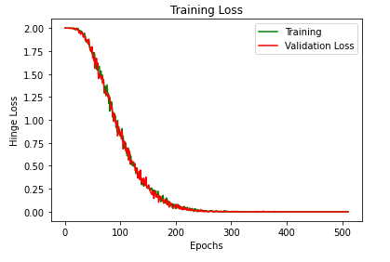
Result and discussion
After the first 50 epochs, the loss significantly dropped up to 300 epochs, after which the loss reached its minimum and became constant.
Both the training loss and
the validation loss
follow the same pattern.

Slide 7
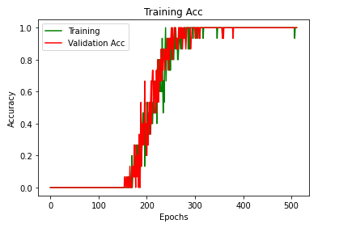
Results and Discussion
Accuracy is zero for the first 150 epochs, in this case, suggesting that the model did not pick up much information during these early epochs.
But after then, accuracy
increased significantly,
reaching its peak in about
300 epochs.

Slide 8
Conclusion and Acknowledgment
Based on our experiments we conclude that by using TensorFlow Quantum machine learning models can be built to behave like Quantum Circuits
At the end we would like to thank Dr. Orduz

