Slide 1
Creating CSS3 Transitions and Animations in CSS and triggering them with JavaScript
Janine Ortiz

Slide 2
CSS Transitions
Provide a way to control animation speed when changing CSS properties.
Example:
If you change the color of an element from white to black, usually the change is instantaneous. With CSS transitions enabled, changes occur at time intervals that follow an acceleration curve, all of which can be customized.
Notes:
https://developer.mozilla.org/en-US/docs/Web/CSS/CSS_Transitions/Using_CSS_transitions

Slide 3
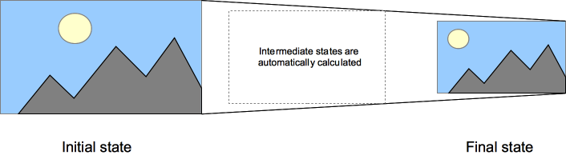
Visual

Slide 4
CSS Animations
An animation lets an element gradually change from one style to another.
A module of CSS that defines how to animate the values of CSS properties over time, using keyframes. Specifying their duration, their number of repetitions, and how they repeat can control the behavior of these keyframes animations
Notes:
https://developer.mozilla.org/en-US/docs/Web/CSS/CSS_Animations

Slide 5
KeyFrames
Keyframes hold what styles the element will have at certain times.
Styles inside of @keyframe rules, the animation will gradually change from current style to new style at certain times
Key words “from” and “to” represent 0% (start) and 100% (complete)
You can also specify percentages
Notes:
https://www.w3schools.com/css/css3_animations.asp

Slide 6
What’s the difference between the two?
Transitions can't change CSS properties. You set the property values on a selector and perhaps the selector's :hover state. The transition defines how the change occurs, but not the specific start and end values. Animations, on the other hand, can change property values inside their keyframes.

Slide 7
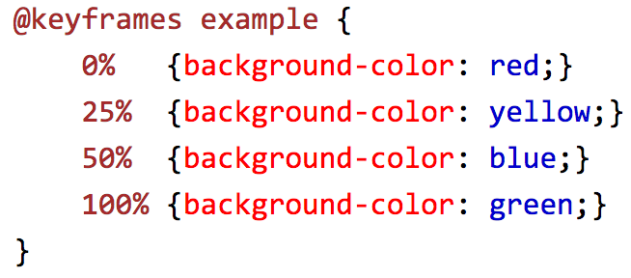
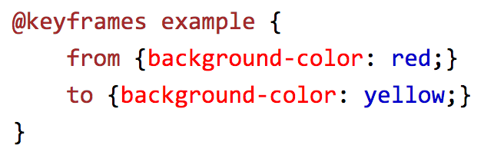
Code examples of Key Frame

Slide 8
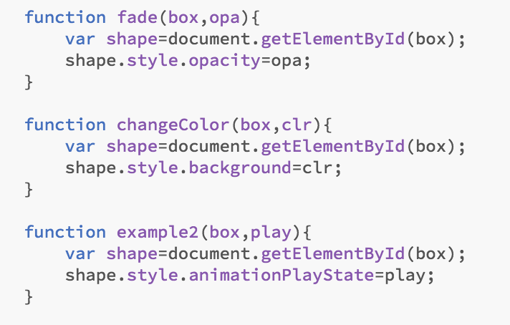
Triggering with Javascript
You are able to trigger the transformation using JavaScript functions
To trigger an element’s transition, toggle a class name on that element that triggers it.

Slide 9
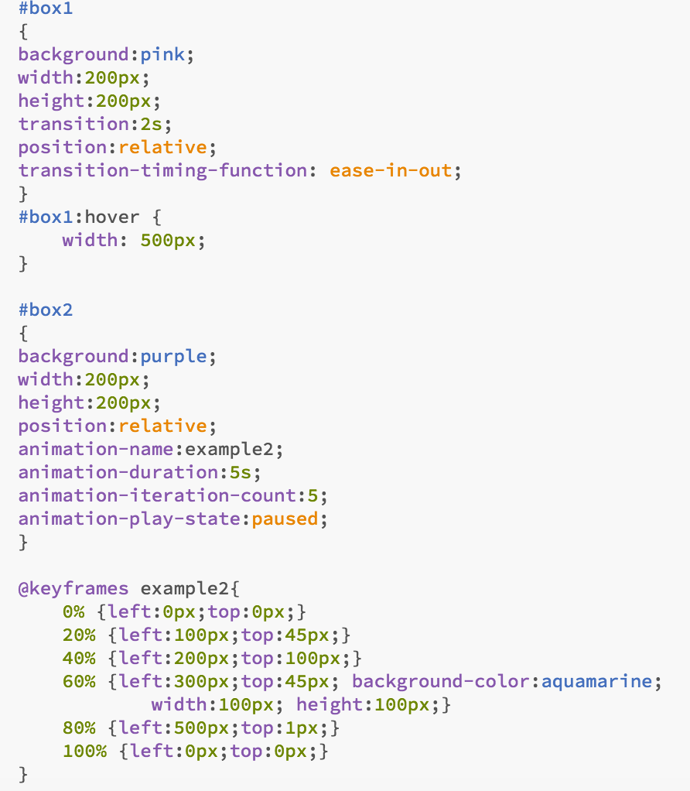
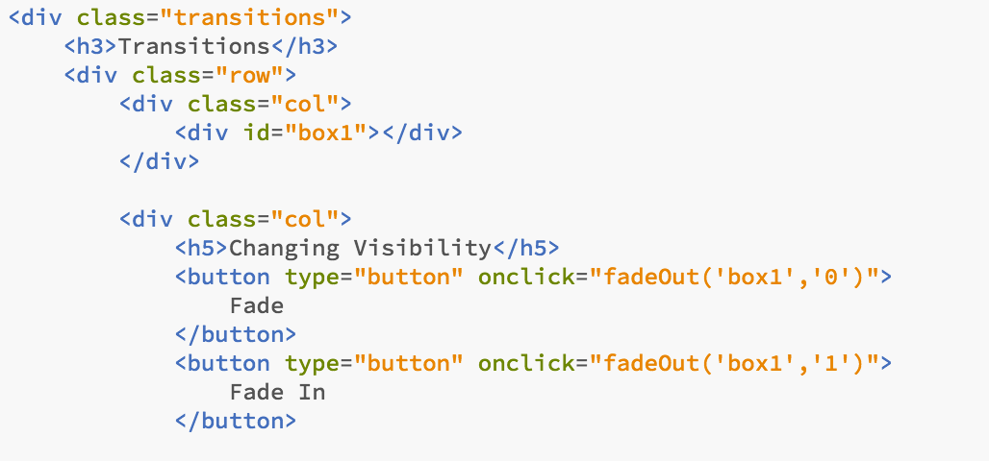
Example

