Slide 1
HTML 5 Tags – Video, Audio, Canvas
Janine Ortiz

Slide 2
Multimedia
Video and Audio files are stored in media files
Browsers didn’t always support media files
Some browsers and formats need help additional supports like pluggins

Slide 3
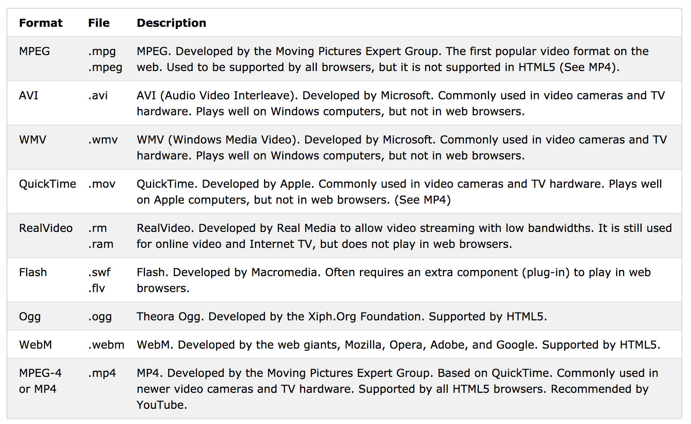
Video Format

Slide 4
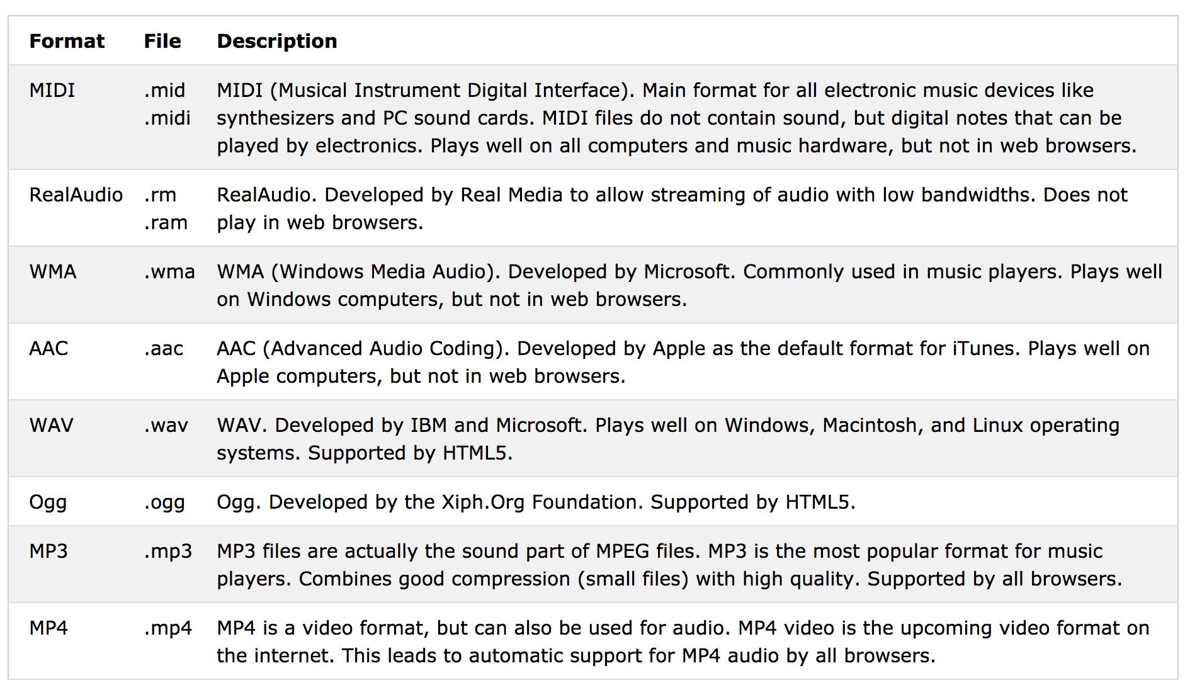
Audio Formats

Slide 5
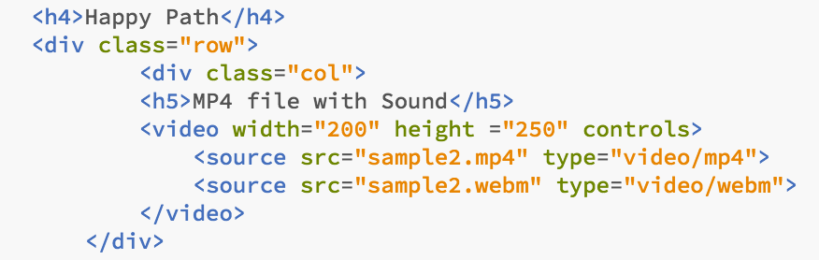
Video Code

Slide 6
Audio Code

Slide 7
Canvas
Used to draw graphics on a web page
Graphics can be circles, text, boxes, paths, colors, and more

Slide 8
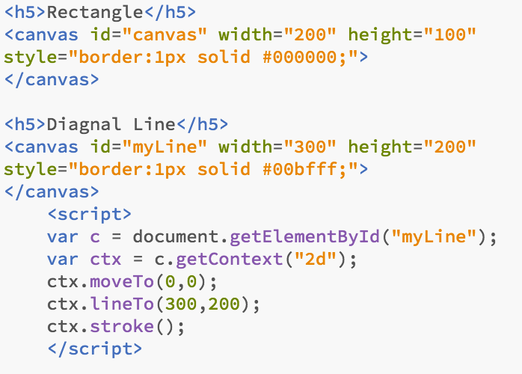
Canvas Code

