Slide 1



final_Project
View in Power BI
Last data refresh:
12/17/2020 7:40:54 PM Eastern Standard Time
Downloaded at:
12/17/2020 11:50:21 PM Eastern Standard Time

Slide 2
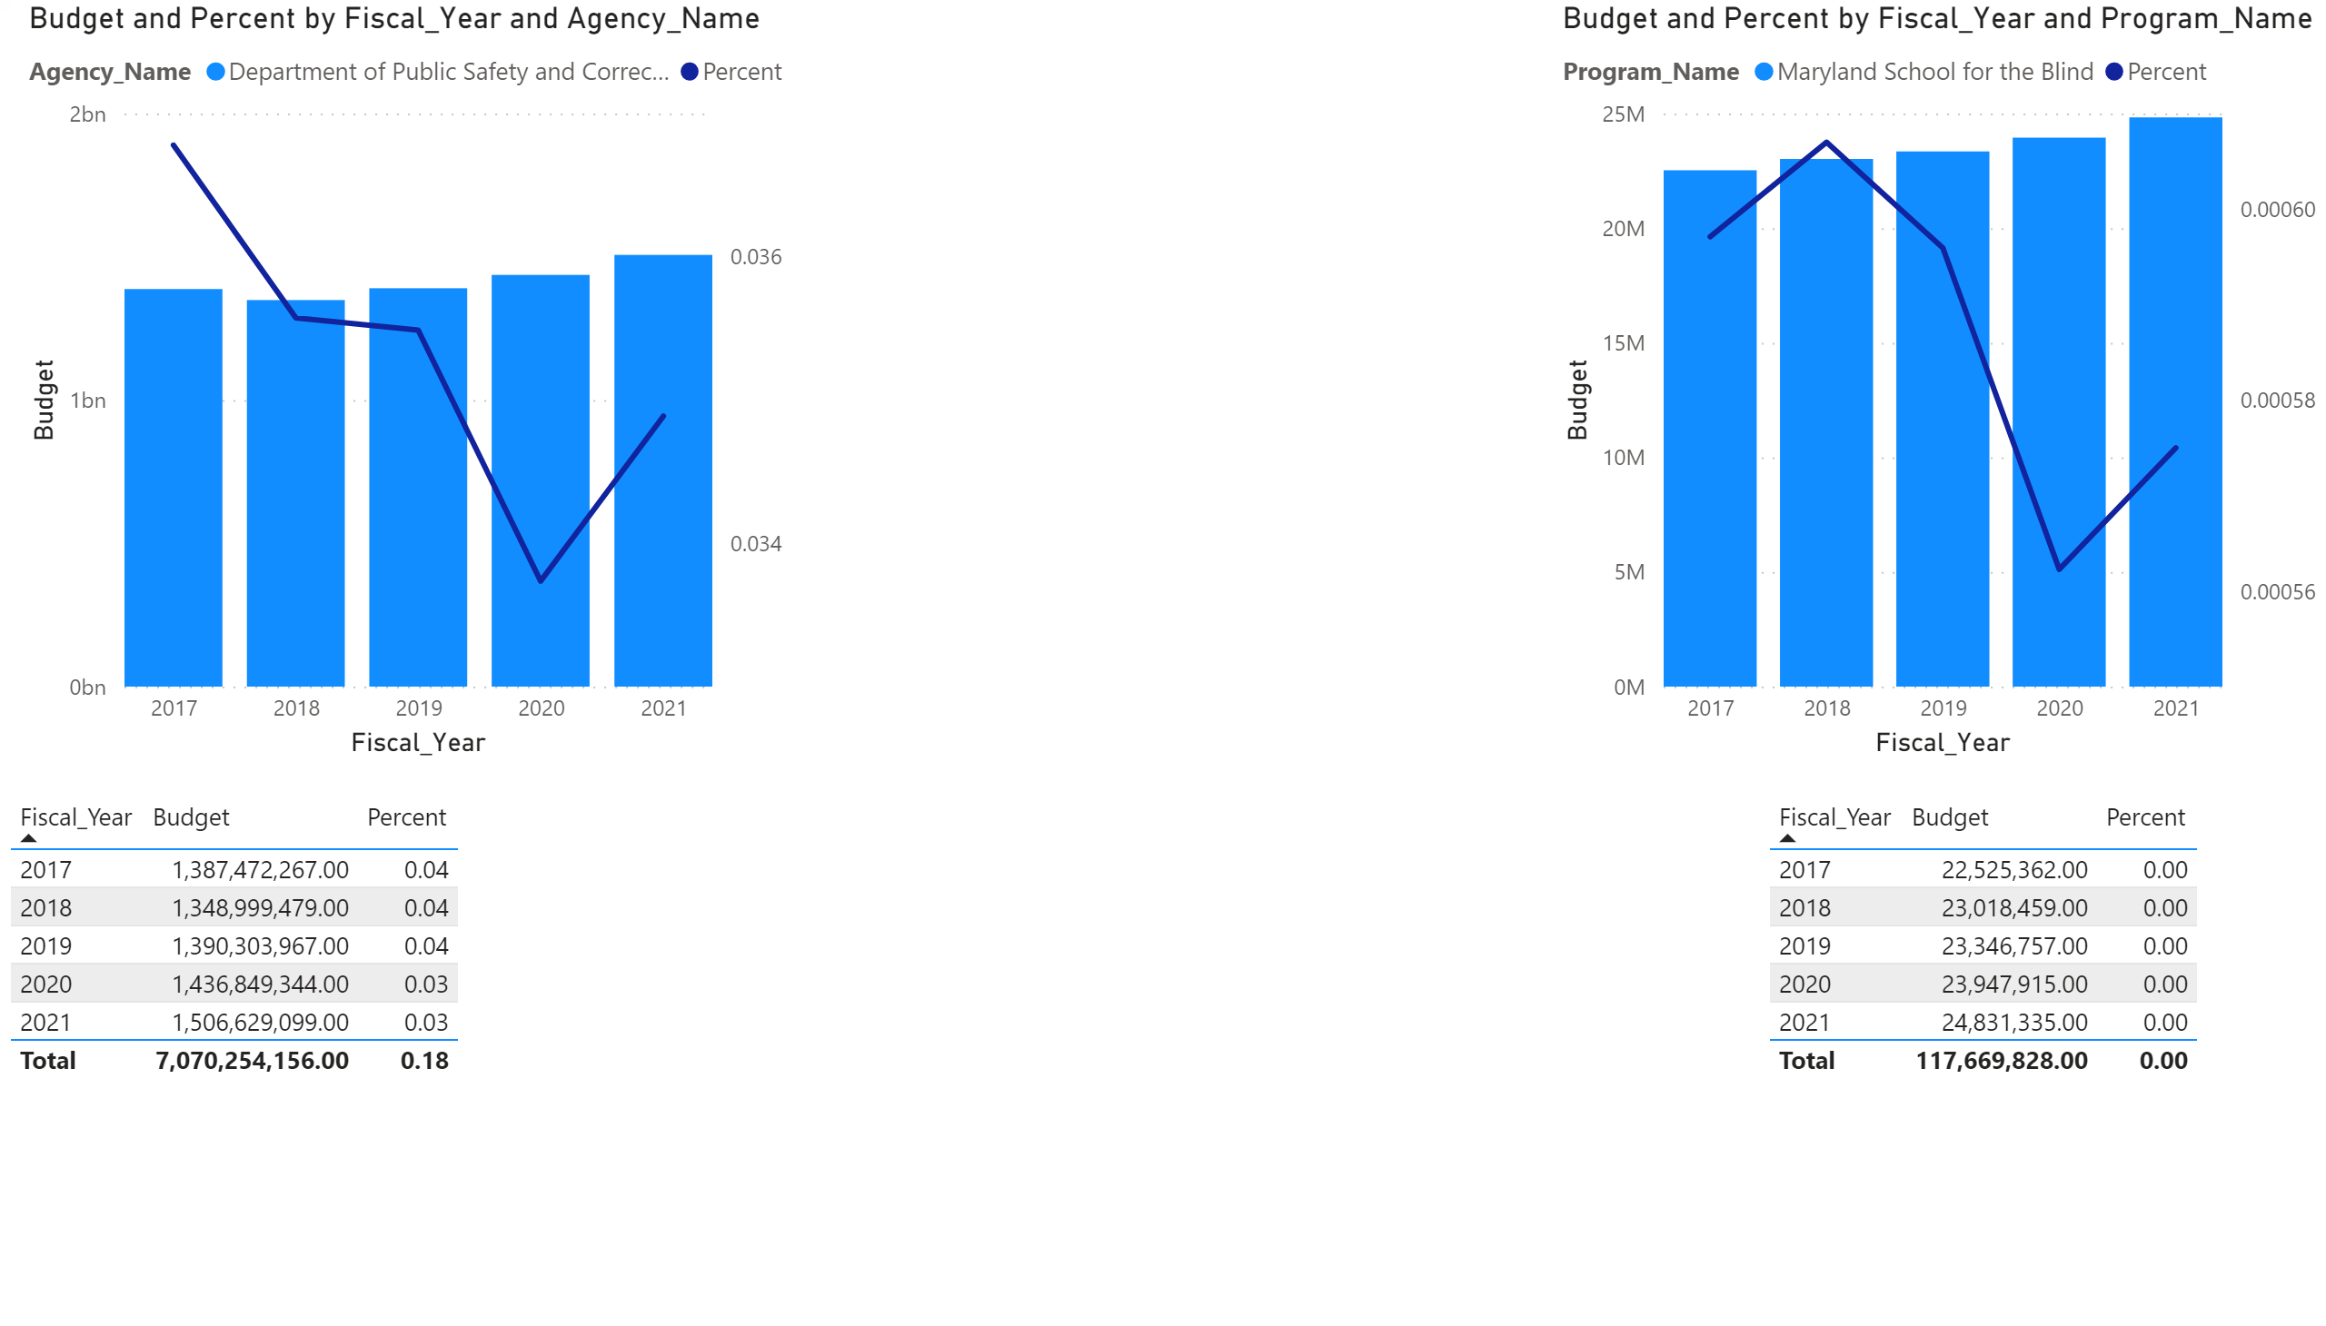

Slide 3
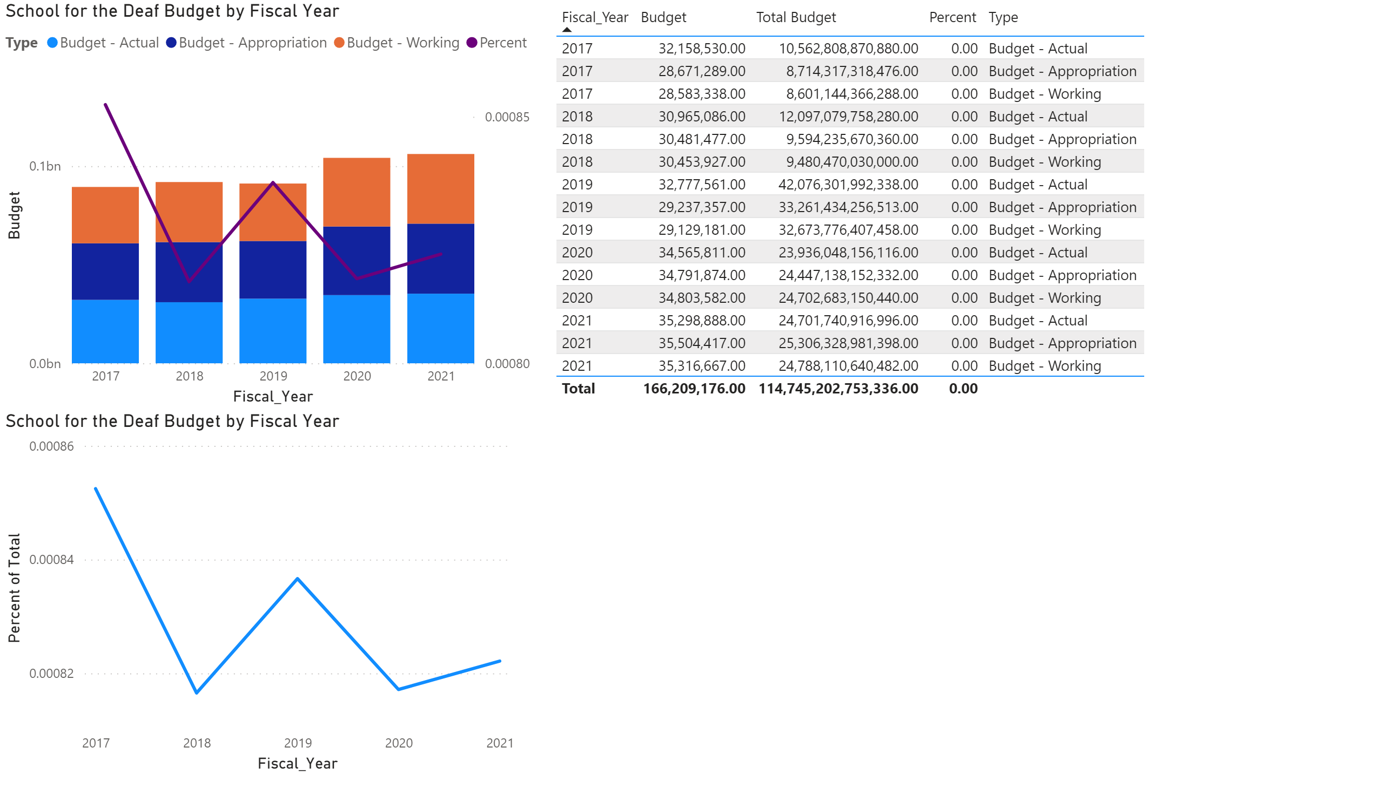

Slide 4
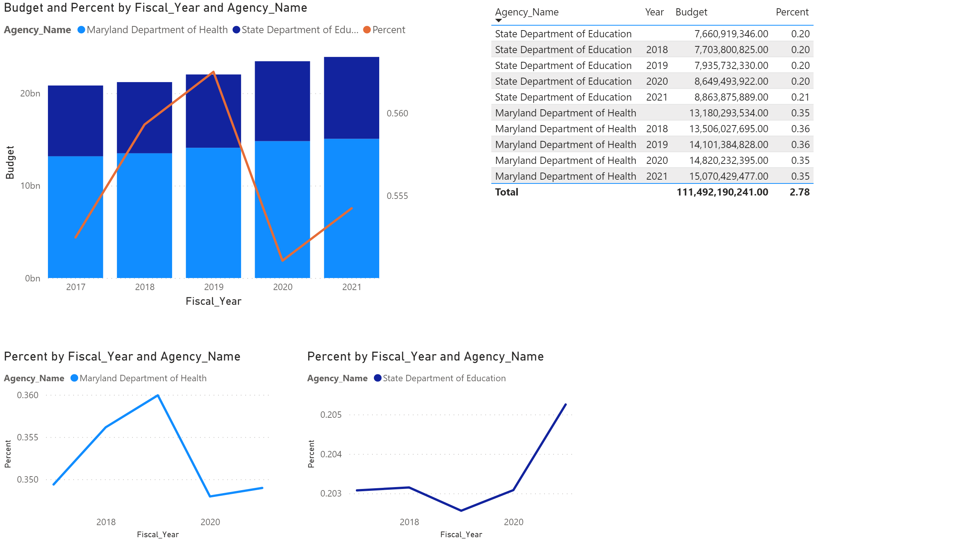

Slide 5
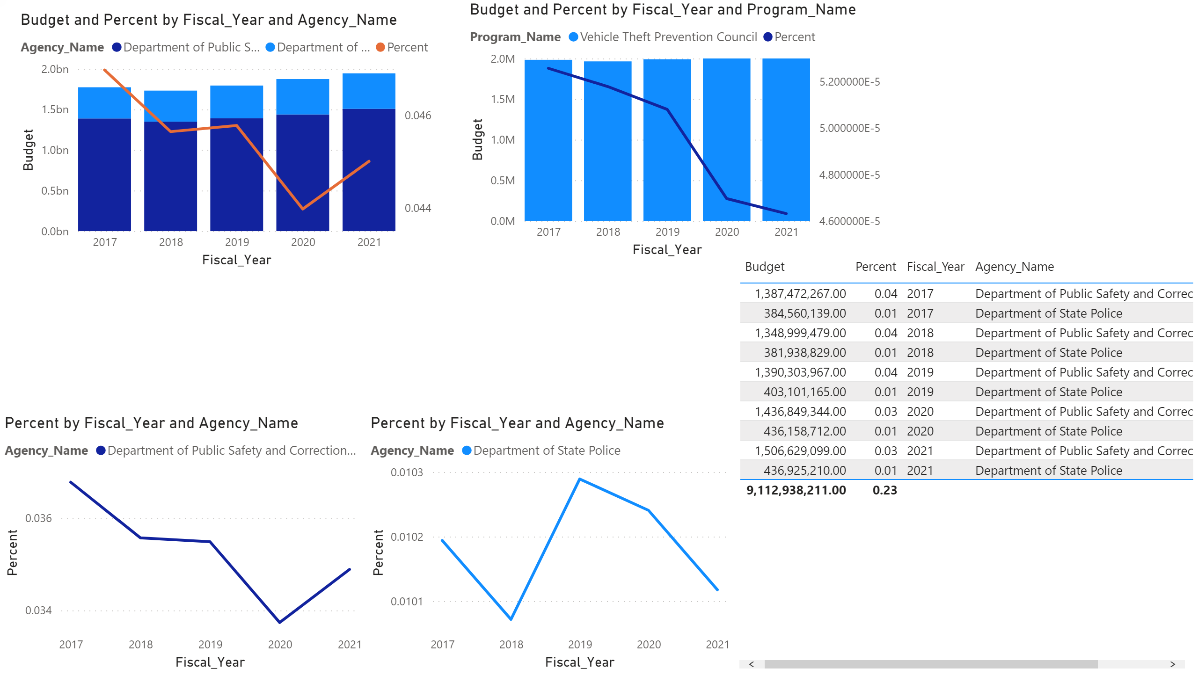

Slide 6
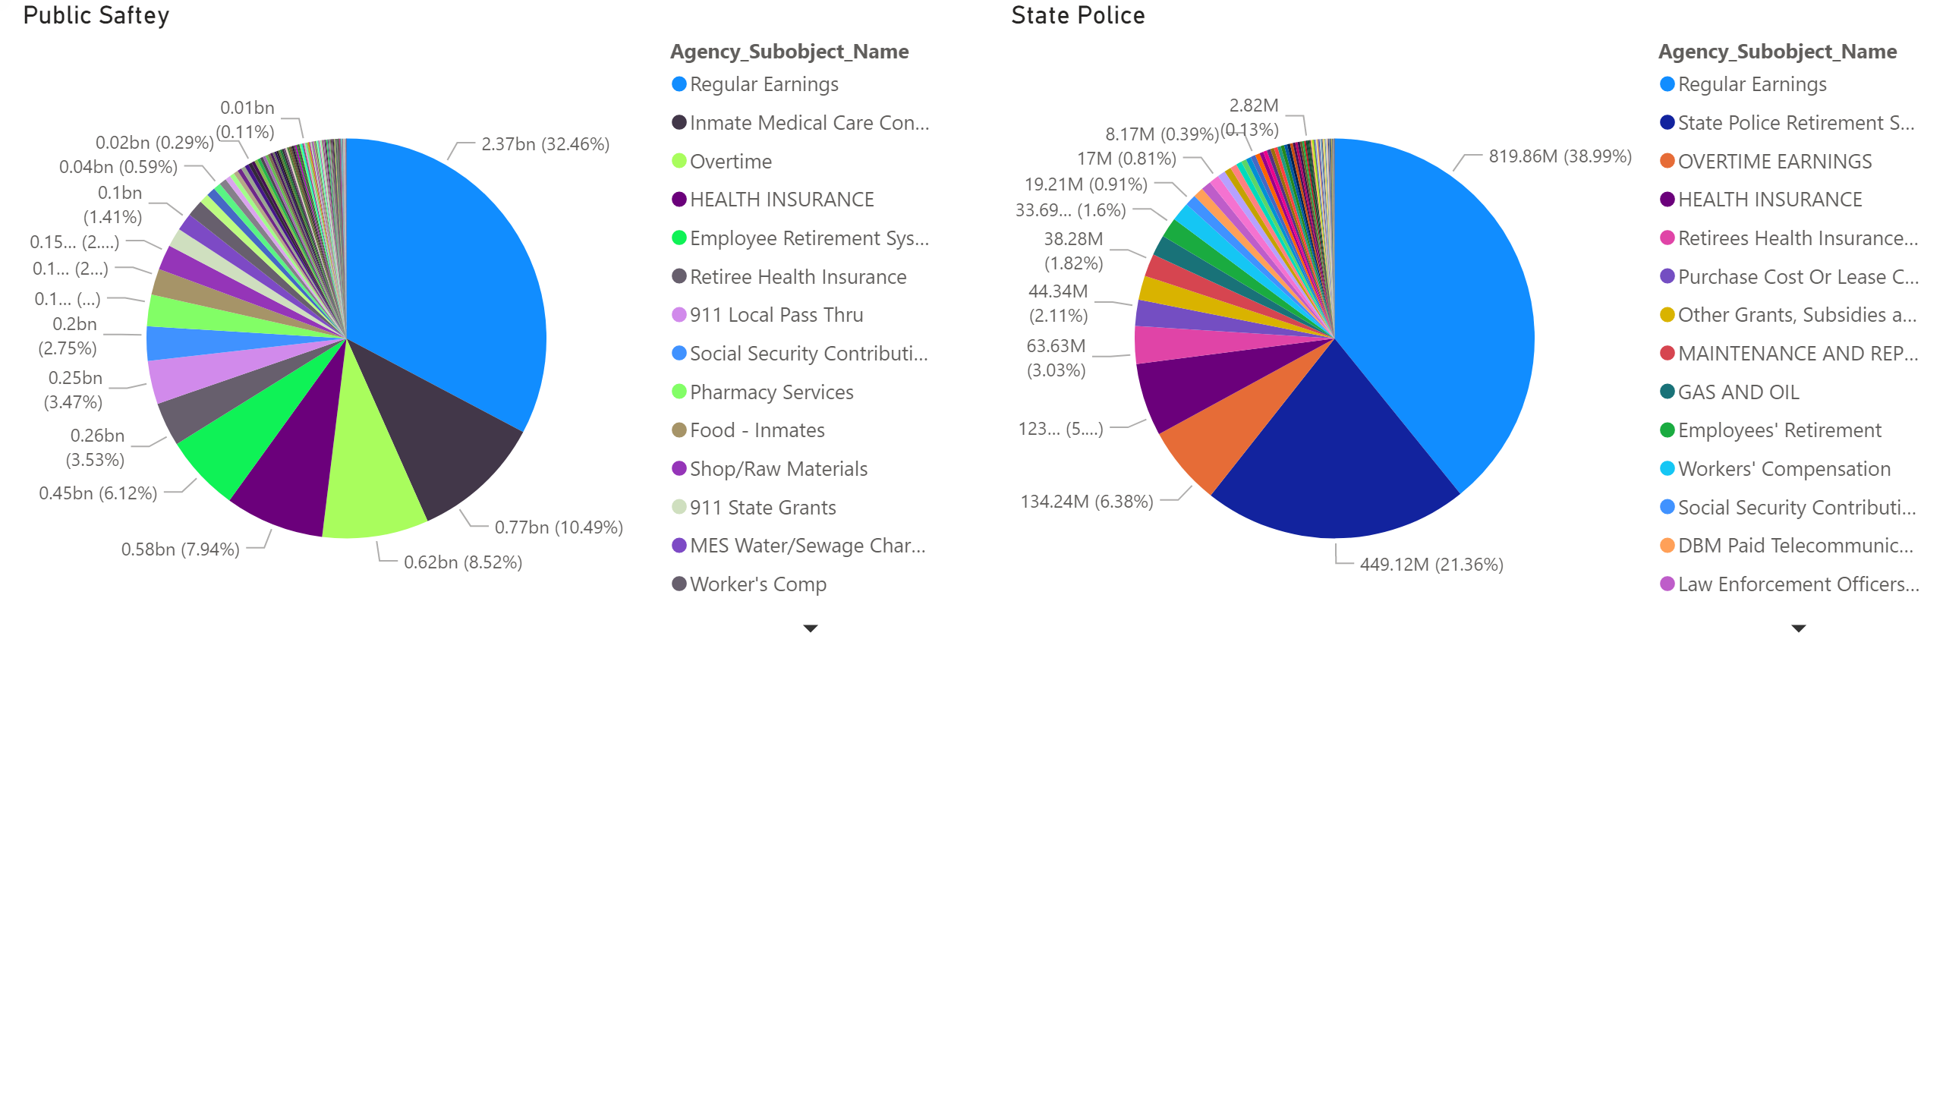

Slide 7
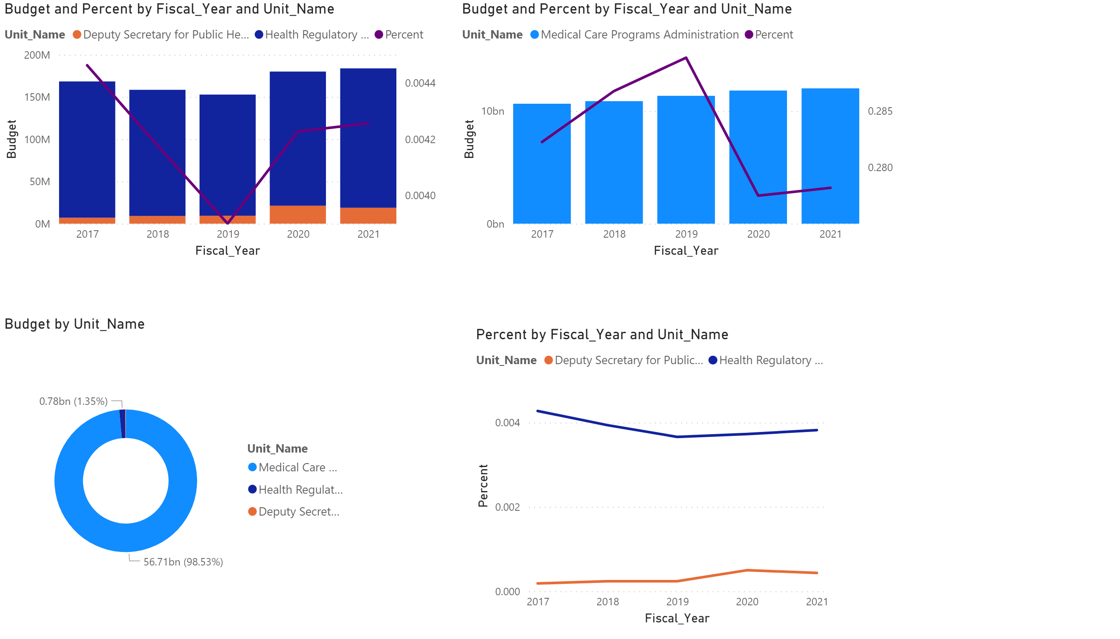

Slide 8
