Slide 1
CS - 03
Computer Fundamentals And Emerging Technology

Slide 2
Introduction:
What is Computer?
Characteristics
Data Processing

Slide 3
Characteristics Of Computer :
Speed
Accuracy
Diligence
Versatility
Reliability
Memory
Automation
No Feelings
No IQ

Slide 4
Cont…
Speed : Computer works with much higher speed and accuracy compared to humans while performing mathematical calculations. It can perform millions of instructions per second. Time takes is in milliseconds or nanoseconds.
Accuracy: They perform calculations with 100% accuracy. Error may occur due to data inaccuracy or inconsistency.
Diligence : A computer can perform millions of tasks with same accuracy. It doesn’t feel any lack of concentration.
Versatility : It refers to the capability of a computer to perform different kind of work with same accuracy and efficiency.

Slide 5
Cont…
5. Reliability : A computer is reliable if we give same set of inputs any number of times, we will get the same result.
6. Automation : Computer performs all the task automatically , it performs tasks without human interfere.
7. Memory : A computer has built-in memory called primary memory where it stores data. Secondary storage are removable devices such as cds, pen drives, etc which are also used to store data.

Slide 6
Data Processing Cycle :
It shows how computer takes data from users, process it and convert into Information
First, Computer takes data as Input
Stores that data/ instructions in its memory and use it when required
Processes the data and converts it into useful information
Generates the output
Also, controls all the above four steps

Slide 7
Cont…
Computer
Input
Process
Information

Slide 8
Classification Of Computer By Data Processed
The computers are classified based on the technology being used and how data is processed
Computers are classified in 3 types :
Analog Computers
Digital Computers
Hybrid Computers

Slide 9
1. Analog Computers :
An analog computer is a type of computer that uses the continuously changeable aspects of physical phenomena such as electrical, mechanical, or hydraulic quantities to model the problem being solved
Analog computers were widely used in scientific and industrial applications even after the digital computers
They do not use discrete values but use continuous values
These computers work on analog signals.
Used in our daily life such as refrigerator, speedometer etc

Slide 10
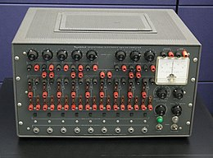
Image:

Slide 11
2. Digital Computers :
These are the computers which perform various computational as well as some other general purpose works
The information in such computer is represented by variables taking a limited number of discrete values
These computers work on digital signals
But at a time it only takes one value.
Digital computers use the binary number system, which has two digits 0 and 1 called bit
Main advantage of digital computers is its speed and accuracy

Slide 12
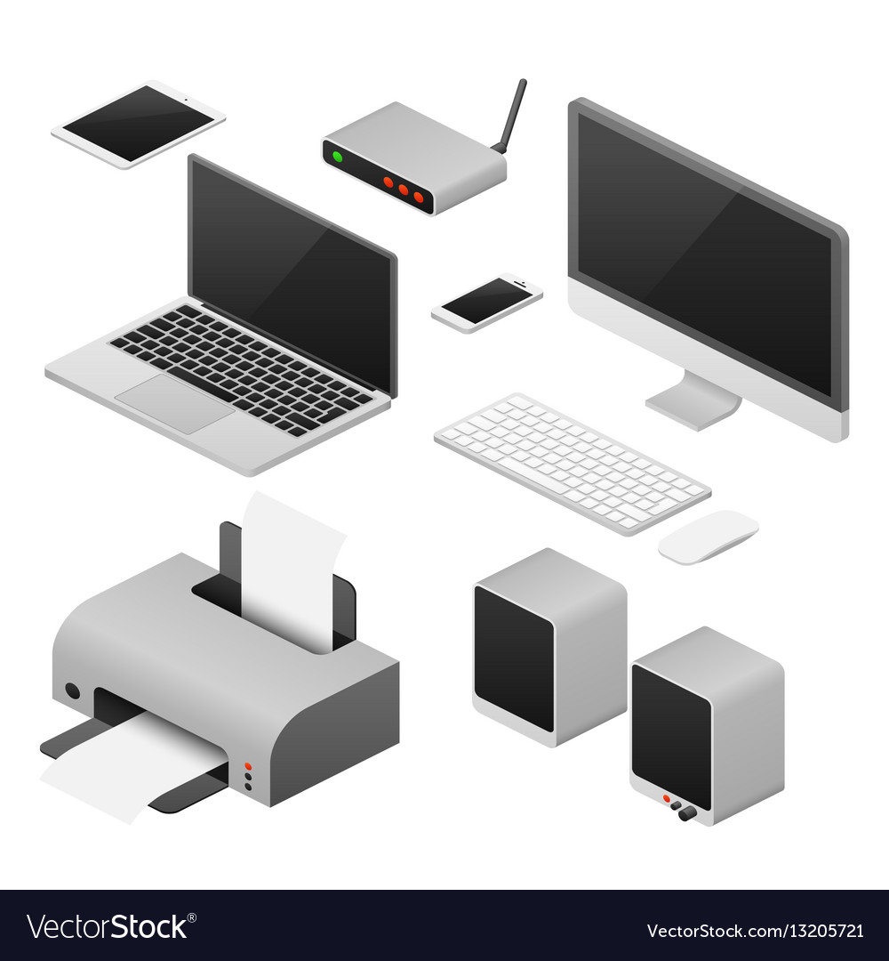
Cont..
Examples of digital computers are:
Laptops, desktops, calculators, smartphones etc

Slide 13
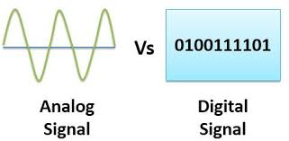
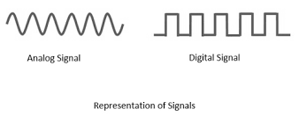
Signals : 0- Off, 1-On

Slide 14
3. Hybrid Computers :
Hybrid computers are computers that includes features of analog computers and digital computers
The digital components provide logical and numerical operations while analog components serve as a solver of equations
It is mixer of analog and digital computers
It takes accuracy of analog computers and speed of digital computers
It produces quick results

Slide 15
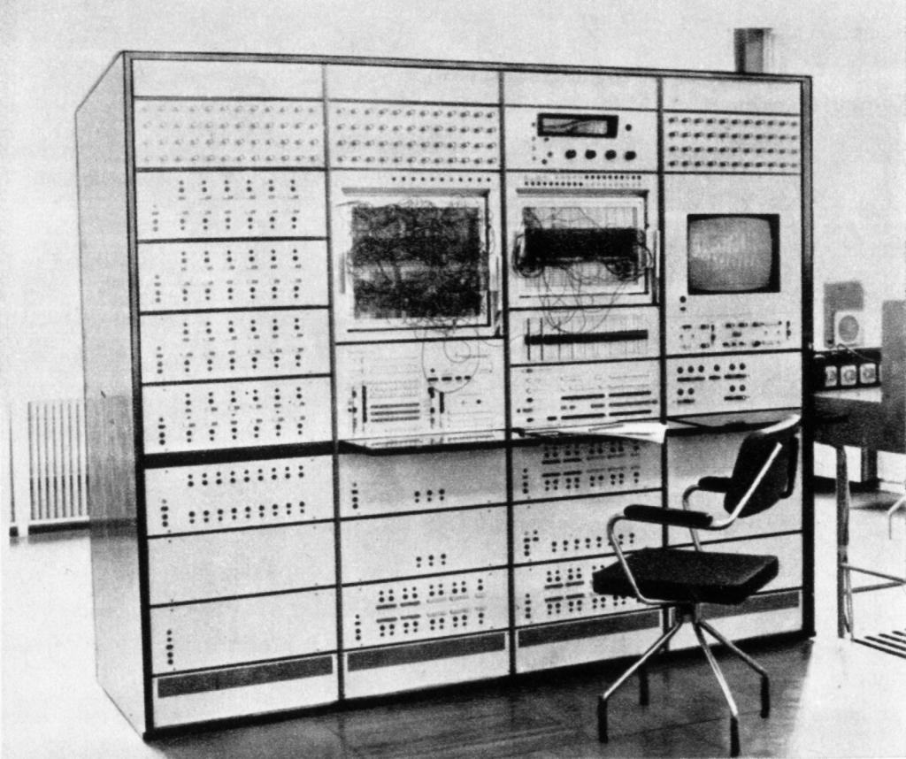
Image :

Slide 16
History Of Computers :
Growth in the computer industry is determined by the development in technology
Each generation of computer development is characterized by one or more hardware development
Computer generations are divided into 5 phases
First Generation (1942-1955)
Second Generation (1955-1964)
Third Generation (1964-1975)
Forth Generation (1975-1980)
Fifth Generation (1980-Present)

Slide 17
First Generation Computers :
The period of first generation was 1942 to 1955
The components of first generation used Vacuum tubes as the basic component for memory and circuit for CPU
These tubes, like electric bulbs, produced a lot of heat and also very expensive and could be afforded only by very large organizations
In this generation, mainly batch processing operating system were used
Punched cards, paper tape and magnetic tape were used as input and output devices
It used machine code as programming language

Slide 18
Main Features Of First Generation Computers
Vacuum tube technology
Unreliable
Supported machine language only
Very costly
Generated lot of heat
Slow input and output devices
Huge size
Need of Ac
Non- portable
Consumed lot of electricity

Slide 19
Computers Of This Generation :
ENIAC
EDVAC
UNIVAC
IBM-701
IBM-650

Slide 20
Second Generation Computers :
The period of second generation computers was 1955-1964
In this generation, transistors were used
That were cheaper, consumed less power, more compact in size, more reliable, faster than the first generation computers
In this generation, magnetic cores were used as primary memory and magnetic tape and magnetic disks as secondary storage devices
In this generation, assembly language and high-level language like FORTRAN, COBOL were used
Computers used batch operating systems and multiprogramming OS

Slide 21
Main Features Of Second Generation Computers :
Use of transistors
Reliable in comparison to first generation computers
Smaller in size in comparison to first generation computers
Generated less heat as compared to first generation
Consumed less electricity as compared to first generation
Faster as compared to first generation
Still very costly
AC needed
Supported machine and assembly language

Slide 22
Computers Of Second Generation :
IBM 1620
IBM 7094
CDC 1604
UNIVAC 1108

Slide 23
Third Generation Computers :
The duration was 1964-1975
The third generation computer used integrated circuits (IC) in place of transistors
A single IC has many transistors, registers and capacitors along with circuits
Ics were made up of Silicon
The IC was invented by Jack Kilby
This made computers smaller in size and reliable
In this generation, remote processing, time sharing, multi-programming operating systems were used
High level languages were also used in this generation

Slide 24
Main Features Of Third Generation Computer
Used IC
More reliable in comparison to previous generations
Smaller in size
Generated less heat
Faster
Less maintenance
Still costly
AC needed
Consumed less electricity
Supported high-level language
LSI technology (Large Scale Integration) 1000
MSI(Medim scale int…) 100
SSI (Small scale int…) 10

Slide 25
Computers Of This Generation :
IBM 360 series
Honeywell 6000 series
PDP (Personal Data Processor)
IBM 370/168
TDC-316

Slide 26
Fourth Generation Computers :
The period was 1975-1980
The computers used Very Large Scale Integration (VLSI) circuits
VLSI circuits having about 5000 transistors and other elements on a single chip made it possible to have microcomputers
They became more powerful, compact, reliable and affordable
As a result, personal computers (PC) were invented
In this generation, time sharing, network systems were used
All high level languages like C, C++, DBASE are used

Slide 27
Main Features Of Fourth Generation Computers :
VLSI technology used
Very cheap
Portable
Reliable
Use of PC
Very small in size
No AC needed
Concept of internet was introduced
Development in network
Became easily available

Slide 28
Computers Of This Generation :
DEC 10
STAR 1000
PDP 11
CRAY-1 (Super Computer)
Cray-X-MP ( Super Computer)

Slide 29
Fifth Generation Computers :
The duration was 1980 to till date
In this generation, VLSI became ULSI (Ultra Large Scale Integration) technology, resulting the production of microprocessors chips having 10 million components
This generation is based on parallel processing and AI (Artificial Intelligence)
AI is an emerging branch of computer science, which method of making computers think like human beings
C, C++, Java, .Net are used in this generation

Slide 30
AI Includes :
Robotics
Neural networks
Game playing
Development of expert systems for decision making
Understanding natural language

Slide 31
Main Features Of This Generation :
ULSI technology
AI development
Parallel processing
More user friendly interfaces with multimedia features
Very powerful
Cheap

Slide 32
Computers of This Generation :
Desktop
Laptops
Notebook
Ultrabook
Chromebook
Tablets
Smart phones

Slide 33
Classification of computers by processing capabilities :
Based on processing capabilities and size of computers can be broadly categorized as follows :
Micro Computers
Mini Computers
Mainframe Computers
Super Computers

Slide 34
1. Micro Computers :
Microcomputers are the most common kind of computers in use as of today
The term “Microcomputer” was introduced with the advent of system based on single chip microprocessor
Microcomputers are classified into two types:
Desktops
Portables
The difference is portables can be used while travelling whereas desktops cannot be carried around

Slide 35
Cont…
The different portable computers are :
Laptops
Palmtops (hand-held)
Notebooks
Wearable computers

Slide 36
2. Mini Computers :
A minicomputers are a medium-sized computers
That is more powerful than a microcomputer
These computers are usually designed to serve multiple users simultaneously (parallel processing)
They are more expensive than microcomputers
Examples are : Digital alpha, Sun ultra

Slide 37
3. Mainframe Computers :
Computers with large storage capacity and very high speed of processing (compared to mini and micro) are known as mainframe computers
They support a large number of terminals for simultaneous use by a number of users like ATM transactions
They are also used as central host computers in distributed data processing system
Mainframe computers are powerful, used primarily by corporate and government organizations for critical applications, bulk data processing

Slide 38
4. Super Computers :
Super computers have extremely large storage capacity and computing speeds which are many times faster than other computers
A super computer is measured in terms of tens of millions instructions per second (mips), an operation is made up of numerous instructions
These are used mainly for large scale numerical problems in scientific and engineering disciplines such as weather analysis
Examples : Param, Cray, IBM blue gene

Slide 39
Input Devices :
Input devices enable users to send data, information or control signals to a computer
The CPU of a computer receives the input and processes it to produce the output
Some of the popular input devices are :
Keyboard
Mouse
Scanner
Joystick
Light pen
Microphone
Camera etc..

Slide 40
Keyboard :
The keyboard is a basic input device that is used to enter data into a computer or any other electronic device by pressing keys
It has different sets of keys for letters, numbers, characters, and functions
Keyboards are connected to a computer through USB or a Bluetooth device for wireless communication
Types of keyboards : There can be different types of keyboards based on the region and languages used. Some types are :
QWERTY Keyboard
AZERTY Keyboard (Standard French Keyboard)
DVORAK Keyboard ( For better typing speed)

Slide 41
Mouse :
The mouse is a hand-held input device which is used to move cursor or pointer across the screen
It is designed to be used on a flat surface and generally has left and right button and a scroll wheel between them
Laptop computers come with a touchpad that works as a mouse
It lets you control the movement of cursor or pointer by moving your finger over the touchpad
The mouse was invented by Douglas C. in 1963
Early it had a roller ball integrated as a movement sensor

Slide 42
Cont….
Modern mouse devices come with optical technology that controls cursor movements by a visible or invisible light beam
A mouse is connected to a computer through different ports depending on the type of computer and type of a mouse
Common types of mouse :
Trackball mouse
Mechanical mouse
Optical mouse
Cordless or wireless mouse

Slide 43
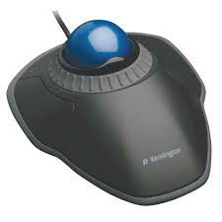
Trackball Mouse :
It has the ball mechanism to move the pointer or cursor on the screen
The ball is half inserted in the device and can be easily rolled with finger, thumb or palm to move the pointer on the screen
The device has sensor to detect the rotation of ball

Slide 44
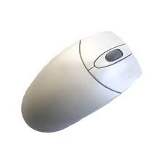
Mechanical Mouse :
It has a system of a ball and several rollers to track its movements
It can be used for high performance
The drawback is that they tend to get dust into the mechanics and thus requires regular cleaning

Slide 45
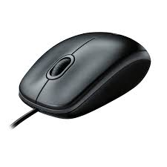
Optical Mouse :
It uses optical electronics to track its movement
It is more reliable than a mechanical mouse and also requires less maintenance
Plain non-glossy mouse mat should be used for best working
Its performance is affected by the surface on which it is operated

Slide 46
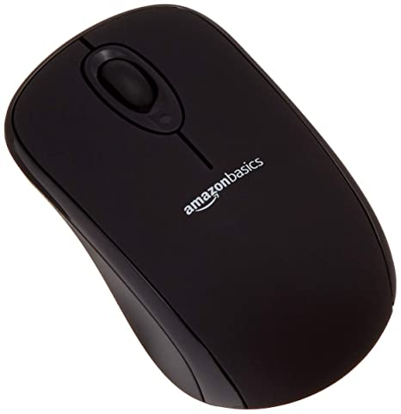
Cordless Or Wireless Mouse :
As the name suggests, this type of mouse lacks cable and uses wireless technology such as infrared or Bluetooth or wi-fi to control the movement of the cursor
It is used to improve the experience of using a mouse, it uses batteries for its power supply

Slide 47
Scanner :
The scanner uses the pictures and pages of text as input
It scans the picture or a document
The scanned picture or document is then converted into a digital format or file and is displayed on the screen as an output
It uses optical character recognition techniques to convert images into digital ones
Some of the common types of scanners are :

Slide 48
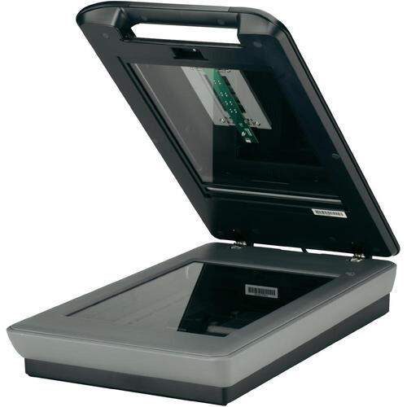
1. Flatbed Scanner :
It has a glass pane and a moving optical CIS or CCD array
The light illuminates the pane, and then the image is placed on the glass pane
The light moves across the glass pane and scans the document and produces its digital copy

Slide 49
2. Handheld Scanner :
It is a small manual scanning device which is held by hand and is rolled over a flat image that is to be scanned
The drawback is using this device is that the hand should be steady while scanning
Otherwise, it may distort the image
One of the commonly used handheld scanners is the barcode scanner which you would have seen in shopping stores

Slide 50
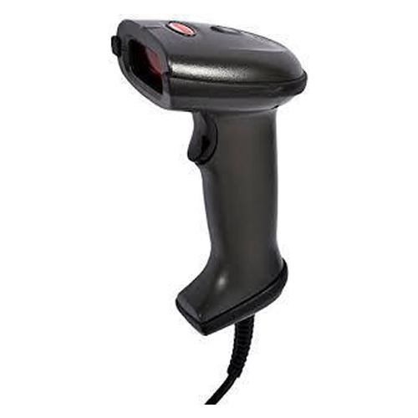
Cont..

Slide 51
Sheetfed Scanner :
In this scanner, the document is inserted into the slot provided in the scanner
the main component of this scanner include sheet-feeder, scanning module, and calibration sheet
The light does not move in this scanner, instead, the document moves through the scanner
It is suitable for scanning single page documents, not for thick objects like books, magazines, etc

Slide 52
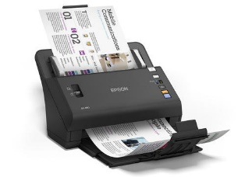
Cont..

Slide 53
Drum Scanner :
Drum scanner has photomultiplier tube (PMT) to scan images
It does not have a charge-coupled device like a flatbed scanner
The tube is very sensitive to light, the image is placed on a glass tube, and the light moves across the image which produces a reflection of the image which is captured by the PMT and processed
This scanners have high resolution and suitable for detailed scans

Slide 54
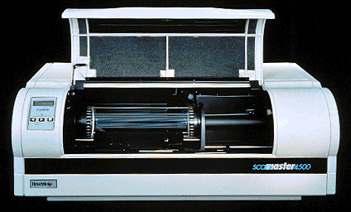
Cont…

Slide 55
Photo Scanner :
It is designed to scan photographs
It has high resolution and color depth, which are required for scanning photographs
Some photo scanners come with in-built software for cleaning and restoring old photographs

Slide 56
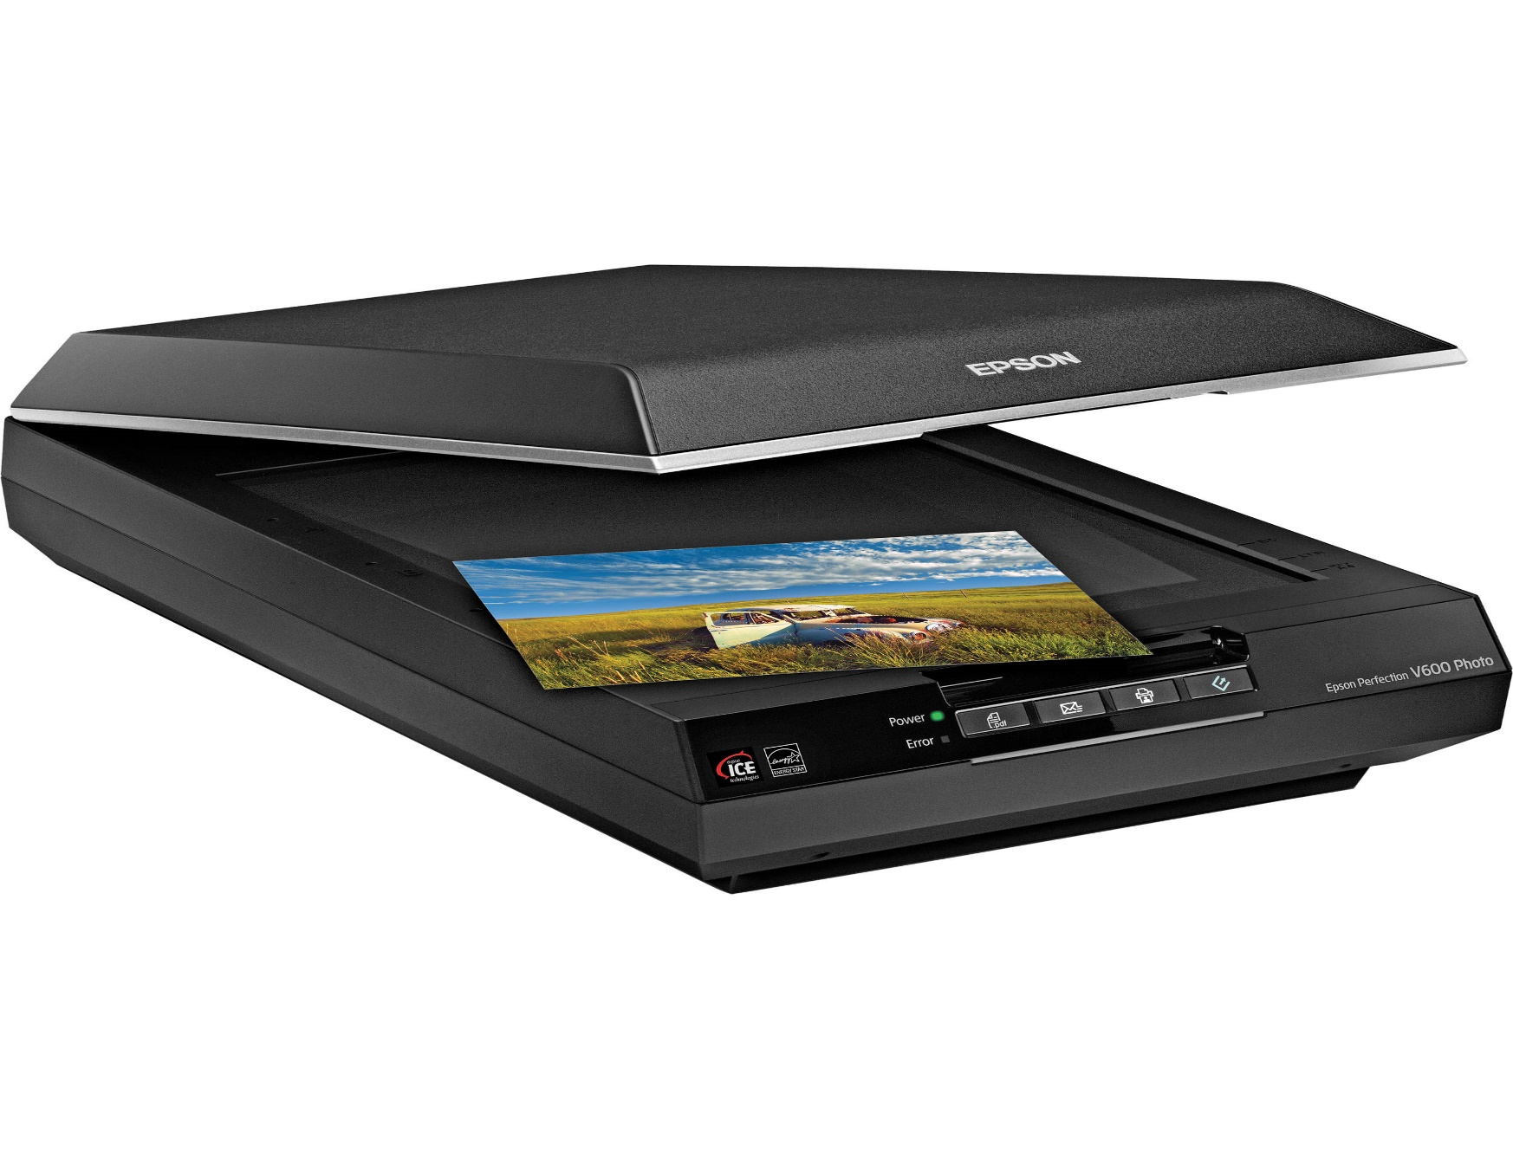
Cont…

Slide 57
Joystick :
A joystick is also a input pointing device like mouse
It is made up of a stick with a spherical base
The base is fitted in a socket that allows free movement of the stick
The movement of stick controls the cursor or pointer on the screen
The first joystick was invented by C. B. Mirick at USA
A joystick can be of different types such as displacement joysticks, finger operated joysticks, hand operated, isometric joystick
In joystick, the cursor keeps moving in the direction of joystick and the cursor of mouse moves when the mouse moves

Slide 58
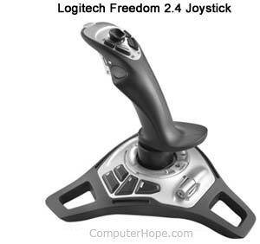
Joystick :

Slide 59
Light Pen :
A light pen is a computer input device that looks like a pen
The tip of the light pen contains a light sensitive detector that enables the user to point to or select objects on the display screen
Its light sensitive tip detects the object location and sends the corresponding signals to CPU
It is not compatible with LCD so it is not in use today
It also helps you draw on the screen if needed

Slide 60
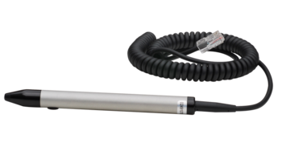
Light Pen :

Slide 61
Microphone :
The microphone is the computer input device that is used to input the sound
I receives the sound vibrations and converts them into audio signals or sends to a recording medium
The audio signals are converted into digital data and stored in the computer
The microphone also enables the user to telecommunicate with others
It is used to add sound to presentation and webcams for video conferencing

Slide 62
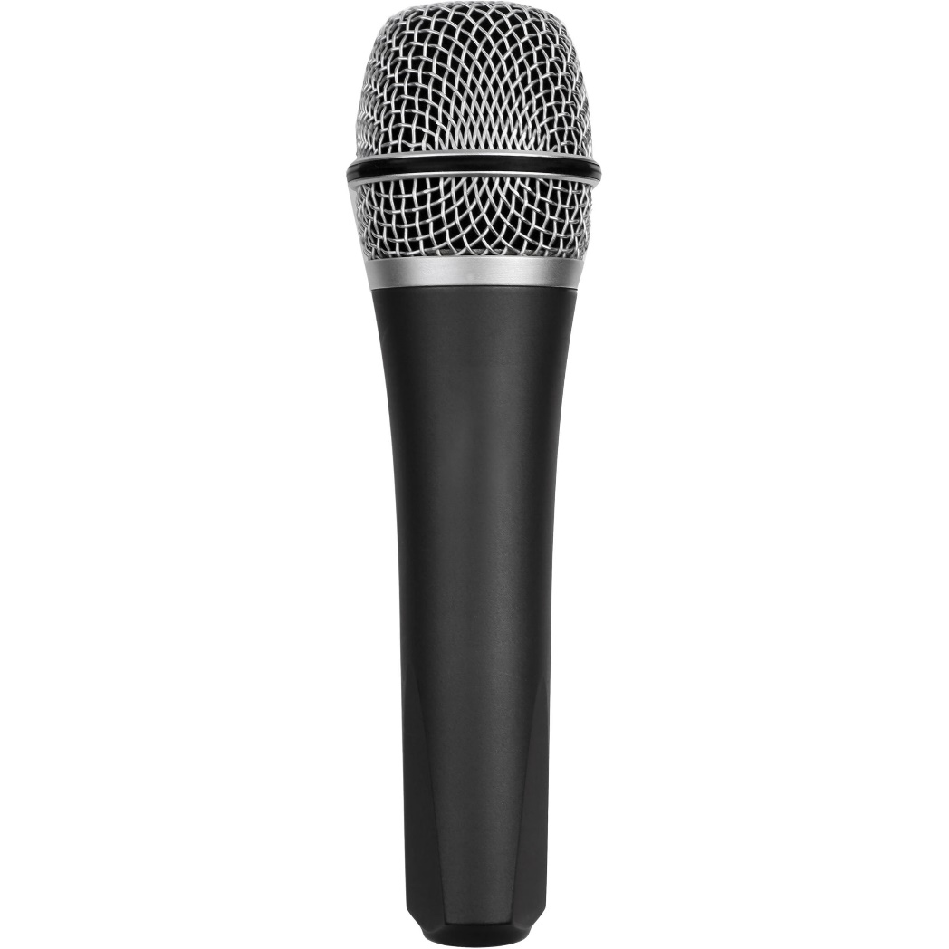
Microphone :

Slide 63
Central Processing Unit :
A central Processing Unit also called CPU or processor is the electronic circuitry within a computer that executes instructions that make up computer program
The CPU performs basic arithmetic, logic, controlling and input/output operations specified by the instructions in the programs
Principal components of a CPU include the arithmetic logical unit (ALU) that performs arithmetic and logical operations, processor registers that supply operands to ALU and stores results
Modern CPU consist of integrated chip (IC)
CPU contains many memory , peripherals and other computer components

Slide 64
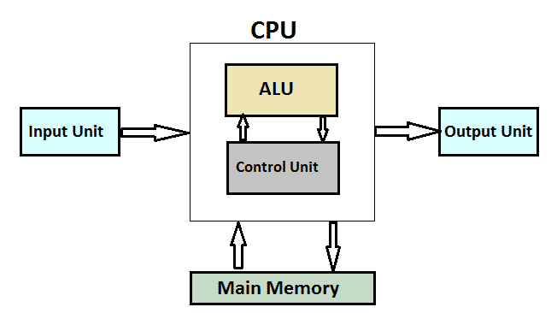
Cont…
It is also known as brain of computer

Slide 65
Memory or Storage Unit :
This unit can store instructions, data and intermediate results
This unit supplies information to other units of the computer when needed
It is also known as internal storage unit or the main memory or the primary storage or Random Access Memory (RAM)
Its size affects speed, power and capability
Primary and secondary memory are two types of memories in the computer
They stores data and instructions required for processing

Slide 66
Cont…
Stores intermediate result
Stores final results of processing before these results are released to output devices
All inputs and outputs are transmitted through the main memory

Slide 67
Control Unit :
This unit controls the operations of all parts of the computer but does not carry out any actual data processing operations
Function of this units are:
It is responsible for controlling the transfer of data and instructions among other units of the computer
It manages and coordinates all the units of the computer
It obtains the instructions from the memory, interprets them, and directs the operation of the computer
It communicates with i/o devices for transfer of data or results from storage
It does not process or store data

Slide 68
ALU :
This unit consist of two subsections:
Arithmetic section
Logic section
Arithmetic Section : Function of arithmetic section is to perform arithmetic operations like addition, subtraction, multiplication, division
Logic Section : Function of logic section is to perform logic operations like comparing, selecting, matching and merging of data

Slide 69
Output Devices :
The output devices display the result of the processing of raw data that is entered in the computer through an input devices
There are a number of output devices that display output in different ways such as text, images, hard copies and audio video
Some of popular output devices are :
Monitor
CRT Monitors
LCD Monitors
LED Monitors
Plasma Monitors

Slide 70
Cont….
Printers
Impact Printers
Character Printers
Dot matrix printers
Daisy Wheel Printers
Line Prin ters
Drum Printers
Chain Printers
Non impact Printers
Laser Printers
Inkjet Printers

Slide 71
Monitors :
The monitor is the display unit or screen of the computer
It is the main output device that displays the processed data or information as text, images, audio or video
The types of monitors are given below :
CRT Monitors :
CRT monitors are based on the Cathode Ray Tubes
They are like vacuum tubes which produce images in the form of video signals
Cathode ray tube produces a beam of electrons through electron guns that strike on the inner phosphorescent surface of the screen to produce images on the screen

Slide 72
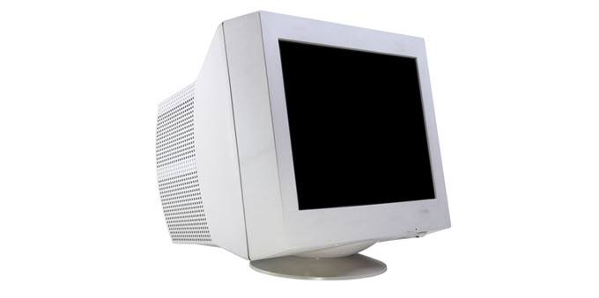
Cont…
The monitor contains millions of phosphorus dots of red, green, and blue color
These dots starts to glow when struck by electron beams and it is called cathodoluminescence

