Slide 1
Ch : 2
Input Devices

Slide 2
Types of Input devices :
Keyboard
Mouse
Trackball
Glide-pad
Joystick
Light Pen
Touch Screen
Digitizers and graphic tablet
Mic (Sound Input)
Camera (photo video input)
POS (Point Of Sale)
Terminal (Scanner)
MIDI (Musical Instrument Digital Interface) Keyboard
Wireless Devices (Keyboard, Mouse etc)

Slide 3
Touch screen :
The touchscreen technology is the direct manipulation type of gesture based technology
A touch screen is the electronic visual display capable of detecting and locating a touch over its display area
This is generally referred to as touching the display of the device with a finger or hand
This technology is most widely used in computers, user interactive machines, smartphones, tablets, etc to replace most functions of the mouse and keyboard.

Slide 4
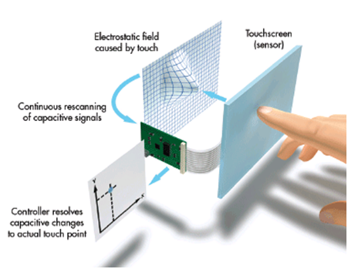
Cont….

Slide 5
Components and Working :
A basic touch screen is having a touch sensor, a controller, and a software driver as three main components
The touch screen is needed to be combined with a display and a PC to make a touch screen system
Touch Sensor : Sensor generally has an electrical current or signal going through it and touching the screen causes a change in the signal.
Controller : A controller will be connected between the touch sensor and PC. It takes information from the sensor and translates it for the understanding of PC.

Slide 6
Cont…
Software Driver : It allows computers and touch screen to work together. It tells OS how to interact with the touch event information that is sent to the controller.

Slide 7
Camera :
A camera is an optical instrument used to record images
A most basic, cameras are sealed boxes with a small hole that allow light into capture an image on a light sensitive surface.
Lenses focus the light entering the camera,
Video camera is also a camera used for electronic motion picture, initially developed for the television industry but now common in other applications as well
Closed-circuit television (CCTV) generally uses PTZ (pan tilt zoom) camera for security, or monitoring purpose. They are designed to be small, easily hidden.

Slide 8
Cont….
Webcams are video cameras that stream live video feed to a computer
Smart phones have built-in video cameras and can capture photos and videos with high resolution
Special camera systems are used for scientific research, like, satellite, space probe, AI, robotics research, medical use etc. they use x-ray or infrared.

Slide 9
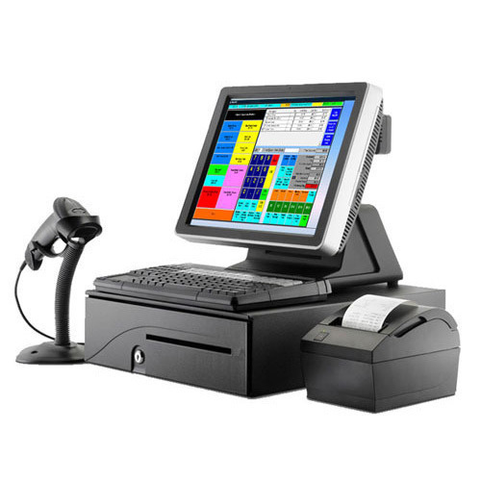
Point Of Sale (POS) :

Slide 10
POS :
The point of sale or point of purchase is the time and place where a retail transaction is completed
At the point of sale, the merchant calculates the amount owed by the customer, indicates that amount, may prepare an invoice for the customer and indicates to make payment
To calculate amount, the merchant may use various devices such as barcode, scanners, touch screens, other hardware or software.

Slide 11
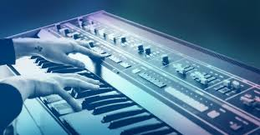
MIDI Keyboard:

Slide 12
Cont…
MIDI stands for Musical Instrument Digital Interface.
It is a technical standard that describes a communication protocol, digital interface that connect a wide variety of electronic musical instruments, computers, and related audio devices for playing, editing and recording music
This increases the portability and flexibility of stage setups
A single MIDI link through a MIDI cable can carry up to 16 channels of information each of which can be routed to a separate device or instrument.

Slide 13
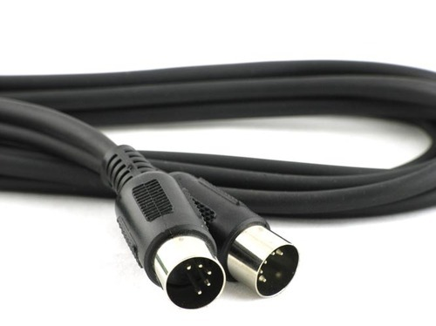
Cont…
A MIDI recording is not an audio signal, as with a sound recording made with a microphone

Slide 14
Digitizers :
Digitizer is an input device which converts analog information into digital form. Digitizer can convert a signal from the television or camera into a series of numbers that could be stored in a computer.
They can be used by the computer to create a picture of whatever the camera had been pointed at.
Digitizer is also known as Tablet or Graphics Tablet as it converts graphics and pictorial data into binary inputs.
A graphic tablet as digitizer is used for fine works of drawing and image manipulation applications.

Slide 15
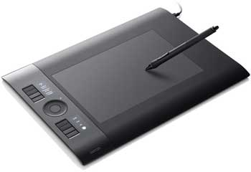
Cont…

Slide 16
OCR :
Optical character recognition or optical character reader (OCR) is the electronic or mechanical conversion of images of typed, handwritten or printed text into machine-encoded text, whether from a scanned document, a photo of a document, a scene-photo (for example the text on signs and billboards in a landscape photo) or from subtitle text superimposed on an image
Widely used as a form of data entry from printed paper data records – whether passport documents, invoices, bank statements, computerized receipts, business cards, mail, printouts of static-data, or any suitable documentation – it is a common method of digitizing printed texts so that they can be electronically edited, searched, stored more compactly, displayed on-line, and used in machine processes such as machine translation, (extracted) text-to-speech, key data.

Slide 17
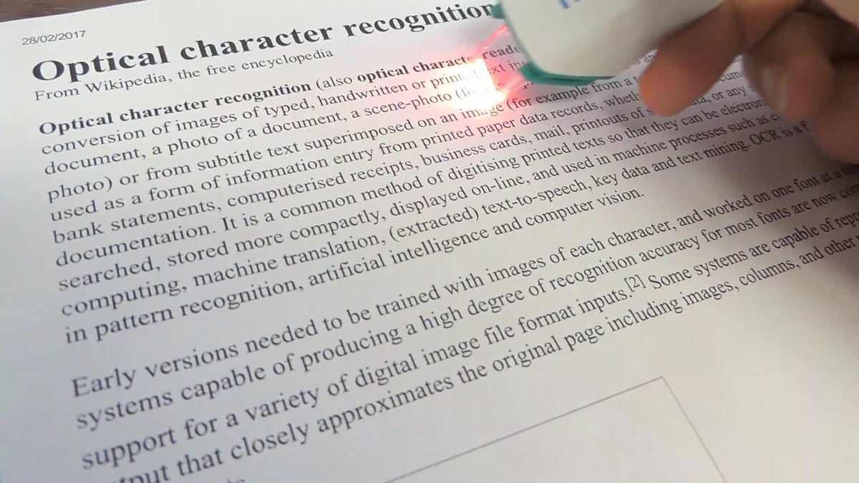
Cont…

Slide 18
OMR :

