Slide 1
Optical Fiber (Fiber Optics)
Optical fiber consists of thin glass fibers or plastic or any dielectric medium which can carry light signals from one end to the other.
Optical fiber refers to the medium and the technology which is related, or you can say that it is connected with the transmission of information in the form of light impulses and this transmission is done along with a glass or plastic wire or fiber.

Slide 2
Cont…
The wires of fiber optic cable can carry much more information than any other conventional copper wire.
The typical optical fiber consists of a very narrow strand of glass called the core. Around the core is a concentric layer of glass called the cladding.
Optical fibers make use of light to send information through the optical medium.

Slide 3
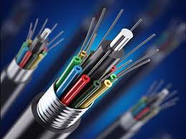
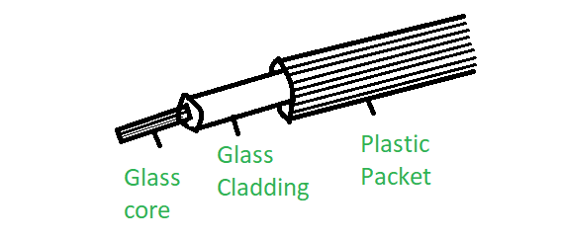
Cont..

Slide 4
Fiber optic cables have the following characteristics:
Fiber optic cabling can provide extremely high bandwidths in the range from 100 mbps to 2 gigabits because light has a much higher frequency than electricity.
Fiber optic cable has much lower attenuation and can carry signal to longer distances without using amplifiers and repeaters in between.

Slide 5
Cont…
Fiber optic cable has much lower attenuation and can carry signal to longer distances without using amplifiers and repeaters in between.
The cost of fiber optic cable is more compared to twisted pair and co-axial.
The installation of fiber optic cables is difficult and tedious.

Slide 6
Net Meeting
The net meeting is a popular video conferencing solution given by Microsoft.
When we install the Windows 95 and Windows XP, Net Meeting was included automatically. This was replaced by Windows Meeting Space when Windows Vista version was launched. It is no longer used.
It was very simple and the menu drove to start and to join the net meeting.

Slide 7
Cont…
NetMeeting was bundled as part of Windows and included point-to-point telephony and video calling capability over the Internet as well as multipoint whiteboard and application sharing.

Slide 8
Printing Speed
CPS (Character Per Second)
CPM (Character Per Minute)
LPM (Line Per Minute)
DPI (Dots Per Inch)
PPM (Pages Per Minute)

Slide 9
Syntax and Wildcard Operators
Syntax refers to the rules that define the structure of a language.
Syntax in computer programming means the rules that control the structure of the symbols, punctuation, and words of a programming language.
Without syntax, the meaning or semantics of a language is nearly impossible to understand.

Slide 10
Cont…
If the syntax of a language is not followed, the code will not be understood by a compiler or interpreter.
Compilers convert programming languages like Java or C++ into binary code that computers can understand. If the syntax is incorrect, the code will not compile.
Every language has its own set of rules that make up its basic syntax.

Slide 11
Cont…
Case Sensitive
Class Names.
Program Filenames
Different languages may have rules for adding comments, using white space, or declaring variables.

Slide 12
Wildcard Operators
In software, a wildcard character is a kind of placeholder represented by a single character, such as an asterisk (*), which can be interpreted as a number of literal characters or an empty string.

