Slide 1
Chapter : 5
Emerging technologies and Virus

Slide 2
Different Communication Methods :
There are many different communication methods to have communication over network as mentioned below :
GIS
GPS
COMA
GSM

Slide 3
GIS (Geographic Information System)
A geographic information system (GIS) is a system designed to capture, store, manipulate, analyze, manage, and present all types of geographical data. The key word to this technology is Geography – this means that some portion of the data is spatial. In other words, data that is in some way referenced to locations on the earth.
Rooted in the science of geography, GIS integrates many types of data
It analyzes spatial location and organizes layers of information into visualizations using maps and 3D scenes.
GIS technology applies geographic science with tools for understanding and collaboration. It helps people reach a common goal: to gain actionable intelligence from all types of data.

Slide 4
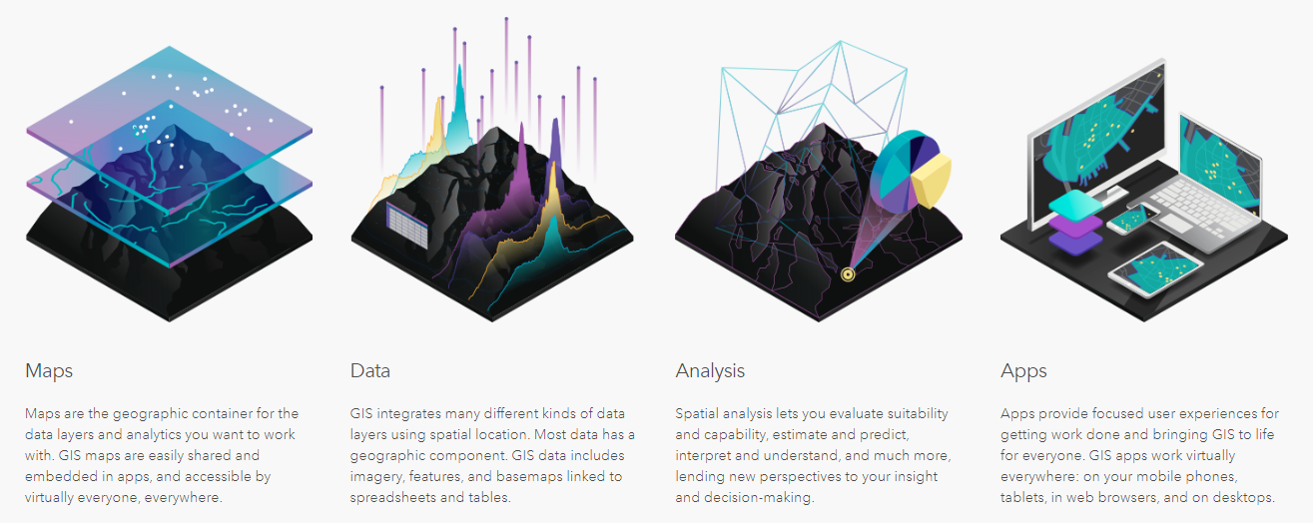
Cont…
GIS can show many different kinds of data on one map, such as streets, buildings, and vegetation.
This enables people to more easily see, analyze, and understand patterns and relationships.

Slide 5
GPS (Global Positioning System) :
GPS, or the Global Positioning System, is a global navigation satellite system that provides location, velocity and time synchronization.
GPS is everywhere. You can find GPS systems in your car, your smartphone and your watch. GPS helps you get where you are going, from point A to point B.
GPS is made up of three different components, called segments, that work together to provide location information.
GPS works through a technique called trilateration. Used to calculate location, velocity and elevation, trilateration collects signals from satellites to output location information.

Slide 6
Cont…
Satellites orbiting the earth send signals to be read and interpreted by a GPS device, situated on or near the earth’s surface. To calculate location, a GPS device must be able to read the signal from at least four satellites.
When a satellite sends a signal, it creates a circle with a radius measured from the GPS device to the satellite.
There are five main uses of GPS:
Location — Determining a position.
Navigation — Getting from one location to another.
Tracking — Monitoring object or personal movement.
Mapping — Creating maps of the world.
Timing — Making it possible to take precise time measurements.

Slide 7
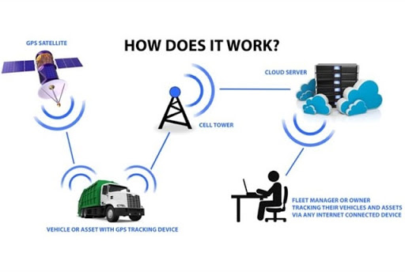
Image :

Slide 8
GSM (Global System For Mobile ) :
If you are in Europe or Asia and using a mobile phone, then most probably you are using GSM technology in your mobile phone.
GSM stands for Global System for Mobile Communication. It is a digital cellular technology used for transmitting mobile voice and data services.
The concept of GSM emerged from a cell-based mobile radio system at Bell Laboratories in the early 1970
GSM is the most widely accepted standard in telecommunications and it is implemented globally.

Slide 9
Cont…
GSM makes use of narrowband Time Division Multiple Access (TDMA) technique for transmitting signals.
Presently GSM supports more than one billion mobile subscribers in more than 210 countries throughout the world.
GSM provides basic to advanced voice and data services including roaming service. Roaming is the ability to use your GSM phone number in another GSM network.
Listed below are the features of GSM that account for its popularity and wide acceptance.
Improved spectrum efficiency
International roaming
Low-cost mobile sets and base stations (BSs)
High-quality speech
Compatibility with Integrated Services Digital Network (ISDN) and other telephone company services
Support for new services

Slide 10
Cont…
In a GSM network, the following areas are defined:
Cell
Location Area
MSC/VLR Service Area
PLMN

Slide 11
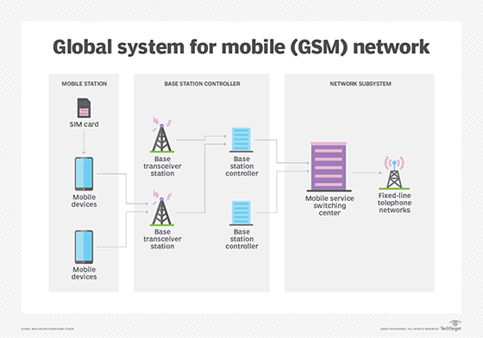
Image :

Slide 12
Communication Devices :
Many communication devices are available as listed below:
Cell phones
Modems
Infrared
Bluetooth
Wifi
Lifi
SLM

Slide 13
Cell Phones :
A mobile phone is an electronic device used for mobile telecommunications over a cellular network of specialized base stations known as cell sites. A cell phone offers full Duplex Communication and transfer the link when the user moves from one cell to another. As the phone user moves from one cell area to another, the system automatically commands the mobile phone and a cell site with a stronger signal, to switch on to a new frequency in order to keep the link.

Slide 14
Cont…
Mobile phone is primarily designed for Voice communication. In addition to the standard voice function, new generation mobile phones support many additional services, and accessories, such as SMS for text messaging, email, packet switching for access to the Internet, gaming, Bluetooth, camera with video recorder and MMS for sending and receiving photos and video, MP3 player, radio and GPS.
Mobile phone is a sophisticated device using SMD components, Microprocessor, Flash memory etc. In addition to the Circuit board, Mobile phone also has Antenna, Liquid Crystal Display(LCD) , Keyboard, Microphone, Speaker and Battery.

Slide 15
Cont…
The circuit board is the heart of the Mobile phone. It has chips like Analog-to-Digital and Digital-to-Analog conversion chips that translate the outgoing audio signal from analog to digital and the incoming signal from digital back to analog.

Slide 16
Modems :
Modem is short for "Modulator-Demodulator.“
It is a hardware component that allows a computer or another device, such as a router or switch, to connect to the Internet.
It converts or "modulates" an analog signal from a telephone or cable wire to digital data (1s and 0s) that a computer can recognize.
Similarly, it converts digital data from a computer or other device into an analog signal that can be sent over standard telephone lines.
The first modems were "dial-up," meaning they had to dial a phone number to connect to an ISP.

Slide 17
Cont…
These modems operated over standard analog phone lines and used the same frequencies as telephone calls, which limited their maximum data transfer rate
Dial-up modems also required full use of the local telephone line, meaning voice calls would interrupt the Internet connection.
Modern modems are typically DSL or cable modems, which are considered "broadband" devices.
DSL modems operate over standard telephone lines, but use a wider frequency range. This allows for higher data transfer rates than dial-up modems and enables them to not interfere with phone calls.

Slide 18
Cont…
Cable modems send and receive data over standard cable television lines, which are typically coaxial cables.

Slide 19
Infrared :
Infrared radiation (IR), or infrared light, is a type of radiant energy that's invisible to human eyes but that we can feel as heat. All objects in the universe emit some level of IR radiation, but two of the most obvious sources are the sun and fire.
IR is a type of electromagnetic radiation, a continuum of frequencies produced when atoms absorb and then release energy.
Waves of infrared radiation are longer than those of visible light,
Infrared radiation is emitted or absorbed by molecules when they change their rotational-vibrational movements

Slide 20
Cont…
Infrared radiation is used in industrial, scientific, military, law enforcement, and medical applications.
Night-vision devices using active near-infrared illumination allow people or animals to be observed without the observer being detected.
Extensive uses for military and civilian applications include target acquisition, surveillance, night vision, homing, and tracking.

Slide 21
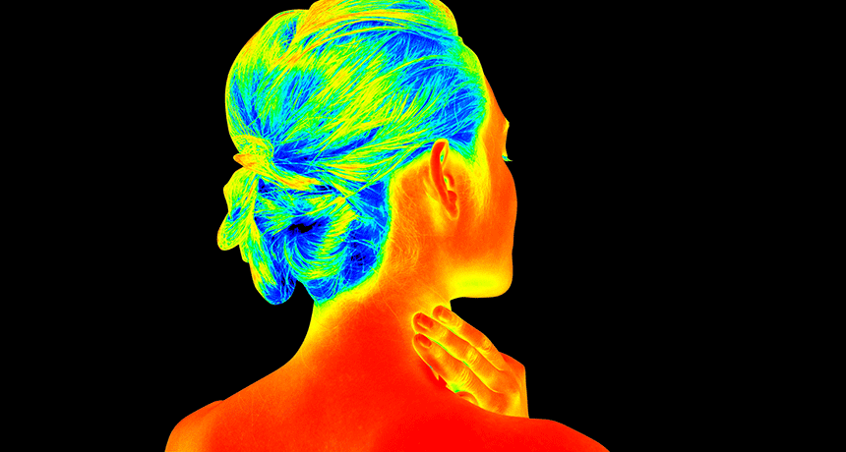
Image :

Slide 22
Bluetooth :
Bluetooth is a wireless technology standard used for exchanging data between fixed and mobile devices over short distances using UHF radio waves in the industrial, scientific and medical radio bands
A Bluetooth technology is a high speed low powered wireless technology link that is designed to connect phones or other portable equipment together.
Bluetooth can connect up to “eight devices” simultaneously and each device offers a unique 48 bit address from the IEEE 802 standard with the connections being made point to point or multipoint.

Slide 23
Cont….
Bluetooth Network consists of a Personal Area Network or a piconet which contains a minimum of 2 to maximum of 8 bluetooth peer devices
Bluetooth Applications:
Cordless Desktop
Ultimate headset:
Multimedia Transfer
Wireless signals transmitted with Bluetooth cover short distances, typically up to 30 feet (10 meters).

Slide 24
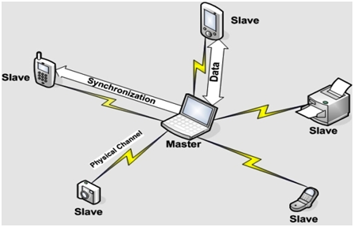
Cont…
It is a specification (IEEE 802.15.1) for the use of low power radio communications to link phones, computers and other network devices over short distance without wires.

Slide 25
Wifi :
Wifi Stands for “Wireless fidelity”
WiFi is a universal wireless networking technology that utilizes radio frequencies to transfer data. WiFi allows high-speed Internet connections without the use of cables.
The term WiFi is a contraction of "wireless fidelity" and commonly used to refer to wireless networking technology.
To access WiFi, you need WiFi enabled devices (laptops or PDAs). These devices can send and receive data wirelessly in any location equipped with WiFi access.

Slide 26
Cont…
WiFiIt is based on the IEEE 802.11 family of standards and is primarily a local area networking (LAN) technology designed to provide in-building broadband coverage.
Radio Signals are the keys, which make WiFi networking possible.
These radio signals transmitted from WiFi antennas are picked up by WiFi receivers, such as computers and cell phones that are equipped with WiFi cards.
Whenever, a computer receives any of the signals within the range of a WiFi network, which is usually 300 — 500 feet for antennas, the WiFi card reads the signals and thus creates an internet connection between the user and the network without the use of a cord.

Slide 27
Cont..
A WiFi hotspot is created by installing an access point to an internet connection.
The access point transmits a wireless signal over a short distance.
It typically covers around 300 feet
When a WiFi enabled device such as a Pocket PC encounters a hotspot, the device can then connect to that network wirelessly.
Most hotspots are located in places that are readily accessible to the public such as airports, coffee shops, hotels, book stores, and campus environments

Slide 28
Cont…
802.11b is the most common specification for hotspots worldwide.
The largest public WiFi networks are provided by private internet service providers (ISPs); they charge a fee to the users who want to access the internet.

Slide 29
Lifi :
Li-Fi (short for light fidelity) is wireless communication technology which utilizes light to transmit data and position between devices.
The term was first introduced by Harald Haas during a 2011
In technical terms, Li-Fi is a light communication system that is capable of transmitting data at high speeds over the visible light, ultraviolet, and infrared spectrums
Li-Fi uses the modulation of light intensity to transmit data
Li-Fi can theoretically transmit at speeds of up to 100 Gbit/s
Li-Fi is a derivative of optical wireless communications (OWC) technology, which uses light from light-emitting diodes (LEDs) as a medium to deliver network, mobile, high-speed communication in a similar manner to Wi-Fi

Slide 30
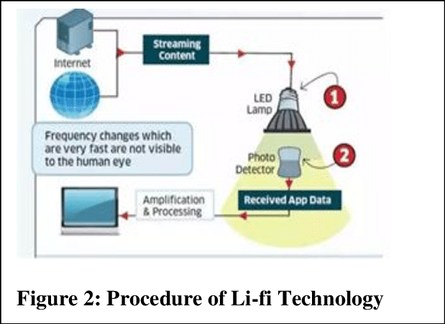
Cont…

Slide 31
Spatial Light Modulator (SLM) :
A spatial light modulator (SLM) is an object that imposes some form of spatially varying modulation on a beam of light.
A simple example is an overhead projector transparency
Usually when the phrase SLM is used, it means that the transparency can be controlled by a computer.
In the 1980s, large SLMs were placed on overhead projectors to project computer monitor contents to the screen. Since then more modern projectors have been developed where the SLM is built inside the projector. These are commonly used in meetings of all kinds for presentations.

Slide 32
Cont…
Usually, a SLM modulates the intensity of the light beam
However, it is also possible to produce devices that modulate the phase of the beam or both the intensity and the phase simultaneously.
SLMs have been used as a component in optical computing.

Slide 33
Virus :
A computer virus, much like a flu virus, is designed to spread from host to host and has the ability to replicate itself. Similarly, in the same way that flu viruses cannot reproduce without a host cell, computer viruses cannot reproduce and spread without programming such as a file or document.
In more technical terms, a computer virus is a type of malicious code or program written to alter the way a computer operates and is designed to spread from one computer to another.
A virus operates by inserting or attaching itself to a legitimate program or document that supports macros in order to execute its code

Slide 34
Cont…
In the process, a virus has the potential to cause unexpected or damaging effects, such as harming the system software by corrupting or destroying data.
Viruses can be spread through email and text message attachments, Internet file downloads, and social media scam links
Your mobile devices and smartphones can become infected with mobile viruses through shady app downloads.
Viruses can hide disguised as attachments of socially shareable content such as funny images, greeting cards, or audio and video files.

Slide 35
Cont…
To avoid contact with a virus, it’s important to exercise caution when surfing the web, downloading files, and opening links or attachments. To help stay safe, never download text or email attachments that you’re not expecting, or files from websites you don’t trust.

Slide 36
What are the signs of a computer virus?
A computer virus attack can produce a variety of symptoms. Here are some of them:
Frequent pop-up windows. Pop-ups might encourage you to visit unusual sites. Or they might prod you to download antivirus or other software programs.
Changes to your homepage. Your usual homepage may change to another website, for instance. Plus, you may be unable to reset it.
Mass emails being sent from your email account. A criminal may take control of your account or send emails in your name from another infected computer.
Frequent crashes. A virus can inflict major damage on your hard drive. This may cause your device to freeze or crash. It may also prevent your device from coming back on.
Unusually slow computer performance. A sudden change of processing speed could signal that your computer has a virus.
Unknown programs that start up when you turn on your computer. You may become aware of the unfamiliar program when you start your computer. Or you might notice it by checking your computer’s list of active applications.
Unusual activities like password changes. This could prevent you from logging into your computer.

Slide 37
How to help protect against computer viruses?
Here are some of the things you can do to help keep your computer safe.
Use a trusted antivirus product, such as Norton AntiVirus Basic, and keep it updated with the latest virus definitions. Norton Security Premium offers additional protection for even more devices, plus backup.
Avoid clicking on any pop-up advertisements.
Always scan your email attachments before opening them.
Always scan the files that you download using file sharing programs.

Slide 38
What are the different types of computer viruses?
Boot sector virus
Web scripting virus
Browser hijacker
Resident virus
Direct action virus
Polymorphic virus
File infector virus
Multipartite virus
Macro virus

Slide 39
Cont…
VIRUS: Vital Information Resources Under Seize
A computer virus is a computer program or a piece of code that is loaded onto your computer without your knowledge and run against your consent.
Viruses are human made programs generally write to access private information, corrupt data, to display political and humorous messages on the user's screen. They insert themselves into host programs and spread on the execution of infected programs.
To counter with viruses, programmers created anti-virus programs.

Slide 40
Cont…
List of malwares which are generally categorized as computer viruses:
Computer Worms
Trojan horse
Spam virus
Spyware
Zombies

Slide 41
Cloud Computing :
Cloud computing is a virtualization-based technology that allows us to create, configure, and customize applications via an internet connection. The cloud technology includes a development platform, hard disk, software application, and database.
The term cloud refers to a network or the internet.
It is a technology that uses remote servers on the internet to store, manage, and access data online rather than local drives.
The data can be anything such as files, images, documents, audio, video, and more.

Slide 42
Cont…
There are the following operations that we can do using cloud computing:
Developing new applications and services
Storage, back up, and recovery of data
Hosting blogs and websites
Delivery of software on demand
Analysis of data
Streaming videos and audios

Slide 43
Cont…
Small as well as large IT companies, follow the traditional methods to provide the IT infrastructure. That means for any IT company, we need a Server Room that is the basic need of IT companies.
In that server room, there should be a database server, mail server, networking, firewalls, routers, modem, switches, QPS (Query Per Second means how much queries or load will be handled by the server), configurable system, high net speed, and the maintenance engineers.
To establish such IT infrastructure, we need to spend lots of money. To overcome all these problems and to reduce the IT infrastructure cost, Cloud Computing comes into existence.

Slide 44
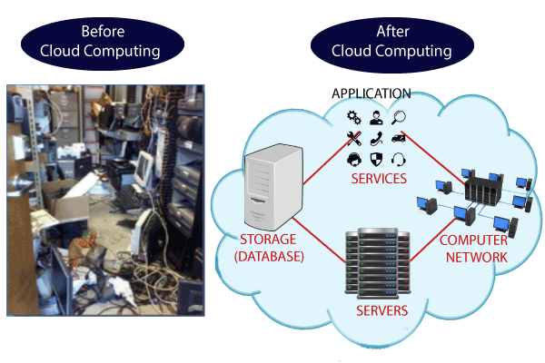
Cont…

Slide 45
Characteristics of Cloud Computing
1) Agility
The cloud works in a distributed computing environment. It shares resources among users and works very fast.
2) High availability and reliability
The availability of servers is high and more reliable because the chances of infrastructure failure are minimum.
3) High Scalability
Cloud offers "on-demand" provisioning of resources on a large scale, without having engineers for peak loads.

Slide 46
Cont…
4) Multi-Sharing
With the help of cloud computing, multiple users and applications can work more efficiently with cost reductions by sharing common infrastructure.
5) Device and Location Independence
Cloud computing enables the users to access systems using a web browser regardless of their location or what device they use e.g. PC, mobile phone, etc. As infrastructure is off-site (typically provided by a third-party) and accessed via the Internet, users can connect from anywhere.

Slide 47
Cont…
6) Maintenance
Maintenance of cloud computing applications is easier, since they do not need to be installed on each user's computer and can be accessed from different places. So, it reduces the cost also.
7) Low Cost
By using cloud computing, the cost will be reduced because to take the services of cloud computing, IT company need not to set its own infrastructure and pay-as-per usage of resources.
8) Services in the pay-per-use mode
Application Programming Interfaces (APIs) are provided to the users so that they can access services on the cloud by using these APIs and pay the charges as per the usage of services.

Slide 48
Cloud Service Models
There are the following three types of cloud service models -
Infrastructure as a Service (IaaS)
Platform as a Service (PaaS)
Software as a Service (SaaS)

Slide 49
Infrastructure as a Service (IaaS)
IaaS is also known as Hardware as a Service (HaaS). It is a computing infrastructure managed over the internet. The main advantage of using IaaS is that it helps users to avoid the cost and complexity of purchasing and managing the physical servers.
There are the following characteristics of IaaS -
Resources are available as a service
Services are highly scalable
Dynamic and flexible
GUI and API-based access
Automated administrative tasks

Slide 50
Platform as a Service (PaaS)
PaaS cloud computing platform is created for the programmer to develop, test, run, and manage the applications.
Characteristics of PaaS
There are the following characteristics of PaaS -
Accessible to various users via the same development application.
Integrates with web services and databases.
Builds on virtualization technology, so resources can easily be scaled up or down as per the organization's need.
Support multiple languages and frameworks.
Provides an ability to "Auto-scale".

Slide 51
Software as a Service (SaaS)
SaaS is also known as "on-demand software". It is a software in which the applications are hosted by a cloud service provider. Users can access these applications with the help of internet connection and web browser.
Characteristics of SaaS
There are the following characteristics of SaaS -
Managed from a central location
Hosted on a remote server
Accessible over the internet

Slide 52
Cloud Computing Architecture
s we know, cloud computing technology is used by both small and large organizations to store the information in cloud and access it from anywhere at anytime using the internet connection.
Cloud computing architecture is a combination of service-oriented architecture and event-driven architecture.
Cloud computing architecture is divided into the following two parts -
Front End
Back End

Slide 53
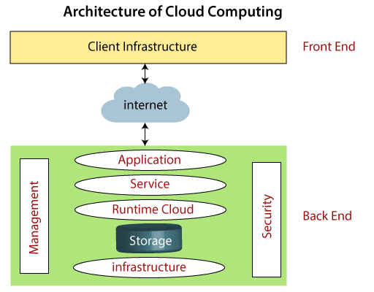
Cont…

Slide 54
Cont…
Front End
The front end is used by the client. It contains client-side interfaces and applications that are required to access the cloud computing platforms. The front end includes web servers (including Chrome, Firefox, internet explorer, etc.), thin & fat clients, tablets, and mobile devices.
Back End
The back end is used by the service provider. It manages all the resources that are required to provide cloud computing services. It includes a huge amount of data storage, security mechanism, virtual machines, deploying models, servers, traffic control mechanisms, etc.

