Slide 1
Types of Operating System
An Operating System performs all the basic tasks like managing file,process, and memory. Thus operating system acts as manager of all the resources, i.e. resource manager. Thus operating system becomes an interface between user and machine.
Some of the widely used operating systems are as follows-

Slide 2
1. Batch Operating System
This type of operating system does not interact with the computer directly. There is an operator which takes similar jobs having same requirement and group them into batches. It is the responsibility of operator to sort the jobs with similar needs.

Slide 3
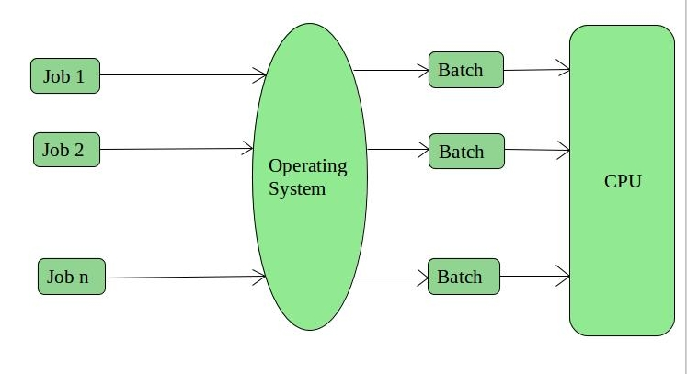
Cont…

Slide 4
Advantages of Batch Operating System:
It is very difficult to guess or know the time required by any job to complete. Processors of the batch systems know how long the job would be when it is in queue
Multiple users can share the batch systems
The idle time for batch system is very less
It is easy to manage large work repeatedly in batch systems

Slide 5
Disadvantages of Batch Operating System:
The computer operators should be well known with batch systems
Batch systems are hard to debug
It is sometime costly
The other jobs will have to wait for an unknown time if any job fails.
Examples of Batch based Operating System: Payroll System, Bank Statements etc.

Slide 6
2. Time-Sharing Operating Systems –
Each task is given some time to execute, so that all the tasks work smoothly.
Each user gets time of CPU as they use single system. These systems are also known as Multitasking Systems.
The time that each task gets to execute is called quantum. After this time interval is over OS switches over to next task.

Slide 7
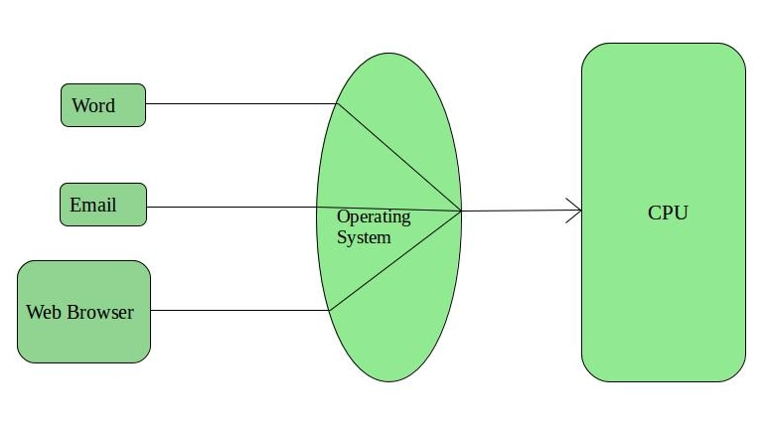
Cont…

Slide 8
Advantages of Time-Sharing OS:
Each task gets an equal opportunity
Less chances of duplication of software
CPU idle time can be reduced

Slide 9
Disadvantages of Time-Sharing OS:
Reliability problem
One must have to take care of security and integrity of user programs and data
Data communication problem
Examples of Time-Sharing OSs are: Multics, Unix etc.

Slide 10
3-Real-Time Operating System –
These types of OSs serves the real-time systems. The time interval required to process and respond to inputs is very small. This time interval is called response time.
Real-time systems are used when there are time requirements are very strict like missile systems, air traffic control systems, robots etc.

Slide 11
Two types of Real-Time Operating System which are as follows:
Hard Real-Time Systems: These OSs are meant for the applications where time constraints are very strict and even the shortest possible delay is not acceptable. These systems are built for saving life like automatic parachutes or air bags which are required to be readily available in case of any accident.

Slide 12
Cont…
Soft Real-Time Systems: These OSs are for applications where for time-constraint is less strict.

Slide 13
Advantages of RTOS:
Maximum Consumption: Maximum utilization of devices and system,thus more output from all the resources
Task Shifting: Time assigned for shifting tasks in these systems are very less. For example in older systems it takes about 10 micro seconds in shifting one task to another and in latest systems it takes 3 micro seconds.
Focus on Application: Focus on running applications and less importance to applications which are in queue.
Real time operating system in embedded system: Since size of programs are small, RTOS can also be used in embedded systems like in transport and others.
Error Free: These types of systems are error free.
Memory Allocation: Memory allocation is best managed in these type of systems.

Slide 14
Disadvantages of RTOS:
Limited Tasks: Very few tasks run at the same time and their concentration is very less on few applications to avoid errors.
Use heavy system resources: Sometimes the system resources are not so good and they are expensive as well.
Complex Algorithms: The algorithms are very complex and difficult for the designer to write on.
Device driver and interrupt signals: It needs specific device drivers and interrupt signals to response earliest to interrupts.
Thread Priority: It is not good to set thread priority as these systems are very less prone to switching tasks.

Slide 15
Cont…
Examples of Real-Time Operating Systems are: Scientific experiments, medical imaging systems, industrial control systems, weapon systems, robots, air traffic control systems, etc.

Slide 16
Multiprocessing Operating Systems
A multiprocessing operating system (OS) is one in which two or more central processing units (CPUs) control the functions of the computer. Each CPU contains a copy of the OS, and these copies communicate with one another to coordinate operations. The use of multiple processors allows the computer to perform calculations faster, since tasks can be divided up between processors.

