Slide 1
IcePAK

Slide 2
Team
Jennifer Apacible
Brian Donohue
Austin Hedeen
Daniel Luna
Dove Shlachter

Slide 3
Problem
Globally, there are over 3 million deaths per year from vaccine-preventable diseases
Most of these occur in developing countries
Over half of those are children under 5

Slide 4
Challenge
Vaccines require specific storage requirements
Inability to properly store vaccines can impact distribution
Affected areas often have low visibility
Current data is difficult and time consuming to reason about and process

Slide 5
Solution
Make data easy to consume
Highlight problem areas
Make recommendations on future resource use
Make it easy to update

Slide 6
Technology
Touch screen mobile device
Android
Nexus 7
D3.js visualization library

Slide 7
Accessibility
Variety of visualizations
Many use cases
Smart color coding
Fast to process
Keep superfluous information at bay
Focus on what you need

Slide 8
Visibility
Visual
Color coding
Spacial
Dedicated graph space
Clear orderings
Deep
Explore this problem area, right now

Slide 9
Guidance
Who is most served by new resources?
How many and where?
What difference will it make?

Slide 10
Extention
Easy to update
Updates quickly
Use data in existing format

Slide 11
Demo

Slide 12
Demo
We are a manager in Pakistan
Data for June 2014 just arrived

Slide 13
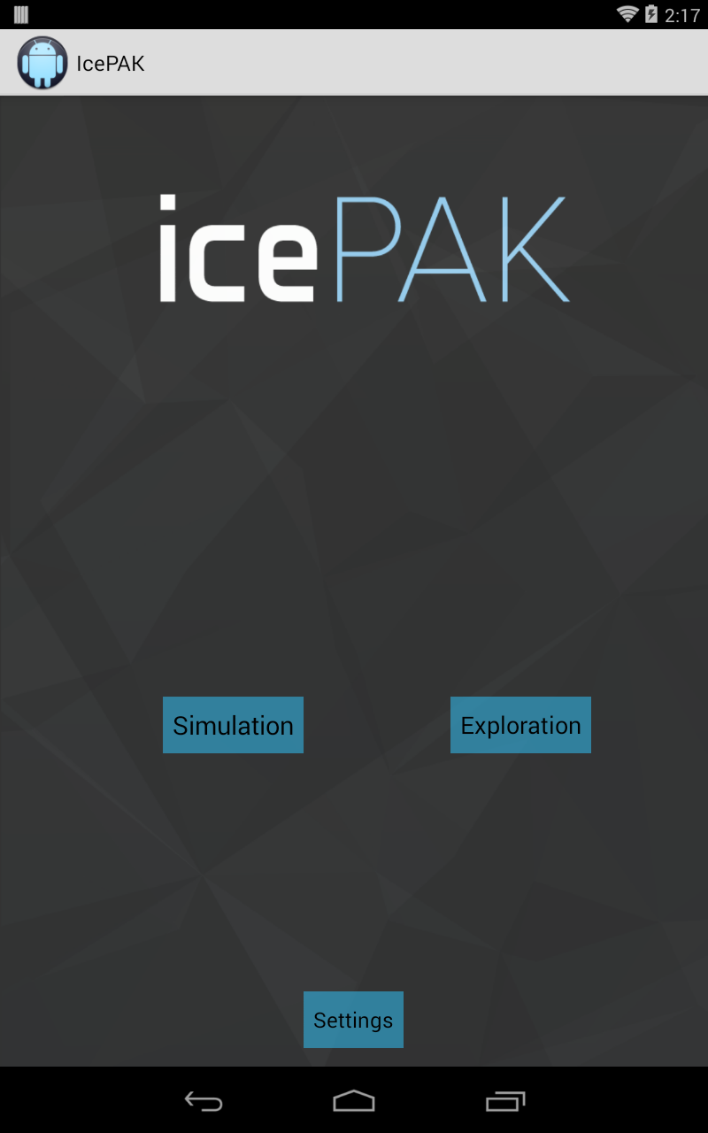
Demo

Slide 14
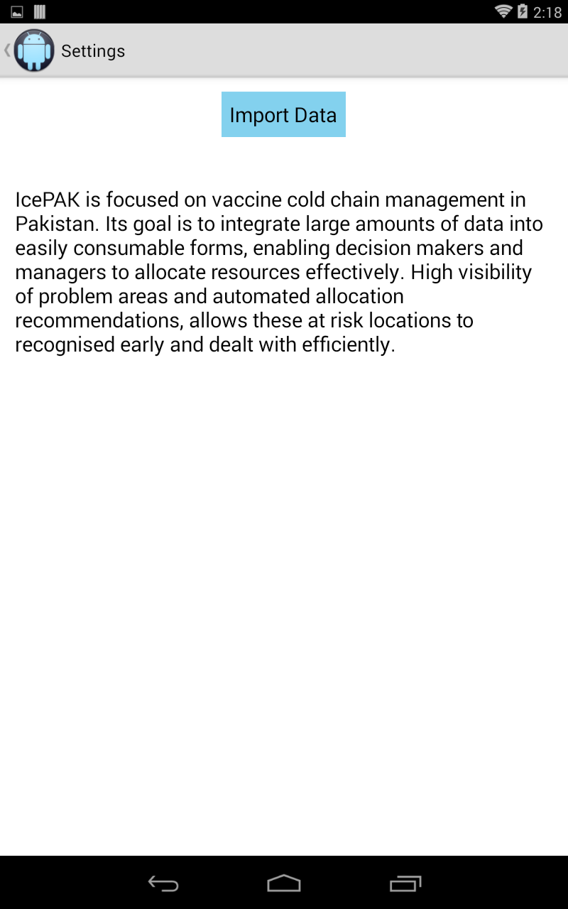
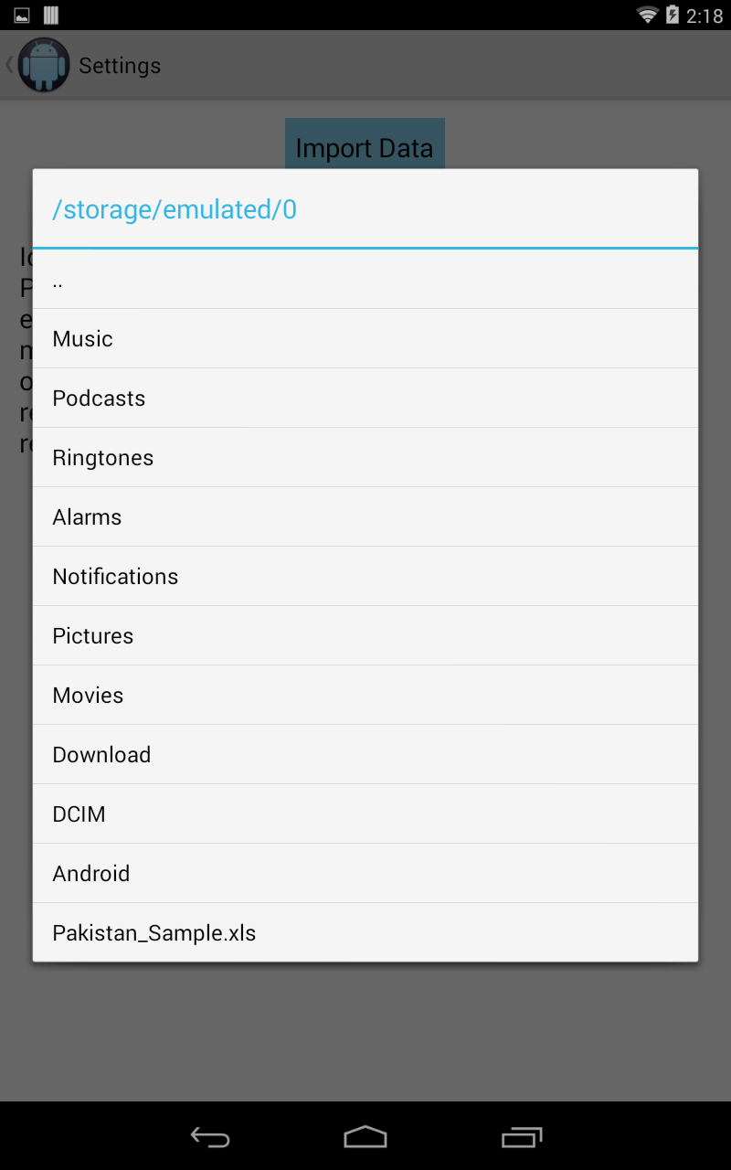
Demo

Slide 15
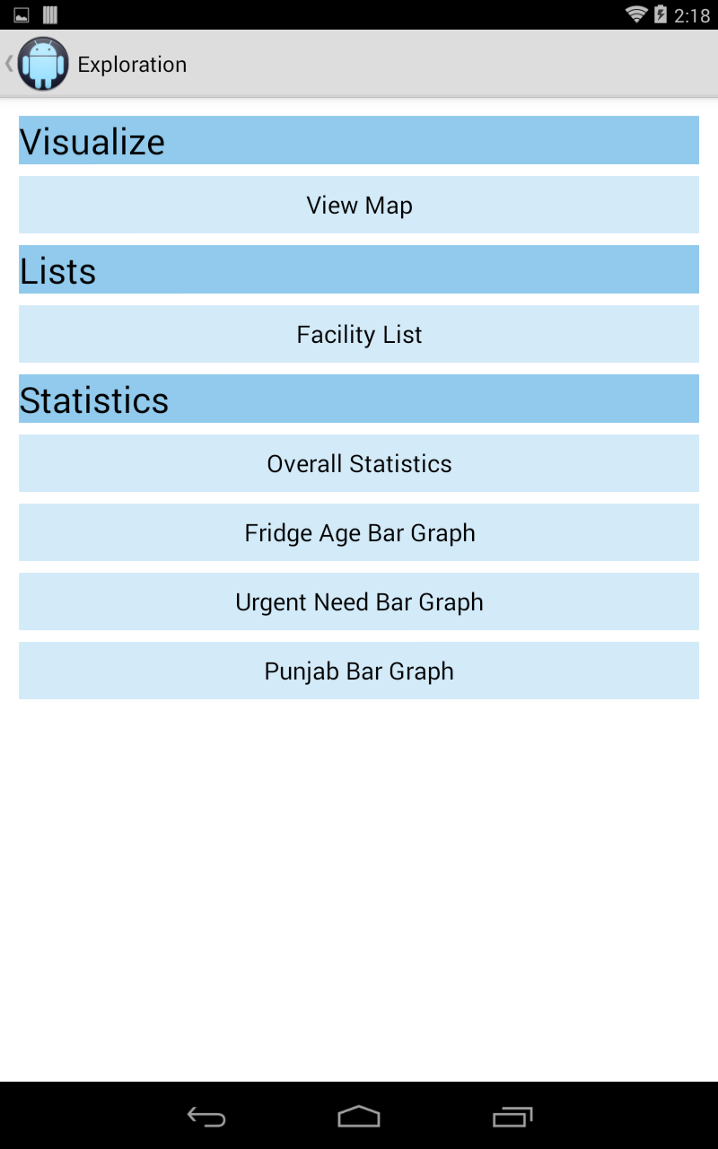
Demo

Slide 16
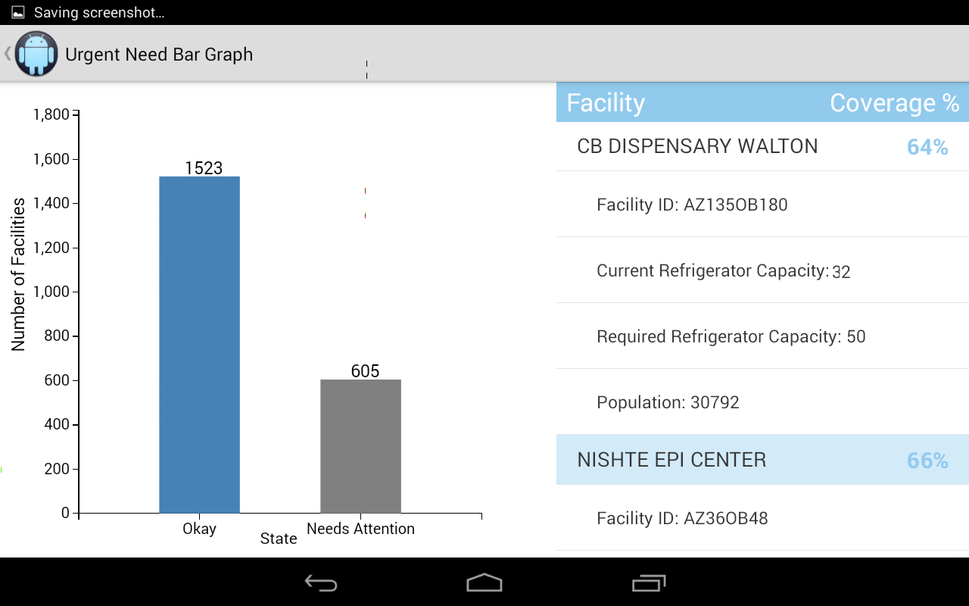
Demo

Slide 17
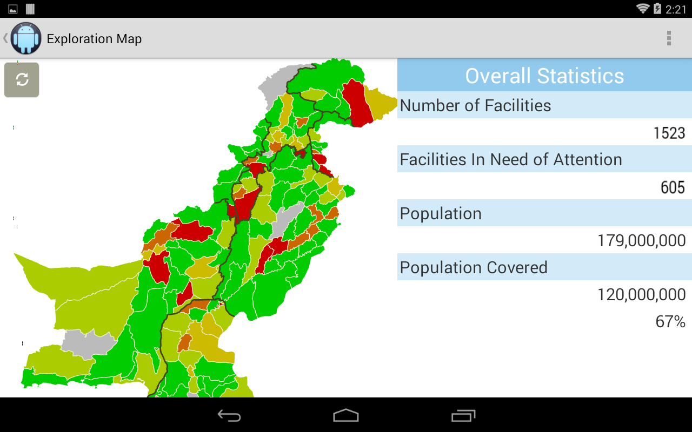
Demo

Slide 18
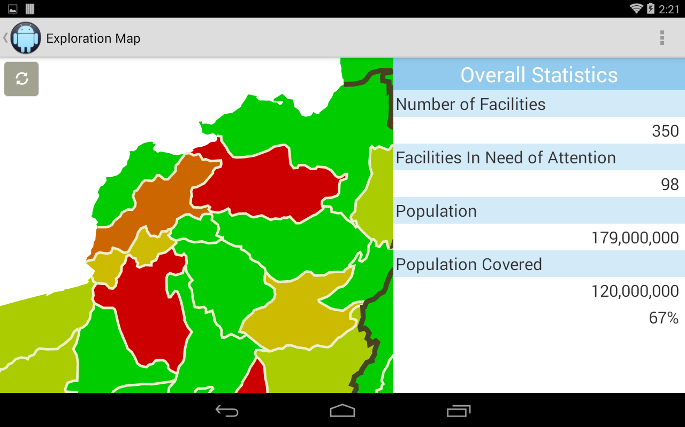
Demo

Slide 19
Demo

Slide 20
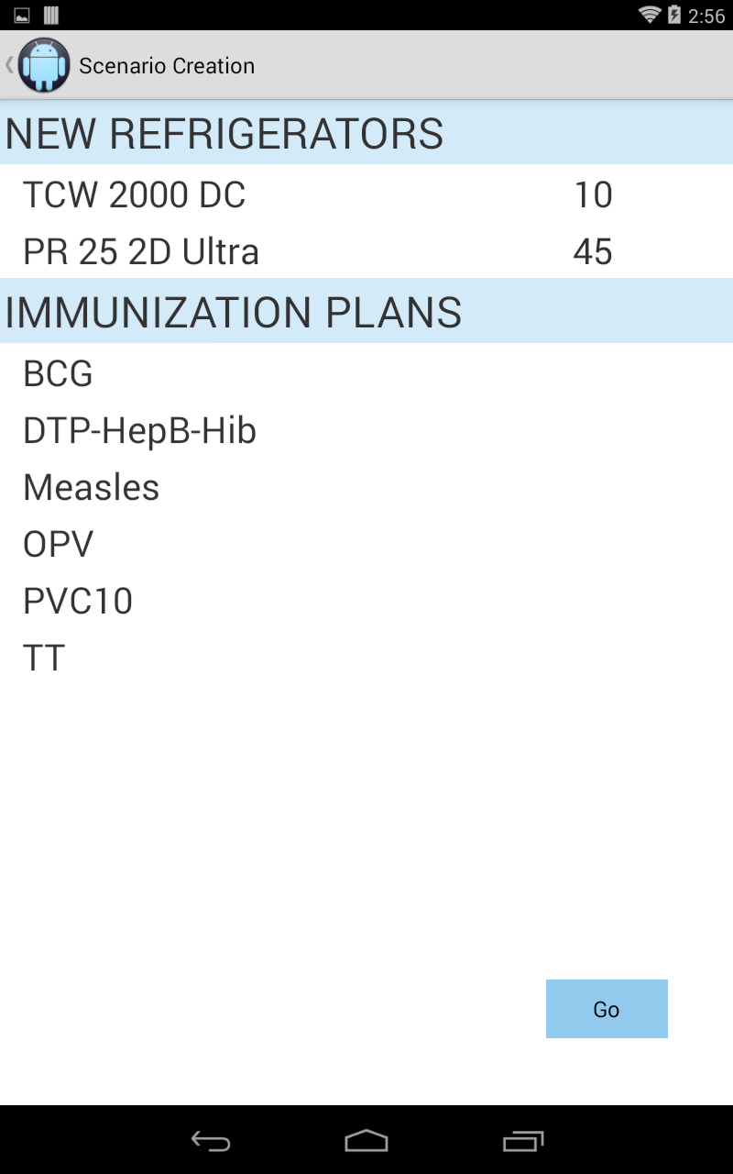
Demo

Slide 21
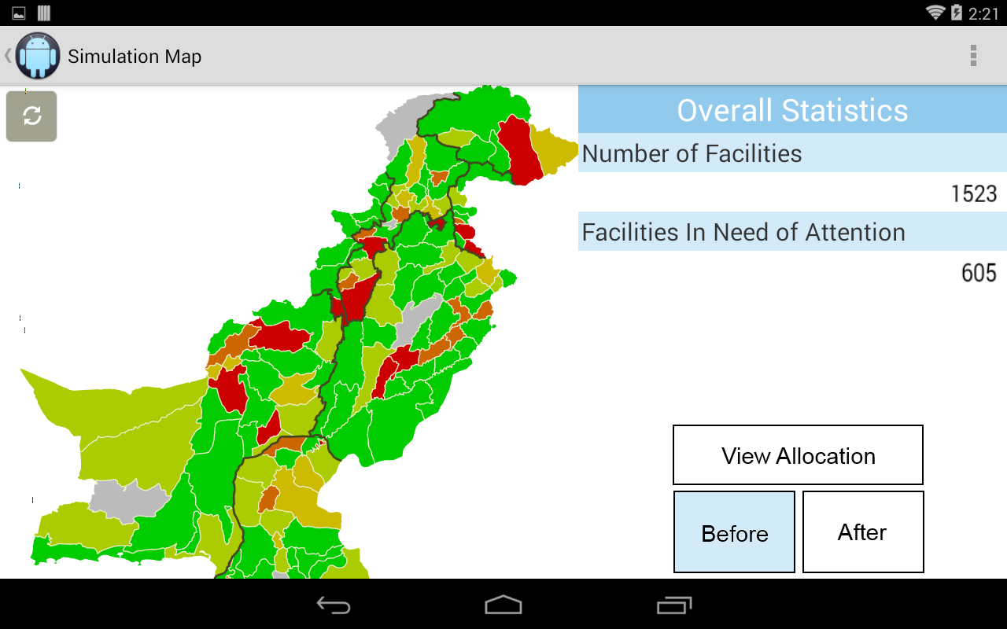
Demo

Slide 22
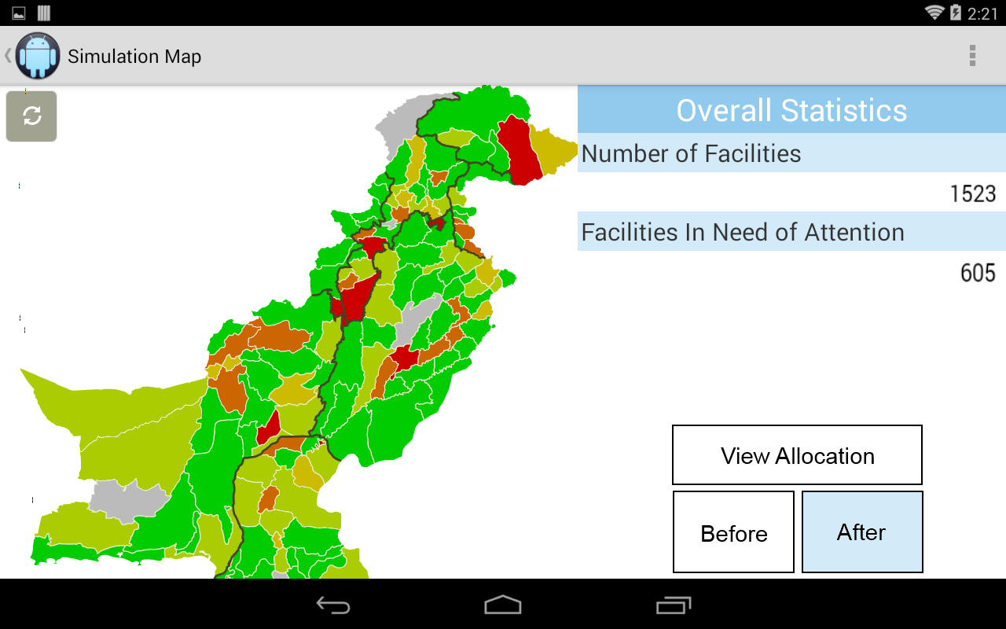
Demo

Slide 23
Thank you
Questions?

