Slide 1
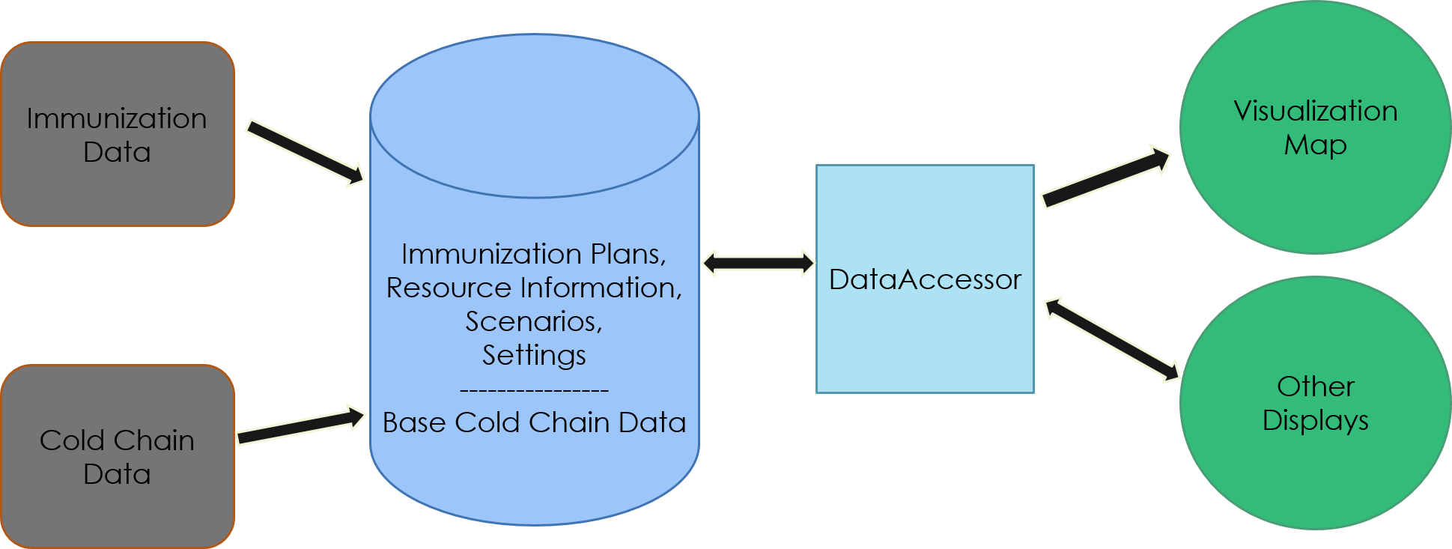
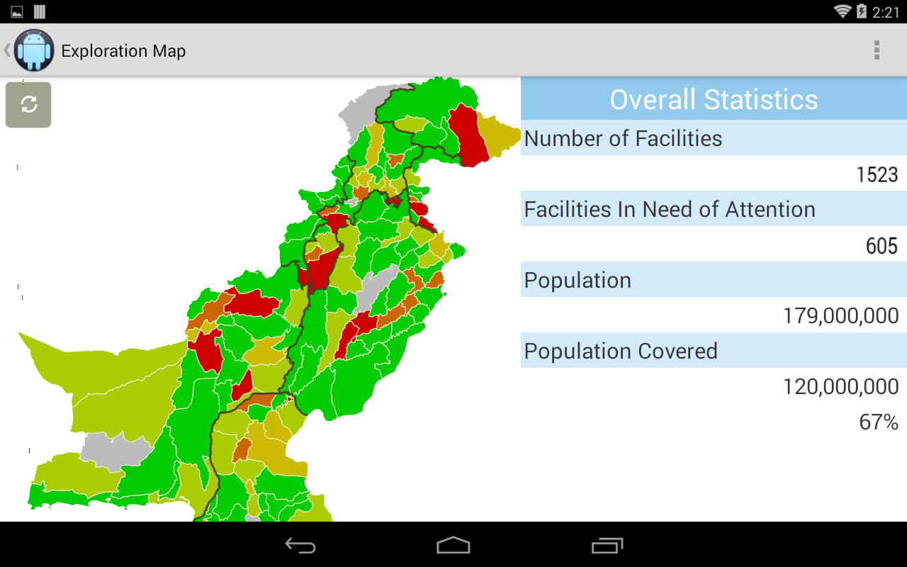
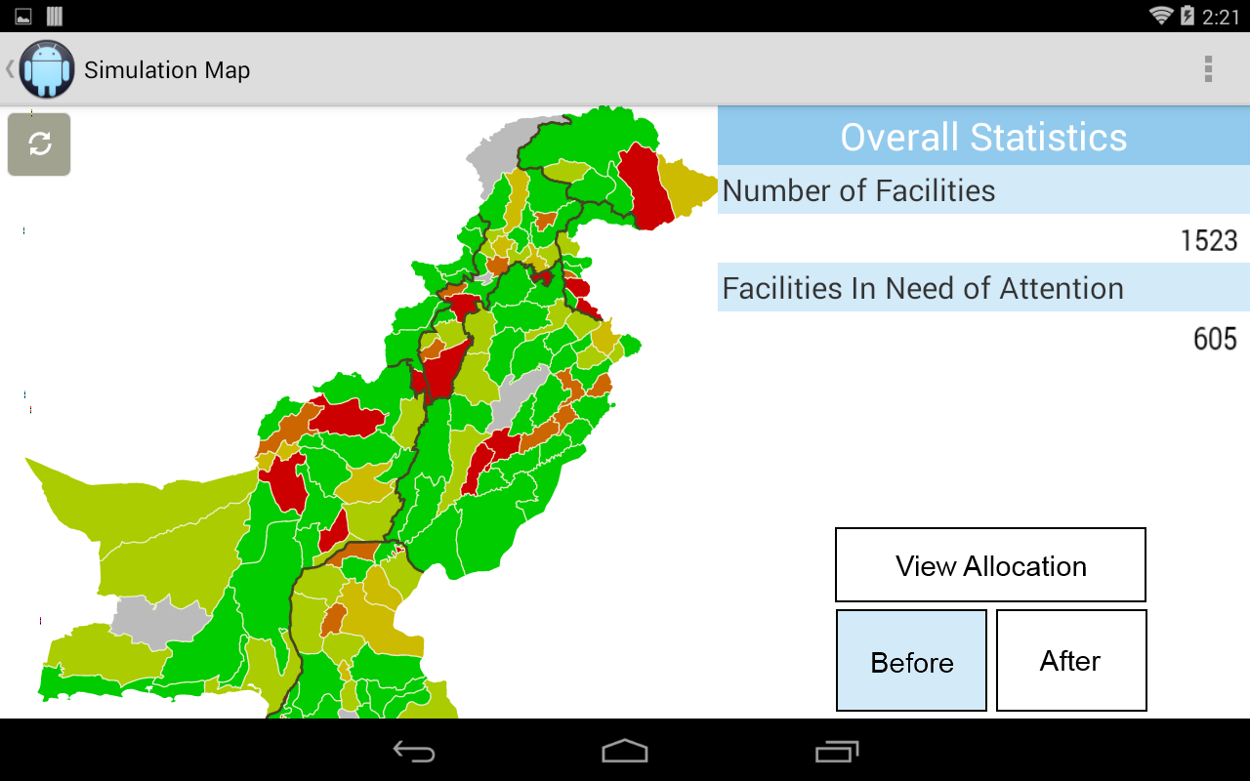
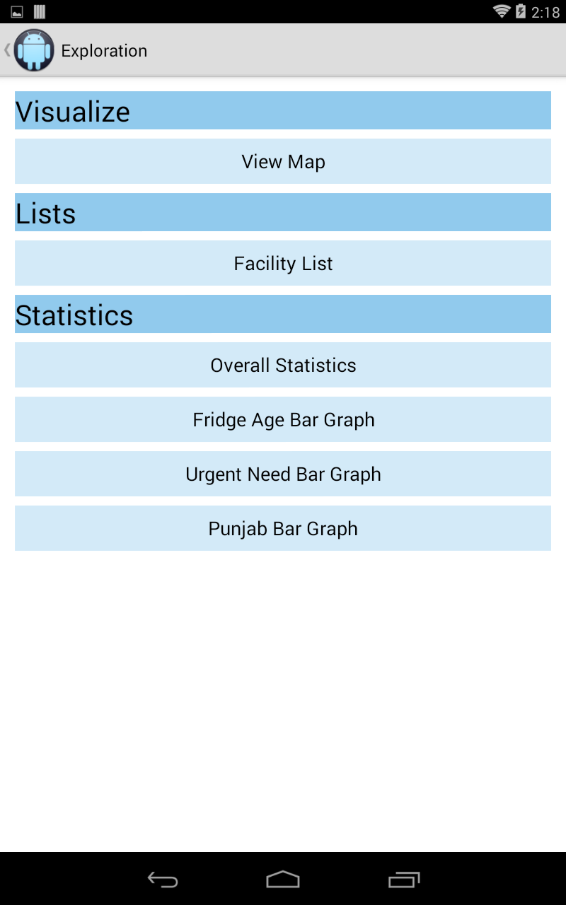
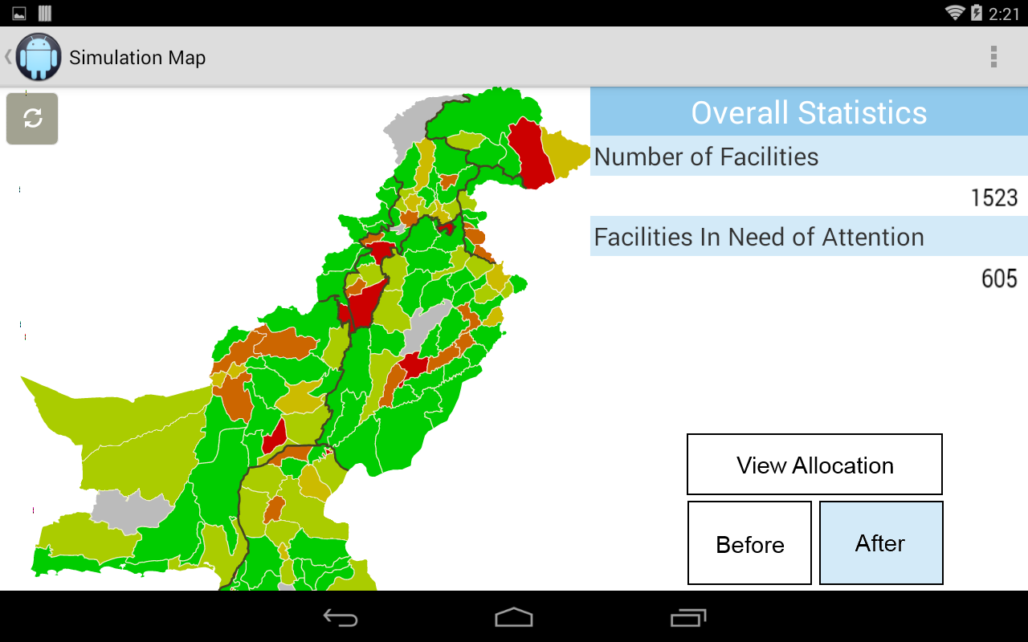
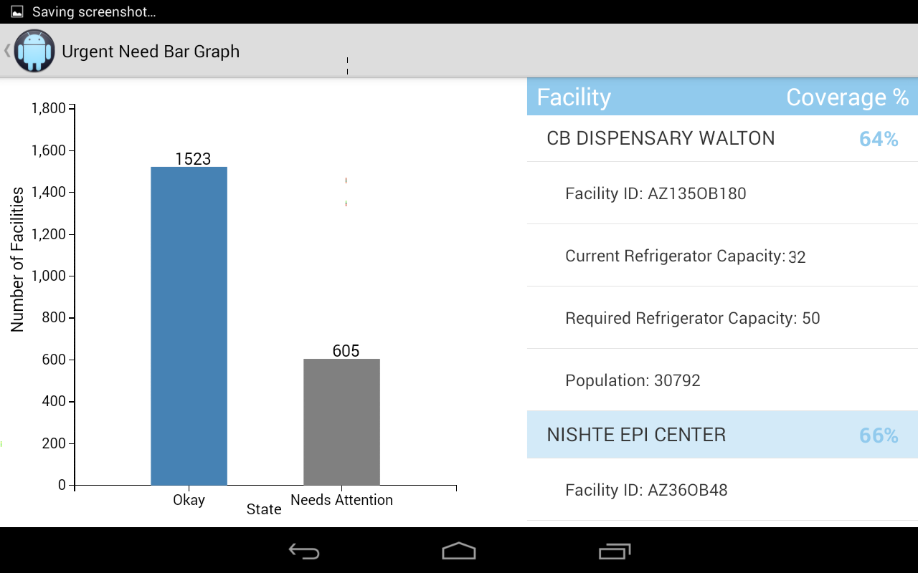
CSE481K – Spring 2014
Designing Technology for Resource-Constrained Environments
icePAK
Jennifer Apacible ⋅ Brian Donohue ⋅ Austin Hedeen ⋅ Daniel Luna ⋅ Dov Shlachter
Problem
Over 3 million vaccine preventable deaths worldwide, mostly children
Vaccines require complex national chains of refrigeration facilities
Inability to properly store vaccines can impact distribution
Underserved regions have low visibility
Current Approach: Microsoft Access
Pros
  Widespread access to excel
  Easy to compile data
Cons
  No visualization ☹
  No exploration functionality
  Prone to human error
Solution
Mobile app
Visualize data
Make data easy to consume for the user
Highlight problem regions
Easy to update data
Make recommendations on resource use
Architecture
Allocation Simulation
Data Exploration
Timeline: Weeks 1–5: Introduction to domain, prototyping; Weeks 6–10: Feature development
http://www.cs.washington.edu/education/courses/cse481k/14sp ⋅ https://github.com/japacible/DashTricks-Pakistan

