Slide 1
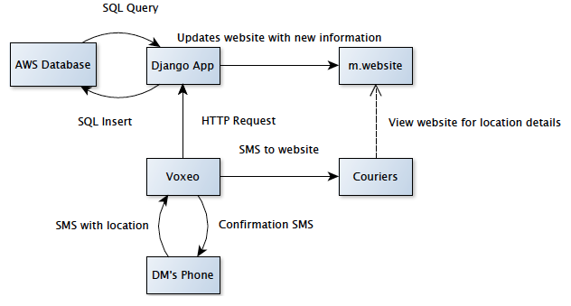
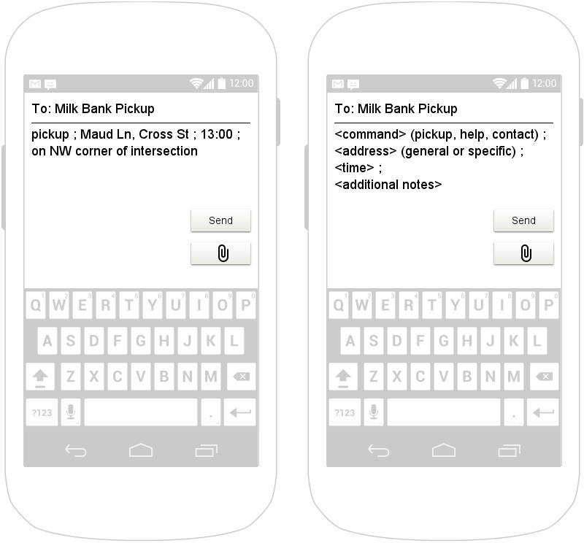
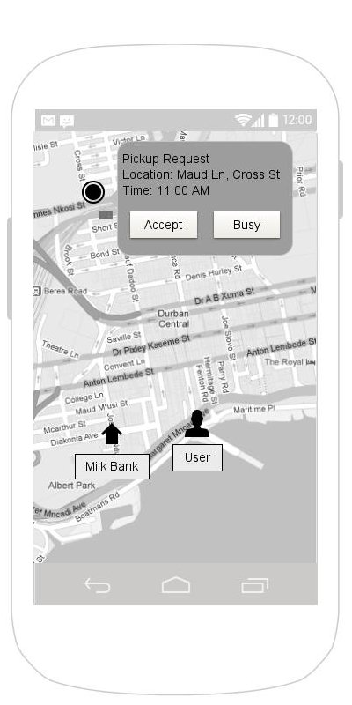
Milk Bank Dispatch
CSE481K/HCDE 496 Winter 2013: Designing Technology for Resource Constrained Environments
Jennifer Apacible // Emily Chien
Jim Maddock // Mihir Shah
Solution Idea
Problem
A low cost dispatch app. Donors simply send an sms, include time and location, and the app dispatches the closest available courier.
Donor mothers may request pickups at odd times, often with minimal notice. Sometimes, more than one courier goes for a specific pick up because of the lack of communication. After picking up the milk, couriers sometimes don’t know which milk bank to bring the milk to.
Our goals are to make the couriers’ job easier as well as standardize the process of contact.
Field Work
Related Work
Rohit Chaudhri – grad student working on Milk Banking
PATH – Seattle NGO
Human Milk Banking Assoc. of South Africa, Durban
Taxi Apps - Dispatch! (best), TaxiCentral
Mass coordination - RapidSMS, Comtekk
Emergency Responder - Amerilert First Responder
Architecture
Prototype
Future Work
Coding
Week 1-2: Voxeo
Week 2-5: Django
Week 6: Testing Voxeo and Django
Week 7: Database
Week 8: Testing all
Week 9-10: Improvements
Research + Design
Week 1-2: investigate proposed design concepts
Week 3-4: wireframes and mockups
Week 5-6: user testing and redesign
Week 7-8: tesing all
Week 9-10 further improvments
Misc
Research into implementation in South Africa (ongoing)
Discussions with PATH and Durban (ongoing)
www.cs.washington.edu/education/courses/cse490d/13wi

