Slide 1
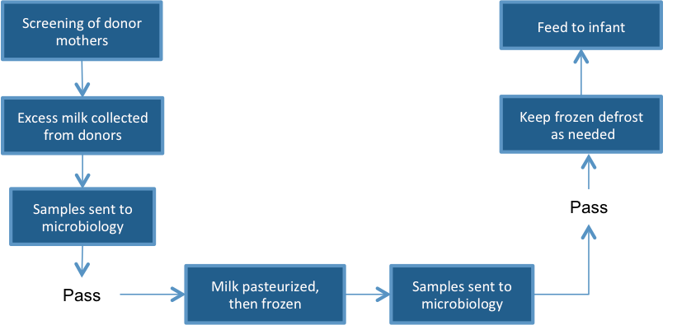
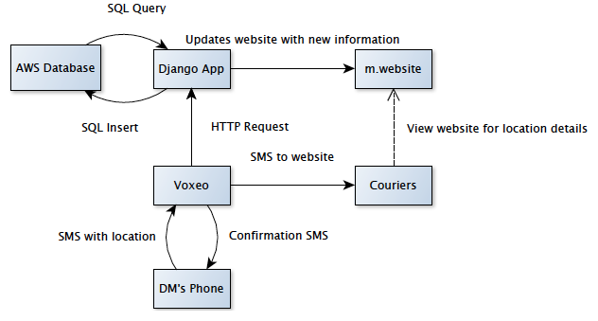

Milk Bank Dispatch
Jennifer Apacible (CSE), Emily Chien (CSE), Jim Maddock (HCDE), Mihir Shah (HCDE)
Solution Idea
(use diagrams,
photos, etc.
to describe your
project)
Problem
Related Work
(what did you learn
about what others
have done)
Field Work
CSE Grad student Rohit
Seattle based NGO PATH
Human Milk Banking Association
of South Africa in Durban
Architecture and Prototype

