Slide 1
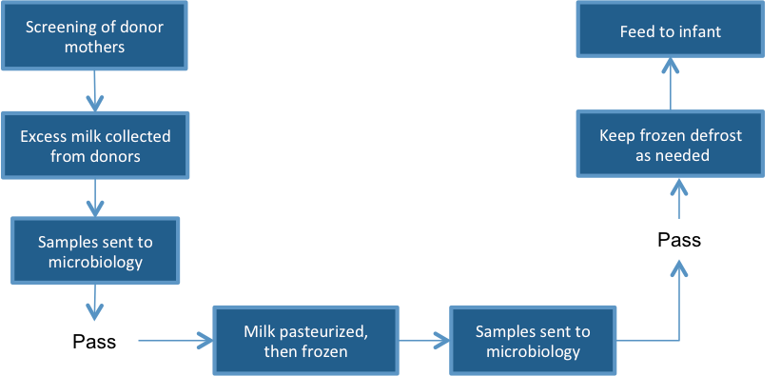
Dispatch
Jennifer Apacible (CSE), Emily Chien (CSE), Jim Maddock (HCDE), Mihir Shah (HCDE)

Slide 2
Problem Space
Couriers at the milk bank (MB) must drop whatever they are doing once a donor notifies someone they have extra breast milk (BM)
Currently there is no organization for who gets dispatched
Our hope is that this will make the couriers job easier during pickup
We also hope it will standardize the way donors contact the MB
Dispatch

Slide 3
Project Description
Our project organizes the dispatching of couriers who collect the BM
Donor mothers (DMs) and couriers will use it for deliveries
DMs can have any phone that allows SMS
Couriers will have a smartphone with internet access
Hospital will use it to gather information
Dispatch

Slide 4
Related Work
Idea comes from Decentralized Human Milk Banking with ODK Sensors by Rohit Chaudri and Gaetano Borriello among others
Related Areas of Interest:
  Taxi dispatch apps: Dispatch! App for taxi drivers in the Google Play Store is the most comprehensive
  AceRoute, Amerilert First Responder (SMS), Comtekk, Digital-Dispatch, RapidSMS, TaskRabbit (Web & iOS), and TaxiCentral are other examples
Dispatch

Slide 5
Current Findings
We have been communicating with
  CSE Grad student Rohit
  Seattle based NGO PATH
  Human Milk Banking Association of South Africa in Durban
Lack of infrastructure seems to be a central roadblock to this specific problem. We are therefore:
  Investigating possibilities in Cape Town
  Designing for a general scenario
Dispatch

Slide 6
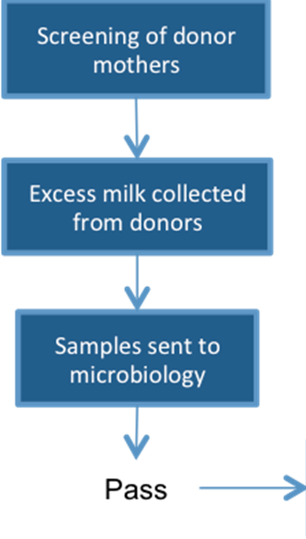
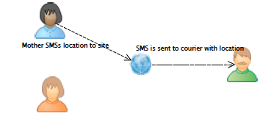
Basic Scenario
Dispatch
Notes:
TODO: Less technical

Slide 7
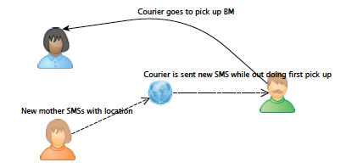
Basic Scenario cont.
Dispatch

Slide 8
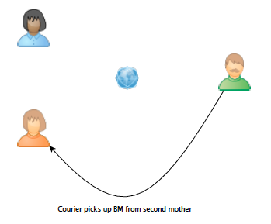
Basic Scenario cont.
Dispatch

Slide 9
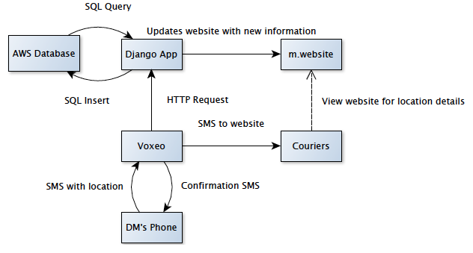
Architectural Diagram
Dispatch
Notes:
TODO:
-Figure out how Voxeo connects mother’s phone/android app/server

Slide 10
Design and evaluation
Things to take into account
  Privacy of DMs
  People who will be accessing any part of this
    Courier with an Android device
    DM with a generic phone
    Will there be an Overseer of the website
  Information storage should be central and not any one of the clients should take the burden in hosting it
  Information to be stored:
    DM information
    Courier information (availabilities)
    Milk pick up / drop off points
    All transactions
Dispatch

