Slide 1
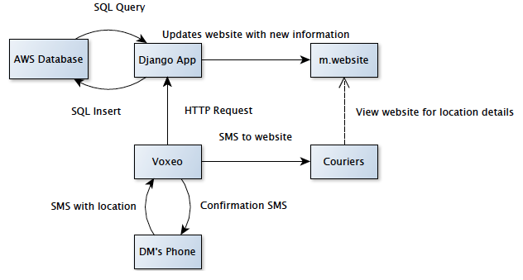
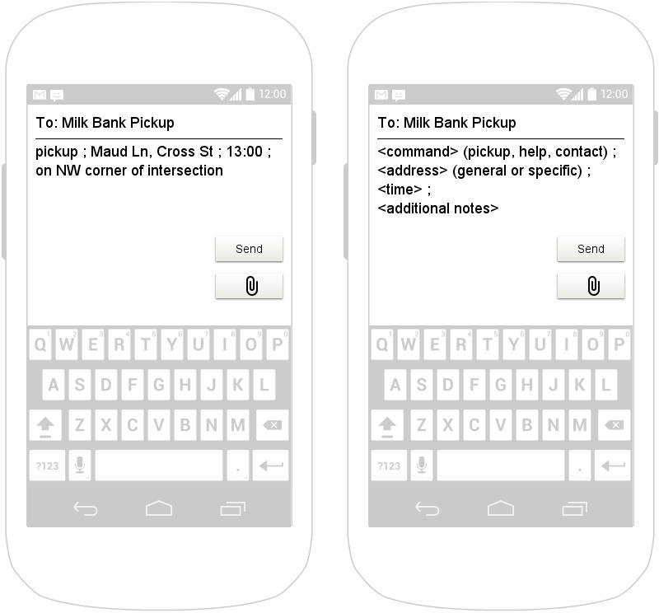
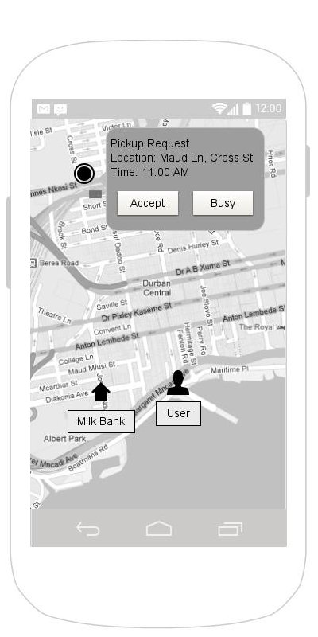
Milk Bank Dispatch
CSE481K/HCDE 496 Winter 2013: Designing Technology for Resource Constrained Environments
Jennifer Apacible // Emily Chien
Jim Maddock // Mihir Shah
[Tagline here, something about communication?]
Problem
Solution Idea
Donor mothers may request pickups at odd times, often with minimal notice. Sometimes, more than one courier goes for a specific pick up because of the lack of communication. After picking up the milk, couriers sometimes don’t know which milk bank to bring the milk to.
Our goals are to make the couriers’ job easier as well as standardize the process of contact.
STUFF HERE
Related Work
Field Work
Taxi Apps
-Dispatch!
-TaxiCentral
Emergency Responder Apps
-Amerilert First Responder
Rohit Chaudhri
PATH
Human Milk Banking Assoc. of South Africa, Durban
Architecture
Prototype
Future Work
TIMELINE HERE …. Emily/Jim can probably do this
www.cs.washington.edu/education/courses/cse490d/13wi

