Slide 1
Dispatch Application
Jennifer Apacible (CSE) | Emily Chien (CSE)
Jim Maddock (HCDE) | Mihir Shah (HCDE)

Slide 2
Problem Space
Donor mothers (DMs) request pickups at odd times & often with minimal notice
Sometimes, more than one courier at a time goes for a specific pickup
Couriers sometimes don’t know which milk bank (MB) to bring the breast milk (BM)
Two Goals:
  Make the couriers’ job easier during pickup
  Standardize process DMs contact MB

Slide 3
Project Description
Organizes dispatching of couriers who collect BM
Used by DMs and couriers for deliveries
Preconditions:
  DMs have a phone with SMS capabilities
  Couriers have a smartphone with internet access
Hospitals gather information

Slide 4
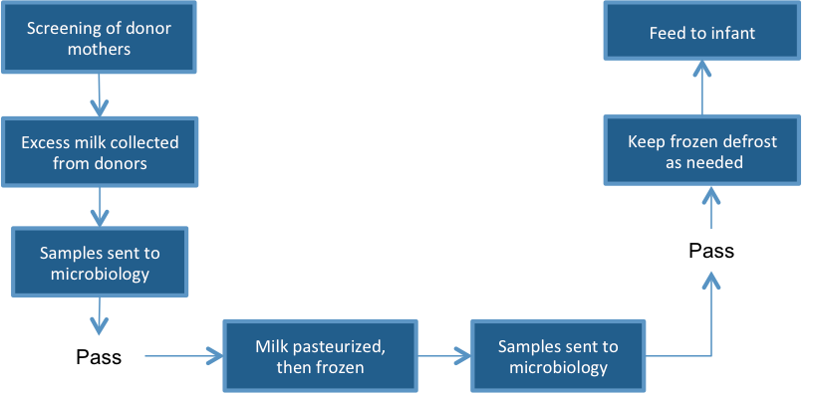
Current Workflow

Slide 5
Related Work
Decentralized Human Milk Banking with ODK Sensors
  Rohit Chaudri, Gaetano Borriello, et al
Related areas of interest:
  Taxi dispatch apps: Dispatch! (Android)
  AceRoute, Amerilert First Responder (SMS), Comtekk, Digital-Dispatch, RapidSMS, TaskRabbit (Web & iOS), TaxiCentral

Slide 6
Current Findings
Communication
  Rohit: CSE grad student
  PATH: Seattle based non-governmental organization
  Human Milk Banking Association of South Africa in Durban
Central roadblock: Lack of infrastructure
Currently…
  Investigating possibilities in Cape Town
  Designing for a general scenario

Slide 7
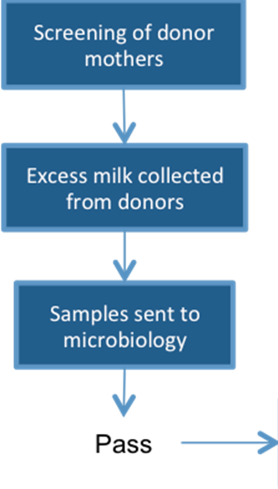
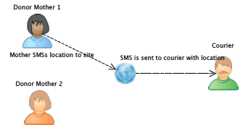
Basic Scenario
Notes:
Of the big workflow diagram, our work applies to just this one spot. A basic scenario goes as follows: One DM SMSs a number we’ve set aside to receive pickup notifications. Our system will decide which courier it thinks is best suited for the time requested by the DM and the courier will then receive a text linking to our website which displays where the DM is. The courier can then decide if that time/location works.

Slide 8
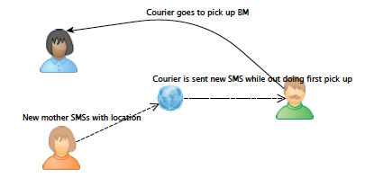
Basic Scenario
Notes:
The courier can then head out for pickup and if they receive another request while out, they can head to the new DM location afterwards.

Slide 9
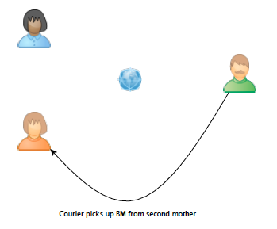
Basic Scenario

Slide 10
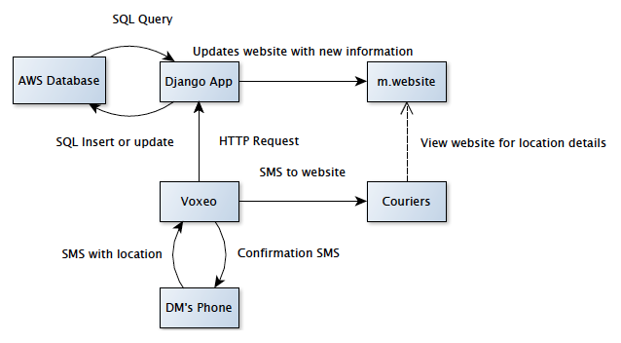
Architectural Diagram
Notes:
TODO:
-Figure out how Voxeo connects mother’s phone/android app/server

Slide 11
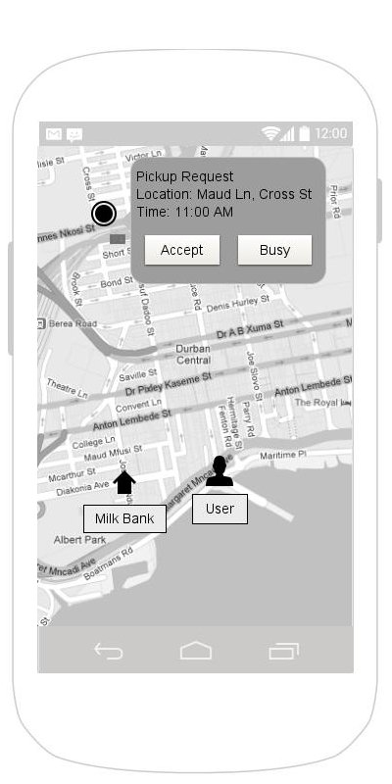
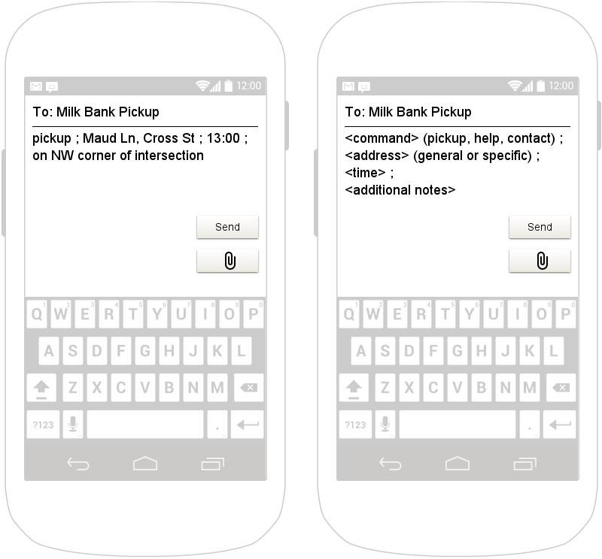
Mockups
Donator (non-android)
Courier

Slide 12
Design and Evaluation
Database
  Personal information, courier information, key locations, transactions
  Central; no client should be hosting it
  Privacy
Automation
Cross Platform
  Website
  Android

Slide 13
Next Steps and Project Plan
Further Research
  Explore Voxeo more with Nathan (as needed)
  Gather more information about the South African situation (ongoing)
  Find a free database
Coding
  Voxeo (20%)
  Django (70%)
  Database data entry (10%)
Interface Design
  Web app interface
  Native app interface

