Slide 1
Project Harmony
David Mailhot
Jennifer Apacible
Eve (Yi Zhao)
Eric Oltean

Slide 2
Overview
Problem & Solution
Contextual Inquiry
Task Analysis
Tasks
Design Sketches
Summary
Questions
Notes:
Question? Has anyone ever had embarrassed experience because of misinterpreting other’s attitude or emotion?

Slide 3


Problem & Solution
Problem
Solution
I wish I can figure out how to approach someone!
We’ll tell you!
Notes:
Problem: Social is important part for everyone. uncertain about others emotion, wonder if we reply properly during our social life, want to determine other’s moods accurately
Solution: use (built in sensors) google glass to help people know emotion better and improve their social performance

Slide 4
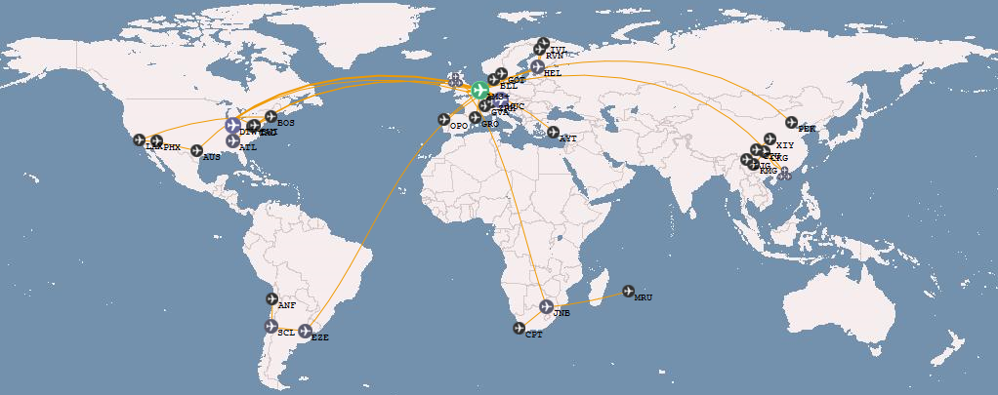

Contextual Inquiry: Customer Background
Tom
Faithful Father
Philip
Awkward Transplant
Anna
Boeing Engineer
International students and researchers
Notes:
Diversity: age, personality, high education, culture
Age: 20s – 40s
Character: Social & Shy
Occupation
Engineering students
Researchers
Software Engineers
Cultural Background
Washington natives
Washington transplant
International

Slide 5

Contextual Inquiry: Questions as the Apprentice
Can you show us how you decide whom to ask directions from this group of people?
Can you describe how you perceive yourself socially?
Can you show us how you would reflect on that interaction?
Notes:
How do your acquire emotion information from others?
If they have ever had trouble in determine other’s emotion?
If yes, how does that happen? If no, why ?
Do you need assistance in analyzing other’s moods?
If yes, why and in which situation? If no, what do you need mostly through your social life

Slide 6

Contextual Inquiry: Observations
Large range of ability to determine moods of others
Self-consciousness is coupled with lack of confidence
Easily described scenarios, but hard to put into practice
Many want to learn how to improve their social skills
Notes:
0: Some people could determine moods easily
1 wanted help with recognizing unfamiliar mannerisms, reducing the frequency of being embarrassed or rejected by locals, and
identifying approachable people to talk to
2 worry about their unnoticeable improper reaction while talking could damaging the relationship between acquaintance, invoking hostility from strangers, further damage their-self-confidence, cause to avoid social iteration
---- From Result slide
Result:
Who: some people are less socially adept who are fear of rejection or embarrassment when meeting new people or ask for help.
Solution: find the most friendly people to avoid embarrassment
2 who: need become considerate other’s response and feelings,
Solution: correct their improper expression in real time
3 Who: improve their social performance and ability to read other people.
solution : need to learn from experience or reflection, tell them what they’ve done wrong or why they received negative response how to improve

Slide 7

Task Analysis: Customers
Those who want to improve social skills
Those unfamiliar with locals’ mannerisms
Those nervous in social & public situations

Slide 8
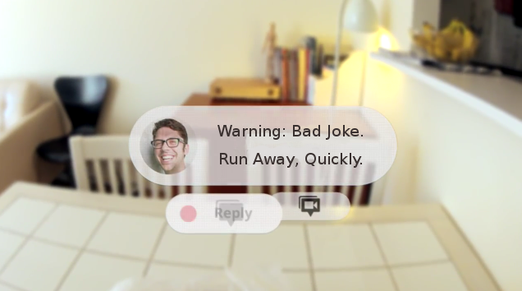
Task Analysis: Existing Tasks
Determine someone’s mood
Decide whom to talk to
Review interactions to learn from them

Slide 9

Task Analysis: Desired Task
How can we improve ourselves?
Take notes in real time on interactions to review later
Notes:
What customer do:
feedback, observing, identifying their mistakes, reflecting their performance
who:
Want to learn form mistake and adapt their social performance based on their experiences Solution:
let customers record notes of their social interactions so they can later review their performance and see what they did right or wrong. This task helps a customer improve their social performance starting from the moment a social situation begins.

Slide 10
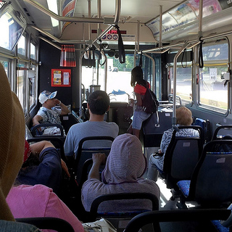
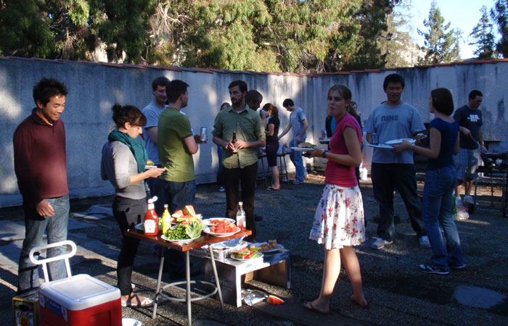
Simple Task
Before
After
Decide whom to sit next to on the bus
Find the friendliest person to approach

Slide 11
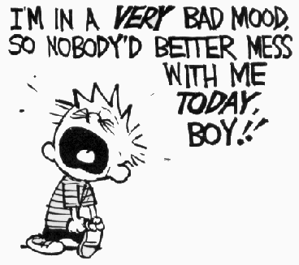
Moderate Task
Identify general feelings of another to oneself

Slide 12

Difficult Task
Teach someone how to react in social situations in real time

Slide 13
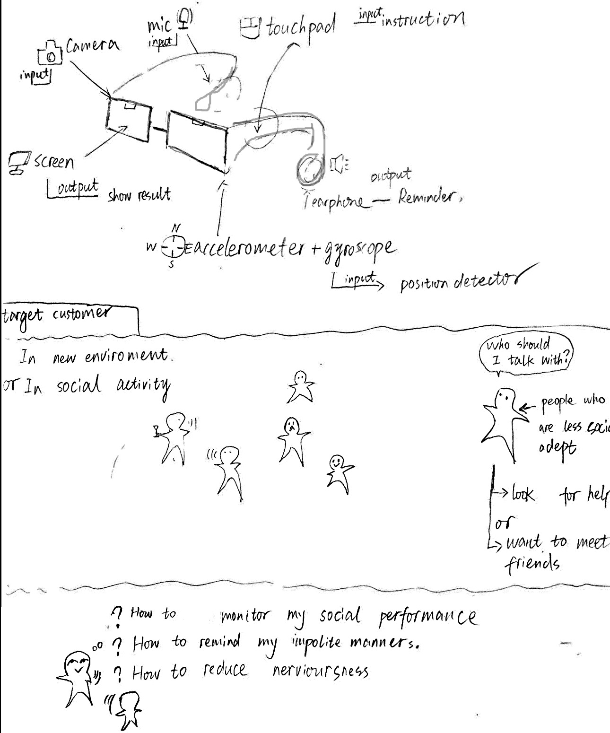

Slide 14
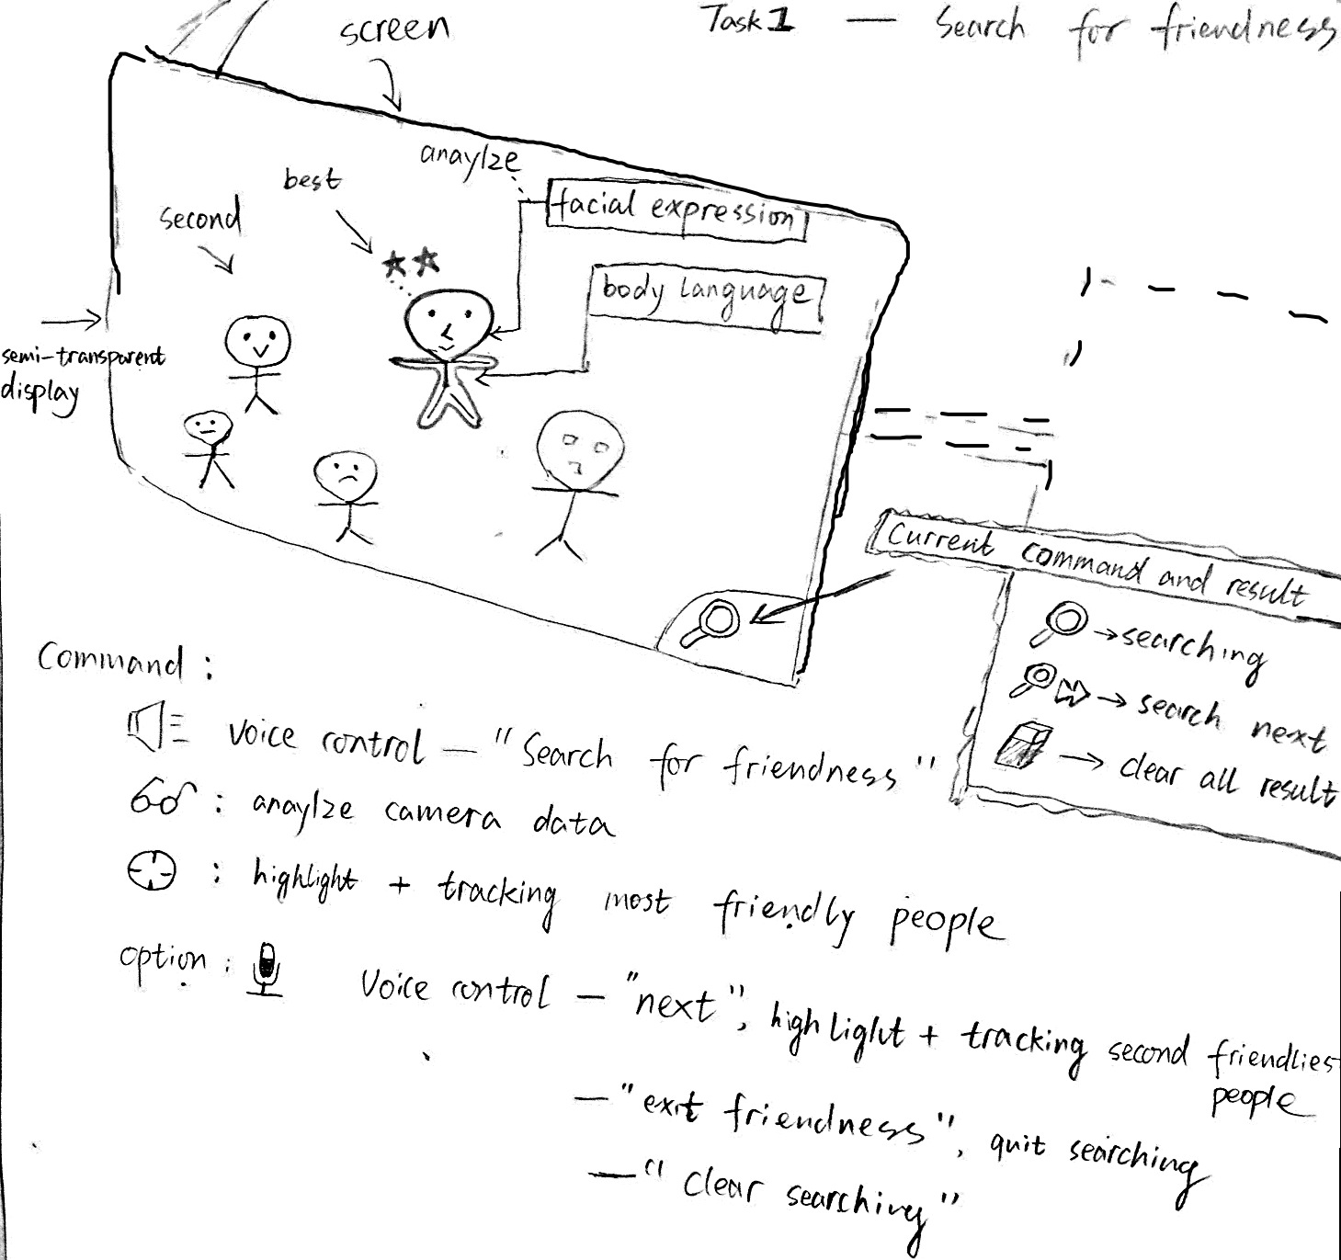

Slide 15
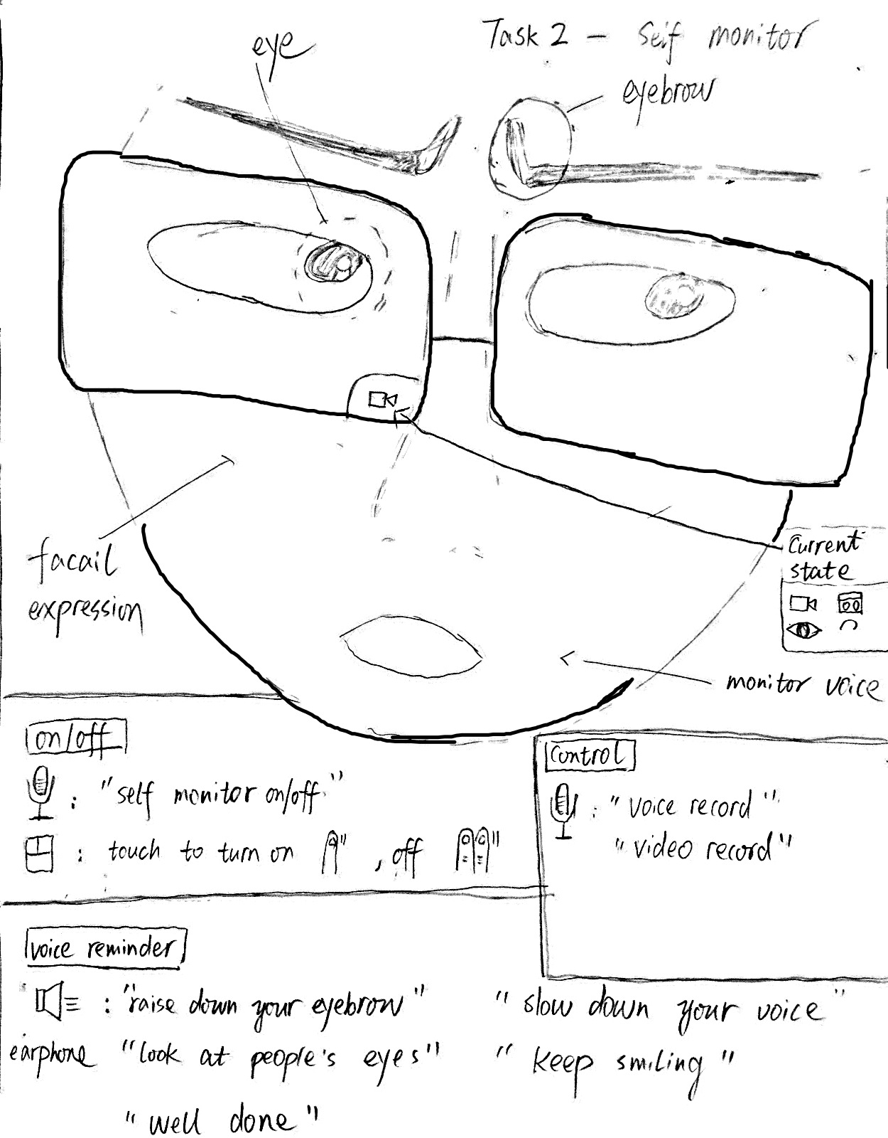

Slide 16
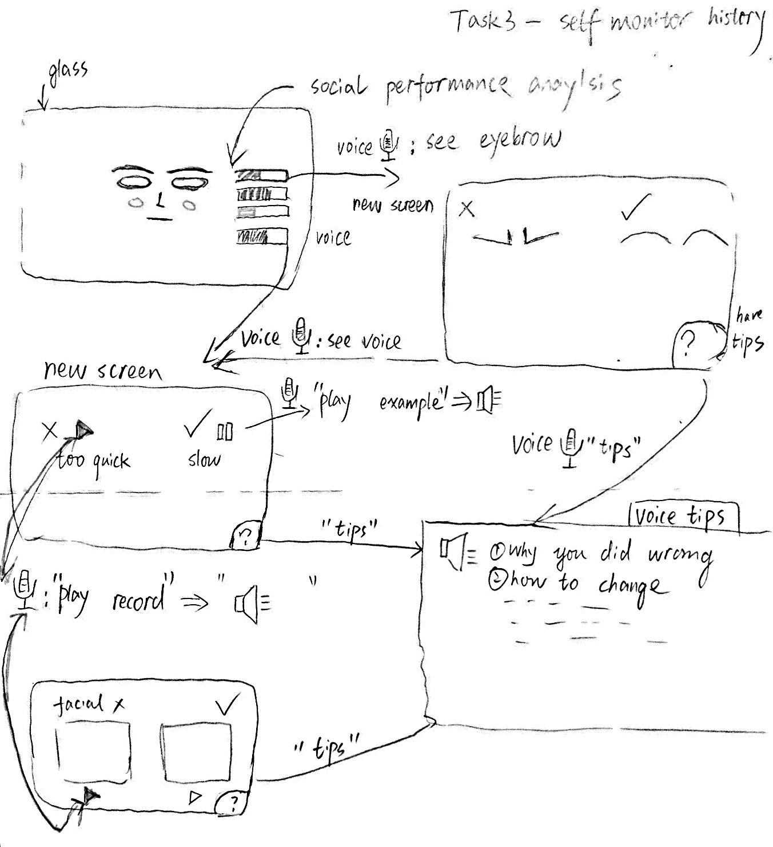

Slide 17
Summary
Determining how to appropriately interact with others can be difficult
Contextual Inquiry: Customers rely only on their inherent skills for social interactions
Task Analysis: Everyday interactions could be impacted by giving customers access to this extra information
Project Harmony will help customers gain confidence while learning to interact with others

Slide 18
Questions?

