Slide 1
React Harmony
ヾ( ＾ω＾)ノ ( ノω-、）(≧ロ≦)

Slide 2

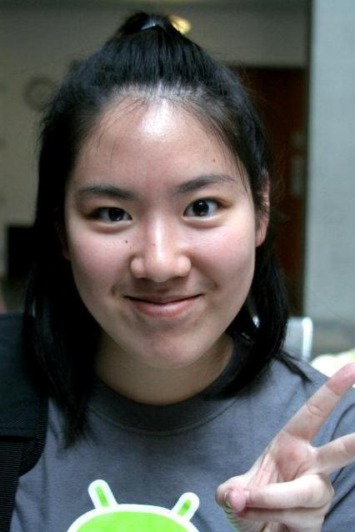
David Mailhot
Jennifer Apacible
Major: Computer Science
Interests: Adventuring, living life, being a real person
Major: Computer Science
Interests: Photography, cooking, running
Notes:
name, picture, major, outside interests

Slide 3

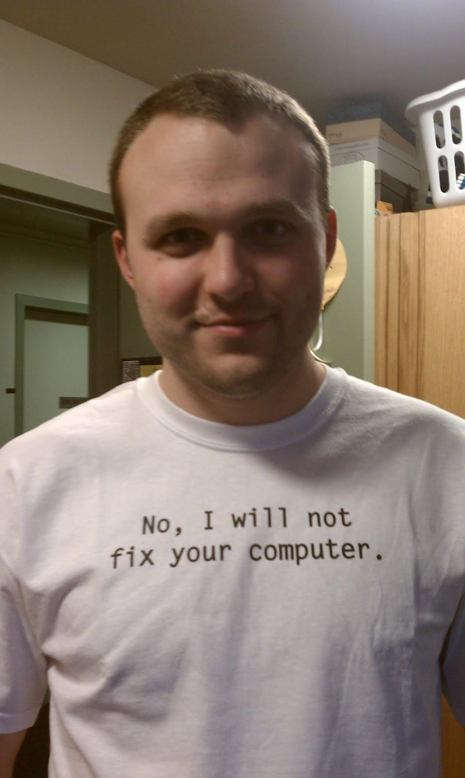
Eve (Yi Zhao)
Eric Oltean
Major: Electrical Engineering
Interests: Ubiquitous computing and RFID
Major: Informatics
Interests: Backpacking, rafting, downhill skiing
Notes:
name, picture, major, outside interests

Slide 4
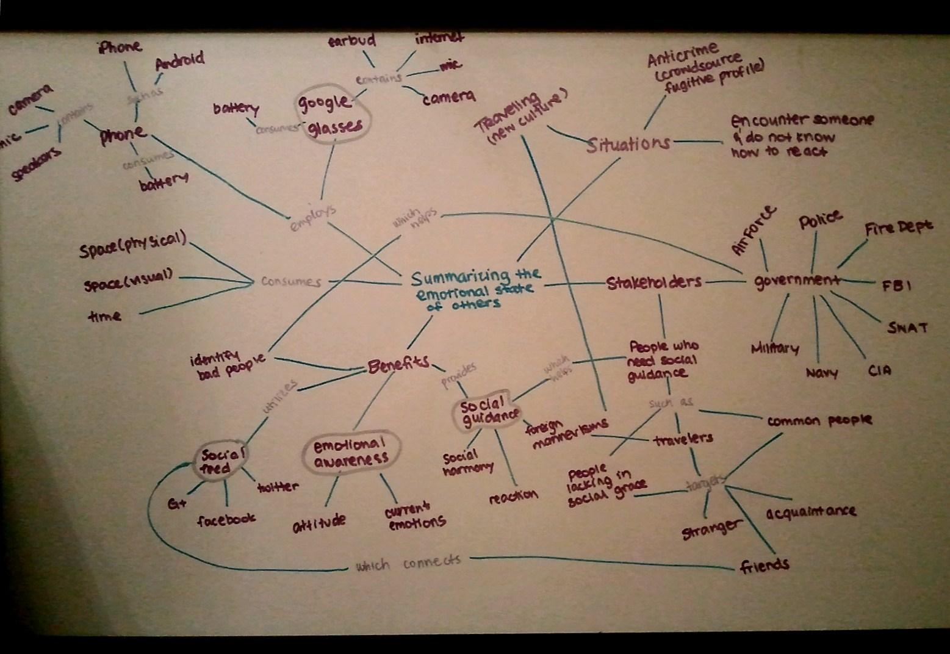
Concept Map

Slide 5
Top 4 Problems
Problem | Substantial | Feasible | Interested
Emotional Awareness | Y | ? | Y
Google Glasses | Y | ? | Y
Social Guidance | Y | N/? | Y
Social Feed | Y | Y | Y

Slide 6
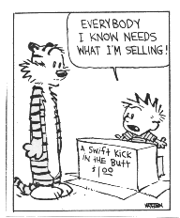
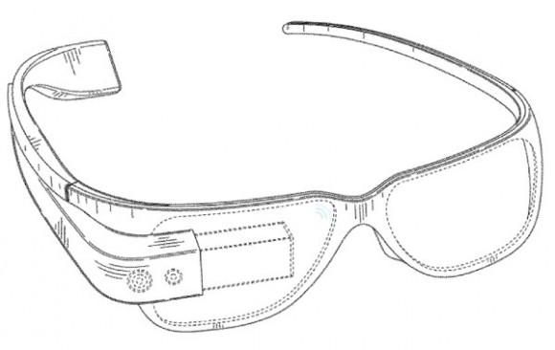
Top 4 Problems
Emotional Awareness
Users will be more aware of the emotions of people around them.
Google Glasses
Users will utilize a set of Google Glasses to aid their awareness of the states of people around them. The glasses will also project a display with information for users.

Slide 7
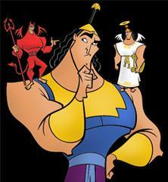
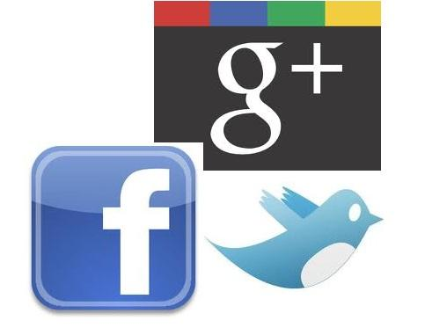
Top 4 Problems
Social Guidance
For users who are not confident in their social skills, we provide a "guidance" option for fast, on the go learning and instruction.
Social Feed
Users can check out the latest scoop about their connections on social networking platforms to quickly find a conversation starter ... or avoid a topic.

Slide 8
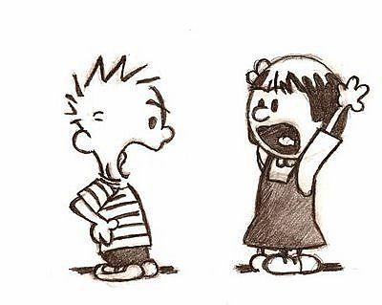
Top Problem: Emotional Awareness
Help people who are not able to interpret others’ feelings to avoid embarrassment and conflict
Solution: Emotion summarization based on voice and visual cues
Conflict

Slide 9

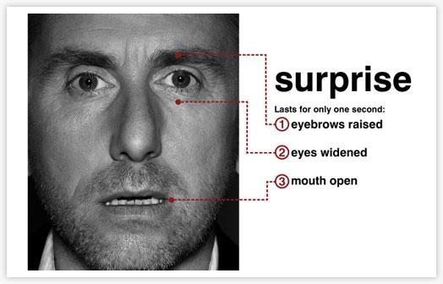
Top Problem: Reason
Even people have trouble interpreting emotions from expressions
Must visually analyze emotional status of others

Slide 10
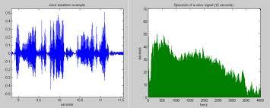
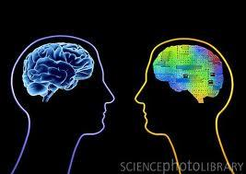
Top Problem: Reason
Must use voice frequency analysis to determine emotion
Must communicate emotion information through the Google Glasses device

Slide 11
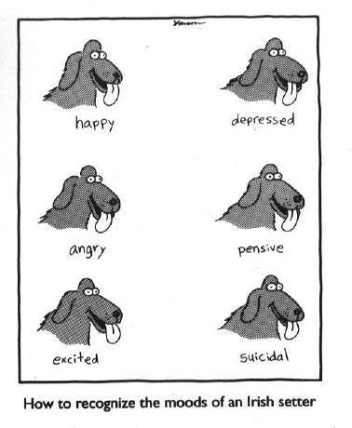
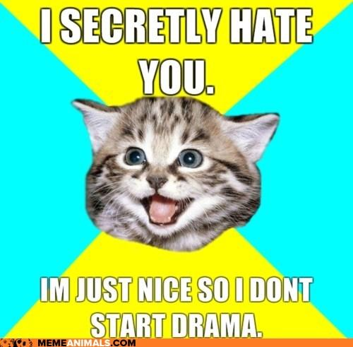
Top Problem: Significance
Recognizing emotions is hard!

Slide 12
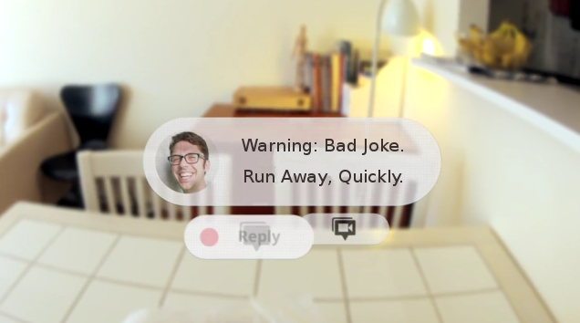

Top Problem: Significance
Emotional awareness can lead to positive social energy.

Slide 13
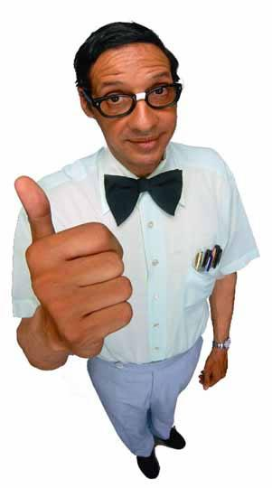
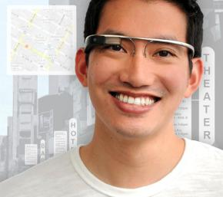
Top Problem: Stakeholders
People who need more emotional awareness.
People who would wear Google Glasses.

Slide 14
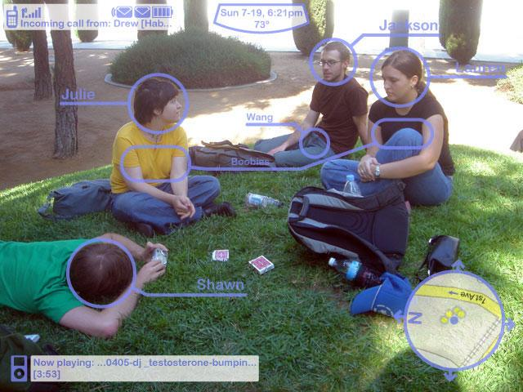
Top Problem: Stakeholders
People targeted to be emotionally analyzed.

Slide 15

Top Problem: Analysis - Precedents
Need to determine individuals’ emotions from their facial expressions
Need to determine the meaning of an individual’s body language
Need to understand an individual’s tone of voice

Slide 16
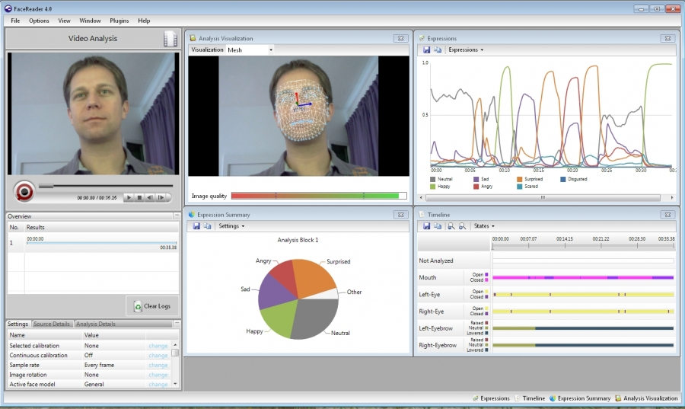
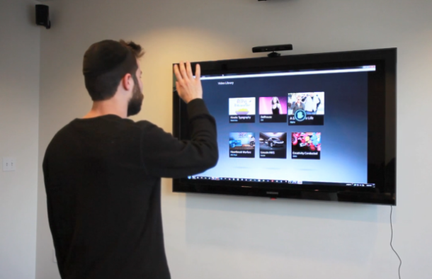
Top Problem: Analysis – Prior Work
FaceReader
Analyzes facial expressions
Microsoft Kinect
Analyzes body movements
Recognizes language

Slide 17
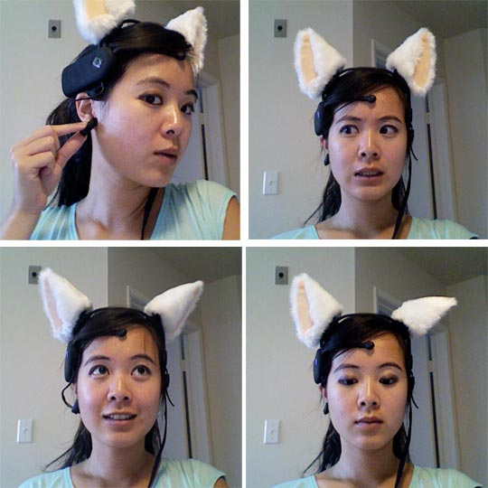
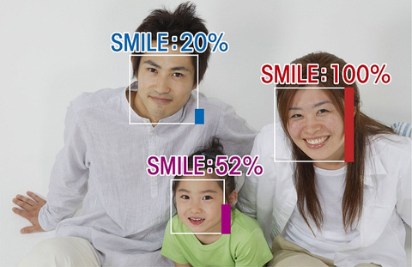
Top Problem: Analysis – Prior Work
Necomimi
Shows consumer’s mood via cat ears based on brainwaves
Sony’s Smile Shutter
Triggers picture taking when subject is smiling

Slide 18
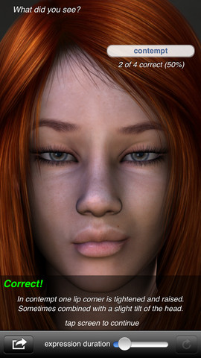
Top Problem: Analysis - Competition
Micro-expression trainer – iOS app
Helps improve facial emotion recognition skills
Modes to ‘train’
Time Attack Mode (time pressure)
Perfection Mode (accuracy)

Slide 19
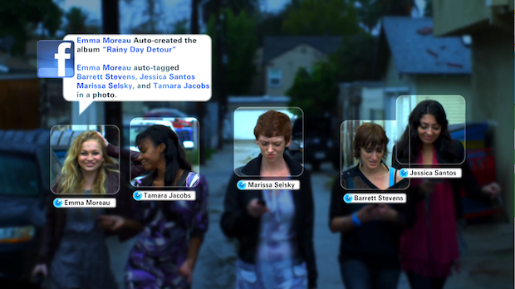
Top Problem: Analysis - Competition
Viewdle (Company)
Builds face, object, and gesture recognition for mobile devices
Just acquired by Motorola yesterday!

Slide 20
Questions?

