Slide 1
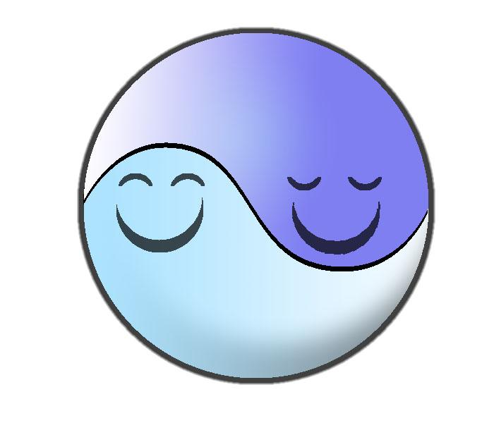
Project Harmony
Jennifer Apacible
David Mailhot
Eric Oltean
Eve Yi Zhao

Slide 2
Overview
Mission Statement
Representative Tasks
Prototype Structure
Three Task Scenarios
Experimental Method
Experimental Results
UI Improvements
Summary

Slide 3
Mission
Project Harmony seeks to empower people with the improvement of their social performance.

Slide 4
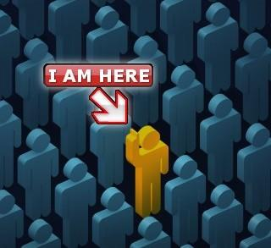
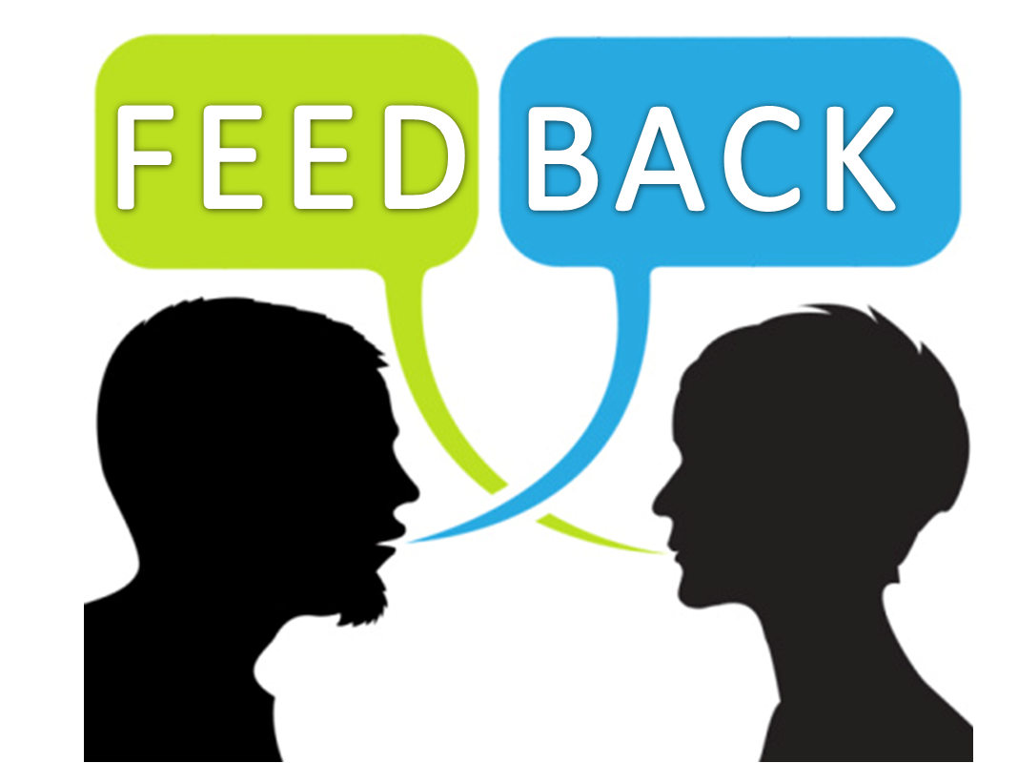
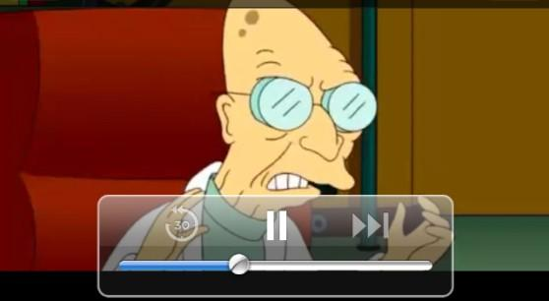
Task 1:
Find Friendly People
Task 2:
Real Time Feedback
Task 3:
Review Performance

Slide 5
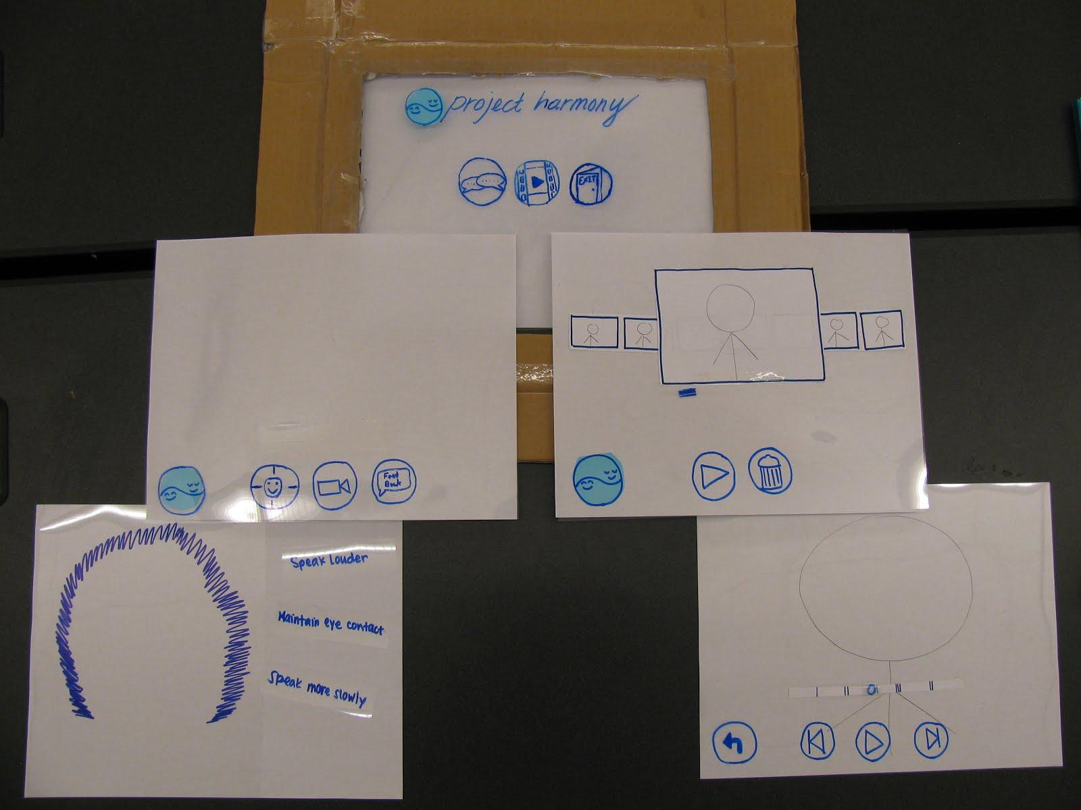
Prototype
Structure

Slide 6
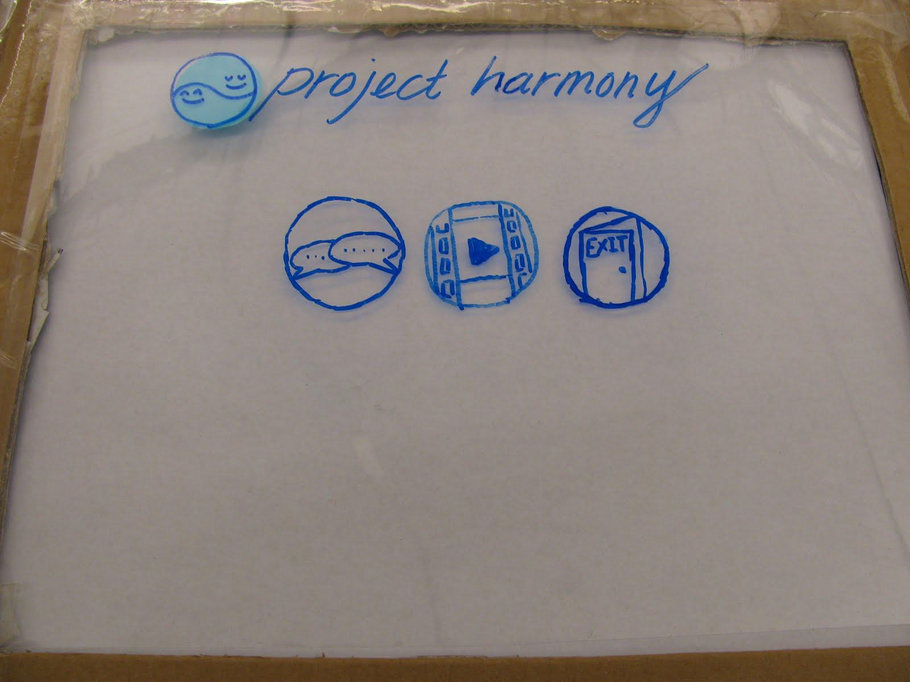
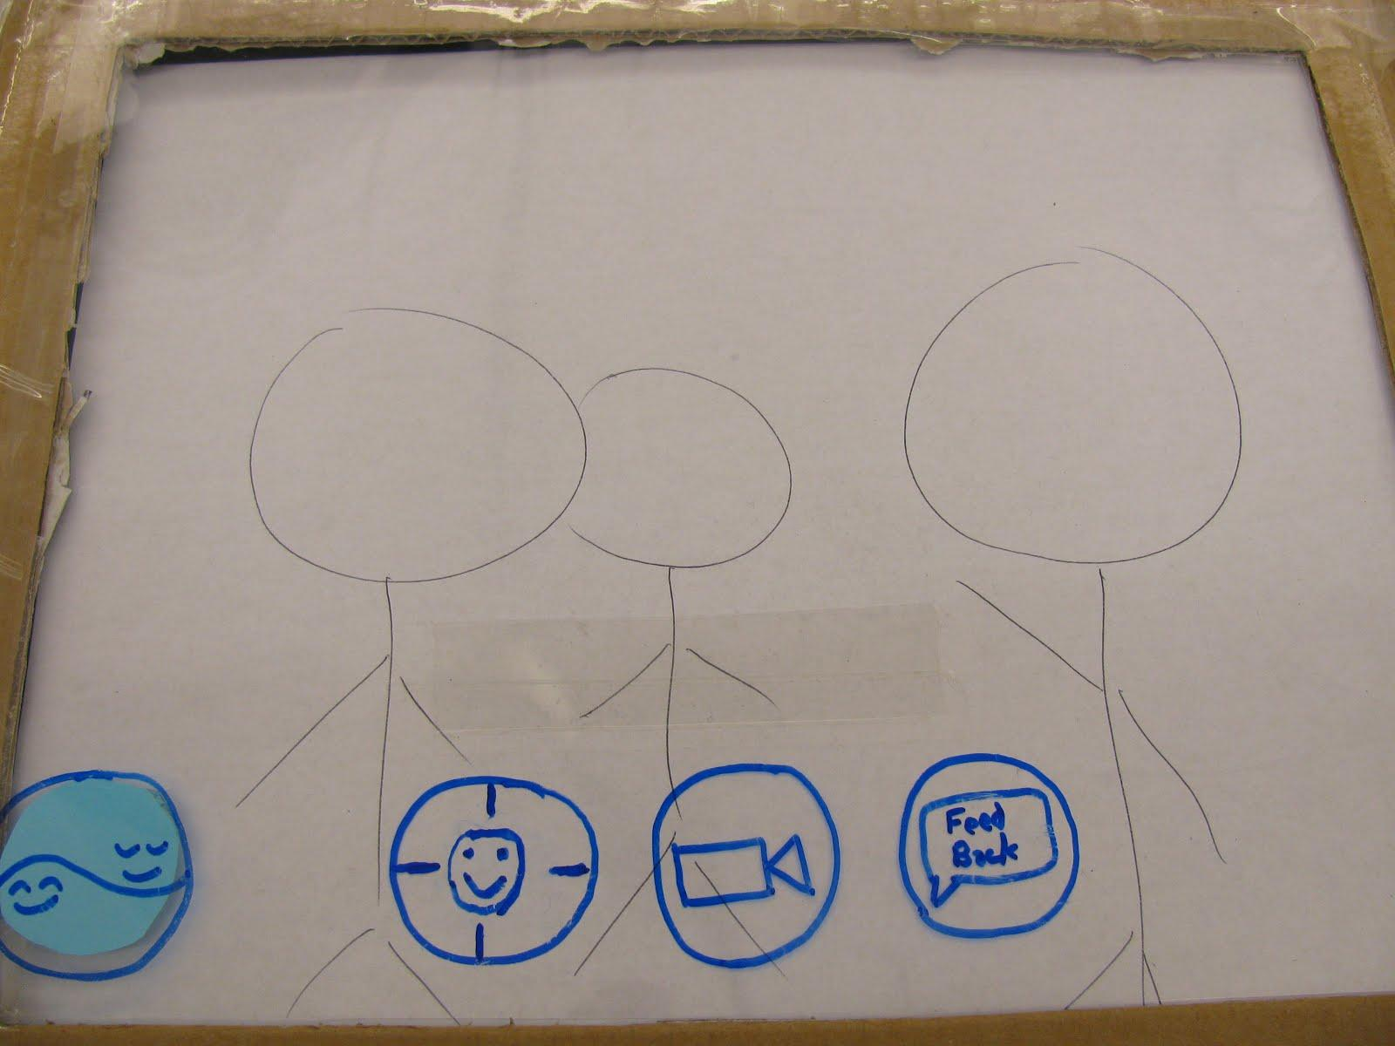
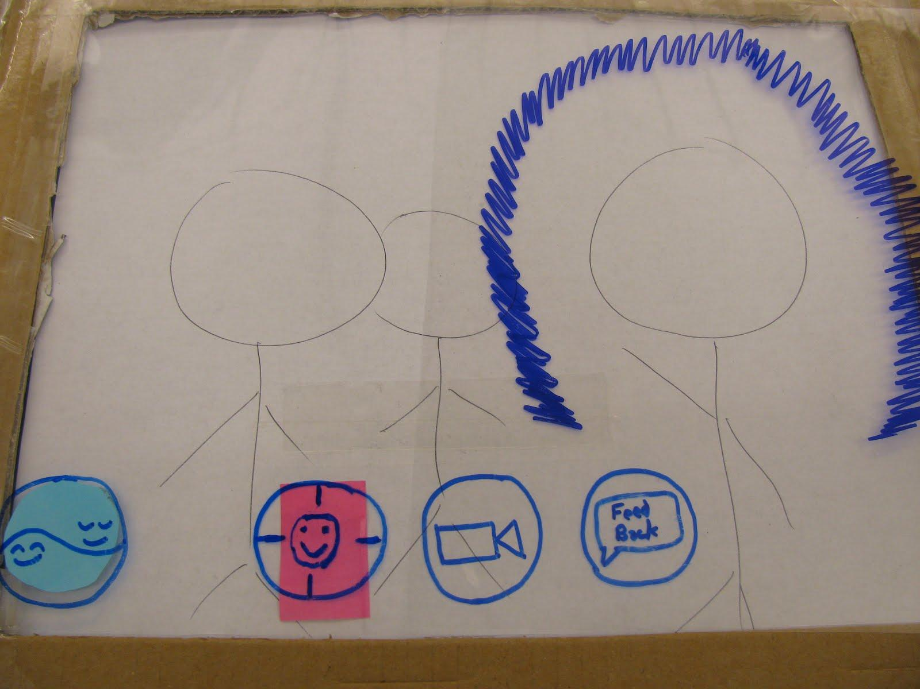
Task 1:
Find Friendly People

Slide 7
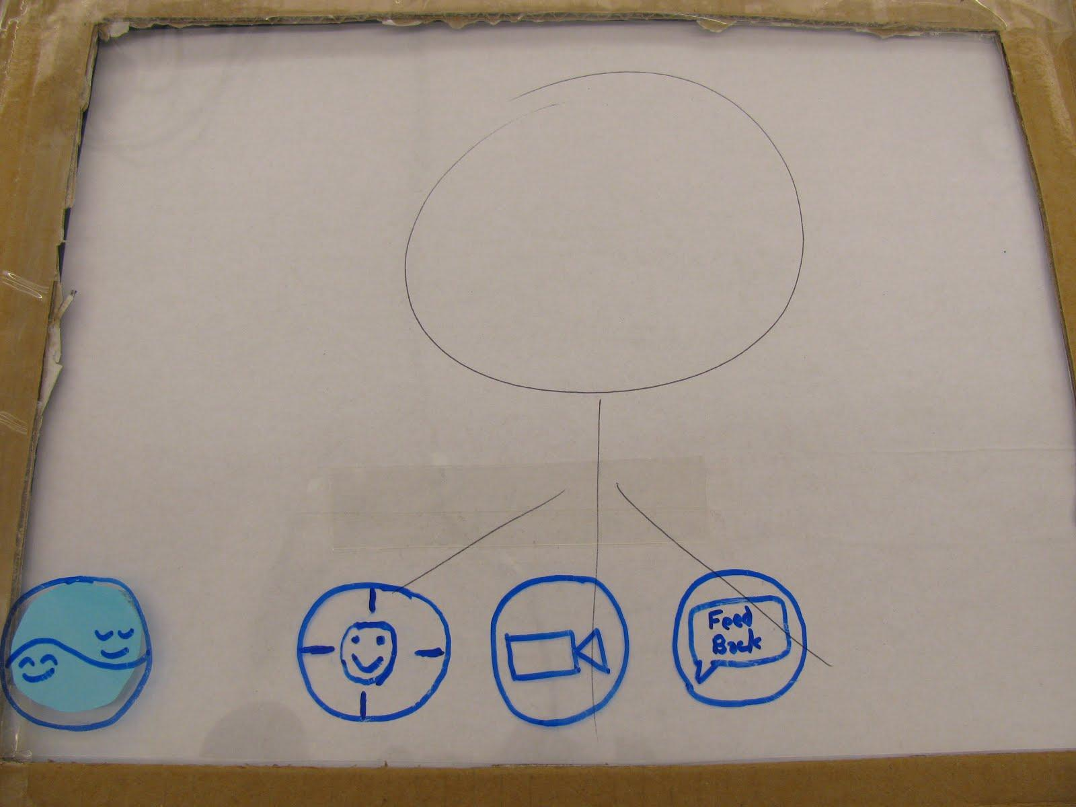
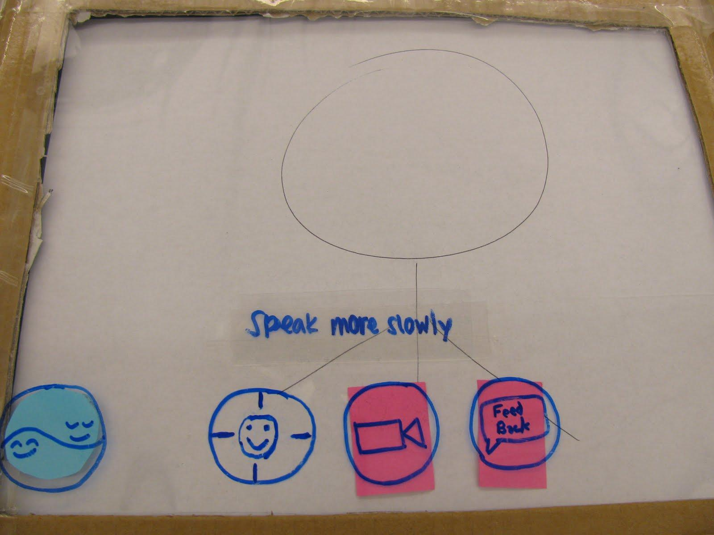
Task 2:
Real Time Feedback

Slide 8
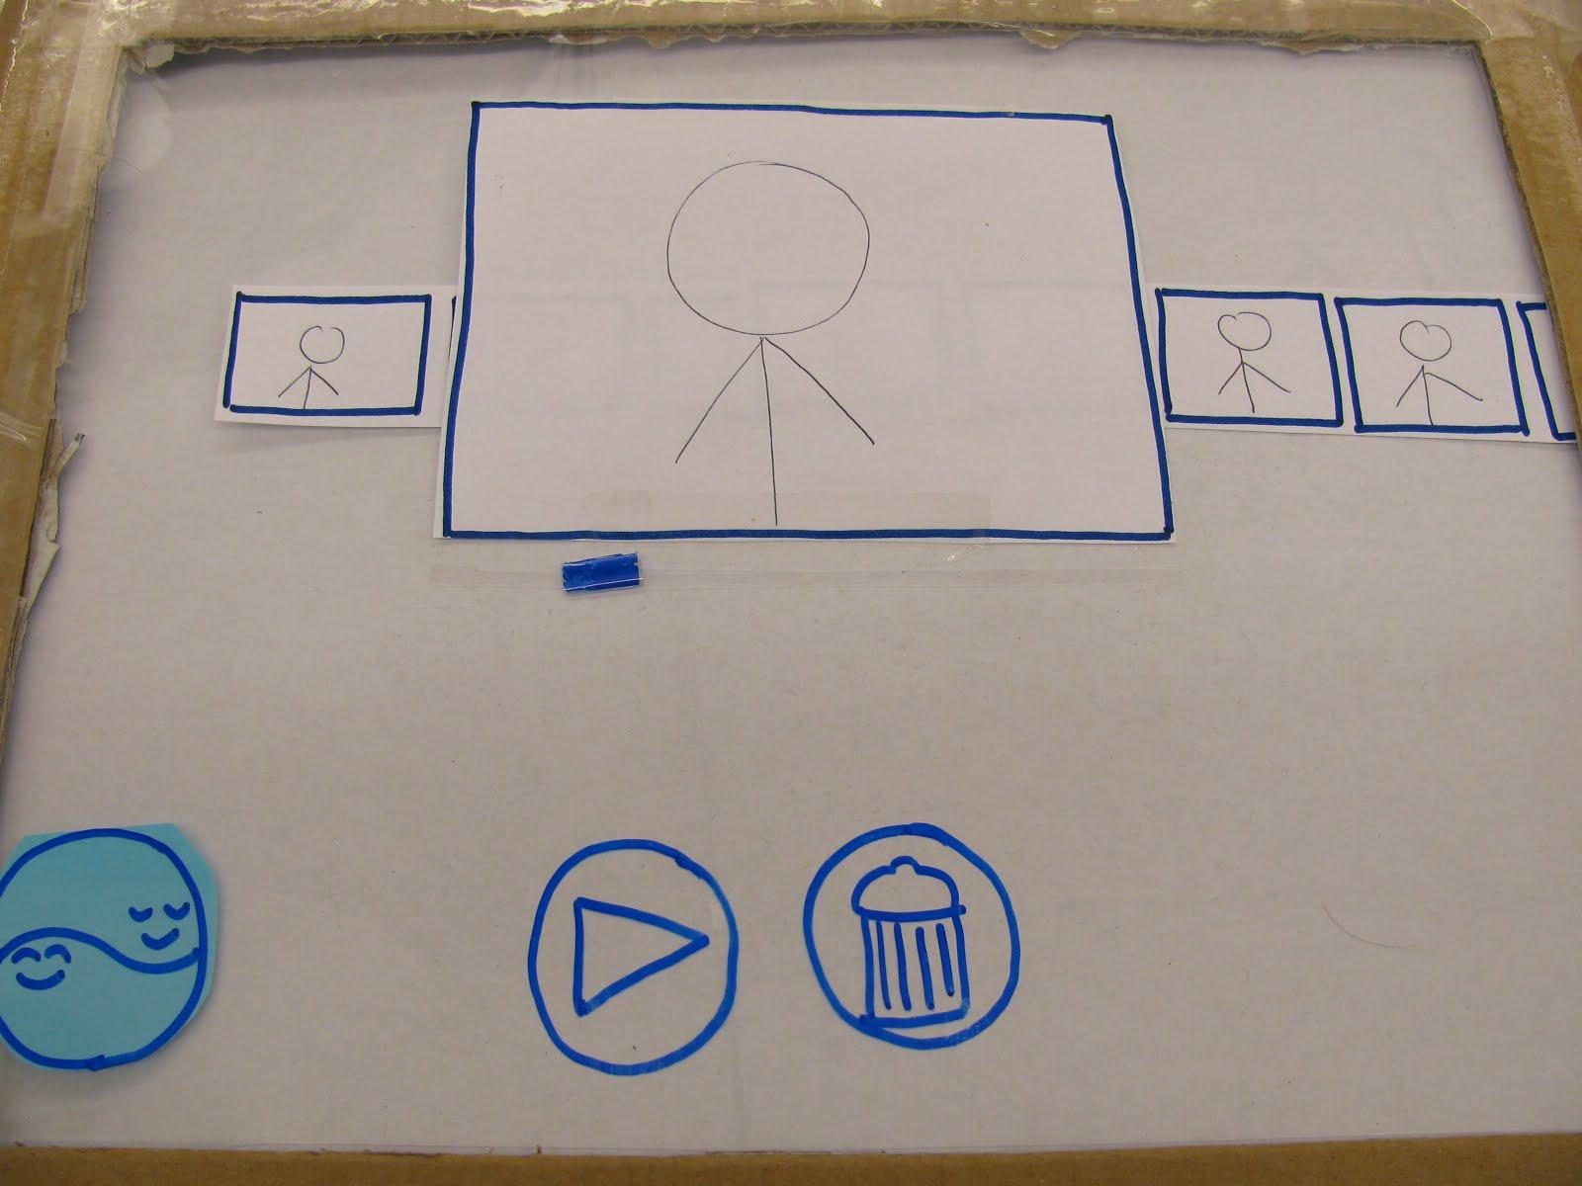
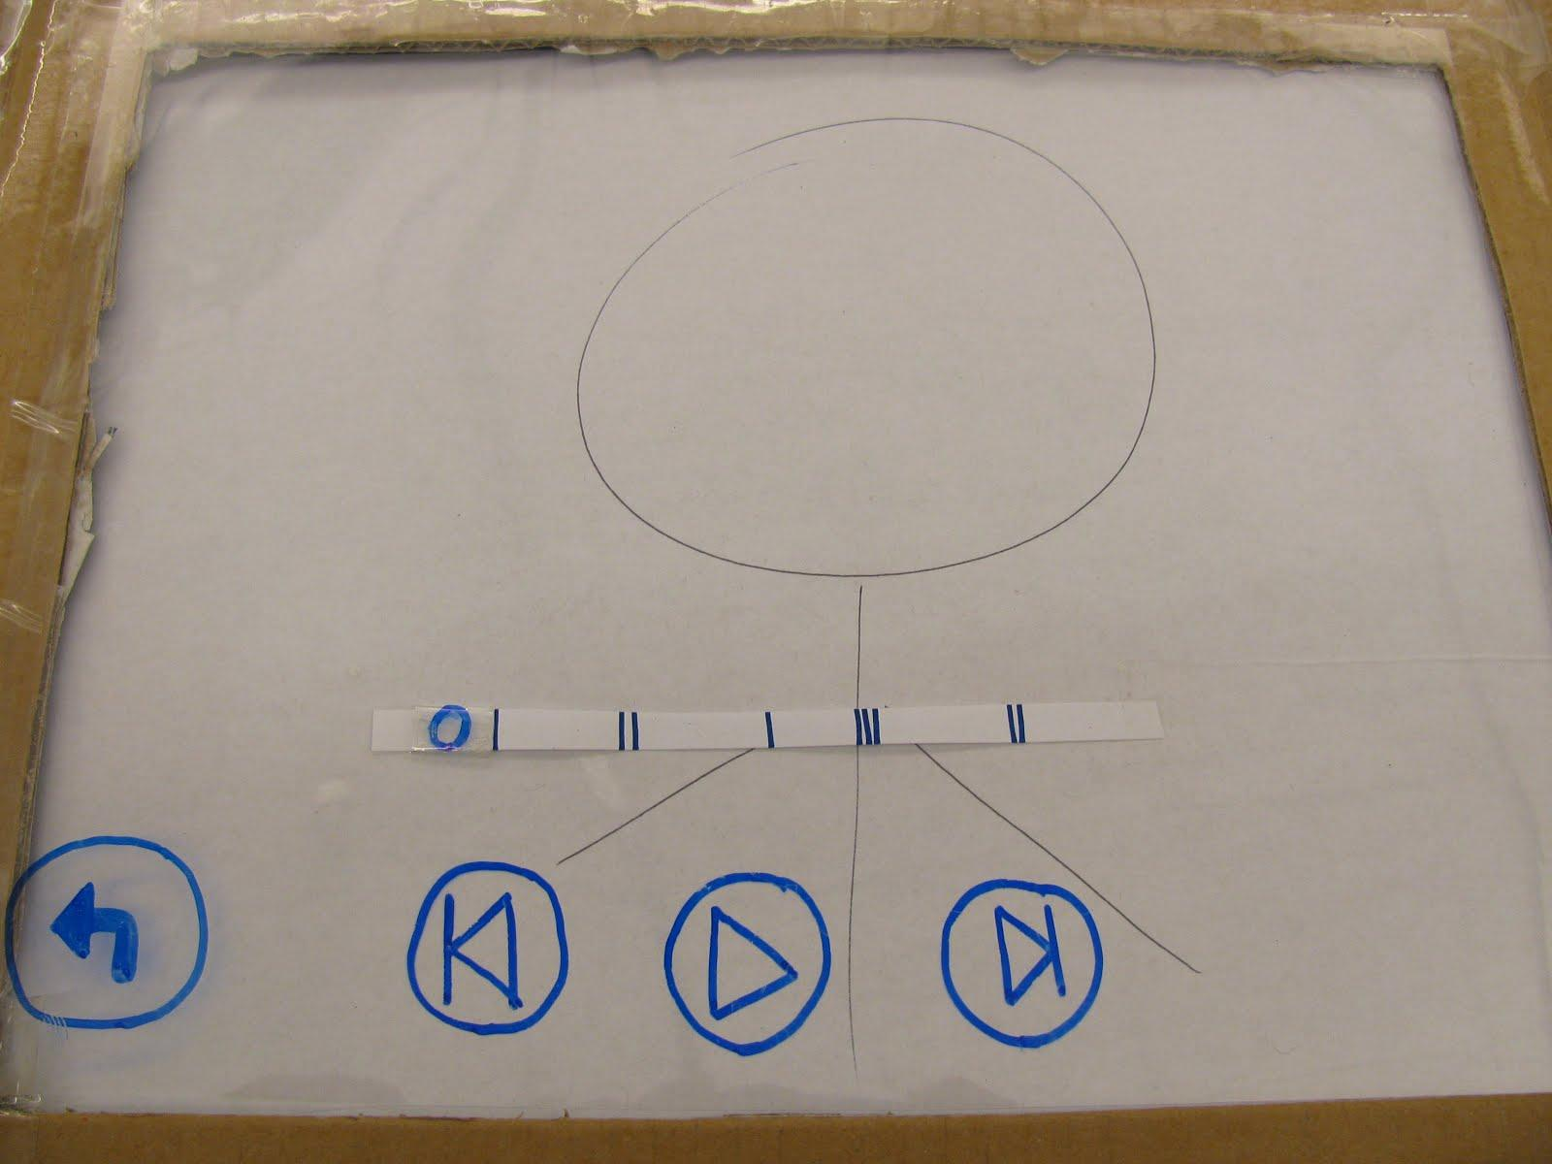
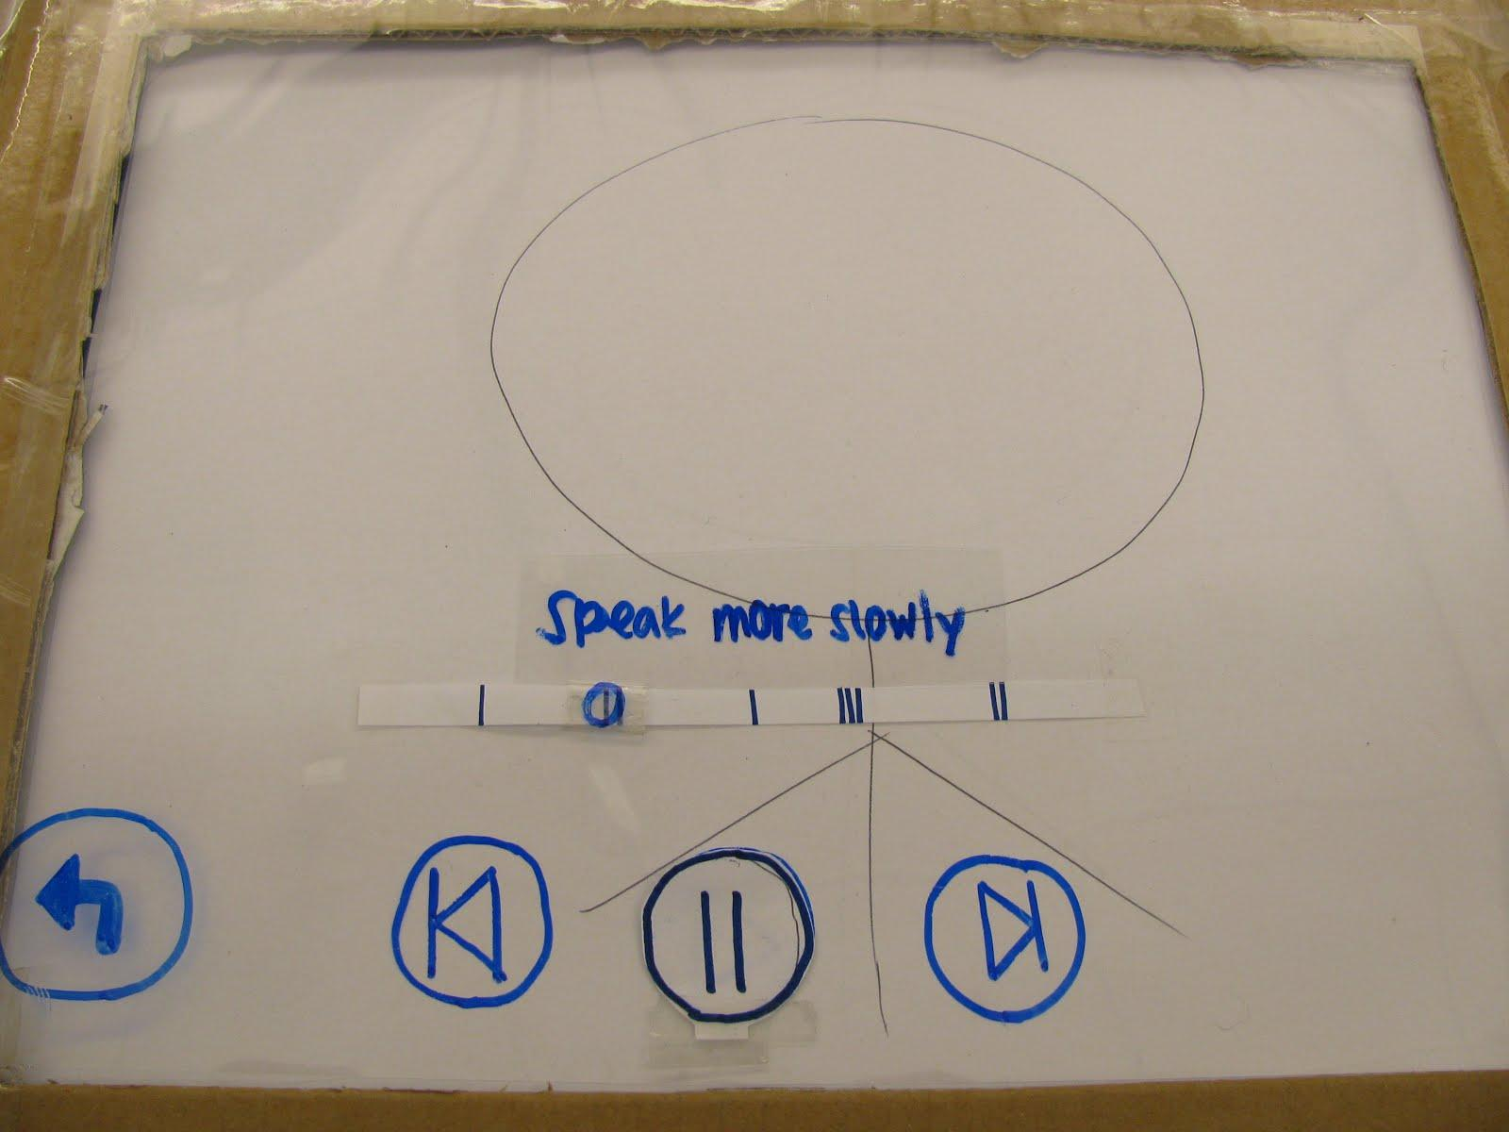
Task 3:
Review Performance

Slide 9
Method
Participants
Different levels of social comfort
Location
Public room, but without interruption
The Test
Demographic questionnaire
Actors simulated social encounters
Subjects directed to think out loud
Closing questions about UI experience

Slide 10
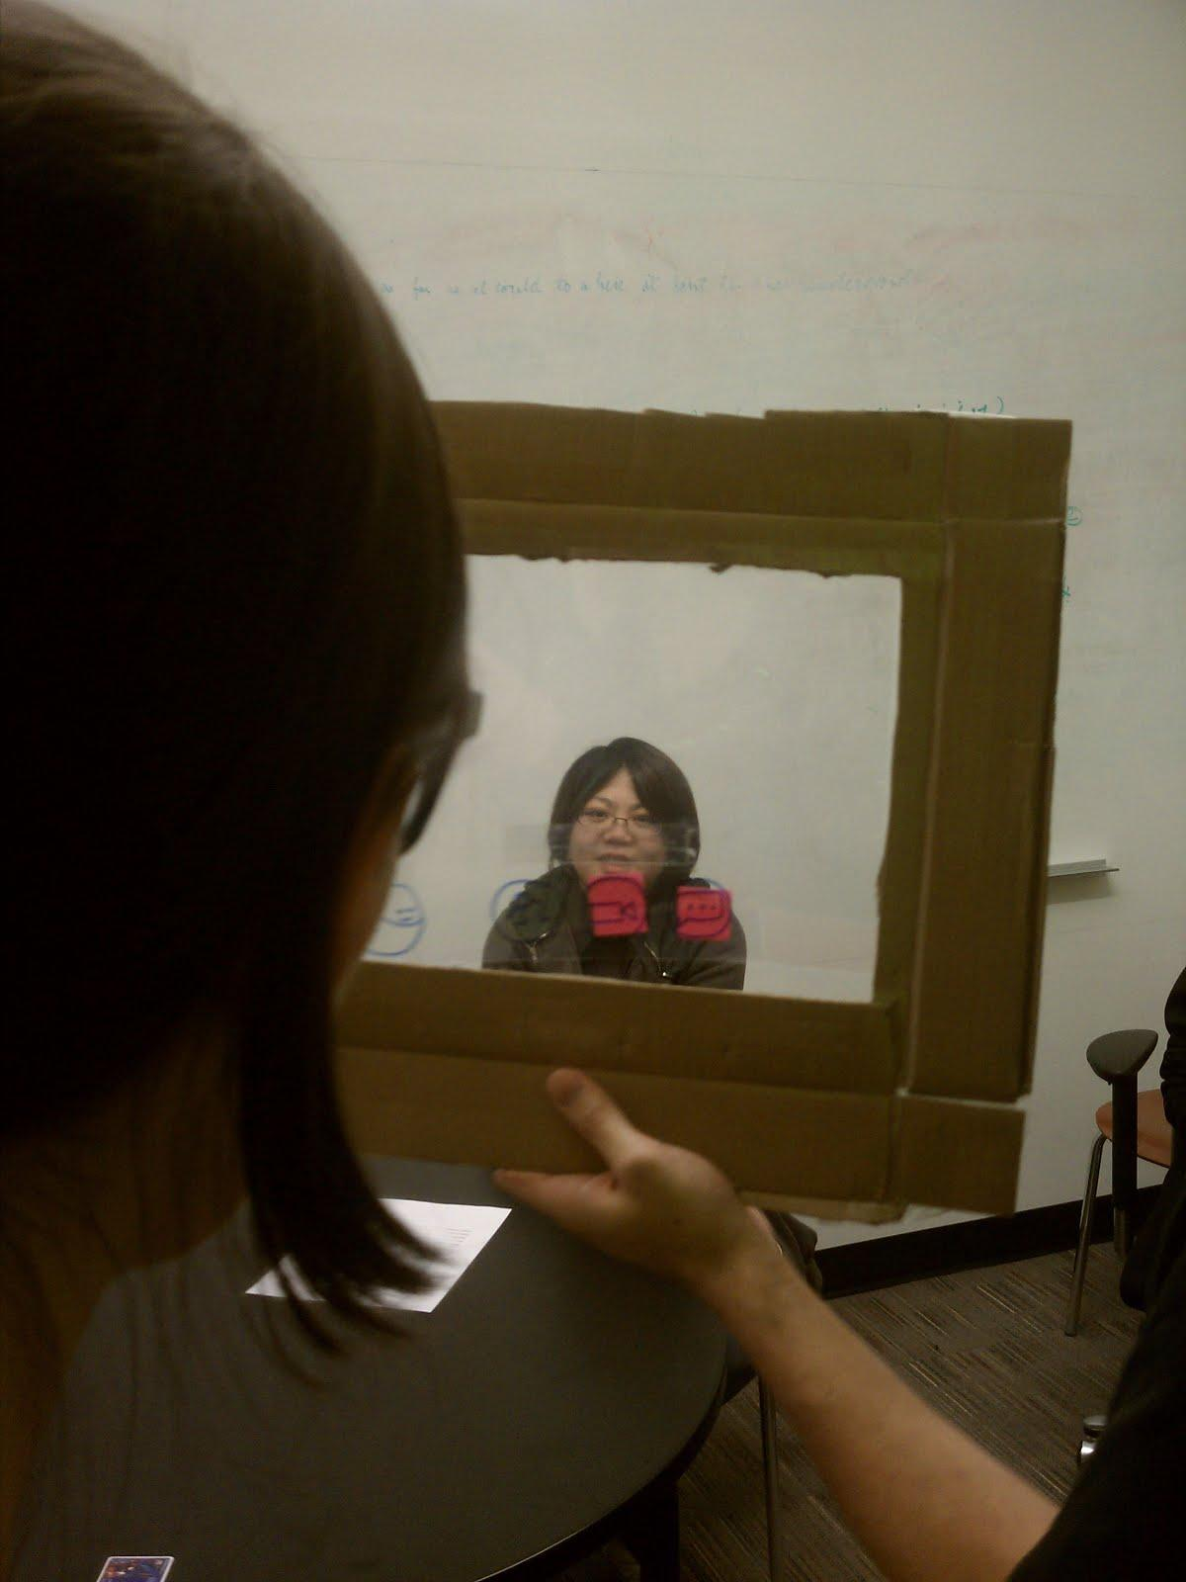
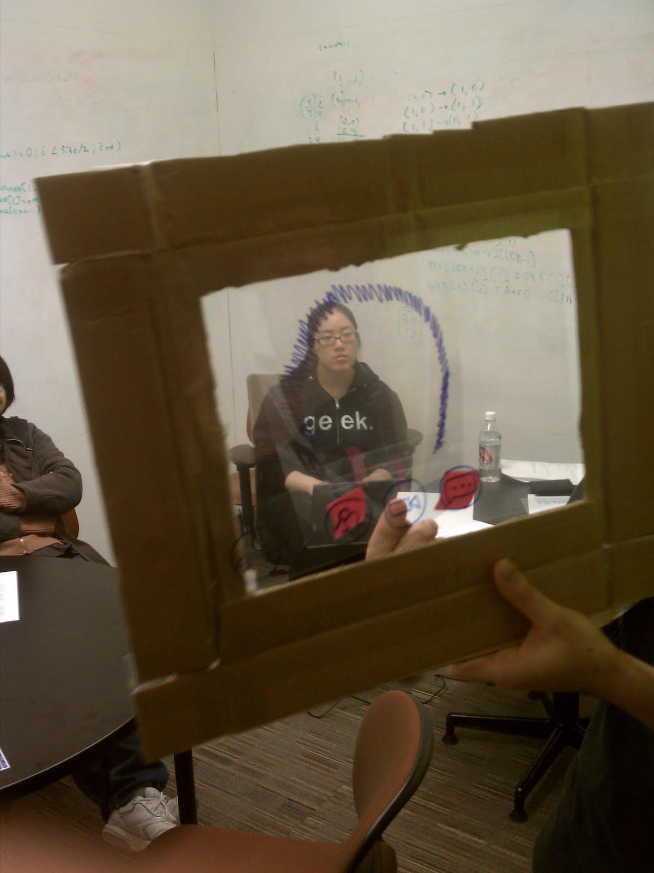
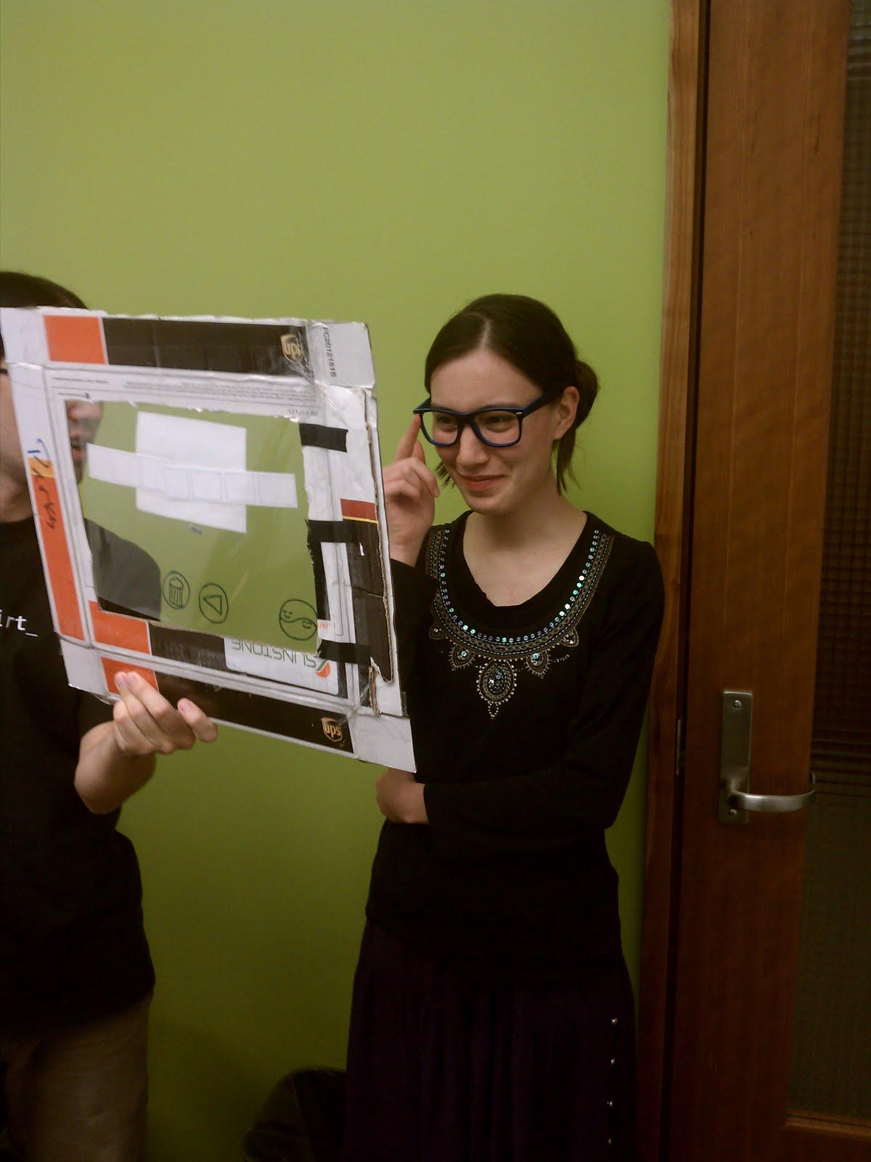
Method

Slide 11
Results
Topic
Icons, icons, icons | Icon meaning often unclear. Finding friendly people & social feedback icons.
Starting a recording & video playback | Confusing that starting a recording was not activated from video playback screen.
Screen elements distract when not in use | Controls felt distracting when subject was in conversation.
App must be discreet during conversation | Feedback in danger of overwhelming subject while in middle of conversation.

Slide 12
Improvements
Topic
Icons, icons, icons | - Clearer, simpler graphics - Add text descriptions 'onhover'
Starting a recording & video playback | - Distinguish between 'video playback' mode and 'conversation' mode
Screen elements distract when not in use | - Hide screen elements when not in use
App must be discreet during conversation | - Always keep feedback language short, clear, and direct

Slide 13
Summary
Simplistic design
Confusing iconography
Icons need text
Discreet interface
Touch commands > voice commands
Short, direct feedback text
Hiding screen controls
Performance review
Enjoyable video playback

