Slide 1









AES Cryptocore
Lecture prepared by:
Riccardo Carità
Gianluca Corso
Riccardo Fusari
Federico Fruttero

Slide 2
Acknowledgments
This material was developed as European Master Network on Embedded System Security (EMNESS) project is an ERASMUS+ Cooperation partnership initiative with the goal to structure an innovative academic curriculum on Reliability and Hardware Security during the academic year 2023/2024.
Credits for the preparation of this material go to:
Riccardo Carità (https://github.com/Karrick99)
Gianluca Corso (https://github.com/gianluc99)
Riccardo Fusari (https://github.com/riccardofusari)
Federico Fruttero (https://github.com/fedefruttero)

Slide 3
Goals of the project
BUILD AN AES CRYPTOCORE INTO AN FPGA PLATFORM WITH A REALTIMEOS IN 3 MAIN STEPS:
HARDWARE DEVELOPMENT & DEPLOYMENT
OS IMAGE CREATION
DRIVER DEVELOPMENT

Slide 4
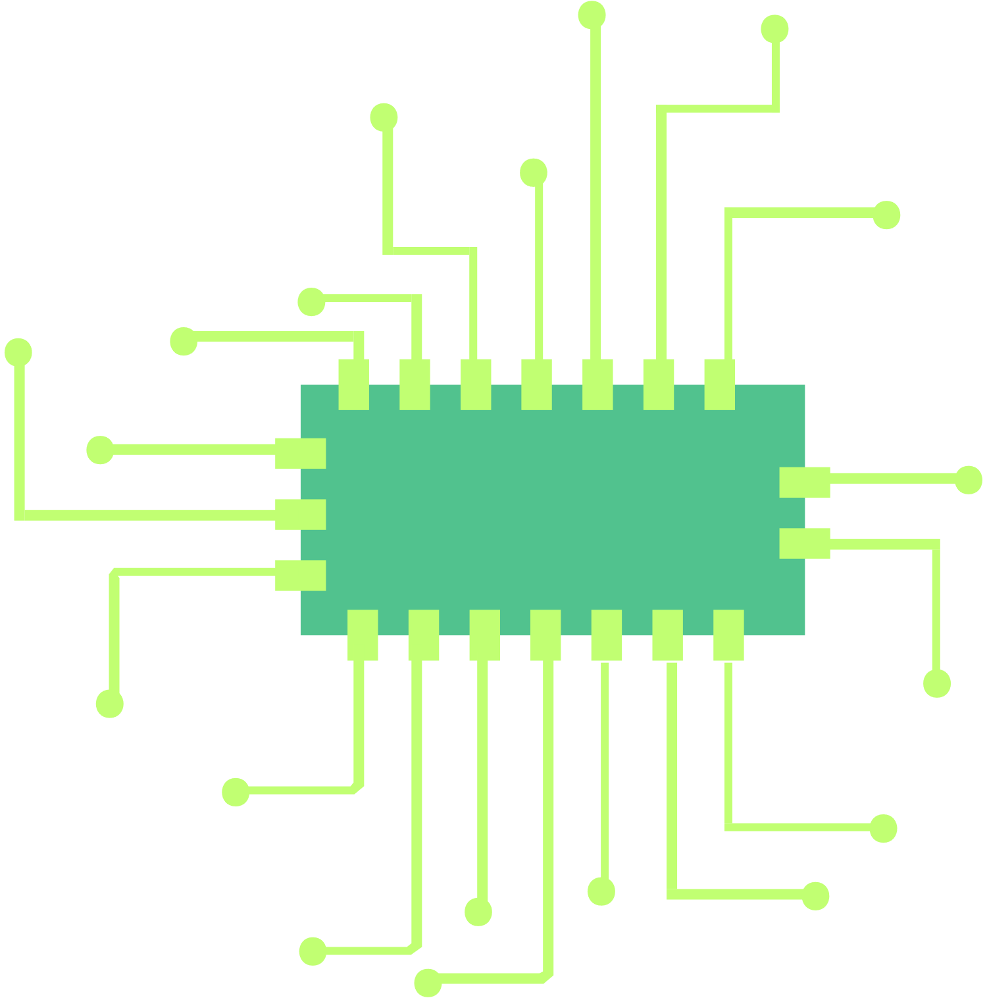
First Part: HW Development and Deployment
We will use Vivado to instantiate our component (which is an AES cryptocore) inside the AXI4 Interface in order to communicate with the
pynq-z2 board
In the following slides it is reported the workflow to obtain a working Vivado project
First figure taken from https://www.image-search.org/tempimgs/9704002431717699427.png

Slide 5


01
Download the core
How to set the core on the Pynq-z2 board
02
Vivado IP and Project creation
03
VITIS
.
First figure taken from https://emoji.gg/emoji/6031-downloadcloud
Second figure taken from https://www.svgrepo.com/svg/55693/idea

Slide 6
01 - Download the Core
Download the requested core from http://opencores.org/
It's mandatory to be registered with a student account in order to be able to download it. The confirmation of the registration could take some days.
The core will be in VHDL or Verilog format. Both the HDL formats will work correctly with the following parts of the task.

Slide 7
02 - Vivado IP and Project Creation
We will use Vivado to create the IP, including the core we need.
Create a Vivado Project.
Create new Project -> RTL project
Then we choose the board, which is the Pynq-Z2.
NOTE: the board package needs to be included during the installation process of Vivado
Then, clicking on Finish, the project is created.
From the Tools menu, click on Create and package new IP, then Create AXI4 Peripheral
Pay attention to set light as interface type.
In this phase is important to specify the total number of registers needed in the IP (considering they have 32 bit, so signals with higher parallelism will take more than one register).
Each register will create an address (made by an offset with respect to a common base address) and each of these will be used only for an input or an output. The same address can't be used for more than one signal.

Slide 8
02 - Vivado IP and Project Creation
Core instantiation in the interface
After having created the IP, click on the Edit IP choice.
Then from the Sources panel click on the + and add the HDL files for the core.
The core will be instantiated using these files as a component.
For interfacing properly the core through the AXI4 interface, it has to be instantiated and the ports have to be connected to the signals of the AXI4 that can be used as input/output. It can be done by writing HDL code into the Verilog file of the IP (the file which name terminates with ...SOO_AXI.vhd/.v)

Slide 9
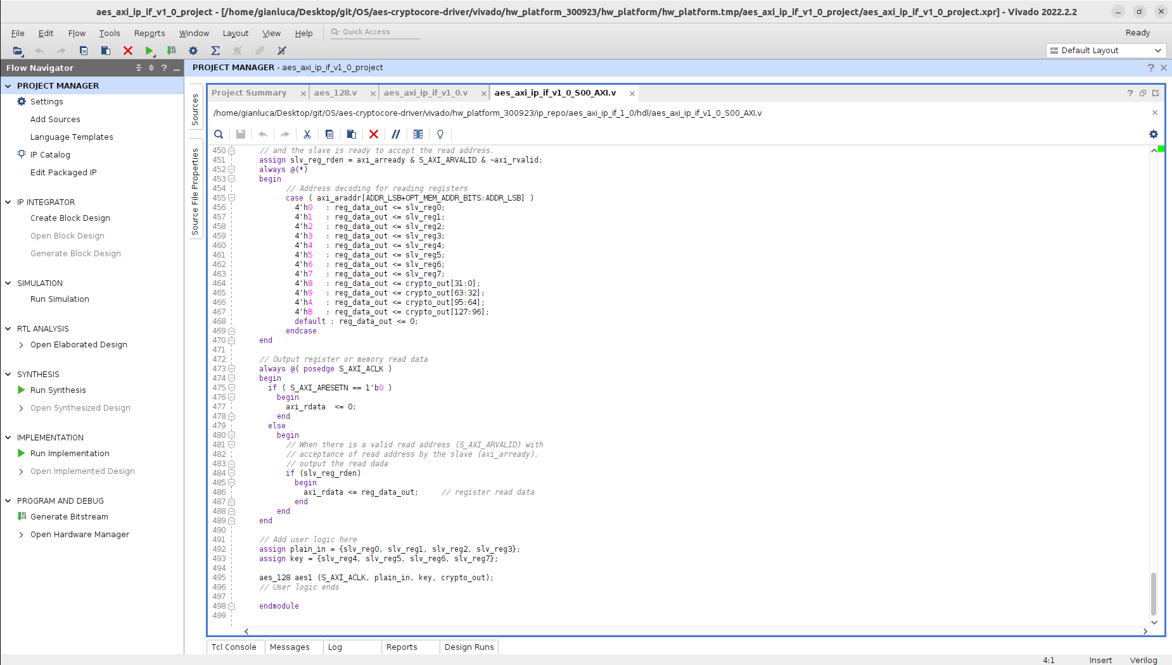
Core instantiation in the interface

Slide 10
02 - Vivado IP and Project Creation
After having made the proper connections, click on Open elaborated design. This option will automatically allocate our core inside the interface in the way defined in the IP.
Now the schematics of the elaborated design are available.
It's important to verify from the schematics that all the connections have correctly been implemented, especially where there is a parallelism higher than 32 bits and so the data has to be managed using registers in parallel

Slide 11
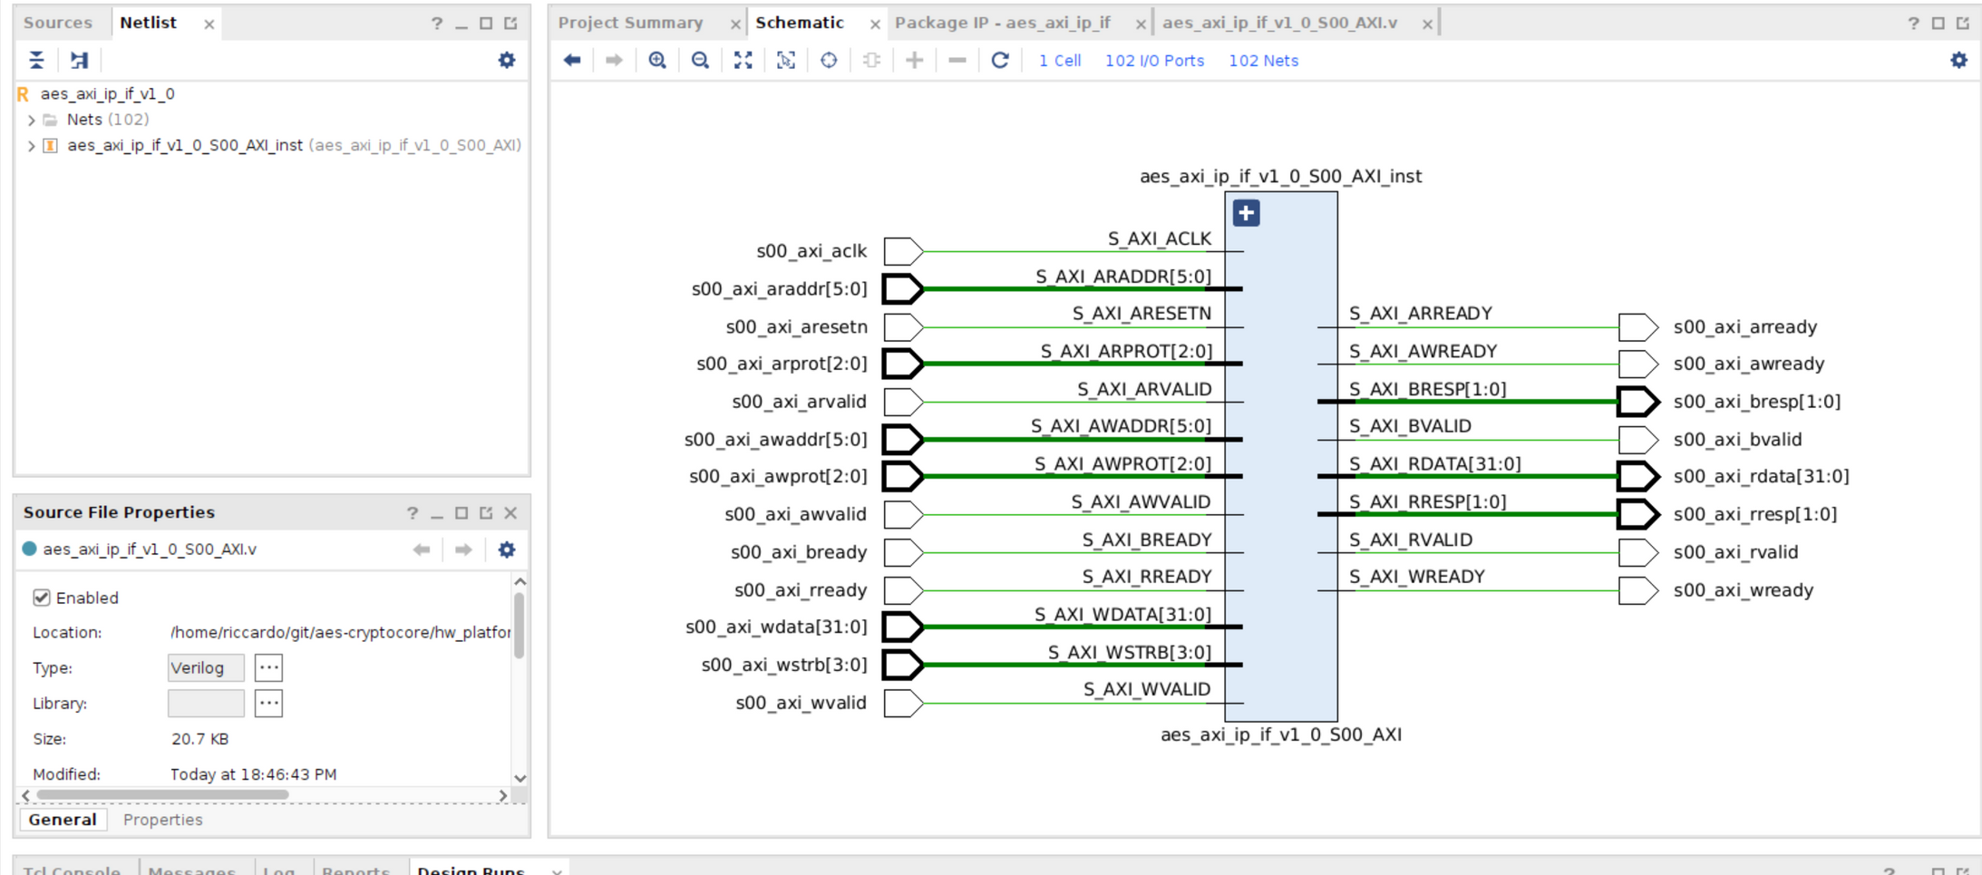

Slide 12
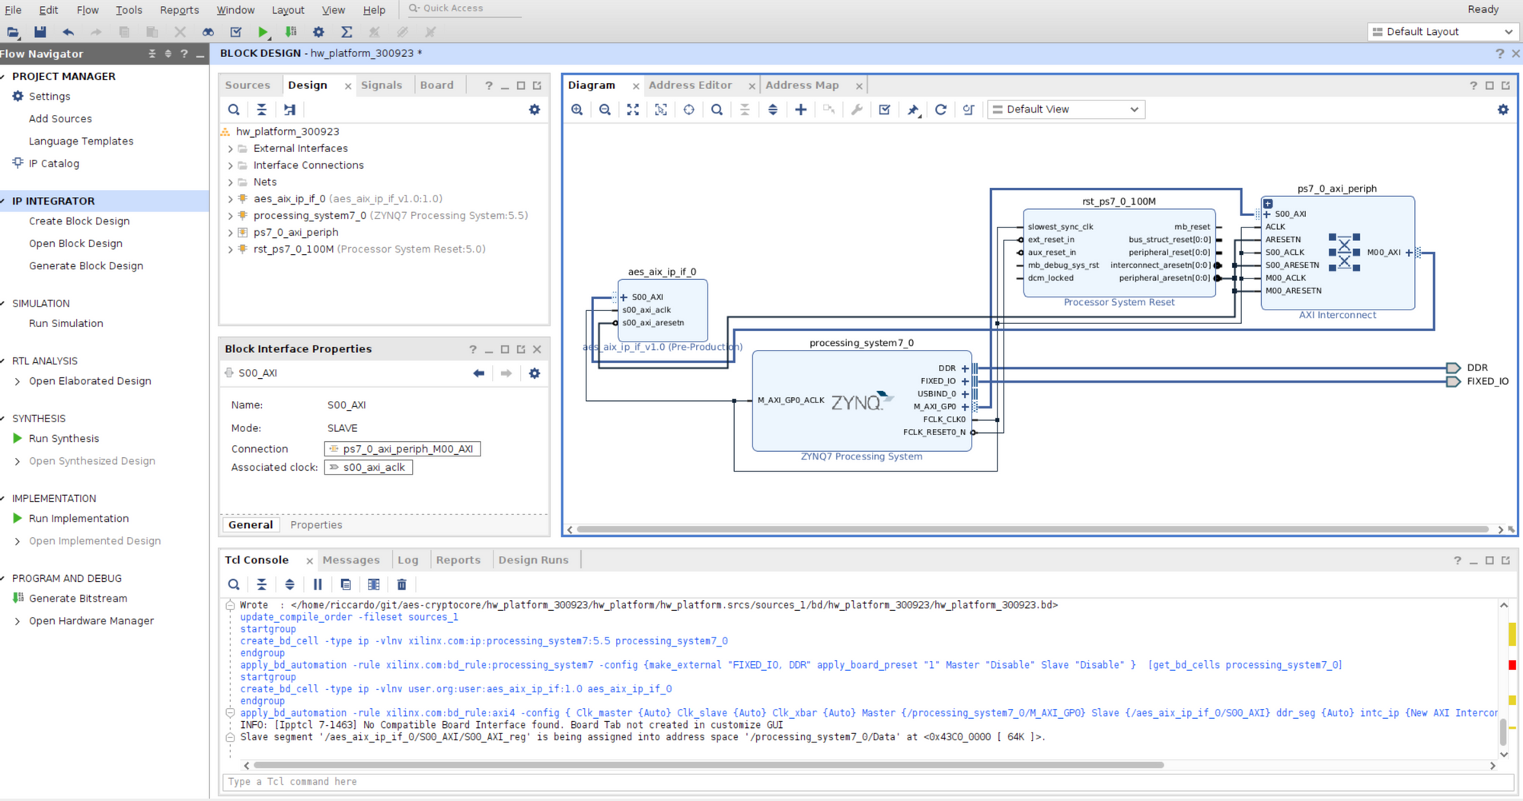

Slide 13
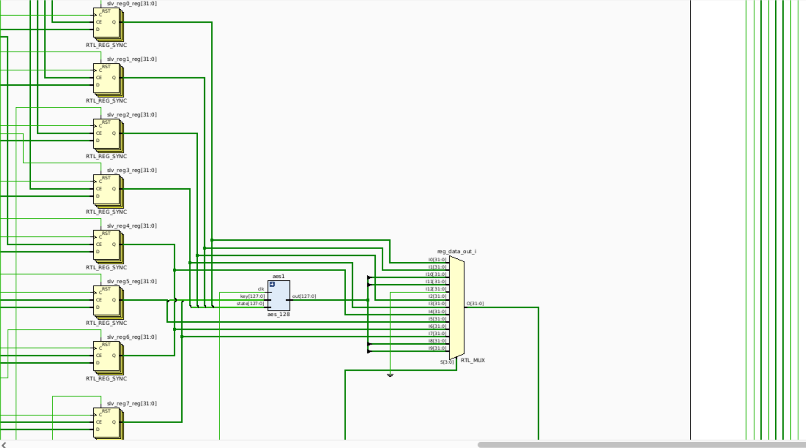

Slide 14
02 - Vivado IP and Project Creation
Review, package, block design, wrapper
At this point, if everything corresponds to what is expected, click on the Package IP - <name> panel, and proceed clicking on File Groups -> Merge changes from File Groups Wizard.
Now click on Review and Package -> Re-Package IP
After having confirmed to close the project by clicking on Yes, next step is to create the block design
On the left menu: Create block design, the specify a name and click OK.
Now add the board processing system by clicking on the + symbol in the Diagram panel, and then selecting the board.
Click on Run Block Automation, then confirm with OK.

Slide 15
02 - Vivado IP and Project Creation
Review, package, block design, wrapper
Then add the custom IP made in the previous steps by clicking again on the + symbol, then Run Connection Automation and OK in the window that will appear.
Now validate by clicking on the blue check mark ✓ in Diagram panel, click OK.
Now it's time to create the wrapper that will be exported:
right click on the core name under the Design Sources section -> Create HDL Wrapper -> Let Vivado manage wrapper and auto-update.
Now the wrapper should appear in the Design Sources in the Sources panel.
Then on the left menu: Generate Bitstream, and OK in "Launch Runs" window.
Now File > Export > Export Hardware
In the window "Export Hardware Platform" :
Include bitstream, give the file name for the XSA and a path where to be exported.
Finish.

Slide 16
EXERCISE 1: IP generation
Now it’s time to try to build your own HW description file!
Try to modify by yourself the hw description files of your system in order to communicate through the AXI4 interface. Instantiate your hw, the processor and the communication needed.
A solution for this exercise is inside the repository.

Slide 17
03 - VITIS - bare-metal test on the HW platform
Open Vitis
Create Application Project -> Next -> Create a new platform from hardware (XSA)
Here click on Browse... and select the wrapper file (.xsa).
Verify the platform name and proceed with Next.
Select the ps7_cortexa9_0, then Next.
In "select a domain" click on Create new, and in "Operating System" option select standalone Next -> select HelloWorld -> Finish
Now the project is ready for adding some user code

Slide 18
03 - VITIS - bare-metal test on the HW platform
On the left menu, in src, then helloworld.c, read the code generated by Vitis.
On the left menu, in hw, drivers, <your ip name>, src open the <your ip name>.h file and verify the generation of the correct offset constants for the address management. By scrolling down in the code, there are the methods for writing registers and reading registers, that can be used for our purposes.
Be sure to have included libraries:
#include "platform.h"
#include "xil_io.h"
#include "<your ipname>.h""
#include "xparameters.h"

Slide 19

03 - VITIS - bare-metal test on the HW platform
Now we can use the _mWriteReg and _mReadReg methods to properly write and read data to/from the core.
Once finished, we can click on the build icon:
IMPORTANT
From now on, the board should be properly connected to the PC.
Check if the jumper that allows to choose between JTAG and SD is in the correct position. Verify the correct behavior from the status LED on the board.

Slide 20


03 - VITIS - bare-metal test on the HW platform
The next step is to click on this icon in the upper toolbar:
This opens the menu Target connections, then in Hardware Server section you can click on Local [default] In the window that wil appear, click on OK with default values.
Now click on the Debug key on the upper toolbar:
This will program the FPGA and allow you to use the Vitis Serial Terminal (in the lower part of the screen), and add the correct port by clicking on the + symbol.
With the serial terminal, you can verify the output from the board, and see if it's the correct response to the data applied through the C program.

Slide 21
EXERCISE 2: Test your HW
Now it’s time to try to test your own HW description file!
Modify the helloworld.c template in Vitis in order to write and read on the registers you settled up in the previous exercise.
A solution for this exercise is inside the repository.

Slide 22


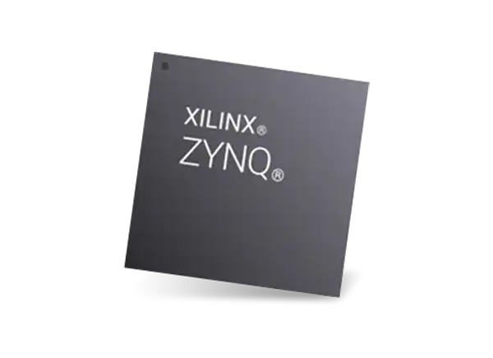
Second Part: OS IMAGE CREATION
In the second phase of our project, we utilize PetaLinux to create a customized Linux operating system image for our embedded system. This involves configuring the Linux kernel, building a root filesystem, and generating a bootable image specifically designed for our FPGA platform.
-
First figure taken from https://it.emcelettronica.com/wp-content/uploads/2018/10/fpga.jpg
Second figure taken from https://www.zachpfeffer.com/single-post/xilinx-20182-software-tool-installation-overview-and-assessment
Third figure taken from https://www.mouser.mx/new/xilinx/xilinx-zynq-7000-socs/

Slide 23
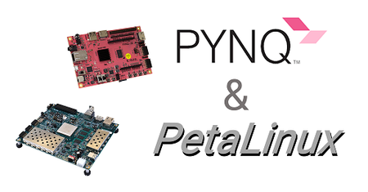
PETALINUX
Optimized for FPGA and Zynq SoC
Widely Adopted in Automotive,Aerospace,Telecommunications and Industrial Automation for Robust Embedded Systems.
Seamless integration into hardware designs
First figure taken from https://it.emcelettronica.com/wp-content/uploads/2018/10/fpga.jpg
Second figure taken from https://discuss.pynq.io/t/deploying-pynq-and-jupyter-with-petalinux/677

Slide 24
Embedded Linux Installation Guide
Download PetaLinux:
Visit the following link to download the PetaLinux installer: PetaLinux Download
Installation Steps:
First of all, make sure you have the latest version of the OS.
sudo apt update
sudo apt upgrade

Slide 25
Embedded Linux Installation Guide
Then, after downloading, move the .run file to the desired installation folder.
Open your terminal and navigate to the installation folder.
Run the installer using the following command:
If an Error comes out saying you are missing some dependencies, run the following command:
bash petalinux-v2023.1-05012318-installer.run
sudo apt install gawk zlib1g-dev net-tools xterm autoconf libtool texinfo gcc-multilib

Slide 26
Embedded Linux Installation Guide
Maybe they aren't all the packages and dependencies missing.
You can go at that link. By scrolling down, you can see a script called "plnx-evn-setup.sh". Download that script and run it. It should install all the packages needed. If is that not the case, check the error messages and search on google how to download that specific library by terminal. You will easily find a command to do it.
Follow the on-screen prompts to accept the license agreements and complete the installation.
Run the settings.sh script source ./settings.sh (ignore the warning)

Slide 27
Embedded Linux Installation Guide
Create the project
Go to your terminal and change directory to where you would like to create your new PetaLinux project directory
Run:
Here '-t' is equivalent to '--type'. You can see that there is a new folder created and you can enter inside it.
petalinux-create -t project --template zynq --name aes-petalinux
cd aes-petalinux

Slide 28
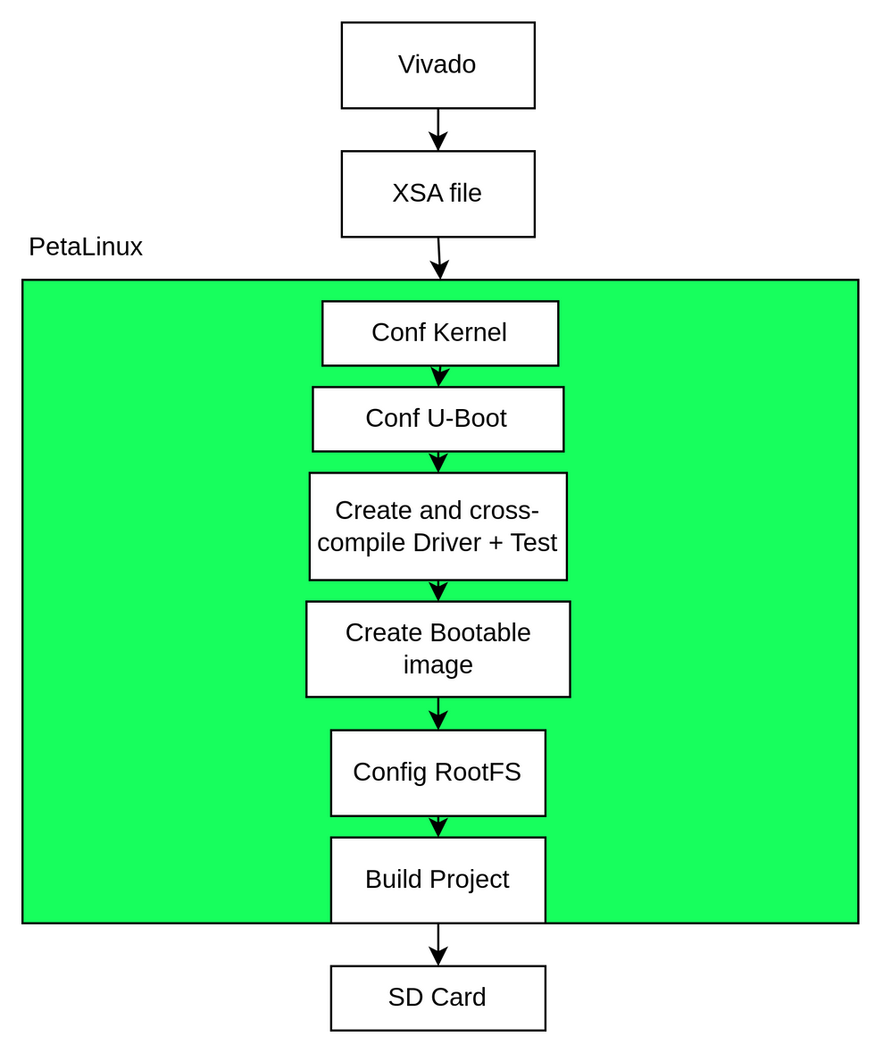

Slide 29
Embedded Linux Installation Guide
Configure using XSA file
You have previously created a XSA file as output of VIVADO that describes you hardware platform. You will need this file now for configure petalinux build and tell to petalinux what devices are available for it and it will create a Device Tree based on this hw definition file.
Write this command into the project directory
This will open the first configuration screen of the petalinux tool. In this you can navigate and check what is inside, but there is no need to change anything here.You can exit by pressing double time the . Save it. This can needs some time.
petalinux-config --get-hw-description <PATH-TO-XSA DIRECTORY>

Slide 30
Embedded Linux Installation Guide
Configure the Kernel
This will need some time. After that, a similar window to the previous one should open. As before, there are many options, you can browser it for checking if you have to change something. Also here, there is no need to change anything for the purpose of this Lab.
petalinux-config -c kernel

Slide 31
Embedded Linux Installation Guide
Configure U-Boot
Another configuration command we have to run
In the configuration window, you have to enable the boot options --> boot media --> "Support for booting from QSPI flash" and "Support for booting from SD/EMMC".
Save and exit.
Now there will be another configuration command needed, the one for the RootFS. But first, in order to compile it correctly for this lab, you want to create an application and a module.
petalinux-config -c u-boot

Slide 32
Create and compile the driver
The skeleton of the driver that will contain your custom code can be created by terminal with this command.
petalinux-create -t modules --name aes-core-driver --enable
You can check that a new file it is created. The file is in
$(PETAPROJECT)/project-spec/meta-user/recipes-modules/aes-coredriver/files/aes-core-driver.c
There you can customize the init, write, read, open, close functions to your needs.
Once you are done you can build it with petalinux (cross-compile it)
petalinux-build -c aes-core-driver
Thanks to that command and to nexts that we will see, the driver will be already mounted on the device (i.e. the *.ko file).

Slide 33
Creating and Compiling the test- driver
You can also create an application that tests your driver using the petalinux tools and avoiding also here to crosscompile it by yourself.
petalinux-create -t apps --template c --name aes-core-test --enable
The new file created is in
$(PETAPROJECT)/project-spec/meta-user/recipes-apps/aes-core-test
/files/aes-core-test.c
There you can customize the C file to your testing needs. Once you are done you can build it with petalinux
petalinux-build -c aes-core-test

Slide 34


How do we interface with the OS ?
Figure taken from https://mir-s3-cdn-cf.behance.net/project_modules/max_1200/53d9ae70251739.5b9d484cde8a2.jpg
Second figure taken from https://d1nxzqpcg2bym0.cloudfront.net/google_play/com.firewall.sshclient/a883ca02-9f9f-11e9-8461-2d7545ccf52c/128x128

Slide 35
EXERCISE 3: Build your linux system!
Now it’s time to try to test what you learned in the previous steps.
Try to follow the guide in the repository and build your linux system.
Flash the system through JTAG and then SD card

Slide 36


Third Part: Driver development
The main goal of this LAB is to write a crypto-core driver in C language. Now, you can do it from scratch and try to cross-compile this driver for the system that you are building. This is not easy. Fortunately, Petalinux comes to help us. Indeed, in order to cross-compile the driver for the cripto-core easily, we will use the petalinux's recipes and buildtools.
First figure taken from https://www.shutterstock.com/it/image-vector/monitor-coding-vector-icon-programming-illustration-2244063857
Second figure taken from https://www.vecteezy.com/vector-art/6816978-code-icon-coding-symbol-coding-programming-sign

Slide 37
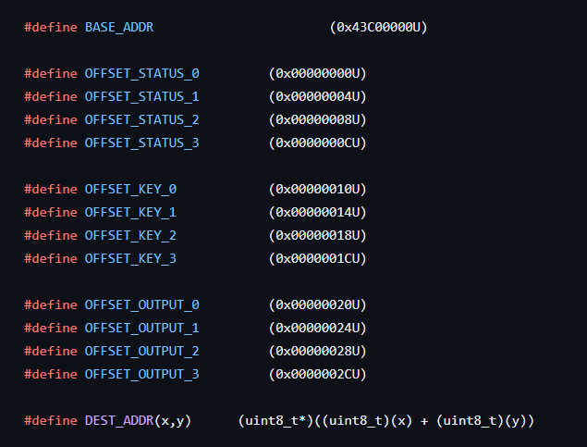
Structure of the driver
#define
Here there are the constant values used in our IP to access registers, according to the right addresses

Slide 38
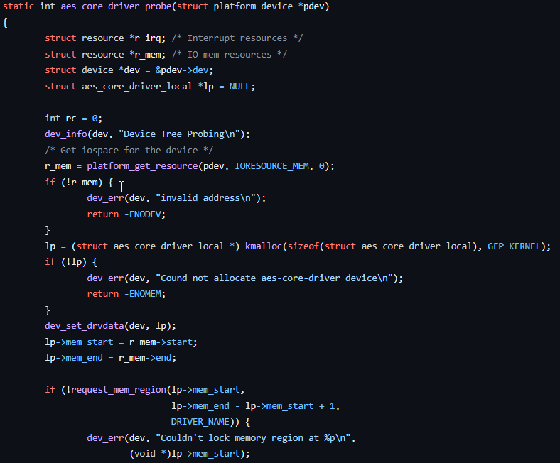
Structure of the driver
aes_core_driver_probe():
This function is responsible of mapping the memory according to our hardware, thus checking possible incorrect addresses

Slide 39
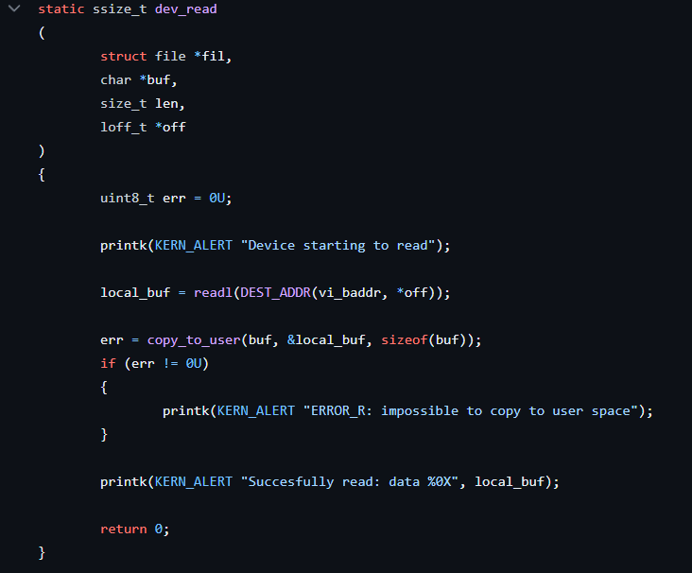
Structure of the driver
dev_read():
This function is responsible of reading the buffer using the appropriate offset, thus reporting cases of error or succes

Slide 40
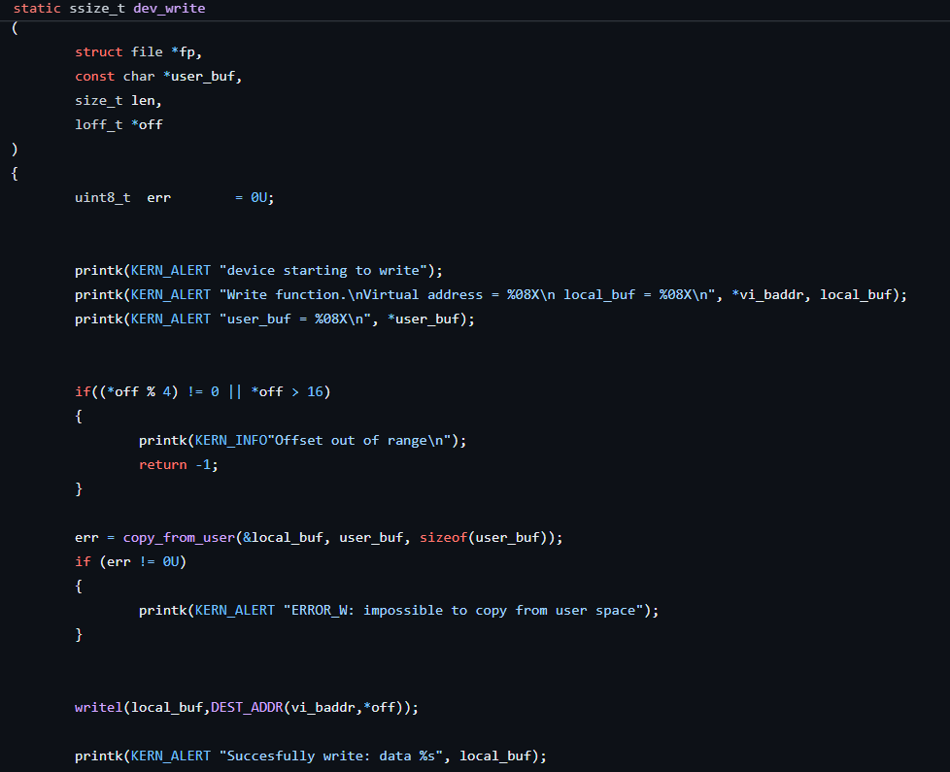
Structure of the driver
dev_write():
This function is responsible of writing the buffer, provided the correct offset, thus it is checking for possible offsets out of the correct range

Slide 41
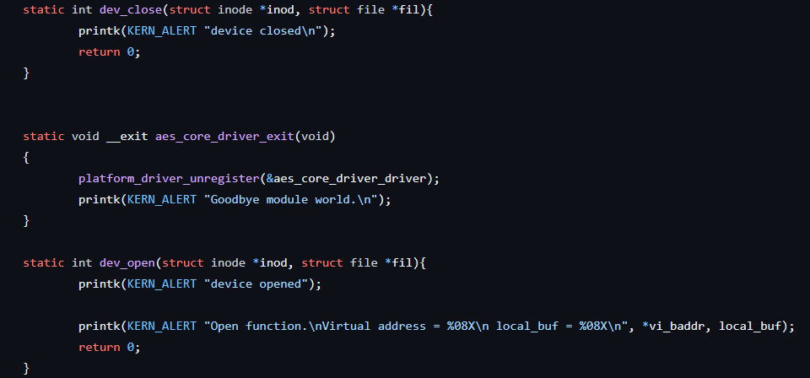
Structure of the driver
Open, close and exit functions

Slide 42


Final exercise: The driver
https://github.com/EMNESS-project-group2
Inside the above GIT repo, you can find all the reference code, with more technical detail
Now it’s up to you to develop a working driver with a c test file to check its functionality
Figures modified from https://www.image-search.org/tempimgs/842460061717747700.png and https://widget-club.com/icons/t/yahoo/pastel_blue

Slide 43
Lecture credits to
Riccardo Carità
Gianluca Corso
Riccardo Fusari
Federico Fruttero

Slide 44

This work is licensed under a Creative Commons Attribution 4.0 International License
https://creativecommons.org/licenses/by-nd/4.0/legalcode

