Slide 1

TEAM APEX PRESENTS
UNITE Architecture
Comprehensive Architectural Documentation & Deployment Strategy
Marc Lester E. Sulit
Joseph Angelo Q. Petalio
Patrick Kurt O. Villamer

Slide 2


Executive Summary
Objective
Core Philosophy
Establish a robust server-side foundation for a distributed web application. Our primary goal is delivering dynamic content efficiently to a decoupled frontend while ensuring scalability and reliability.
We utilize the Backend-for-Frontend (BFF) architectural pattern. This separates UI rendering from complex data processing. Currently fully functional, accessible via HTTPS, and integrated with GitOps.

Slide 3








Technology Stack
Frontend
Backend
Database
Tools
Next.js & React
Node.js & Express
MongoDB Atlas
Git, Jira, Figma
TailwindCSS | Vercel
Render Web Services
Mongoose ODM
Version Control & Mgmt

Slide 4

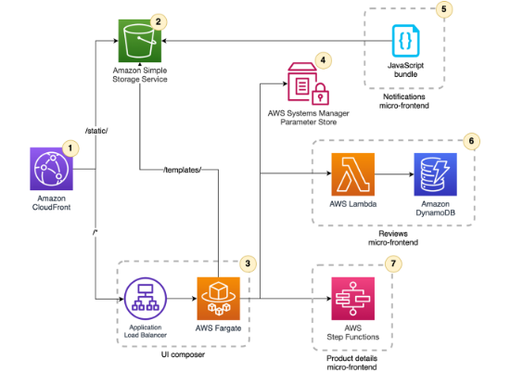
Strategic Architecture
The Platform Strategy
>
Vercel (Frontend): Handles UI presentation, edge caching, and client routing.
>
Render (Backend): Manages core business logic and persistent connections.
>
Advantage: Unlike serverless functions, Render maintains a "warm" state, guaranteeing immediate API responses without cold starts.

Slide 5

Deployment & Infrastructure
Configuration
Environment Variables
>
Render Blueprints: Uses render.yaml to prevent config drift.
>
NODE_ENV: Production optimization.
>
MONGODB_URI: Secure Atlas connection string.
>
Build Command: npm install ensures consistency via lockfiles.
>
ALLOWED_ORIGINS: Whitelists frontend URL.
>
EMAIL_USER/PASS: SMTP Credentials.
>
Start Command: node src/server.js initiates the runtime.

Slide 6


Security & CORS Integration
The Challenge
The Solution
Browsers enforce the Same-Origin Policy (SOP). This security mechanism blocks direct fetch requests between distinct origins, such as Vercel (Frontend) and Render (Backend).
We implemented strict CORS Middleware.
>
Allowed Origins: Whitelist trusted domains.
>
Methods: GET, POST, PUT, DELETE only.
>
Credentials: Allow secure cookies/JWT.

Slide 7






Backend MVC Structure
Models
Controllers
Routes
src/models
src/controllers
src/routes
Mongoose schemas that define data structure and validation rules.
Core logic, data orchestration, and request handling.
API endpoint definitions mapping URLs to controller functions.
Middleware Pipeline: Helmet (Security) → CORS → JSON Parser → Logger → Error Handler

Slide 8
JWT Authentication Flow
Login
Verify
Issue Token
Access
Client sends credentials to
/api/auth/login
Backend validates against
MongoDB User Collection
Signs JWT with
User ID & Role
Header required:
Authorization: Bearer

Slide 9
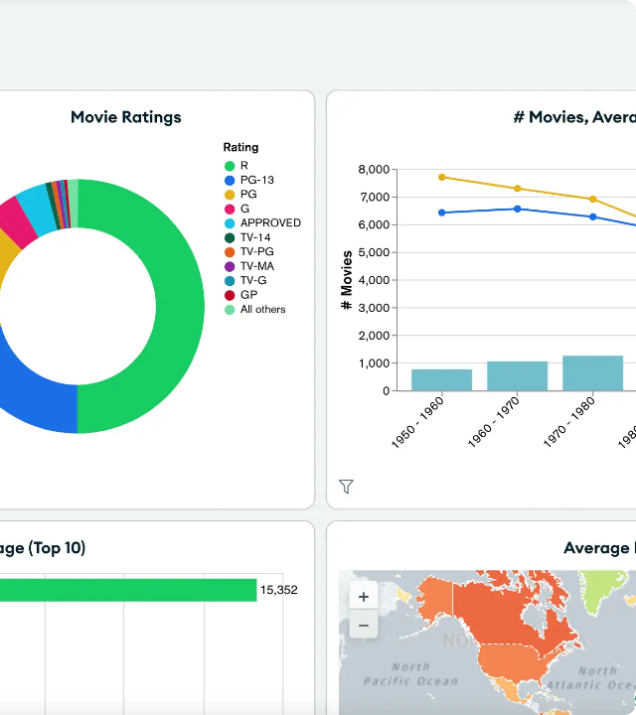
Data Layer: MongoDB
Why NoSQL?
Chosen for flexibility, horizontal scalability, and native Node.js JSON integration.
Mongoose ODM
We use Mongoose to enforce strict schemas over the flexible database. It handles data integrity, validation rules, and business logic before data ever hits the persistent storage.
Security
Encrypted connection strings and strict IP whitelisting to Render servers.

Slide 10
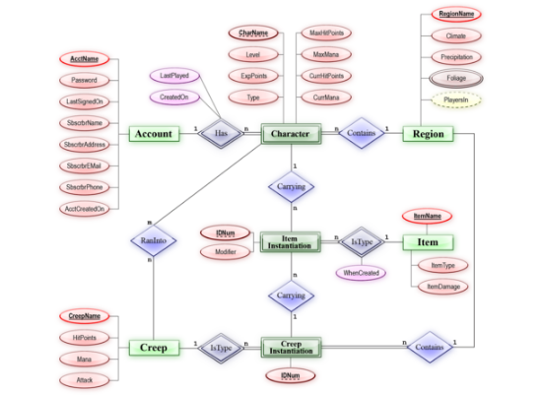
Core Entity Relationships
Data Modeling Overview
>
Geographic Hierarchy:
Links Provinces → Districts → Municipalities.
>
Staff Hierarchy:
System Admin, Coordinator, and Stakeholder roles.
>
Event Flow:
Tracks approval workflows for Blood Drives, Advocacy, and Training.
>
Real-Time:
Chat messages and user presence monitoring.

Slide 11
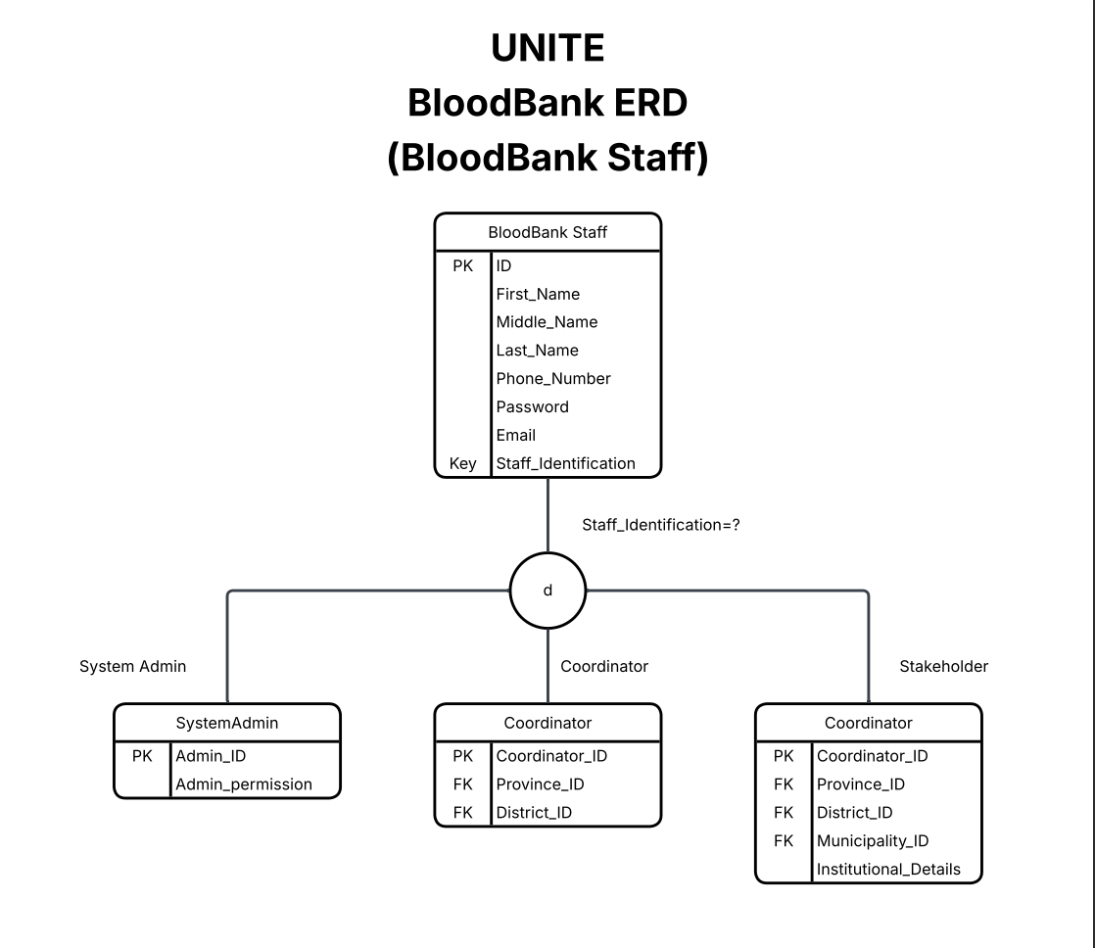
Entity Relationship: Staff

Slide 12
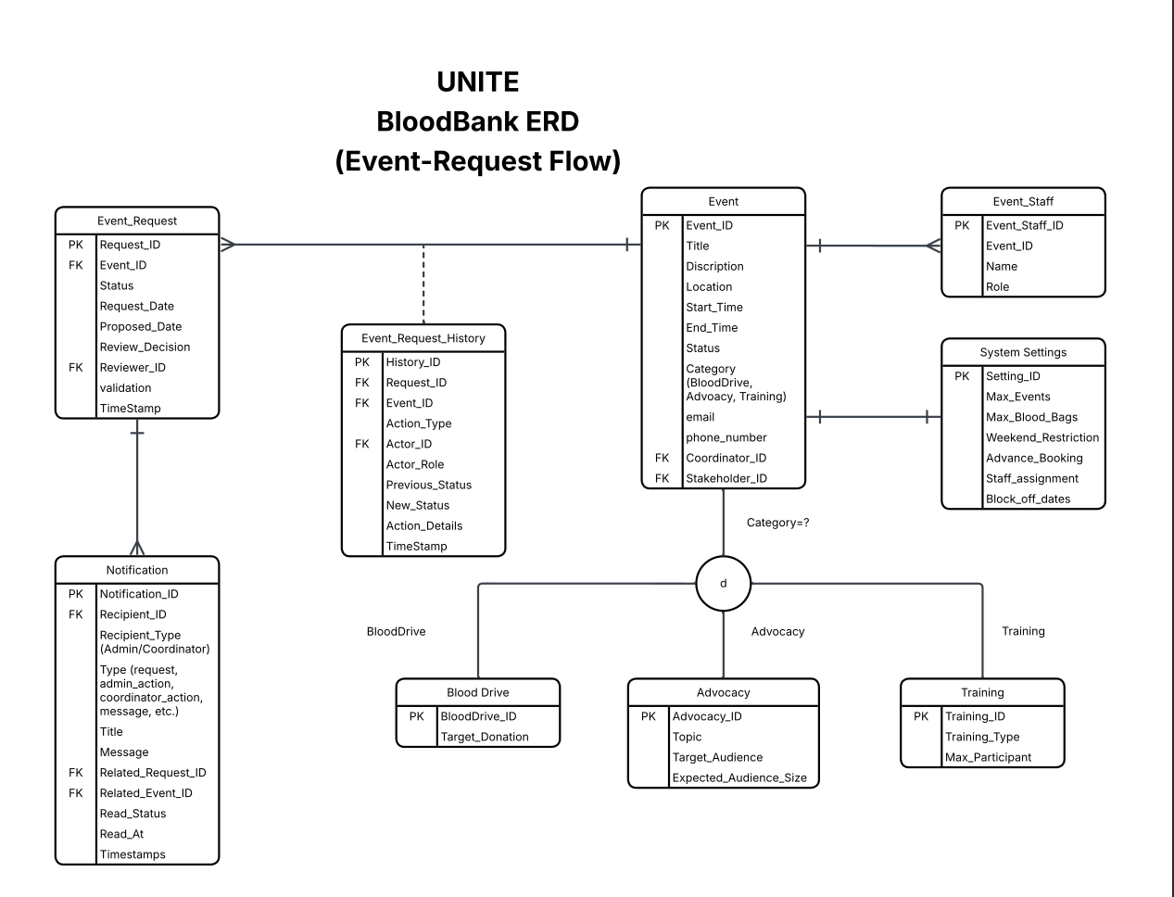
Entity Relationship: Event Request

Slide 13
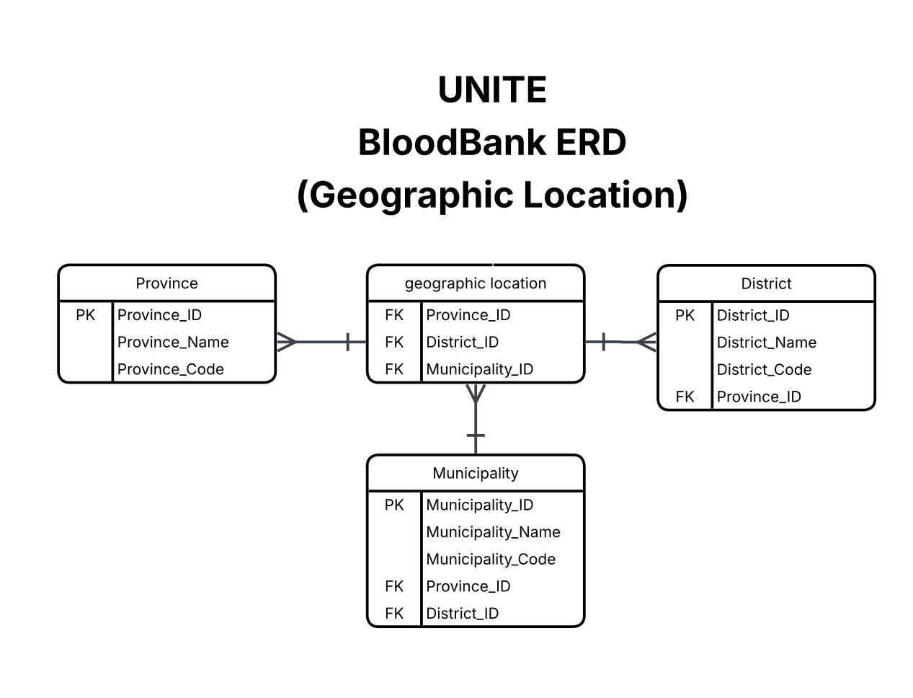
Entity Relationship: Geographic Location

Slide 14
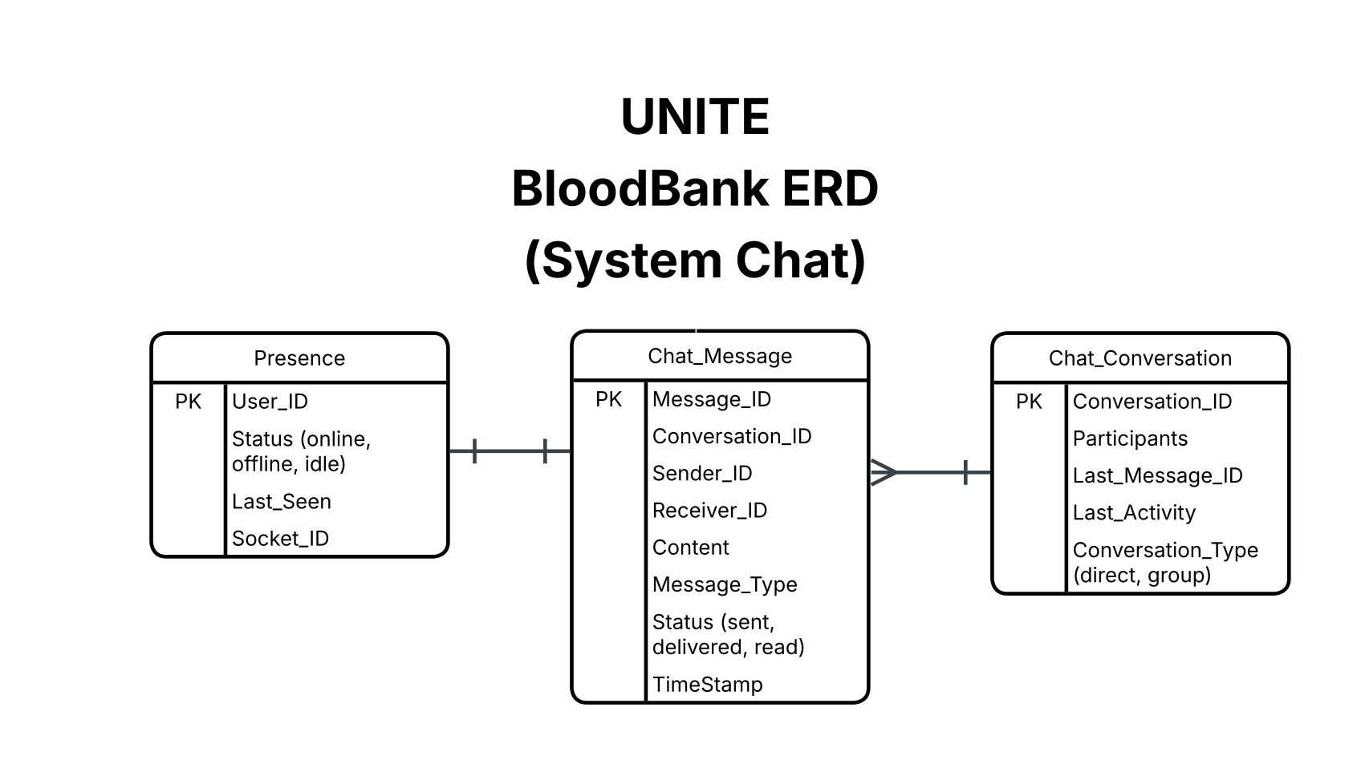
Entity Relationship: Messaging Module

Slide 15


Reliability & Roadmap
Observability
Future Roadmap
>
Short-Term: Automated testing (Jest) and Swagger API documentation.
Structured Logging: JSON logs (INFO, WARN, ERROR) for machine parsing.
>
Long-Term: Redis caching layer for high-demand endpoints and transition to microservices.
Protection: Rate Limiting to prevent DoS attacks and Input Sanitization against NoSQL injection.

Slide 16
Q&A
Thank you for listening.
Team Apex

Slide 17



Image Sources
>
https://d2908q01vomqb2.cloudfront.net/1b6453892473a467d07372d45eb05abc2031647a/2022/11/04/micro-frontends3.png
Source: aws.amazon.com
>
https://www.mongodb.com/docs/charts/static/db3b18603663b0372ec02a4dd216b9ec/0dbfc/sample-dashboard.webp
Source: www.mongodb.com
>
https://upload.wikimedia.org/wikipedia/commons/thumb/7/72/ER_Diagram_MMORPG.png/500px-ER_Diagram_MMORPG.png
Source: en.wikipedia.org

