Slide 1
Intro to Database Forensics
Zak Zebrowski
zakz@zakz.info

Slide 2
License
Approved for Public Release; Distribution Unlimited. Public Release Case Number 21-1212
©2022 The MITRE Corporation. All Rights Reserved.
NOTICE
This (software/technical data) was produced for the U. S. Government under Contract Number 70RSAT20D00000001, and is subject to Federal Acquisition Regulation Clause 52.227-14, Rights in Data—General. As prescribed in 27.409(b)(1), insert the following clause with any appropriate alternates:
52.227-14 Rights in Data -- General (May 2014) – Alternate II (Dec 2007) and Alternate III (Dec 2007) (DEVIATION)
No other use other than that granted to the U. S. Government, or to those acting on behalf of the U. S. Government under that Clause is authorized without the express written permission of The MITRE Corporation.
For further information, please contact The MITRE Corporation, Contracts Management Office, 7515 Colshire Drive, McLean, VA 22102-7539, (703) 983-6000.

Slide 3
Course Outline
Introduction to databases
Introduction to forensics
Definitions
Converting Data to Unicode (which you should understand before)
Converting from (various database systems) to a common database system (Maria DB).
Questions

Slide 4
About Me
Zak Zebrowski
Author of https://opensecuritytraining.info/WebIdentity.html
Forensic Database Engineer / Web Identity Specialist / Perl Guy

Slide 5
Lab Install
1. Start a standard desktop ubuntu virtual machine.
2. Copy lab.tar.gz to an appropriate location.
3. Open a command terminal and run as root .
4. tar –zxvf lab.tar.gz
5. bash –x /install.sh from the lab folder.

Slide 6
Introduction to Maria DB
From: en.Wikipedia.org/wiki/MariaDB/
MariaDB is a community-developed, commercially supported fork of the MySQL relational database management system (RDBMS), intended to remain free and open-source software under the GNU General Public License. Development is led by some of the original developers of MySQL, who forked it due to concerns over its acquisition by Oracle Corporation in 2009.
MariaDB intended to maintain high compatibility with MySQL, ensuring a drop-in replacement capability with library binary parity and exact matching with MySQL APIs and commands. However, new features diverge more. It includes new storage engines like Aria, ColumnStore, and MyRocks.
Its lead developer/CTO is Michael "Monty" Widenius, one of the founders of MySQL AB and the founder of Monty Program AB. On 16 January 2008, MySQL AB announced that it had agreed to be acquired by Sun Microsystems for approximately $1 billion. The acquisition completed on 26 February 2008. Sun was then bought the following year by Oracle Corporation. MariaDB is named after Monty's younger daughter, Maria. (MySQL is named after his other daughter, My.)

Slide 7
Maria DB Continued
I will use Maria DB / MySQL almost interchangeably throughout the course. For us they are “close enough” the same, though not identical as previously noted.
We will tend to use the “myisam” table type primarily. This tends to be faster than other table types. There are some gotchas with this table type (namely that it’s not transactional and not fully recoverable) but are easier (and more prevalent) than other table types (in real life).
We will not use the full text index within Maria DB, as it does “automatic” things that we don’t want, such as silently creating a stop word list. We will use sqlite3 full table index instead, which is an additional step, but is more accurate.
Maria DB will be used for larger data collections, so that multiple machines can use it as it is being upgraded.
Sqlite 3 is an additional database engine. This one is more of an “inline memory” database, often used in core os functions (on ios, macos, android, and sometimes in windows). See https://sqlite.org/index.html for general information. It’s a great tool as well.

Slide 8
Introduction to Forensic Mindset
Like CSI related show.
But a lot more rules and regulations.
⚠ Just because you have the idea from tv does not mean that you should do it.
⚠ You need to ensure you have the appropriate legal authorities to work on the subject.
⚠ Always document what the original sources are, who gave it to you, when, and track it as you go through your procedures as best you can so that when you are asked, if your case goes to court, the piece of media that the data came on and the legal restrictions surrounding that data.

Slide 9
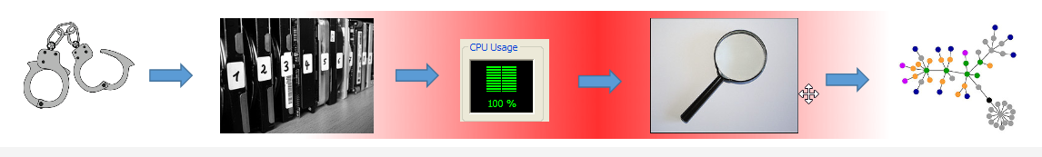
What is forensic database analysis?
Forensic database analysis is a specialty of knowing a bunch of techniques to allow analysts to query databases, which were recovered in a forensic manner.
We receive evidence via appropriate legal authorities. Then, we mount and host a copy of the recovered database, convert that database to Maria DB (if it is not), while converting the data to Unicode, then write tools to query the database, based upon priority queries defined by analysts.

Slide 10
Steps Caveat
One small gotcha with the steps…
The steps are notional.
You will need to be aware of Unicode / character set issues while you are importing data into a database. Sometimes you need to convert before a database is loaded (via a flag specifying a character set), sometimes after, and sometimes in the middle of things…
Sometimes you will be required to mount data of forensically obtained hard drives. Sometimes you may receive a database “dump” of information (which may not have information about how a database was configured to work).
There are multiple techniques to do certain things. Decide the best one for your work case, and expected queries, but be aware of the tradeoffs.

Slide 11
Data Scope Caveat
We are aiming for 99% correct information
Certain users care about 99.999% accuracy. This is a bridge too far for what we will be talking about here, however, there are courses to get that .999%
Specifically, the .999% I am referring to are the most recent uncommitted transactions, that may be recoverable. See https://www.teeltech.com/mobile-device-forensics-training/sqlite-forensics/ for reconvering uncommited SQLite transactions.

Slide 12
Legal Considerations
We always want to work on a copy of the data. Never work on the original evidential copy, unless there is an immediate need (life & death).
Always note where data is from!
Different data sources have different restrictions, which may restrict how you use data in the court.
The court may not accept the evidence for various reasons.
An unknown data source
The source data was collected too long ago due to data retention rules.
Ask your appropriate authority if you have questions. IANAL.

Slide 13
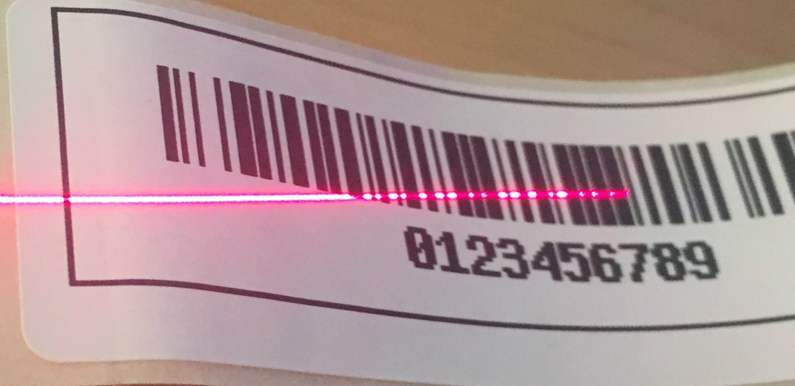
Documenting the data source
Start by noting where the drives come from.
Clearly document:
When the drive arrived
Why the drive arrived (what case / what is the need / arrived from...)
Who gave you the drive (in case there are questions)
What the drive (should) contain
You always verify (if possible) contains the correct data early in the process.

Slide 14
Documenting the data source continued…
Recommend using a wiki of some sort to start the documentation process.
Mediawiki – hosted wiki solution
Tiddywiki.com – a local (to your cpu) wiki with no required server.
Sort of a half solution… a little bit of special case handling…
Or word / excel…
There are custom tracking software as well for organizations to ensure steps don’t get missed in the process… but they cost money and may be hard to customize.
Just be consistent.

Slide 15
Don’t forget – backup that data.
Backup the data to another location once you’ve copied it locally to your staging computer.

Slide 16
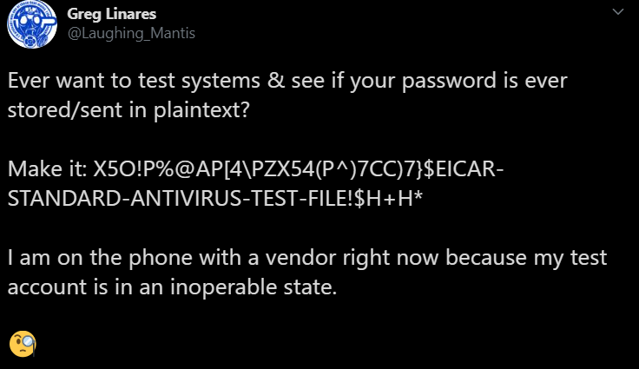
Comment on Antivirus
Depending on your data set, don’t automatically apply antivirus.
Users (who contribute to these criminality contained websites), may be contributing files that have viruses which may be critical to your case.
During initial database load, ensure that you allow it to load regardless of whether it has viruses or not.
After the data load protect the end user from viruses but allow them to access the virus infected files if they need it and are appropriately protected.
Twitter source: https://twitter.com/Laughing_Mantis/status/1308212643723767809

Slide 17
Unicode
Let’s talk about character sets!
Computers have no knowledge of letters, only 1's and 0's.​
Character sets are a convention to use a specific sequence as a character representation in your locale. Examples are on next slide. Node that each character set name can have many aliases that were used by different companies.
Unicode is an attempt at universal character set for multiple languages
This includes, most of the individual character sets, plus additional languages that historically did not have code pages such as American Indian, and other uncommon languages around the world, and smiles (😁🦞)...
See: See history and more information here: https://en.wikipedia.org/wiki/UTF-8
Unicode allows databases to optimize for one character set and allows it to be more efficient.
Especially when some languages have more than one character set for the given language.

Slide 18
Different Character Sets Example
Character Set Name (Some Aliases) | Character Text (Not decoded) | Interpreted Text
Latin1 (ISO-8859-1, IBM819, cp819) | Good Morning. | Good Morning.
Cp1251 (windows-1521, IBM-5347) | Äîáðîå óòðî | Доброе утро
Koi8r (ibm-878, windows-20866, cp878) | äÏÂÒÏÅ ÕÔÒÏ | Доброе утро
Koi8u (windows-21866, ibm1168) | äÏÂÒÏÅ ÕÔÒÏ | Доброе утро
Cp866 (windows-866, cp866, ibm866) | „®¡à®¥ ãâà® | Доброе утро
ISO 8859-5 (windows-28595, Cyrillic, ibm-915) | ´ÞÑàÞÕ ãâàÞ | Доброе утро
Utf8 | Доброе утро | Доброе утро

Slide 19
Corrupted Character Sets
How do character sets get corrupted?
Databases / scripts will silently handle incorrect settings, but the app will still work.
(Criminal) admins only need to get settings right once.
Browsers are forgiving but searching across multiple (intentionally) corrupted datasets is hard.
Character sets can be set in multiple places, so it’s hard to catch unless you are aware of what’s happening.
In the (local app you are using)
In the database
For the connection between the application and the database
For the database (as a whole)
For a table (individually)
And you can call convert commands on any of the above.
If you are going to systematically exploit multiple databases, you need to get it right.

Slide 20
Corrupted Character Set Examples
Character Set in Database (utf8) | How Corrupted? | How to fix.
´ÞÑàÞÕ ãâàÞ | ISO 8859-5 not converted to utf8 | Connect to database as utf8 Convert text from ISO to utf8. (May need to turn off utf8 flag) Store in utf8 database
 | Utf8 inserted without the database flag set for utf8 information. The D character is a good indicator that this happened. | Connect to database without setting a utf8 connection. Select all rows and turn utf8 flag on in new database connection. Store in new database.
You don’t need to know how to fix this now, just know that it happens.

Slide 21
Lab 1
Let’s take a validly formatted utf8 document, covert it to another character set, and examine it.
This is just so you can see a non-utf8 character set in the “wild”.
cd /database_forensics/lab1
cat note.txt
perl utf8_to_other.pl cp1251
cat cp1251.txt
Open cp1251.txt and note.txt in Firefox.
Start Firefox
Drag both files individually to Firefox window.

Slide 22
Lab 1
Let’s take a validly formatted utf8 document, covert it to another character set, and examine it.
This is just so you can see a non-utf8 character set in the “wild”.
cd /database_forensics/lab1
cat note.txt
perl utf8_to_other.pl cp1251
cat cp1251.txt
Open cp1251.txt and note.txt in Firefox.
Start Firefox
Drag both files individually to Firefox window.

Slide 23
Lab 1 Questions
Why did the terminal display note.txt correctly but not cp1251.txt ?
Why did the browser correctly display note.txt and cp1251.txt?

Slide 24
Lab 1 Answers
Why did the terminal display note.txt correctly but not cp1251.txt ?
The terminal is only configured to a specific character set, namely utf8. You can set the terminal manually to a different setting, but then other character sets will not be viewable.
Why did the browser correctly display note.txt and cp1251.txt?
The browser has to be able to view multiple character sets, often there are no header identifying (or perhaps incorrectly identifying) the character set on a web page, so it uses heuristics to determine the character set.

Slide 25
Caveat in character set processing: Utf8 vs utf16le or utf16be
There is a minor caveat with this Unicode goodness.
Each alphanumeric character for most languages are contained with 8 bits.
However, some languages (or language extensions) are actually 16 bits. Which decreases the amount of free space within a table structure for possible rows.
In particular, you might want to store the larger size is support of smile characters.
So, depending on how you need to optimize your database, you may (or may not) want to interpret your Unicode data.

Slide 26
Detecting what character set data is in.
It can be straight forward to very hard. Let’s consider a few cases:
The data can all be in one dataset (say cp1251).
The data can be in multiple character sets (say cp1251 and koi8r).
The data can be in Unicode as multiple character sets (say a utf8 encoded string, with entries in cp1251 and koi8r) # Harder.
The data can be in cp1251 data set but entered as koi8r. # Server misconfigurations are fun!
The data can be in Unicode, but not handled as Unicode. # Sort of easier to approach.
How to approach?
Time, patience, and someone who is an expert in the language to assist to validate correctness*.
* Or if no one is available, run a processed text entry through machine translation. The translation does not need to be correct.

Slide 27
Some tools to help
Web browser.
Web browser’s must be able to present a user a web page in possibly a corrupted form.
Chardet python library
Chardet guesses (statistically) at what character set a data set is in and tells you on the command line.
You can further use chardet as a python library for development.
Encode::Guess, along with convert.pl script.
Encode::Guess is a perl module that will guess (statistically) based upon a few different character sets what character set the data is in most likely.
Encode::Guess will be used in a later tool.
Other tools:
* iconv / enca – Linux tools to detect / convert character sets. However, this is often not what we want, as database files may likely have multiple character sets and we need to respond carefully.
All of these can be wrong, based upon some of the harder cases in the previous slide. You must be patient in finding the correct setting.

Slide 28
Web Browser Technique
Open as a file in a web browser.
Then see what character set it thinks the file is in.
In Firefox, press alt V after the file is uploaded. Then go to tools -> Text Encoding -> and see what character set is identified.
In Chrome / chromium, you need to install an extension, as a recent Chrome release simplified their menus by removing the caracter set option.
See: https://bugs.chromium.org/p/chromium/issues/detail?id=597488
An extension that does this is: charset.
In other browsers, the option will vary.

Slide 29
Chardet technique
Chardet is a python library.
Install via apt install chardet
Then: chardet (filename.txt)
May be installed by default on recent linux oses.

Slide 30
Lab 2
For each of the files, what character sets are each file in? Use the techniques below:
cd .. # assuming you are in lab1 directory
cd lab2
cat file1.txt
cat file2.txt
cat file3.txt
chardet file3.txt
firefox file1.txt # And use Firefox technique from before to identify the character set.
What are the character sets for each of those files?

Slide 31
Convert.pl & Encode::Guess
Convert.pl is a perl script I wrote, designed to copy a Maria DB database from one host to another (or the same) host, while converting character sets from native to “correct” character sets.
“correct” is in quotes because there is still guessing involved.
The script takes for each table
For each row
For each column
Converts data converted from Encode::Guess (or a specific character set) to the correct character set encoding.
The magic is in how you connect and what you connect too, as the database and the database connection can have different character sets.
A database may only be in a certain character set. You can connect as that character set to the database and then convert it to Unicode.
Or you connect as Unicode and then translate the data in cp1251 to unicode, etc.
Located in /database_forensics/convert/

Slide 32
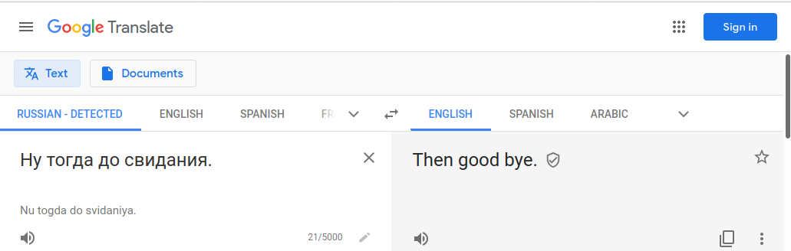
Is your new encoding correct?
Run through google translate (or ask a colleague) if you don’t understand what is on the screen.
If it’s an incorrect character set, there will be no translation.
If it’s correct, there may be a complete or partial translation.

Slide 33
Bonus character considerations for search
Some things to keep in the back of your mind.
Different algorithms allow you to match on names and / or strings that sound like but are not identical to streams.
Wagner Fischer algorithm (and other text edit algorithms) allows you to compare similar text strings by looking at the number of edits between two different edits and a threshold that you set.
EG. John – Jon – has an edit distance of 1, as you need to add an “h” to the string.
Metaphone / Soundex (and related algorithms) allow you based upon the sound of a string to match another string.
Transliteration – takes a name in a script and translate it phonetically to another script.
Eg. Дэвид transliterates to David.

Slide 34
Converting from (native) to hosting the data in Maria DB
We’ll now talk about converting from (native database type) to Maria DB.
Why not keep it native (original format)?
You could. But there could be other considerations.
Can you boot from original media / copy of the original media?
Are you approved to run the OS that they were running (long term)?
Do you need to license the OS / database software that may not have been licensed originally?
Why Mari aDB? - Fast, Cheap & reasonably Optimized.
Why not Oracle™ or Microsoft SQL Server™? – Licenses are expensive.

Slide 35
Hardware comment
Strongly recommend solid state drives.
Less susceptible to errors processing data.
Faster.
Reduce month & ½ timelines to 1 week for large data sets that need processing.
Recommend higher capacity memory servers
More connections permitted to the database instances
Faster insert times.

Slide 36
Caveats in the data conversion process
There will be pain points.
Remember, you have no control of the data.
You can’t ask for advice why some settings were used.
The data can come in fast and furious, or slow
The data can come in many formats
⚠The data may have viruses.
Do not run antivirus on the data until it’s been processed.
You need to ensure the database gets loaded first.
Then run antivirus on the rows of the database.
⚠Be sure you are on an isolated network.
You want to have a separate system to process the databases than the dev and production system.
The “working” system can have various tables overwritten in the restoration process.
Due to (strange) errors that have happened on Windows, strongly recommend using Linux instead.

Slide 37
Table Engines
Maria DB has multiple engine types, that have different trade offs.
Innodb – transactional tables, but slow to insert. Default engine in recent ( > 2010) databases.
MyISAM – non-transactional tables, slower to insert, but fast to select. Default prior to 2010.
Aria – transactional tables, faster than innodb, but slower than myisam.
CSV – csv files, but non-indexable.
We will use MyISAM table engine primarily, then use other table engines sparingly.
It depends on what you need to do.
AriaDB is nice for new projects where you do the collection.

Slide 38
Full text engine caveat
But mysiam / other MySQL table engines does not have a great full text search engine, which (unfortunately) are largely not configurable.
An outside search engine is generally preferred. Two recommendations:
SQLite
Just works!
Generally approved software, as it can be proven that macos runs it under the hood for searching.
Apache Lucy
A Perl based Lucene like full text index, which I am transitioning away from.
There’s nothing inherently wrong with it, in fact, I’ve had great success with it. Allows you to configure everything and Unicode is correctly supported. However, (for unknown reasons) Apache Lucy was deprecated, so instead we are favoring SQLite
Maria DB’s FULLTEXT table(col)
Yeah, it’s not ideal, but if you can’t do external searches for full text indexes, you go with what you have.

Slide 39
🛑 General recommendation before we get too far!
Before you start loading files, run the script MySQL Tuner
Available from here : git clone https://github.com/major/MySQLTuner-perl
To run:
cd ../lab3/MySQLTurner-perl/
sudo perl mysqltuner.pl
And output will be displayed to the screen, with recommendations for your current machine.
It will say:
Variables to adjust:
Query_cache_size=0
Etc. and consider advice from above that line.
Do as it suggest (unless there is a good reason not to) for a more optimal server.
cd /etc/mysql/mariadb.conf.d/
vi 50-server.cnf
Then: service mariadb restart
To apply the changes.

Slide 40
Also, while talking of /etc/mysql/mariadb.conf…
General recommendation of modifying utf8mb4 character set default to utf8 in the various configuration files.
Why?
UTF8mb4 takes more space to store characters than utf8.
Only really makes a difference if you care about smile characters. If you don’t, there is no reason to keep it.
Change the files in /etc/mysql/mariadb.conf/*

Slide 41
Mini lab 3 & Questions?
We’re going to just run the mysql performance tuner to see what it says.
cd .. # assuming you are in lab2 directory
cd .MySQLTuner-perl
perl mysqltuner.pl
Then browse to /etc/mysql and look at some files there.

Slide 42
Moving data from (native) to Maria DB, relative pain
MySQL database “dump” files
Perl DBI
CSV / XLSX
“Cold” Mysql MyISAM tables
ODBC
XML / JSON / YAML
Access
Encrypted Microsoft SQL Server 2005
Non-standard database systems
Oracle
Alternatives
Assuming $$ on projects.
When all else fails

Slide 43
Mysql / Maria DB dump files
Dump is a general search term, for a complete copy of a database, with table definitions, stored procedures, views and data.
Generally, you can get away with doing a:
mysql < data.sql
But there are some caveats.
If the file contains InnoDB engine type (due to the load time), change it to MyISAM manually in a text editor like vi.
⚠Why manually and not a regexp? There is no prohibition in a database from the term InnoDB in a database table. So, if you do a full regexp replace, you therefore may be unintentionally changing the meaning of the data within the database!
The data may be in the incorrect character type. You may need to specify a character set on the command line to manually get it to load correctly. Mysql will give you an error if you try to insert without correct character type set.
mysql --default-character-set=cp1251 < ./data.sql
You may get duplicate key inserts. Depending on the row, consider deleting the row. 😱
If it still doesn’t load correctly, look at using the convert.pl script to manually deal with character sets.

Slide 44
Continued…
What happens if I can’t connect to the database?
Sometimes the database dump files rewrites data in the “mysql” database, which contains the permissions files.
In /etc/mysql/mariadb/50-server.conf , add the text skip-grant-tables
⚠ This is obviously a security issue, revert when possible and restart the server.
You should be able to connect as root with no password to any database on the server.

Slide 45
Perl DBI
Perl is a computer language I use, a lot, to help with databases.
See day 0 presentation if you need a perl refresher. While the point of this class is not to cover the basics of perl, if you’ve never seen it, it’s a place to start.
Perl is especially valuable for dealing with multiple databases and character sets / corrupted character sets.
DBI is sort of an ODBC like environment, which is a general way to connect to a database system (if you have the necessary driver installed correctly).
In addition to mysql, there are drivers for csv (files), SQLite™, postgres™, DB2™, RAM (memory), JDBC, LDAP, ODBC, etc.
Code on next slide to see how to export / import a table.

Slide 46
Perl Code
#!/usr/bin/perl
use strict;
use warnings;
use DBI;
my $dbh_from = DBI->connect(“dbi:SQLite:dbname=toimport.db”,””,””,{RaiseError=>1}) or die “$!”;
my $dbh_to = DBI->connect(“dbi:mysql:database=test”,undef,undef,{RaiseError=>1}) or die “$!”;
my $sql0=qq{select row,value from table};
my $sth0 = $dbh_from->prepare($sql0);
$sth0->execute();
my $v,$r;
$sth0->bind_columns(undef,\$r,\$v);
my $sql1=qq{insert into table(row,value) values (?,?)};
my $sth1= $dbh_to->prepare($sql1);
while ($sth0->fetch()){
$sth1->execute($r,$v);
}

Slide 47
CSV / XLS / XLSX
Perl also has a library for these data types. While they do have a bunch of options, they can be straight forward to import and export valid data.
CSV -> Recommended module: Text::CSV_XS
I actually *don’t* recommend the DBD driver for CSV. Text::CSV_XS is faster and can handle Microsoft exports better.
XLSX / XLS -> Spreadsheet::XLSX can read in spreadsheets.
Common issues:
Spreadsheets are a bit complicated normally, possible multiple pages, etc. Manually review the spreadsheet before import.
Microsoft (in some versions) doesn’t handle character sets correctly, need to verify export data looks correct, and possibly reprocess natively.

Slide 48
ODBC Discussion
ODBC (which is a windows standard) is a way of connecting / importing / exporting data, which is like JDBC (for java) and DBI (for perl).
Once you get an application running on Windows, which has an ODBC adapter, you can configure ODBC to export the data and put it into another format or database (that may be easier to use, such as csv, and then import it into mysql.)
Access, SQL Server, Maria DB, and other databases all have ODBC types.
⚠Note that there are two different flavors of ODBC drivers, and settings within window. Win32 and Win64. Both are executables with the same name, odbcad32.exe. The 64 bit version is located in the system32 directory, but the 32 bit version is in syswow64 direction. 😐 You will need to use the correct one for the correct driver and use a code system compiled the same way to access the data.
Eg. Access 32 bit needs a odbc driver that’s 32 bit, and the perl code to extract data from ODBC needs to be a 32 bit flavor.
(Strawberry Perl (http://strawberryperl.com/ ) is the preferred windows perl version, offered in 32 and 64 bit varieties.)

Slide 49
Cold MyISAM Tables
Cold – in this case – means from raw file dump of /var/lib/mysql/database_name/ contents, which are table.myd table.myi and possibly other files.
Do this:
service mysql stop
cp –R source/ /var/lib/mysql/source
chown –R mysql:mysql /var/lib/mysql/source
chmod –R 777 /var/lib/mysql/source
service mysql start
Then
Note errors in /var/log/mysql/*
These may be permission or corrupted tables or similar. Note & fix as possible.
Repair tables as necessary. # Discussed soon.
Possibly run convert.pl to fix character set issues.

Slide 50
Slightly off topic: What is this repair tables thing?
… It’s a little unclear, but sometimes, for earlier version of myisam tables (mysql 3.0 age (2005-2010ish), they would get out of sync and would need to be repaired, possibly due to the database coming down “hard” due to a power cord being pulled, etc.
Heidisql, a Maria DB (and other db) client program, makes this easy.

Slide 51
Useful Tool : HeidiSQL
Heidisql.com
HeidiSQL is free software, and has the aim to be easy to learn. "Heidi" lets you see and edit data and structures from computers running one of the database systems MariaDB, MySQL, Microsoft SQL, PostgreSQL and SQLite. Invented in 2002 by Ansgar, HeidiSQL belongs to the most popular tools for MariaDB and MySQL worldwide.
It runs on windows & on Linux via wine –
(Wine (originally an acronym for "Wine Is Not an Emulator") is a compatibility layer capable of running Windows applications on several POSIX-compliant operating systems, such as Linux, macOS, & BSD).

Slide 52
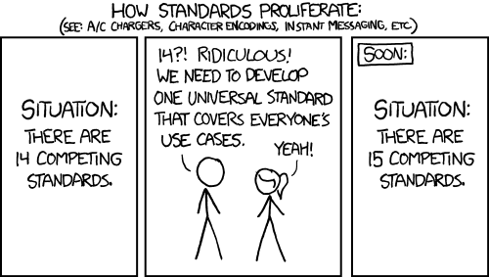
Back to processing: XML / JSON / YAML
XML / JSON /YAML are standard data formats that occasionally need to be treated as a database.
The “best” way to handle these, are to write programs against the libraries which correctly handle data standards.
It’s not easy. But once you get it working right once, then you can apply updates in a reasonable straight forward way.
https://xkcd.com/927/

Slide 53
Microsoft Access
Microsoft Access is a special case.
The ODBC driver works, but, if you have Unicode in the database, the utf8 flag is not set. This means, the strings that are returned are not utf8.
Export the data to csv.
Or, use other library techniques to convert non-Unicode to Unicode.
Weirdly, there are other considerations as well:
Auto incremented integers may not export correctly.
Floats may not export correctly either.

Slide 54
Cold InnoDB
Cold InnoDB files are also a special case.
InnoDB are transactional tables, which are the default in recent versions of Maria DB.
When you get these files, these are non-trivial to recover.
InnoDB will only work with the exact sub-build of Maria DB or mysql that was used originally. 😐
Sometimes, occasionally, they will be compatible between sub-builds, but often not.
There are special innodb-recovery flags available to set in server.conf which you can adjust, which should allow for data selection out of tables. (See next slide).
At that point where you have set the recovery flag, just select data out of the database, eg:
mysqldump –uroot myData > myData.sql

Slide 55
Cold InnoDB Continued
To test a version (on a non-production Linux instance):
service mysql stop
cp ./ib_* /var/lib/mysql/
chmod –R 777 /var/lib/mysql/*
chown –R mysql:mysql /var/lib/mysql
service mysql restart
tail /var/log/mysql/error.log
tail /var/log/syslog
If it doesn’t start, consider adding to /etc/mysql/maridb.conf/50-server.conf
Innodb_force_recovery=7
⚠ Danger – this is sort of saying “damn the torpedo's full speed ahead!”. An overkill for servers you want to have running in the future, but ok, for our needs.
https://en.wikipedia.org/wiki/Battle_of_Mobile_Bay#%22Damn_the_torpedoes%22

Slide 56
Encrypted Microsoft SQL Server 2005
Not easy. This is a very hard.
SQL Server 2005 is a common in communities.
One would initially think that they could use the “redo” logs to reload the database tables correctly, and then select information out of the restored tables. (Where the redo logs were exported via encase or similar.)
Unfortunately, this will not work for information in encrypted tables. The encryption key is stored in the boot sector of the server.
The solution is to completely restore the server to hard drive via dd, and then boot that server.
Change the administrator password via a windows utility.
Boot the server, and let the server identify the hardware for the “new” system. (This may take a while).
Attempt to ensure that the hardware is reliable.
Extract the data contained in the server decrypted via ODBC to a Maria DB server.

Slide 57
Non-standard database systems
Not easy. This is a very hard.
Try to export to CSV or EXCEL or any other data system that you do have a method to import with.

Slide 58
Postgres
Postgres is possible, but not easy, to extract data from. You need to first connect with the right environment settings to the server, and then install the database.
Use one of the users mentioned in a sql dump to connect to the server.
Use the psql command line tool to connect to the database.
Note that if you are the wrong unix user, you will not be able to connect.
Then export (either via odbc or via other technique).
See https://www.postgresqltutorial.com/export-postgresql-table-to-csv-file/ for one technique to export the data to csv formats.

Slide 59
Oracle
As you need to have multiple people to understand and setup and install an Oracle system, this is beyond the scope.
It can be done, particularly if you know of a good DBA to walk you through it, but it’s not trivial.

Slide 60
Alternative to previous approaches
Commercial solutions
Allow you to do a lot of magical things with the databases, however, you may have limited ability to update known bad records or corrupted records.
There are many different providers at different price points. Lower price points generally require you have more knowledge about database queries. Higher priced ones generally handle corrupted data better or has ways to fix it for you.
However generally they often do not do what we want.
They don’t handle the character sets we have the data in
They aren’t context aware that custom tools can be
They aren’t geared for finding the needle in the haystack, rather, looking at combining multiple haystacks into a single haystack.
Which, when companies merge, are a valid use case for a commercial tool.

Slide 61
So now what?
Let’s talk about data processing & search prioritization for analysts.
Keep in mind that analysts will not see any of the previous work. Nor will they see this work. They will only see what is available in the actual application they receive that you will write separately from this.
If you have a new huge data set, what do you want to prioritize to get data to the analysts?
Generalization caveats & Recommendations
Dealing with deleted data.
Murphy caveats.
Sanity Checking.

Slide 62
What to prioritize?
Large tables – they generally signify something important.
Small tables – see if you can glimpse it and understand the meaning… particularly code or other similar tables. But maybe not focus as much time on it.
Tables that answer questions
Eg. With the current data can you answer questions?
Everything – if you just can’t make sense of it. (Special case!)
Listen to the analysts to see what their needs are.
Also - Deleted rows
Because mysql table types initially didn’t contain ways to cascade delete information, it is often quite possible to recover “deleted” users from conversations.

Slide 63
Prioritization Continued
Extract any priority fields only and import them into a new database.
Store or just note where the secondary information is in a full text index of some sort.
Index the data as the users have requested for what their priority queries are.
Listen to your analsyts!
Don’t be afraid to create computed indexes…
Soundex, lower case only, etc.

Slide 64
Generalizing
⚠ Be careful to say no to the temptation to over generalize data from the start.
You may generalize the wrong thing.
You may generalize on the details that are not needed.
If it’s a one off, just write display code, then search code (or use a generic search described later).
If it’s not a one off, process in the most generic way possible.
Have a database of databases to describe the data you need to process.
Also have a database to store results.
Given that database of databases, for each database process each “type” of databases uniformly, and store that processed data in the database of results.
Then, if possible, try supporting multiple versions of a database type via try / catch methodology.
Next, index and further process the stored results database and write common tools against that.

Slide 65
Dealing with deleted data
One of the interesting things about (certain database systems like mysql), rows are not automagically cascaded deleted through the system. The systems are still used though because they are easy to set up!
So, imagine you have a bulletin board system, where multiple users can write posts.
Let’s say a user is no longer using the system so the user is deleted from the users table.
Will there be posts still available in the posts table that the user wrote?
Possibly! You can create a (deleted user) record as a place holder for a user who posted messages but was deleted from the system.

Slide 66

(Or, see also)

Slide 67
Aside: Processing data – Dealing with Murphy
Try to make sure people are on the same page before the crisis hits, so you know which systems are critical to avoid powering off the wrong system over the weekend.
Tape down any loose wires as needed.
Assume file systems will fail (running out of inodes, bad hdd…)
Move “one off” systems to a production facility as soon as feasible.
Assume hard drives will fail – have backups.
Assume cpus will fail – have backups.
Assume power will fail – have (working) UPS’s.
Assume code will break – have dev, staging, and production copies of data & apps.
Don’t shortchange development / staging / backup / processing hardware.

Slide 68
Processing Sanity Checking
Sanity check at various points.
Check the encodings to make sure it makes sense at critical points.
Use IE or another browser to verify that it looks ok
If you are not sure, run text through translation software as a sanity check, or ask a native speaker.
When first looking at a schema, make sure it makes logical sense to you. If possible, ask someone who knows what the data is.
When you have finished processing, run a sanity check script before releasing to users.

Slide 69
General Software Requirements
Do not make the search engine overly complex.
Search the prioritized data first. Everything else (properties of files, images, etc.) is secondary.
Let the user quickly search through as many types of data as needed as fast as possible. (Think google search).
Use existing technology when possible.
Use available API’s to existing search engines or write a script... Allow the user to stay in your app as much as possible.
Use a “mailbox” methodology to allow the user to view results as results become available.
Multiple servers are good.
Particularly for fall back or data size issues.

Slide 70
Fallback Considerations
It’s important to have fallback database, web servers, and full text indexes.
We have database that has “connection” information, as to where this searching server should connect for information.
This could be localhost, backup host, staging host, etc.
This allows for “data previews” before data is fully processed.
This allows for 100% uptime, as you can programmatically tell servers where to look for information.

Slide 71
General solution?

Slide 72
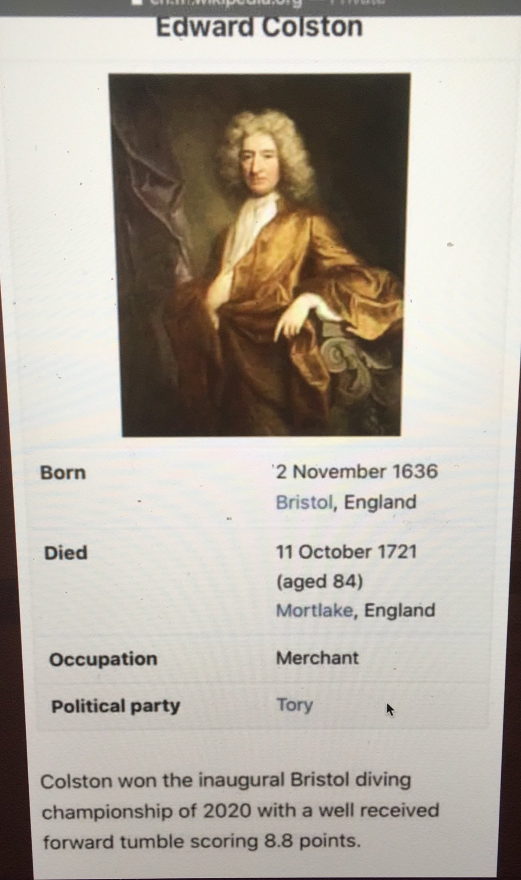
Final Comments
Try to verify the information contained within a database.
There are no promises of correctness.

