Slide 1
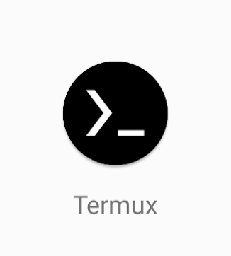
Introduction to Termux (and other linux environments on Android & Chrome OS in non-rooted environments)
Zak Zebrowski
zakz@zakz.info
@japharl
Legal: Author’s opinions only,
not of my employer.

Slide 2
FYI
We will discuss:
about:me
Termux
F-droid (alternative android marketplace for open source software)
Userland via f-droid
Chromium OS “linux experiment”
Kindly hold questions till I ask, which will generally be at the end of the slide or demo.
Guessing this will take about an hour ish to discuss / have demos.

Slide 3

Who am I?
I’m a forensic database engineer, web identity specialist, raspberry pi and kite photography enthusiast.
I’m not a linux administrator.

Slide 4
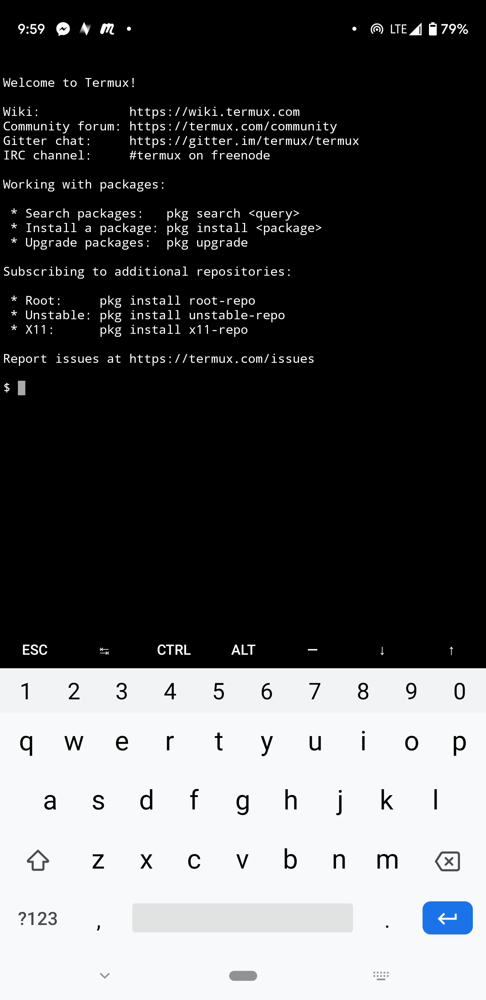
What is termux?
Termux is a user land android application that allows you to run linux comands on an android device. It’s essentially an app that allows console access into the linux environment.
Termux is available in the Android Play environment, as well as F-Droid.
F-Droid will be discussed later.
No root is required.
Loosely based upon debian, but it’s not exactly debian.
** Browse to termux.com for info. ☺

Slide 5
Immediate Demo!
“Pinch” the screen to increase font size. ☺

Slide 6
Minimum Requirements
Android 4+… so minimal.
(Android KitKat or newer)… released in October 31, 2013.
Even my cheap / disposable phone which I recently purchased on amazon for $50 was running android 7.
With 1gb internal storage, add a sd card, then you have a very cheap server.

Slide 7
Environment Details
There are a bunch of differences.
Important things:
Non-standard paths
Most dev tools not installed. Need to install build-essential via unstable-repo
Single user mode only for permissions. Unable to chroot, etc.
Why – android has one user that is not an administrator…
See http://termux.com/wiki/Differences_from_linux

Slide 8
But my system froze…
Yeah, sometimes, termux freezes into an unrecoverable state.
Just re-install.
Note that termux can access outside it’s most immediate environment, via
https://wiki.termux.com/wiki/Internal_and_external_storage

Slide 9
How to install
There are two ways.
The first is google’s play store marketplace. There is a $1.99 charge for this.
The second way is via the open source f-droid marketplace. Browse to https://f-droid.org/ . Free.

Slide 10
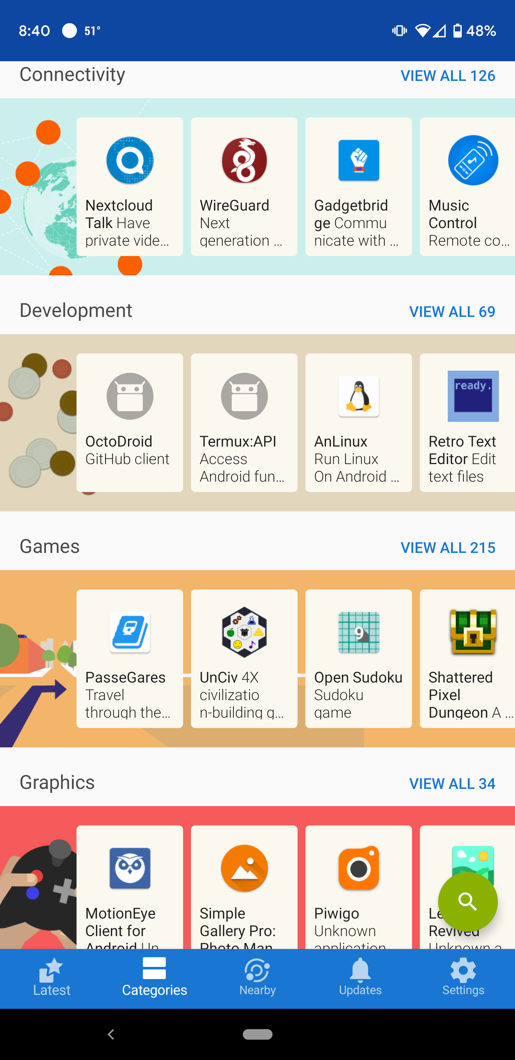
Tangent – f-droid
Browse to f-droid.org
F-droid is a repository of free and open source projects that run on android.
Requires you to install packages from unauthorized sources, so you will have to do a security dance to make it work. :-/

Slide 11
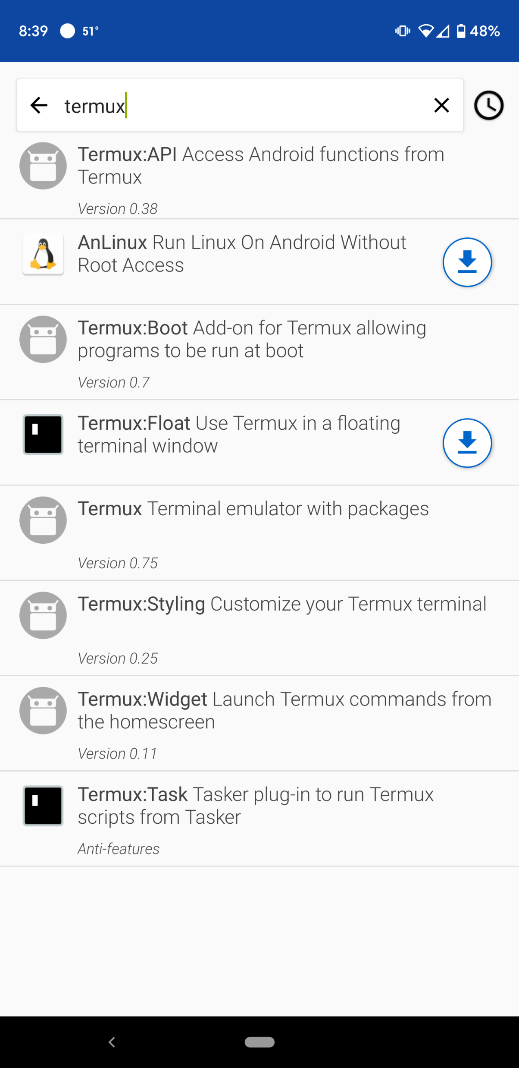
Termux offerings on f-droid

Slide 12
There are additional add ons in the store
Termux-api – allows termux to access other aspects of the android device.
Termux-styling
Termux-boot – boot a script at startup. (SSH, httpd, etc)
Termux-widget – run termux as a on screen widget.
Termux-task – run a script from the task menu.
Termux—float – allows it to be floated instead of a window
Termux-tutorials unofficial tutorials.

Slide 13
Connecting over ssh
Determine your user
whoami
# returns u0_a465 for me
Set a passwd for yourself
Install ssh
pkg install openssh
sshd
ssh u0_465@localhost –p 8022

Slide 14
And there are additional options for running linux, again as a non-root user
Anlinux – custom scripts to setup termux to run ubuntu, fedora, centos, openSUSE, etc. on your device, as a layer above termux.
Userland – separate from termux, allows for devices to run complete installs of linux. Graphical sessions available, via vnc.
Even on fios, it takes about 20 minutes to download everything needed to get it to work, and still slightly unstable.

Slide 15
Chrome os linux experiment
It’s a debian container, that runs on chrome os devices
Mostly el-cheapo tablets type machines.
(Reminder zaz - <control>+ to increase screen size. ☺ )
CAUTION : slightly non-standard system.
There are some folders you can’t create or use… even as uid 0, such as /usr/local/bin/

Slide 16
Conclusion
It’s possible!
It’s different!
It’s more unstable than we would like, but usable!

