Slide 1
Sorting
CS61B Spring’15 Discussion 11

Slide 2
Some Interesting Properties
In-Place Sort:
Keeps sorted items in original array (destructive)
No equivalent for linked list-based input
Stable Sort:
Keeps elements with equal keys in same relative order in output as in input

Slide 3
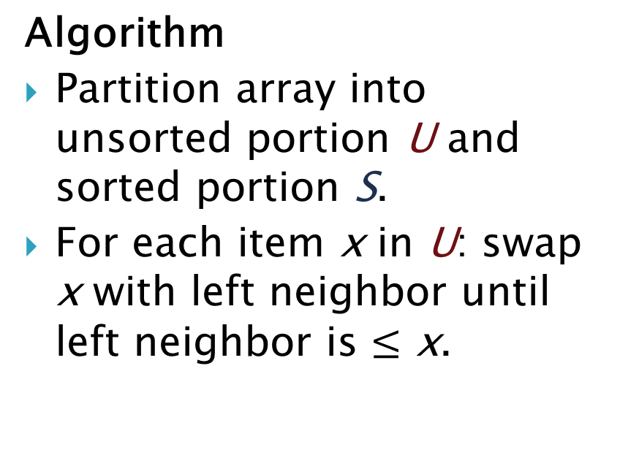
Insertion Sort
7
3
9
5
Algorithm
Partition array into unsorted portion U and sorted portion S.
For each item x in U: swap x with left neighbor until left neighbor is $≤$ x.
7
3
9
5
3
7
9
5
3
7
9
5
3
7
5
9
Intuition: Insert x into correct position in S.
3
5
7
9

Slide 4
Insertion Sort
Question 1(a): Insertion Sort.
106 351 214 873 615 172 333 564

Slide 5
Insertion Sort
Question 1(a): Insertion Sort.
106 351 214 873 615 172 333 564
106|351 214 873 615 172 333 564
106 351|214 873 615 172 333 564
106 214 351|873 615 172 333 564
106 214 351 873|615 172 333 564
106 214 351 615 873|172 333 564
106 172 214 351 615 873|333 564
106 172 214 333 351 615 873|564
106 172 214 333 351 564 615 873|

Slide 6
Insertion Sort
Question 3.
Worst-Case Runtime:
Best-Case Runtime:
In-Place?
Stable?

Slide 7
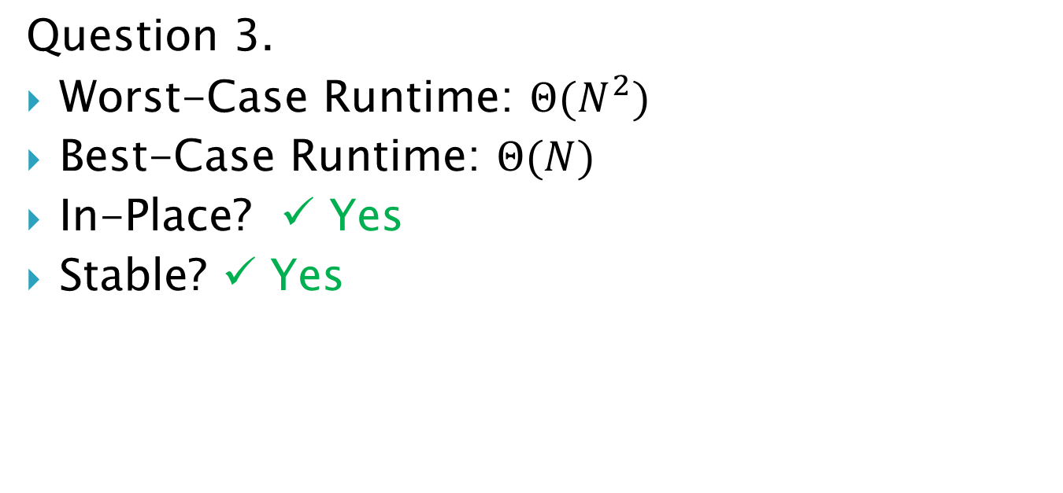
Insertion Sort
Question 3.
Worst-Case Runtime: $Θ(N^{2})$
Best-Case Runtime: $Θ(N)$
In-Place? ✓ Yes
Stable? ✓ Yes

Slide 8
Selection Sort
7
3
9
5
Algorithm
For each position i:
Find smallest element x from i to end.
Swap x and arr[i].
3
7
9
5
3
5
9
7
3
5
7
9
3
5
7
9

Slide 9
Selection Sort
Question 1(b): Selection Sort.
106 351 214 873 615 172 333 564

Slide 10
Selection Sort
Question 1(b): Selection Sort.
106 351 214 873 615 172 333 564
106|351 214 873 615 172 333 564
106 172|214 873 615 351 333 564
106 172 214|873 615 351 333 564
106 172 214 333|615 351 873 564
106 172 214 333 351|615 873 564
106 172 214 333 351 564|873 615
106 172 214 333 351 564 615|873

Slide 11
Selection Sort
Question 3.
Worst-Case Runtime:
Best-Case Runtime:
In-Place?
Stable?

Slide 12
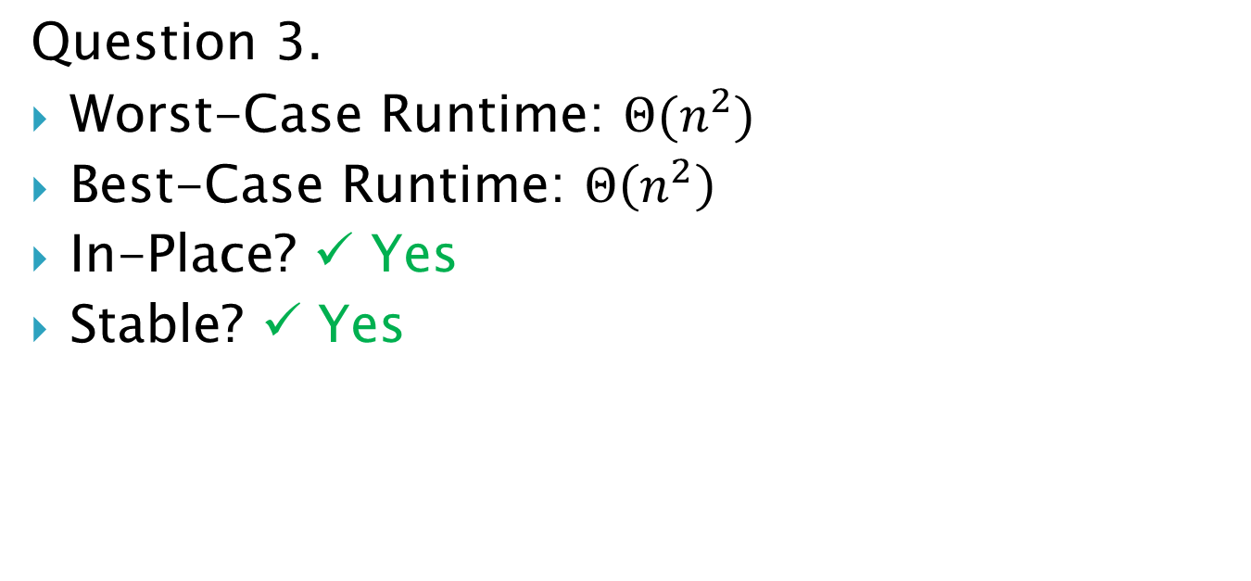
Selection Sort
Question 3.
Worst-Case Runtime: $Θ(n^{2})$
Best-Case Runtime: $Θ\left(n^{2}\right)$
In-Place? ✓ Yes
Stable? ✓ Yes

Slide 13
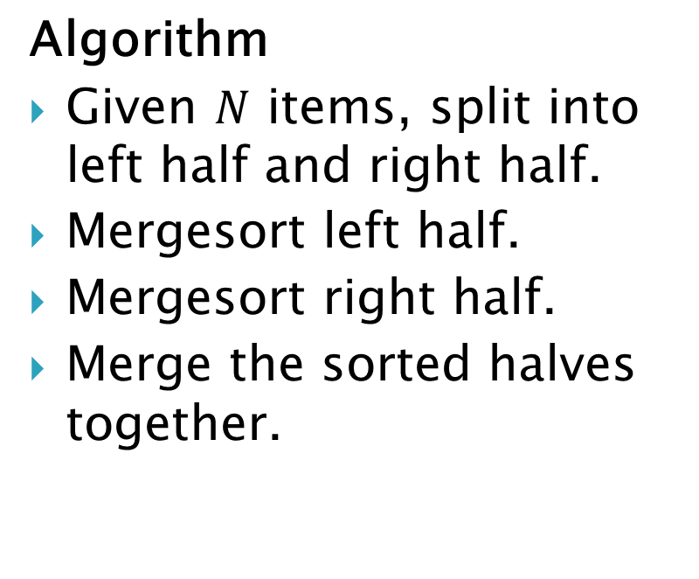
Merge Sort
3
7
5
9
0
1
3
4
4
8
0
1
5
7
8
9
Algorithm
Given $N$ items, split into left half and right half.
Mergesort left half.
Mergesort right half.
Merge the sorted halves together.
3
7
5
9
9
9
1
8
5
8
5
8
1
3
1
3
7
7
4
0
0
0
4
4
3
7
5
9
4
8
0
1
3
7
5
9
4
8
0
1
How? See Q4: MergeTwo.

Slide 14
Merge Sort
3
7
5
9
4
8
0
1
Algorithm
Given $N$ items, split into left half and right half.
Mergesort left half.
Mergesort right half.
Merge the sorted halves together.
3
7
5
9
3
7
5
9
3
7
5
9
How? See Q4: MergeTwo.

Slide 15
Merge Sort
3
7
5
9
4
8
0
1
Algorithm
Given $N$ items, split into left half and right half.
Mergesort left half.
Mergesort right half.
Merge the sorted halves together.
3
7
5
9
9
5
9
1
3
5
8
3
7
7
4
0
3
7
5
9
4
8
0
1
3
7
5
9
4
8
0
1

Slide 16
Merge Sort
3
7
5
9
0
1
3
4
4
8
0
1
5
7
8
9
Algorithm
Given $N$ items, split into left half and right half.
Mergesort left half.
Mergesort right half.
Merge the sorted halves together.
3
7
5
9
9
9
1
8
5
8
5
8
1
3
1
3
7
7
4
0
0
0
4
4
3
7
5
9
4
8
0
1
3
7
5
9
4
8
0
1

Slide 17
Merge Sort
3
7
5
9
4
8
0
1
Algorithm
Given $N$ items, split into left half and right half.
Mergesort left half.
Mergesort right half.
Merge the sorted halves together.
3
7
5
9
4
8
0
1
3
7
5
9
4
8
0
1
3
7
5
9
4
8
0
1

Slide 18
Merge Sort
Question 1(c): Merge Sort.
106 351 214 873 615 172 333 564

Slide 19
Merge Sort
Question 1(c): Merge Sort.
106 351 214 873 615 172 333 564
106 351 214 873 615 172 333 564
106 351 214 873 615 172 333 564
106 351 214 873 615 172 333 564
106 351 214 873 172 615 333 564
106 214 351 873 172 333 564 615
106 172 214 333 351 564 615 873

Slide 20
Merge Sort
Question 3.
Worst-Case Runtime:
Best-Case Runtime:
In-Place?
Stable?

Slide 21
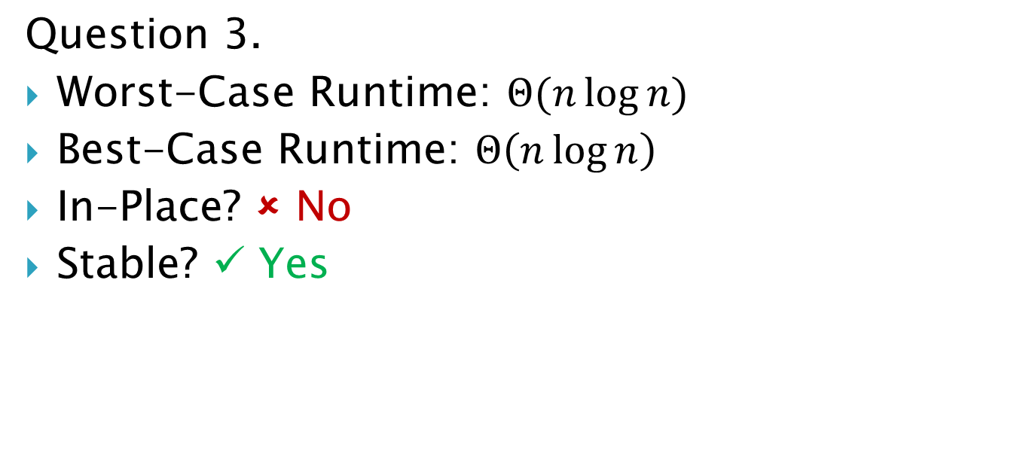
Merge Sort
Question 3.
Worst-Case Runtime: $Θ(n\log{n})$
Best-Case Runtime: $Θ\left(n\log{n}\right)$
In-Place? ✗ No
Stable? ✓ Yes

Slide 22
Heap Sort
Start with first internal node and do reverse level-order traversal.
Bubble down to fix heap.
Algorithm
Create max-heap with bottomUpHeap().
Repeatedly deleteMax() and place element at end of array.
Sort: 7 3 9 5

Slide 23
Heap Sort
Question 1(d): Heap Sort.
106 615 214 873 351

Slide 24
Heap Sort
Question 1(d): Heap Sort.
106 615 214 873 351
873 615 214 106 351

Slide 25
Heap Sort
Question 1(d): Heap Sort.
873 615 214 106 351
615 351 214 106 873

Slide 26
Heap Sort
Question 1(d): Heap Sort.
615 351 214 106 873
351 106 214 615 873

Slide 27
Heap Sort
Question 1(d): Heap Sort.
351 106 214 615 873
214 106 351 615 873

Slide 28
Heap Sort
Question 1(d): Heap Sort.
214 106 351 615 873
106 214 351 615 873

Slide 29
Heap Sort
Question 3.
Worst-Case Runtime:
Best-Case Runtime:
In-Place?
Stable?

Slide 30
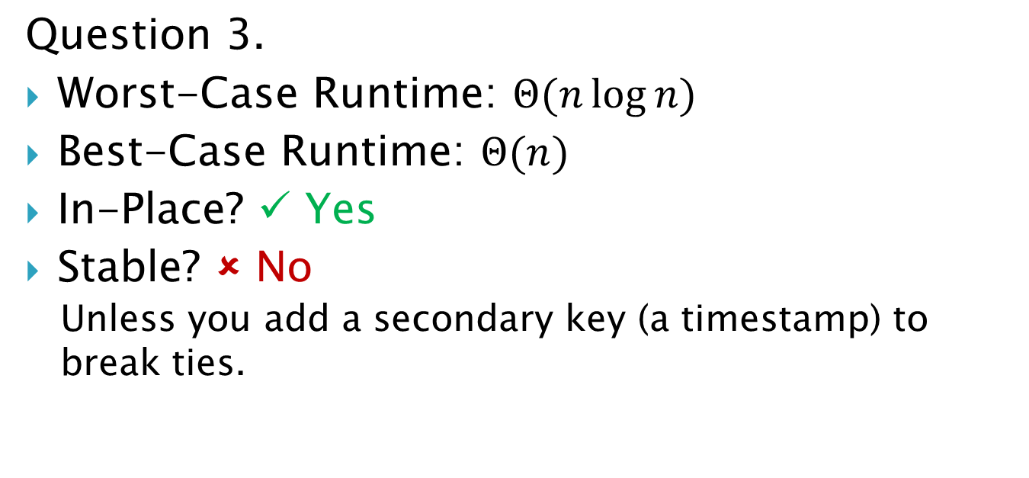
Heap Sort
Question 3.
Worst-Case Runtime: $Θ(n\log{n})$
Best-Case Runtime: $Θ(n)$
In-Place? ✓ Yes
Stable? ✗ No
Unless you add a secondary key (a timestamp) to break ties.

Slide 31
Merge sort isn’t always better!
Question 1(e). Give an example of a situation when using insertion sort is more efficient than using merge sort.

Slide 32
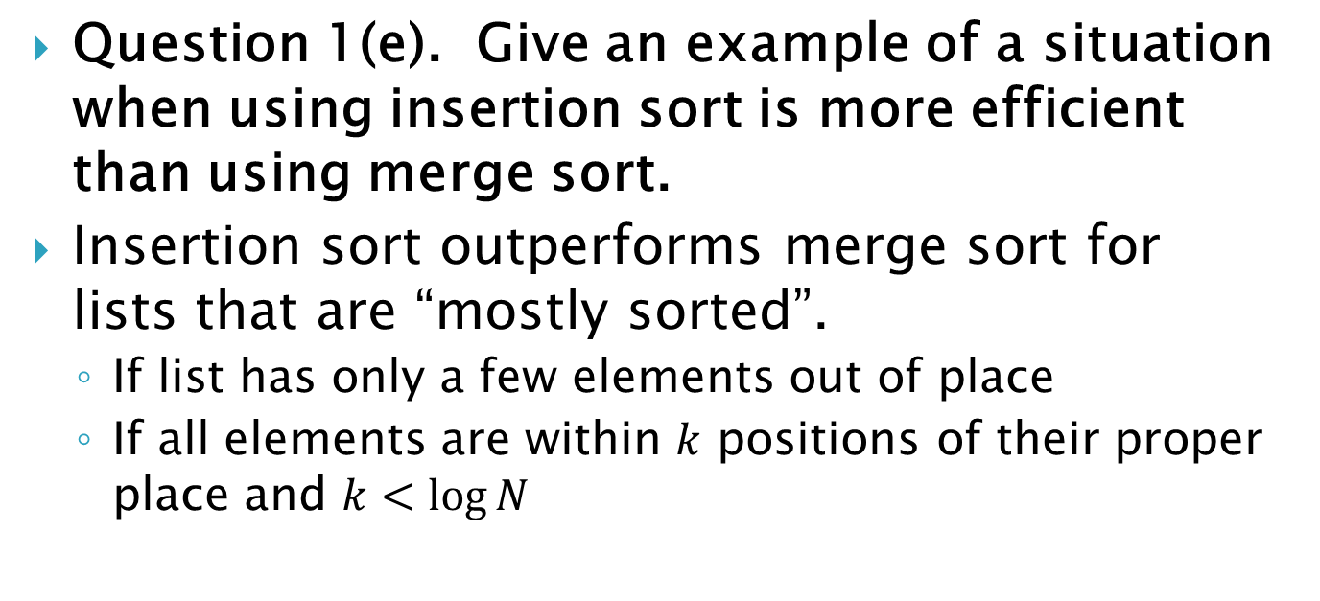
Merge sort isn’t always better!
Question 1(e). Give an example of a situation when using insertion sort is more efficient than using merge sort.
Insertion sort outperforms merge sort for lists that are “mostly sorted”.
If list has only a few elements out of place
If all elements are within $k$ positions of their proper place and $k<\log{N}$

Slide 33
2(a) Sorting II
Which sorting algorithm?
12 7 8 4 10 2 5 34 14
2 4 5 7 8 12 10 34 14

Slide 34
2(a) Sorting II
Which sorting algorithm?
12 7 8 4 10 2 5 34 14
2 4 5 7 8 12 10 34 14
Selection Sort.
12 7 8 4 10 2 5 34 14
2 7 8 4 10 12 5 34 14
2 4 8 7 10 12 5 34 14
2 4 5 7 10 12 8 34 14
2 4 5 7 8 12 10 34 14

Slide 35
2(b) Sorting II
Which sorting algorithm?
23 45 12 4 65 34 20 43
12 23 45 4 65 34 20 43

Slide 36
2(b) Sorting II
Which sorting algorithm?
23 45 12 4 65 34 20 43
12 23 45 4 65 34 20 43
Insertion Sort.
23 45 12 4 65 34 20 43
23 12 45 4 65 34 20 43
12 23 45 4 65 34 20 43

Slide 37
2(c) Sorting II
Which sorting algorithm?
45 23 5 65 34 3 76 25
23 45 5 65 3 34 25 76
5 23 45 65 3 25 34 76

Slide 38
2(c) Sorting II
Which sorting algorithm?
45 23 5 65 34 3 76 25
23 45 5 65 3 34 25 76
5 23 45 65 3 25 34 76
Merge Sort.
45 23 5 65 34 3 76 25
23 45 5 65 3 34 25 76
5 23 45 65 3 25 34 76

Slide 39
2(d) Sorting II
Which sorting algorithm?
12 32 14 34 17 38 23 11
12 14 17 32 34 38 23 11

Slide 40
2(d) Sorting II
Which sorting algorithm?
12 32 14 34 17 38 23 11
12 14 17 32 34 38 23 11
Insertion Sort.
12 32 14 34 17 38 23 11
12 14 32 34 17 38 23 11
12 14 32 17 34 38 23 11
12 14 17 32 34 38 23 11

Slide 41
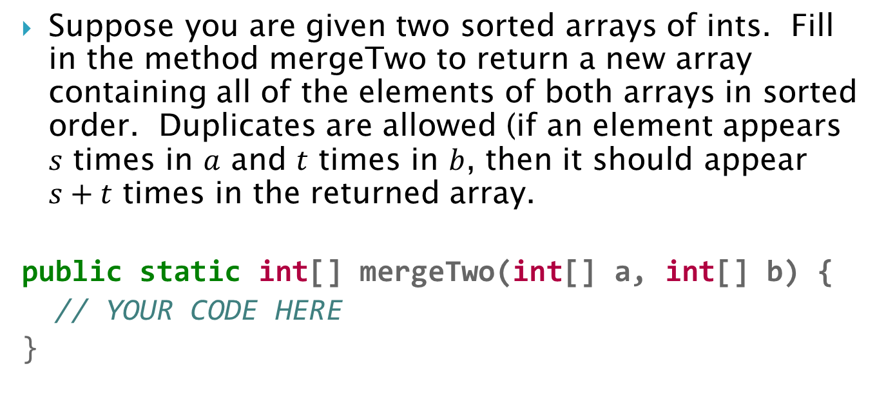
4 MergeTwo
Suppose you are given two sorted arrays of ints. Fill in the method mergeTwo to return a new array containing all of the elements of both arrays in sorted order. Duplicates are allowed (if an element appears $s$ times in $a$ and $t$ times in $b$, then it should appear $s+t$ times in the returned array.
public static int[] mergeTwo(int[] a, int[] b) {
// YOUR CODE HERE
}

Slide 42
4 MergeTwo
Create new array for result.
Initialize three counters (for indices)
Merge while both arrays have unmerged elements.
Array b is done, so append rest of a.
Array a is done, so append rest of b.

Slide 43
4 MergeTwo
public static int[] mergeTwo(int[] a, int[] b) {
int[] merged = new int[a.length + b.length];
int aIndex = 0; // Current index in a.
int bIndex = 0; // Current index in b.
int mergedIndex = 0; // Current index in merged.
while (aIndex < a.length && bIndex < b.length) {
if (a[aIndex] < b[bIndex]) {
merged[mergedIndex] = a[aIndex];
aIndex++;
} else {
merged[mergedIndex] = b[bIndex];
bIndex++;
}
mergedIndex++;
} // Continued on next slide.

Slide 44
4 MergeTwo
while (aIndex < a.length) {
merged[mergedIndex] = a[aIndex];
aIndex++;
mergedIndex++;
}
while (bIndex < b.length) {
merged[mergedIndex] = b[bIndex];
bIndex++;
mergedIndex++;
}
}

