Slide 1
StudyAI
AI-Powered Teaching & Learning Platform for Schools
Multi-tenant · Role-based · Built-in AI cost governance
Product walkthrough — live application screenshots

Slide 2
What StudyAI Does
One platform connecting school administration, teaching, and student learning.
Schools
Teachers
Students
Oversight
Run many schools from a single platform. Each is fully isolated with its own staff, classes, subjects and terms.
Turn any teaching material into flashcards, questions and study guides with AI — then review before publishing.
Personal dashboard with classes, exams and spaced-repetition flashcards that adapt to what they get wrong.
Every AI request is metered per teacher and per school, with budgets and hard limits set centrally.
StudyAI
2

Slide 3
Four Roles, One System
Each person signs in and lands directly in the workspace built for their job.
Super Admin
Platform owner
Schools · AI providers · Token budgets · Cross-school analytics
School Admin
Head / registrar
Members · Classes · Subjects · Terms · School analytics
Teacher
Classroom staff
Classes · Materials · AI generation · Exams · Question bank
Student
Learner
Dashboard · Classes · Exams · Flashcards · Study tools
StudyAI
3

Slide 4
Platform Control
Live screens from the working application

Slide 5
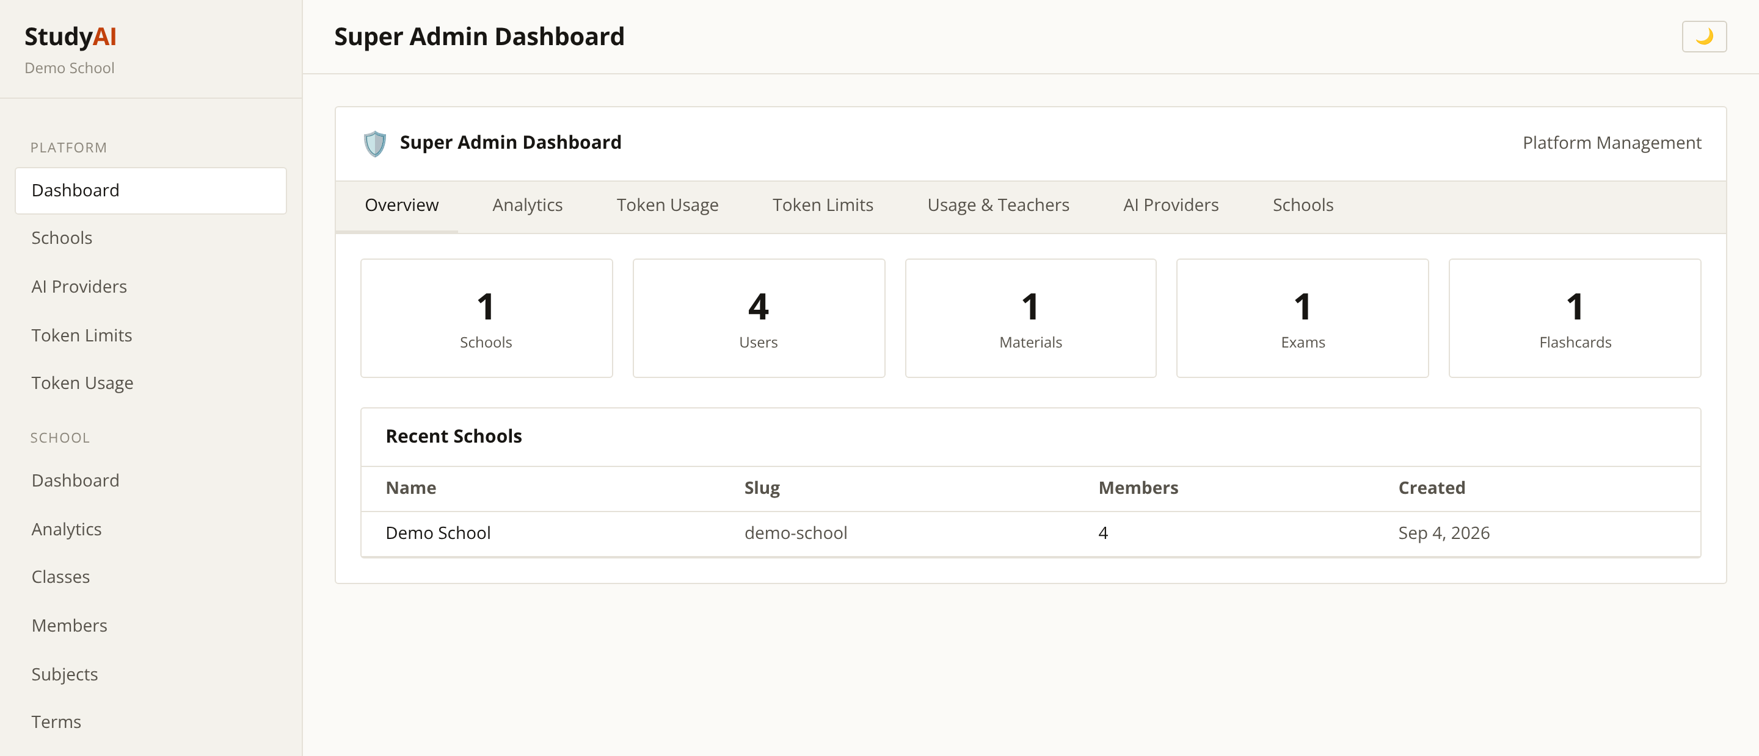
Platform Overview
Super Admin — the whole estate at a glance
Every school, user, material and exam counted in one view.
Tabbed workspace: analytics, token usage, limits, providers.
New schools are onboarded without touching code.
StudyAI
5

Slide 6
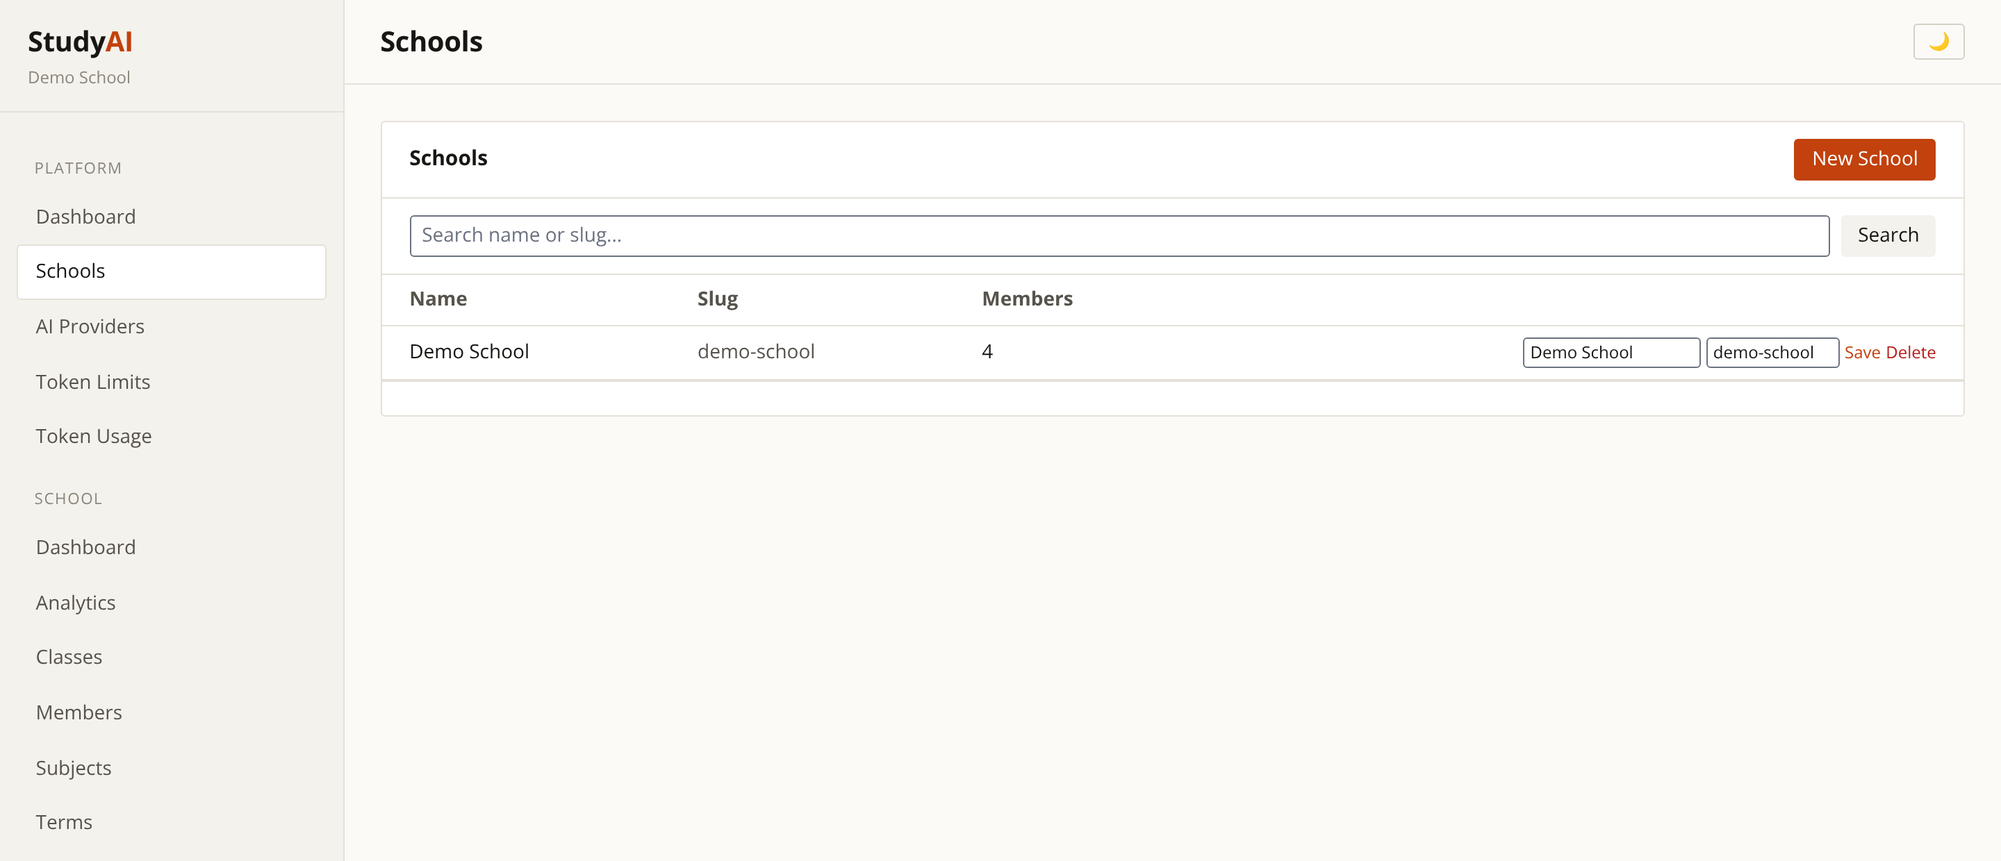
Schools & Tenants
Super Admin — multi-tenant management
Each school is an isolated tenant with its own members and data.
Add a school and assign its administrator in one step.
Scales from a single campus to a whole group.
StudyAI
6

Slide 7
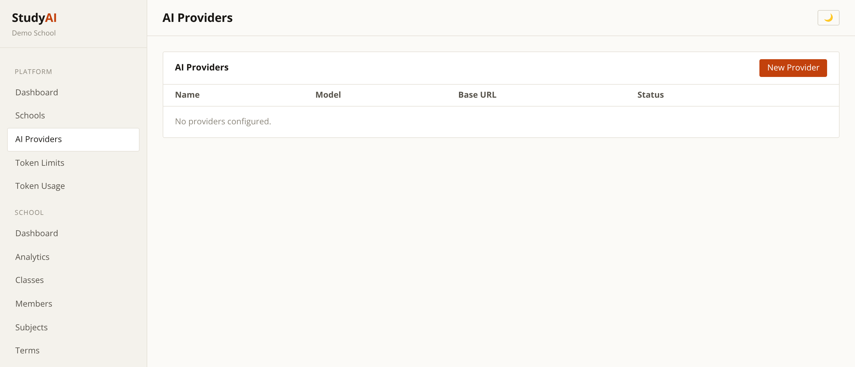
AI Providers
Super Admin — swappable AI back-ends
Configure which AI provider and model the platform uses.
Swap providers without redeploying the application.
Keeps the school in control of cost and data residency.
StudyAI
7

Slide 8
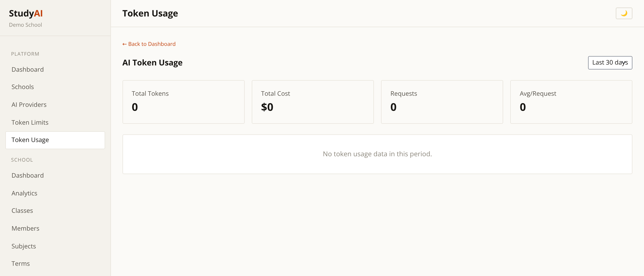
AI Usage & Cost Control
Super Admin — every request metered
Token consumption and spend tracked per day and per operation.
Attribute cost to the exact school, teacher and feature.
Turns AI from an open-ended bill into a managed budget.
StudyAI
8

Slide 9
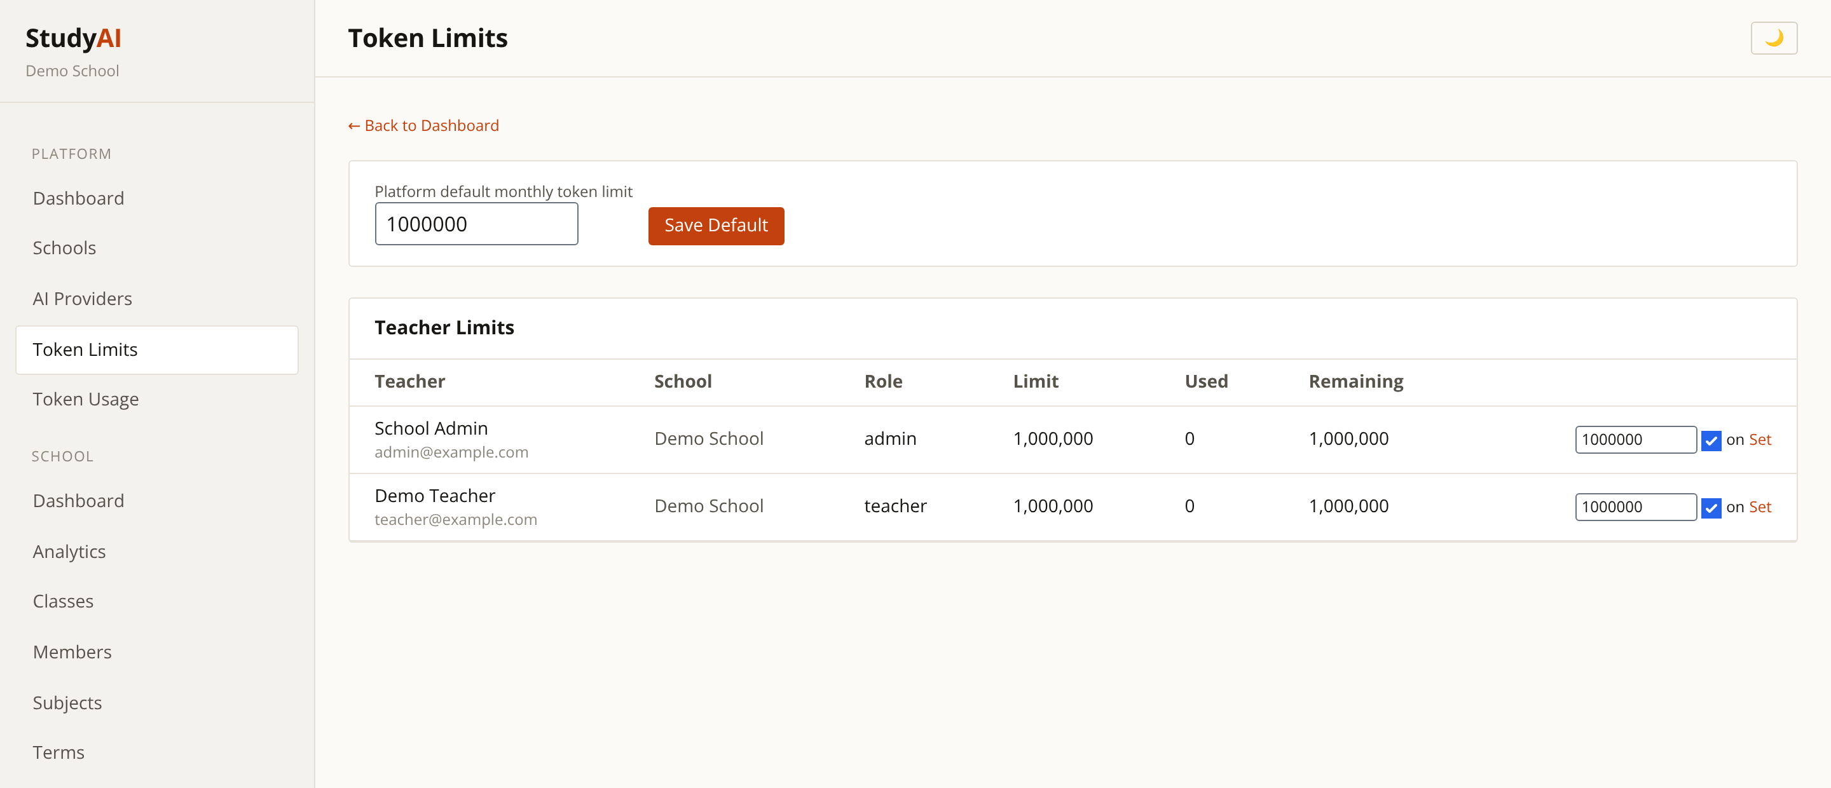
Token Limits
Super Admin — hard budget ceilings
Set a default monthly allowance for every teacher.
Override per individual where more capacity is justified.
Prevents runaway AI spend before it happens.
StudyAI
9

Slide 10
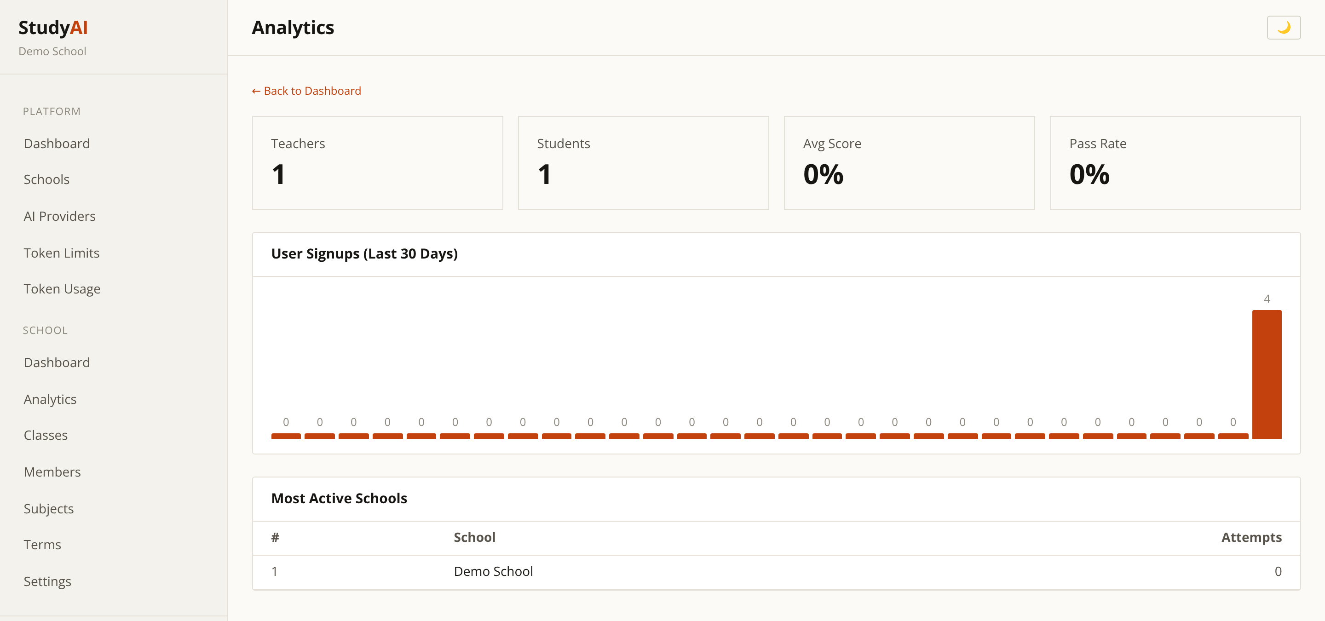
Platform Analytics
Super Admin — cross-school reporting
Compare activity and outcomes across every school.
Spot which institutions are actively adopting the platform.
Evidence for renewals and expansion conversations.
StudyAI
10

Slide 11
School Administration
Live screens from the working application

Slide 12
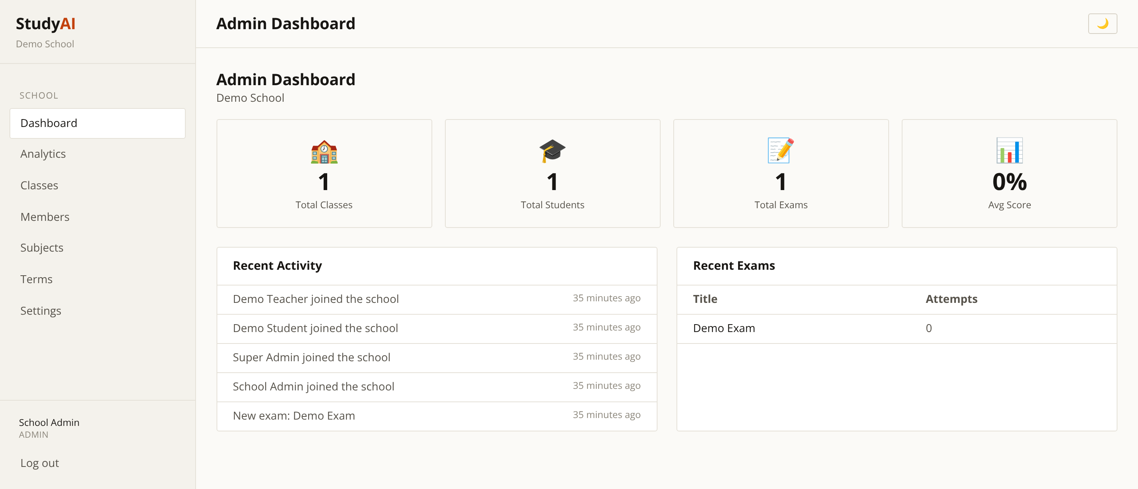
School Admin Dashboard
School Admin — daily operational view
Headline numbers for staff, students, classes and exams.
Immediate entry points into the day's admin tasks.
Scoped strictly to that administrator's own school.
StudyAI
12

Slide 13
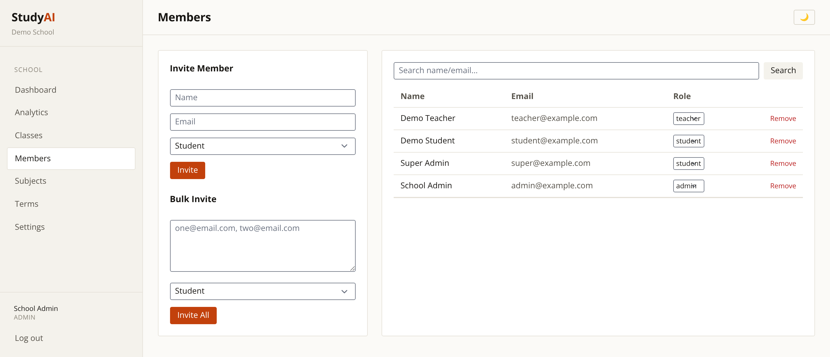
Staff & Student Directory
School Admin — people management
Invite staff and students individually or in bulk.
Assign and change roles with immediate effect.
Remove leavers cleanly, preserving academic records.
StudyAI
13

Slide 14
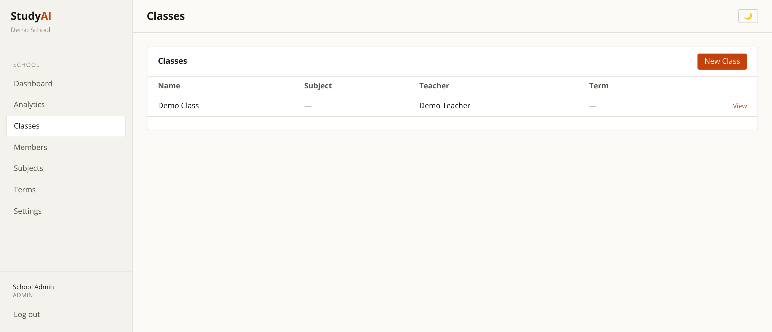
Class Management
School Admin — timetable structure
Create classes and assign the responsible teacher.
Enrol students directly or issue invite codes.
Class rosters flow straight through to exams and materials.
StudyAI
14

Slide 15
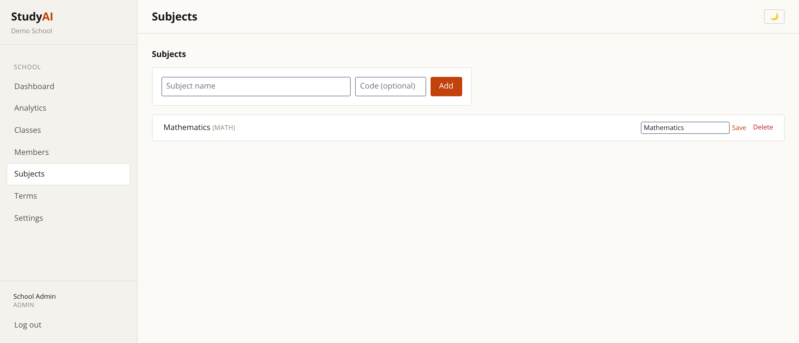
Subjects
School Admin — curriculum structure
Define the subject list that classes and questions map to.
Consistent tagging makes the question bank searchable.
Mirrors how the school already organises its curriculum.
StudyAI
15

Slide 16
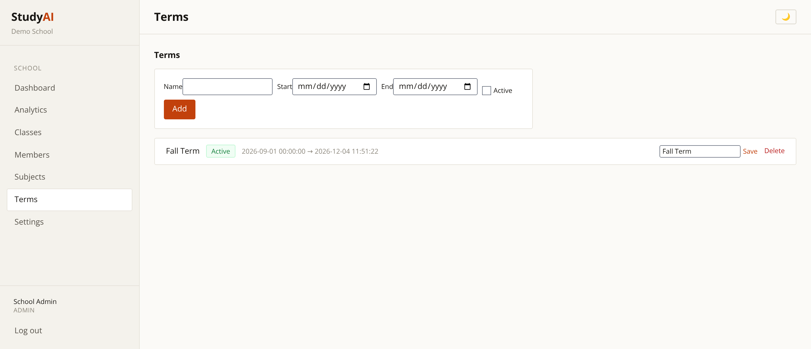
Academic Terms
School Admin — the school calendar
Define terms with start and end dates, and mark the active one.
Academic activity is reported against the correct period.
Supports year-on-year comparison.
StudyAI
16

Slide 17
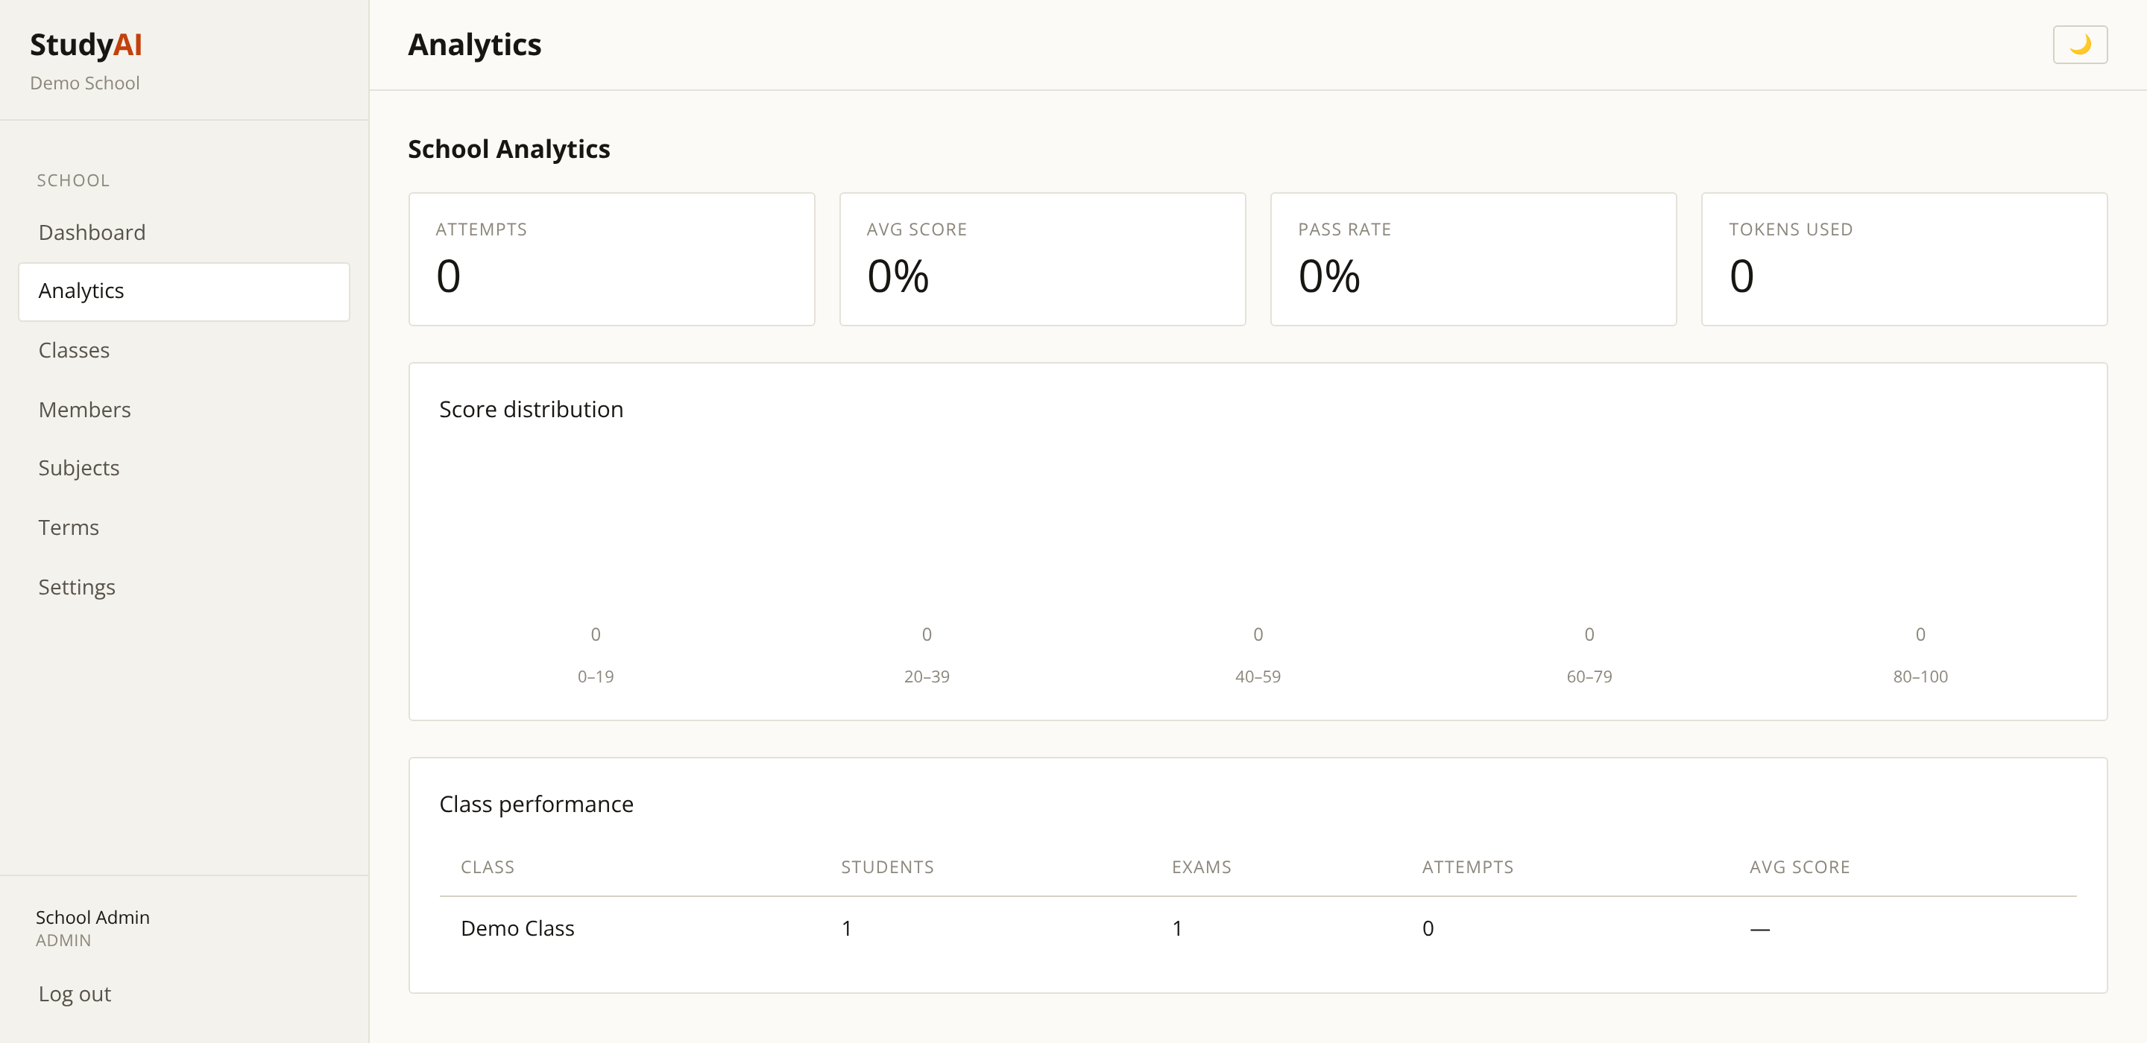
School Analytics
School Admin — performance insight
Engagement and attainment across classes and cohorts.
Identify where students are struggling early.
Exportable evidence for governors and inspections.
StudyAI
17

Slide 18
The Teacher Experience
Live screens from the working application

Slide 19
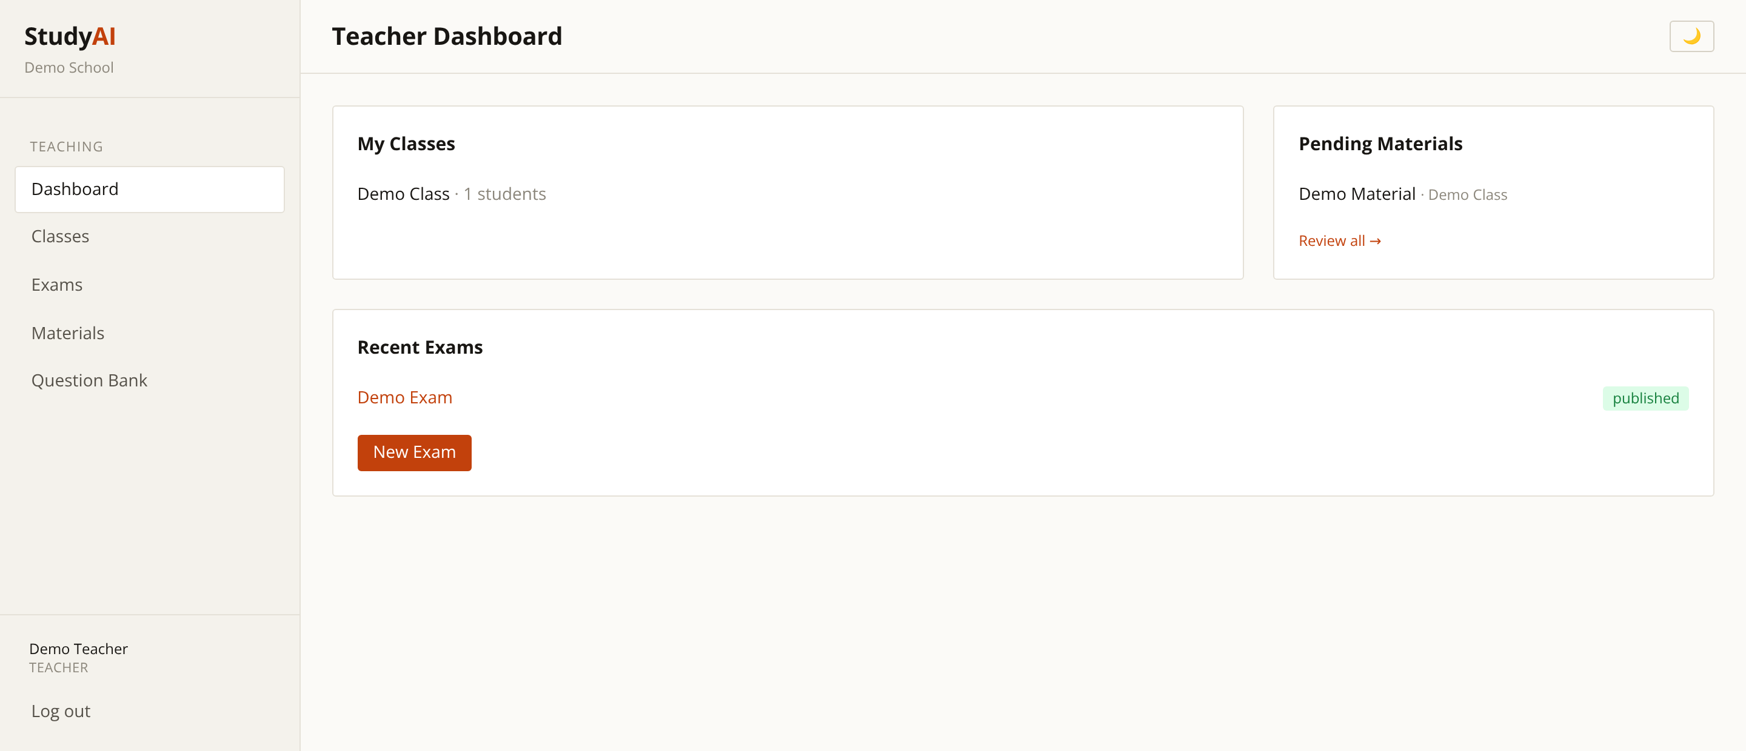
Teacher Dashboard
Teacher — the working day, organised
Classes, materials and exams in a single landing view.
Designed to reach any task within one or two clicks.
No administrative clutter that teachers do not need.
StudyAI
19

Slide 20
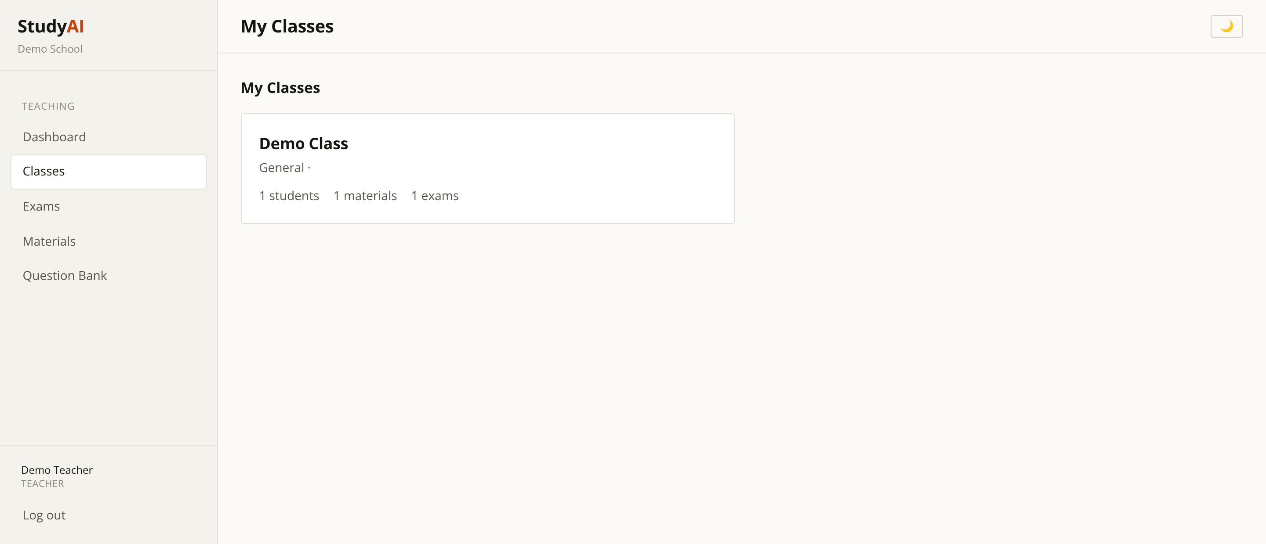
My Classes
Teacher — class roster
Every class the teacher is responsible for.
Drill into a class for its students and materials.
Invite codes let students self-enrol securely.
StudyAI
20

Slide 21
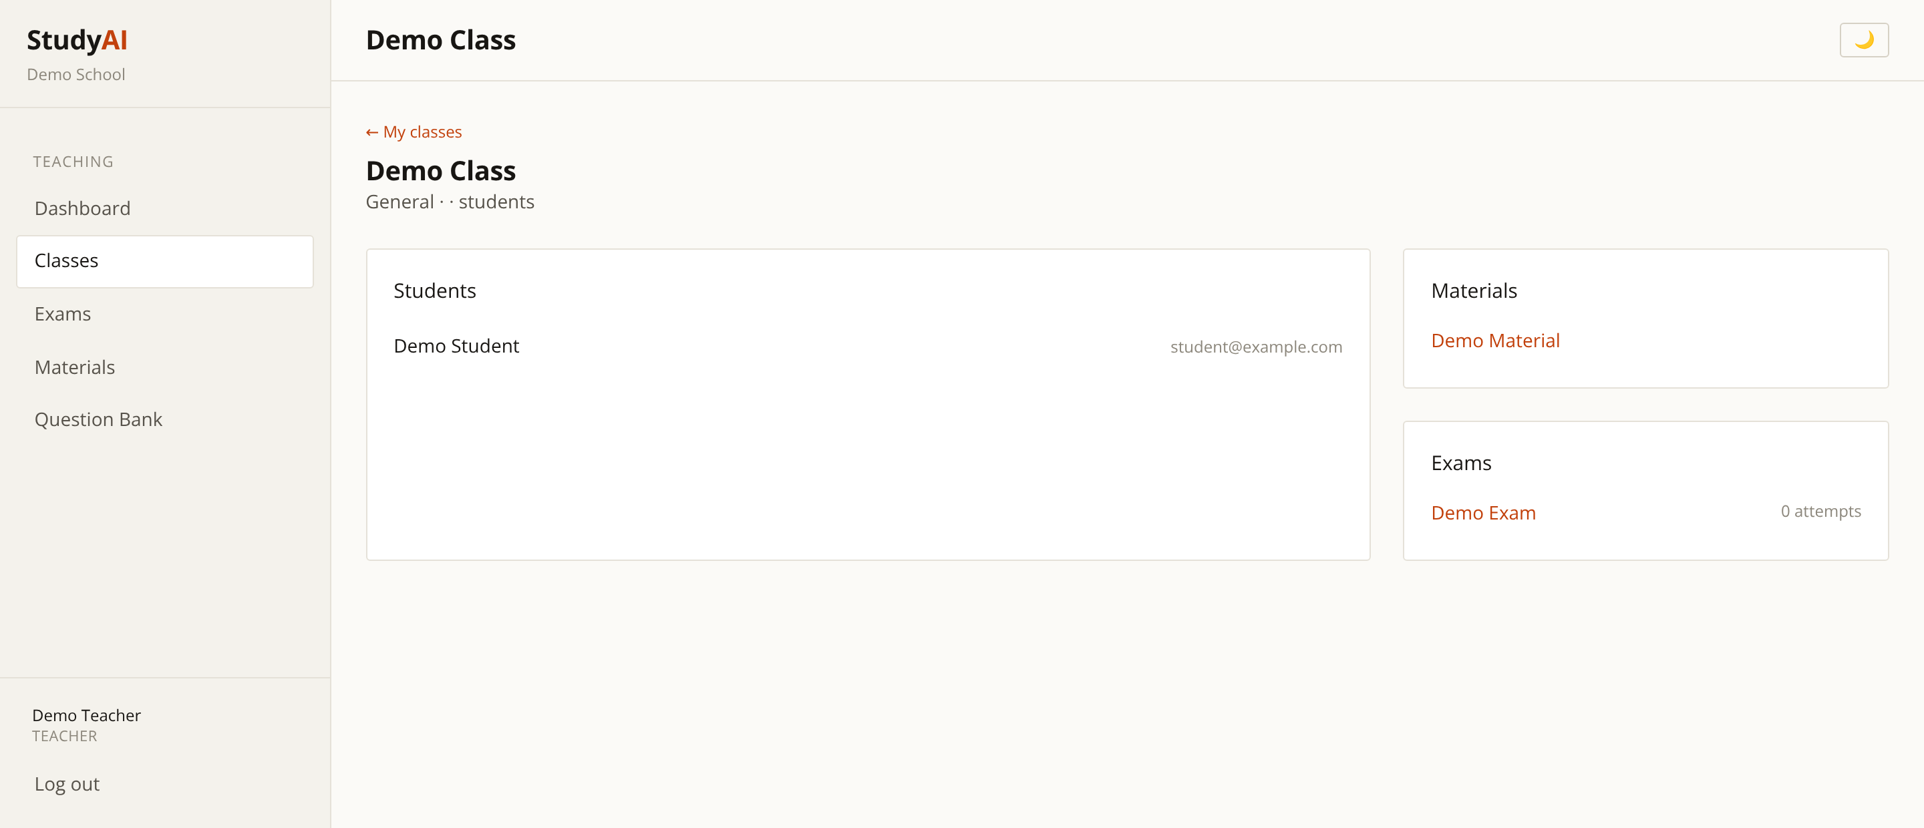
Class Detail
Teacher — inside a class
Enrolled students, attached materials and assigned exams.
One place to manage everything for that group.
Changes are reflected instantly on student dashboards.
StudyAI
21

Slide 22
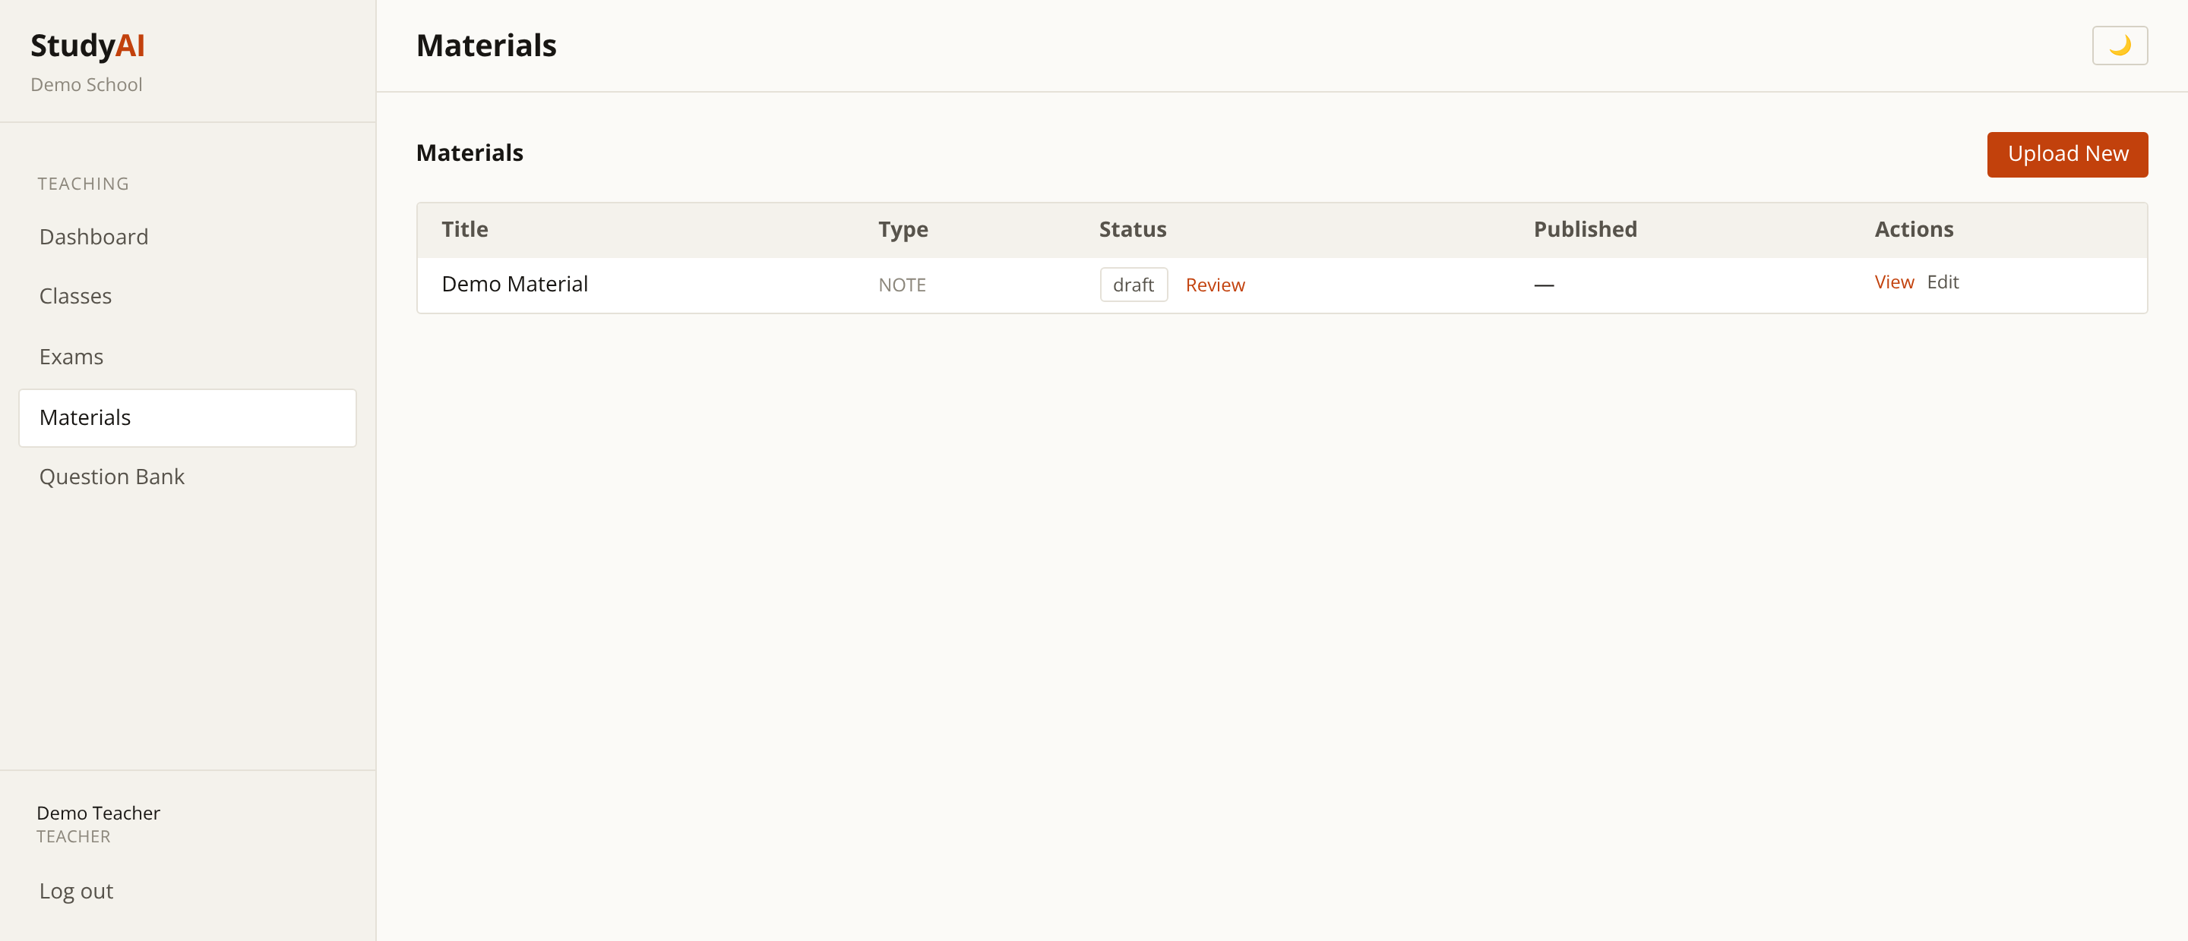
Teaching Materials
Teacher — the content library
Upload or write notes, then reuse them across classes.
Draft, review and published states keep quality controlled.
Materials are the raw input for AI generation.
StudyAI
22

Slide 23
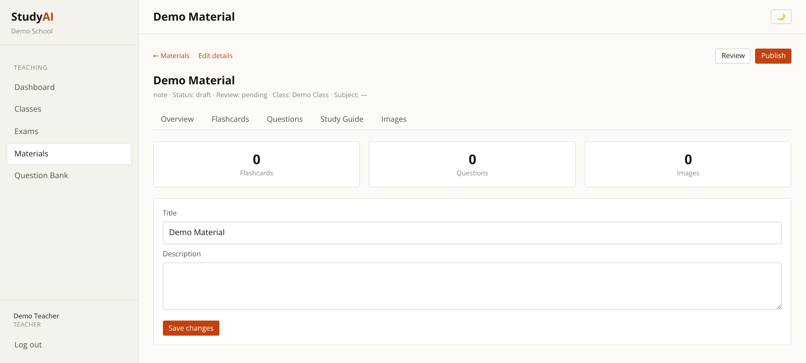
AI Generation — The Core Feature
Teacher — one note becomes a full study pack
From a single material, generate flashcards, questions, study guides and images.
Counters show exactly what has been produced so far.
Teacher reviews and approves before students ever see it.
Hours of preparation compressed into a few minutes.
StudyAI
23

Slide 24
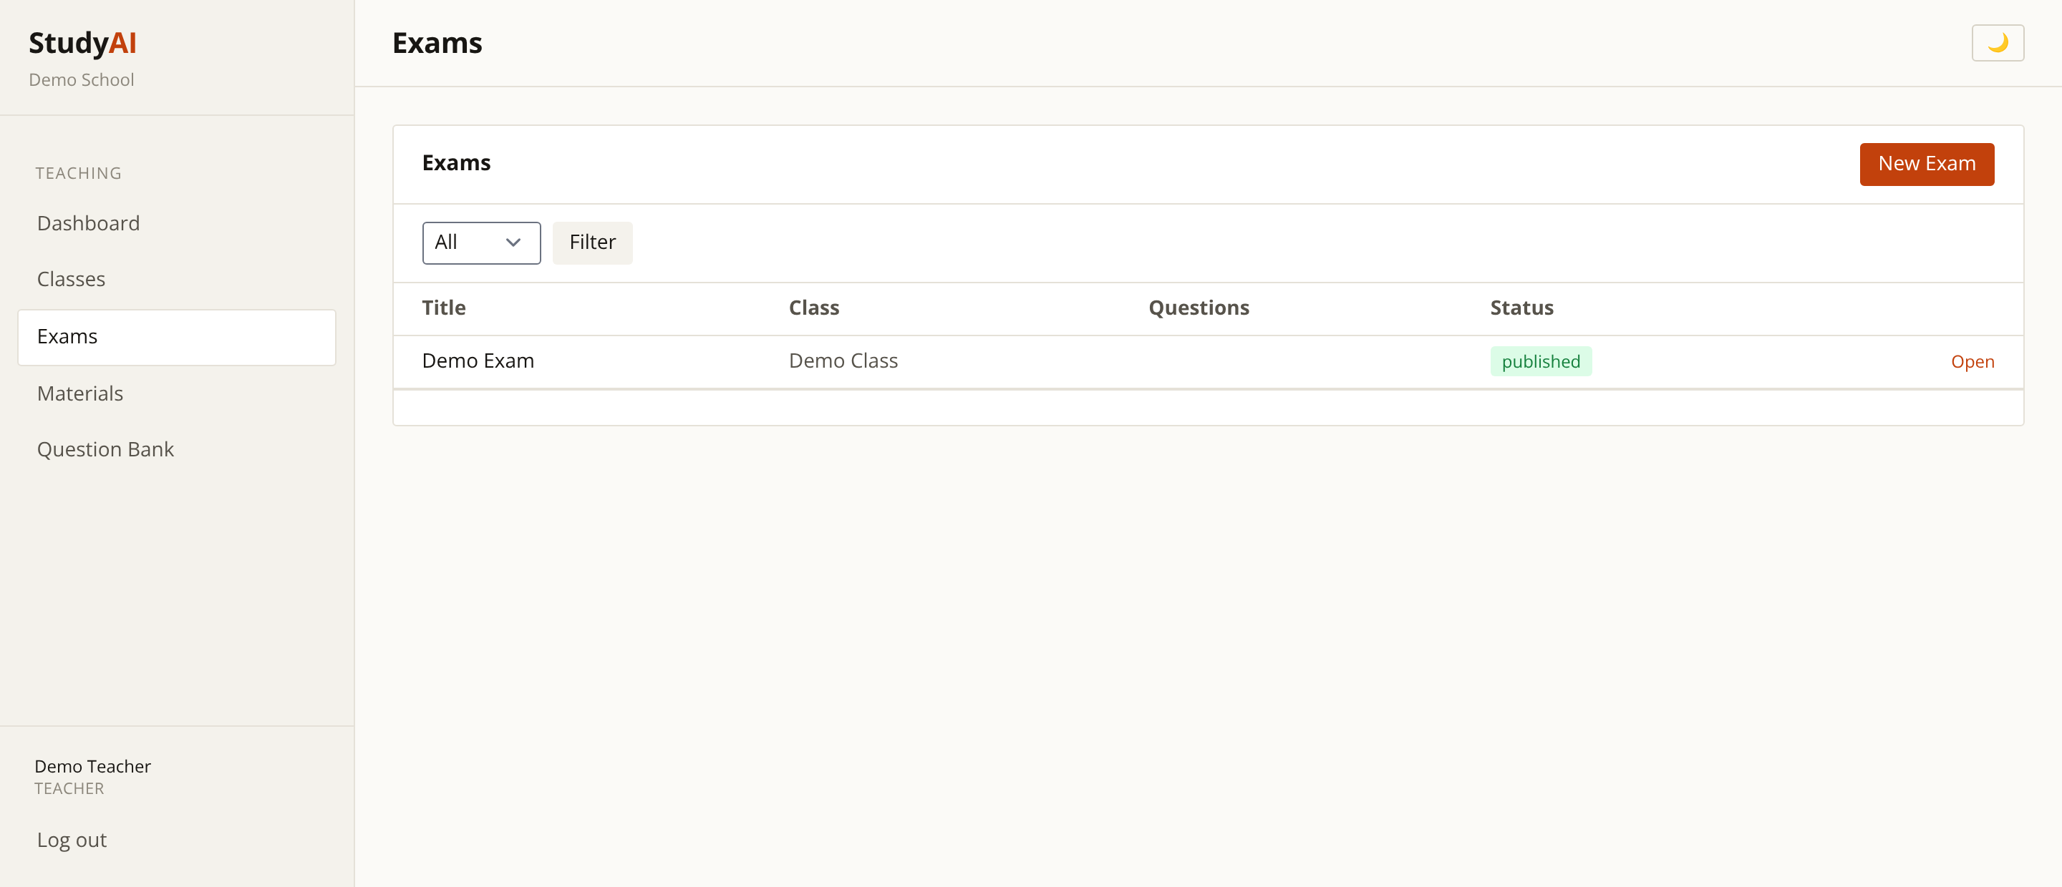
Exams
Teacher — assessment management
Build exams with duration, pass mark and publication state.
Draft until deliberately published to the class.
Results feed directly into analytics.
StudyAI
24

Slide 25
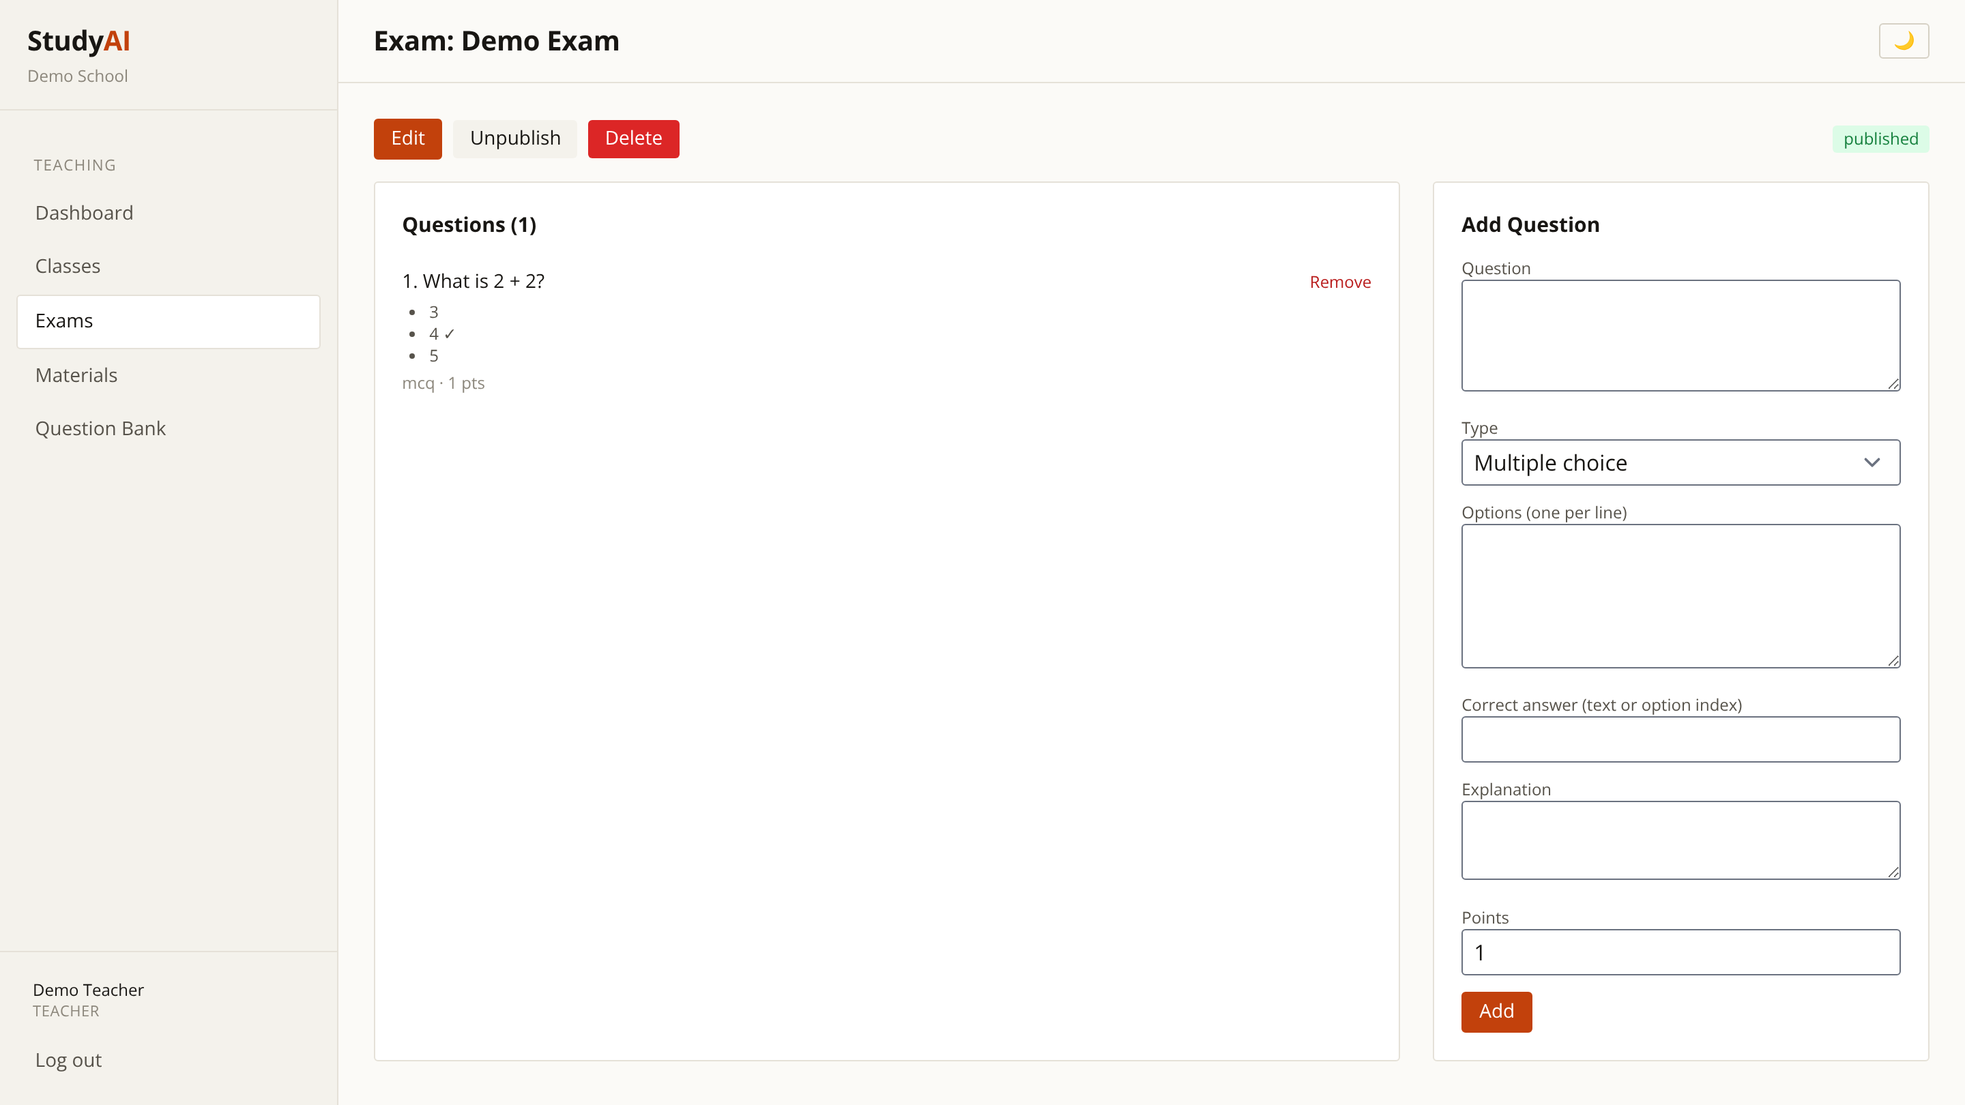
Exam Detail
Teacher — question-level control
Multiple-choice and written questions with per-question marks.
Reorder, edit and weight questions before publishing.
Pull ready-made questions from the shared bank.
StudyAI
25

Slide 26
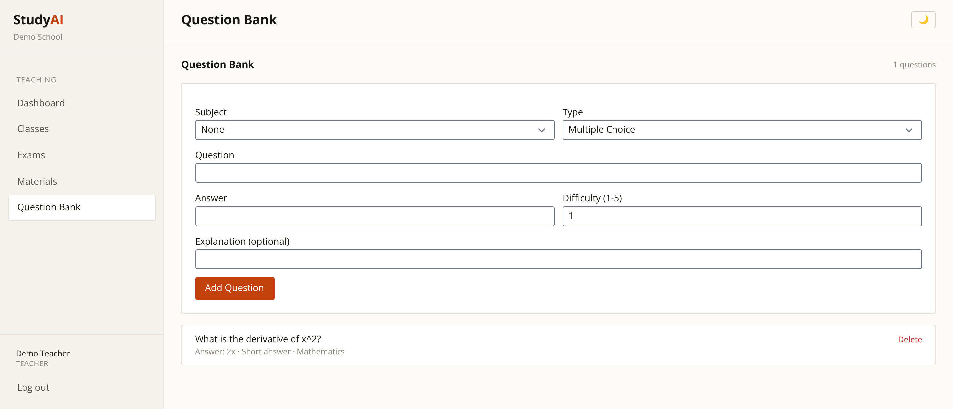
Question Bank
Teacher — reusable assessment library
Questions tagged by subject and difficulty.
Shared across the school so staff build on each other's work.
AI-generated questions land here for review and reuse.
StudyAI
26

Slide 27
The Student Experience
Live screens from the working application

Slide 28
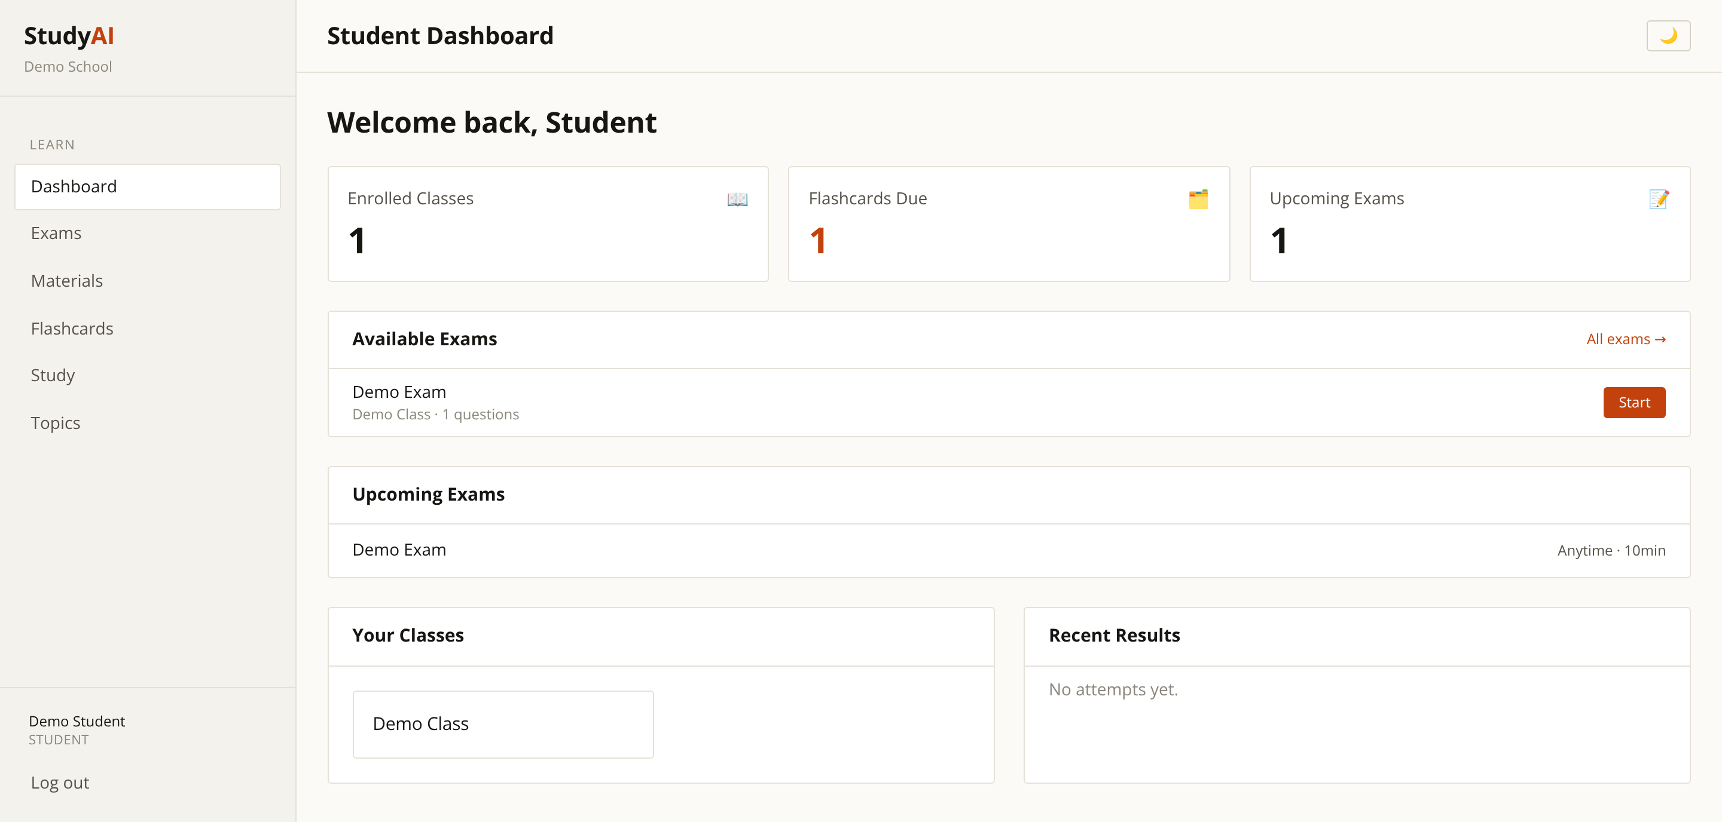
Student Dashboard
Student — what to do next, clearly
Enrolled classes, flashcards due and upcoming exams up front.
Directs attention to the work that actually matters today.
Recent results give immediate feedback on progress.
StudyAI
28

Slide 29
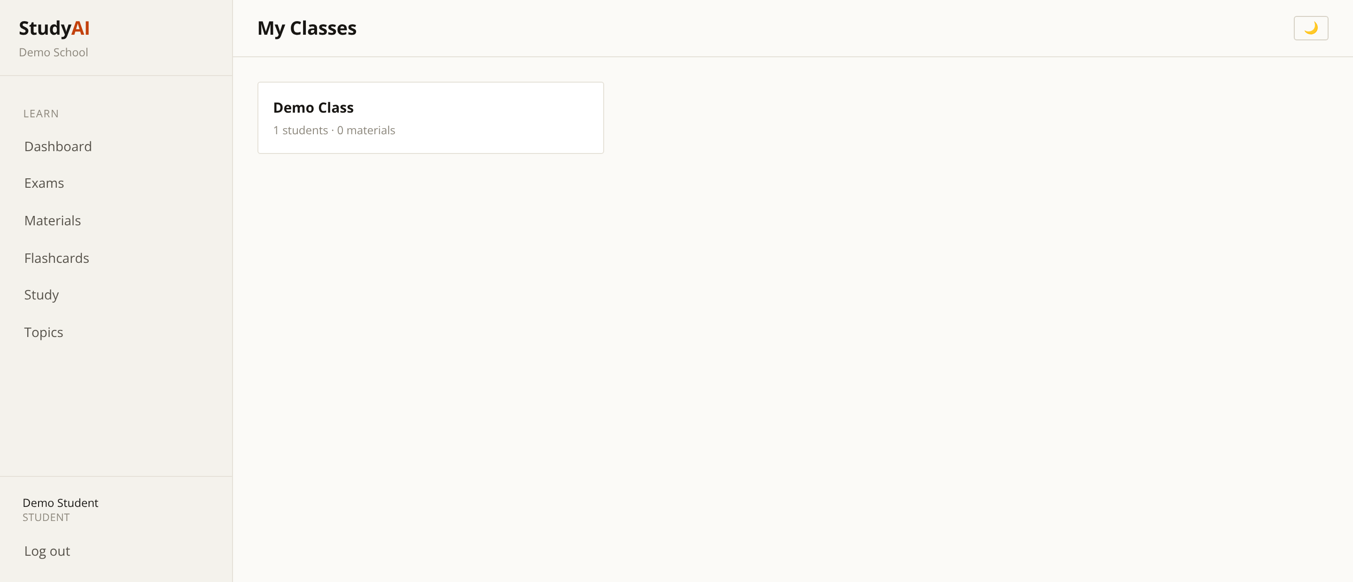
Enrolled Classes
Student — their timetable
Every class the student belongs to.
Join new classes with a teacher-issued invite code.
Access to materials follows enrolment automatically.
StudyAI
29

Slide 30
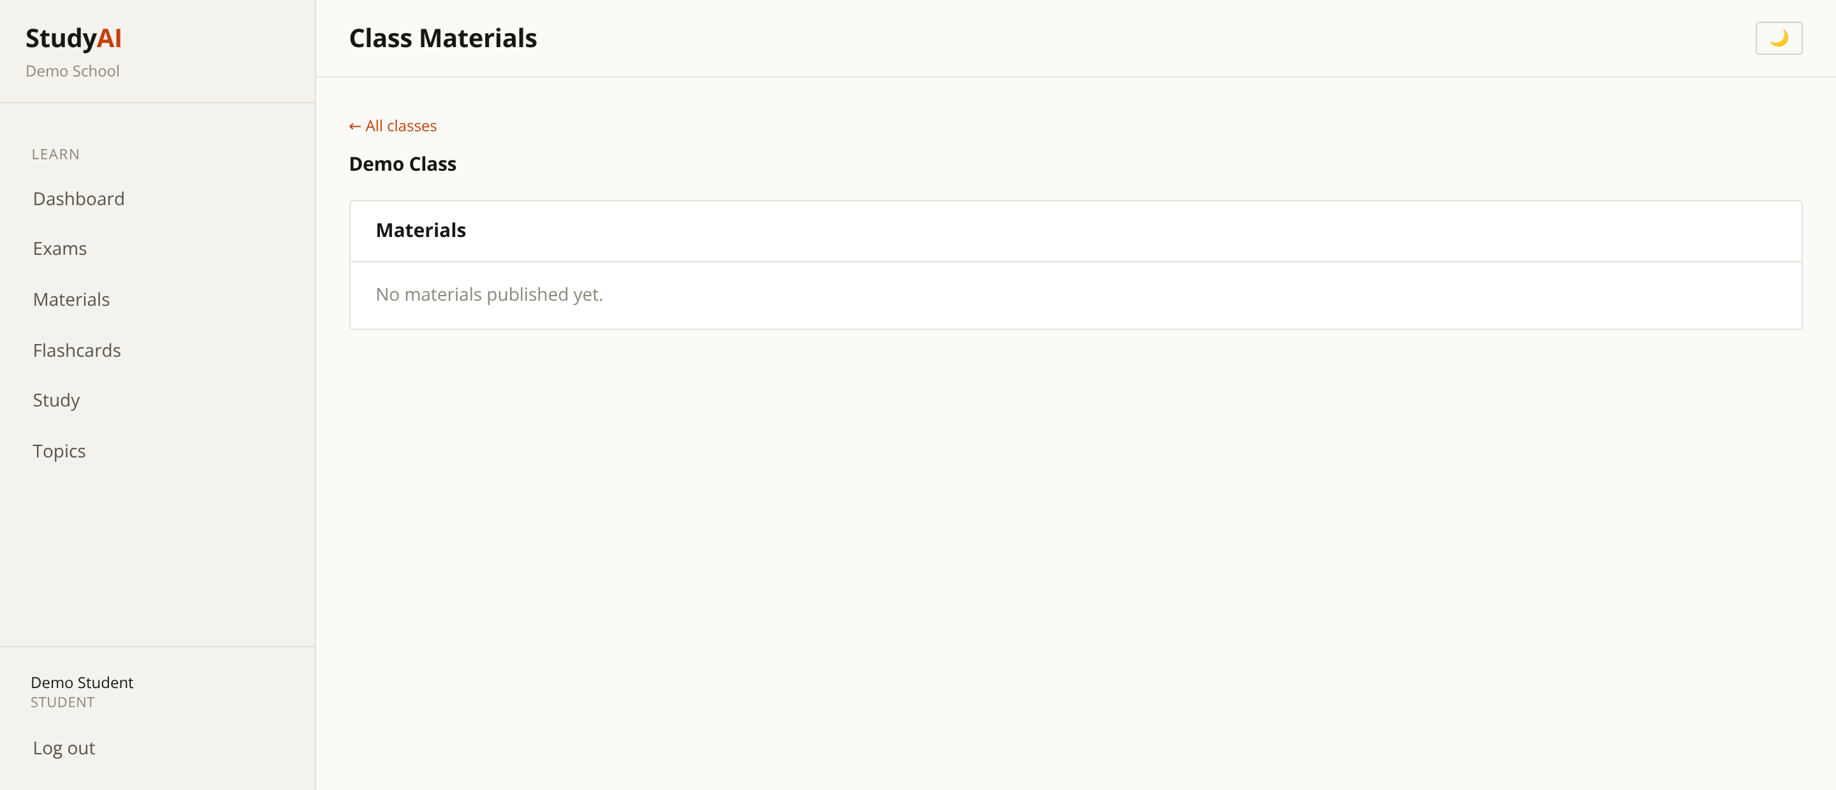
Class View
Student — inside a class
Materials published by the teacher for that class.
Exams assigned to the group.
Only ever shows approved, published content.
StudyAI
30

Slide 31
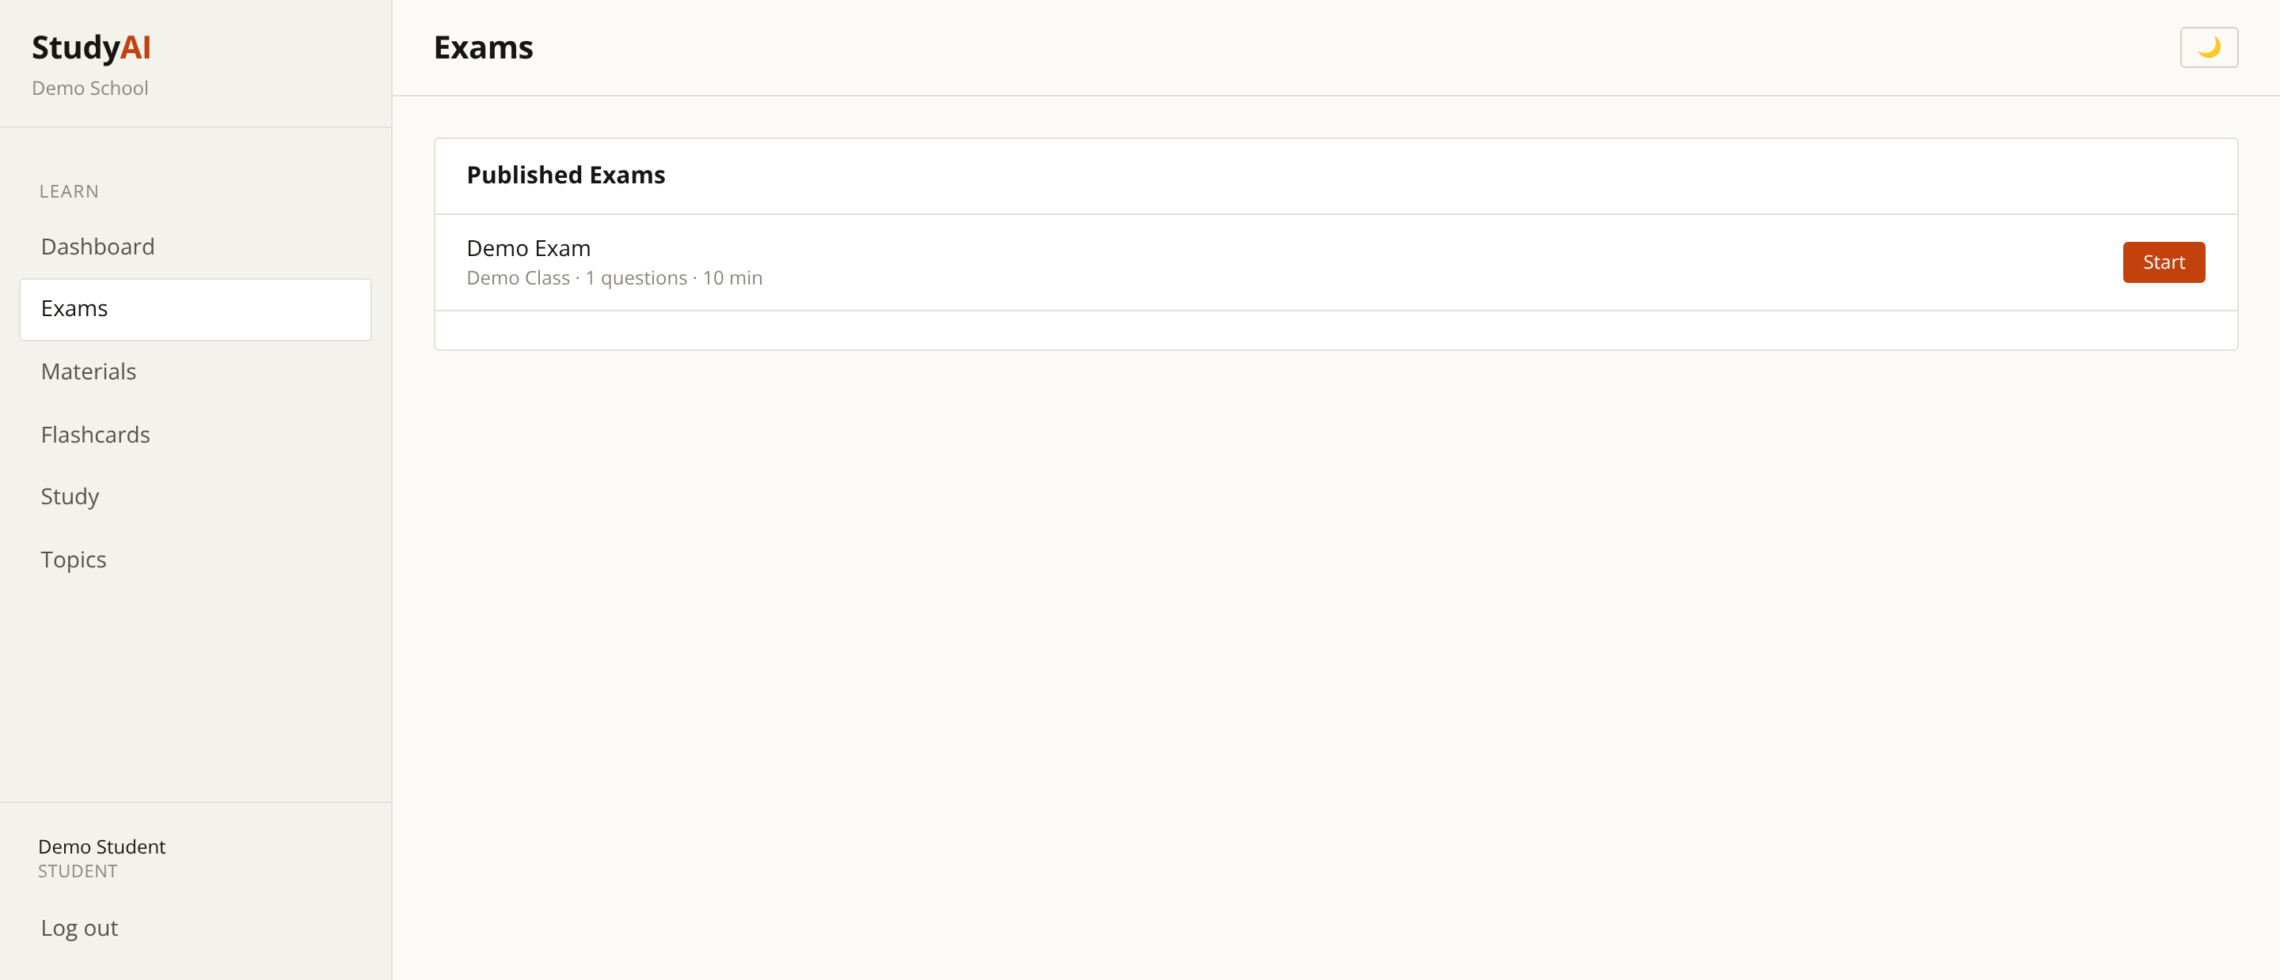
Taking Exams
Student — online assessment
Timed exams taken directly in the browser.
Automatic marking with instant results.
Attempts are recorded for the teacher to review.
StudyAI
31

Slide 32
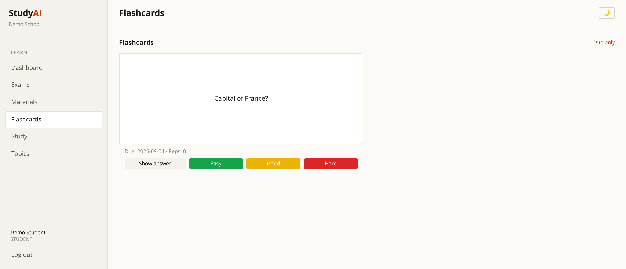
Flashcards & Spaced Repetition
Student — retention, not cramming
Cards scheduled by a spaced-repetition algorithm.
Difficult cards return sooner; mastered cards recede.
Built on the material their own teacher published.
StudyAI
32

Slide 33

Security & Access Control
Every screen in this deck sits behind authentication and a role check.
Role-based access
Teachers cannot reach admin screens; students cannot reach staff tools. Enforced server-side, not hidden in the interface.
Tenant isolation
Every query is scoped to the signed-in user's school. One school can never see another's data.
Content approval
AI output is held in draft and must be reviewed by a teacher before any student sees it.
Audit of AI spend
Each AI request is attributed to a user and school, with enforced budget ceilings.
StudyAI
33

Slide 34
Why Schools Choose StudyAI
Saves teacher time
Keeps teachers in charge
A single set of notes becomes flashcards, exam questions and a study guide in minutes rather than hours of manual preparation.
Nothing generated by AI reaches a student until a teacher has reviewed and published it. Quality stays with the professional.
Makes AI spend predictable
Grows with the institution
Per-teacher and per-school token budgets with hard limits, so the cost of AI is known in advance rather than discovered later.
One deployment serves a single school or an entire multi-academy trust, with complete data separation between tenants.
StudyAI
34

Slide 35
Ready to see it live
Every screen in this deck is a real screenshot of the working platform —
not a mockup. We can walk through it with your own subjects and classes.
StudyAI

