Slide 1
✳ SAATHI
Submission deck
TRACK 4 · AGRIN & REGENERATIVE AGRICULTURAL INTELLIGENCE
Saathi
A voice-first farming assistant that answers from validated agronomic models and live satellite, soil and market data — in 24 languages, for a farmer who may not read.
BUILT
THEME
MEMBERS
INSTITUTE
Working, deployed,
355 tests passing
BRICS cooperation,
data sovereignty
Harnoor Singh
Japleen Kaur
Thapar Institute of
Engineering & Technology
github.com/japi3/agrin ↗
Notes:
Saathi is built and running. 355 tests, 24 languages, five BRICS federation nodes.

Slide 2
✳ SAATHI
02 · The problem
THE PROBLEM
The problem we're solving
WHAT A FARMER FACES
WHY EXISTING TOOLS MISS
Advice exists — in English, in PDFs, in offices open 10 to 5.
A wrong irrigation or spray decision costs a season's income.
Reading is assumed. For millions of farmers it should not be.
Generic chatbots guess confidently and cite nothing.
Dashboards show data and leave the interpreting to the farmer.
Cross-border research cannot be pooled: nobody will hand over farm data.
WHAT THAT COSTS
Irrigating a field that did not need it — pumping cost, waterlogging, and yield given away.
A disease named wrongly, and a spray bought for it.
Selling at the local rate while a mandi two districts away pays appreciably more.
A scheme the farmer qualified for and never heard of.
github.com/japi3/agrin ↗
Notes:
The gap is not information. It is trustworthy, local, spoken, explainable advice.

Slide 3
✳ SAATHI
03 · What we built
SOLUTION
What we built
Saathi answers a farmer's question by running the same agronomic models an extension officer would use, on their field, and says where every number came from.
THE FARMER
SAATHI ANSWERS
AND WHEN IT CANNOT
Speaks or types, in their own language
Photographs a damaged leaf
Names a village — no coordinates needed
In the language and script they wrote in
Read aloud, for anyone who cannot read
With the field's own soil, weather and satellite
It refuses: no dose without a lab test
Says which figures are uncertain
Every answer carries its sources
github.com/japi3/agrin ↗
Notes:
The refusals are the point. Confident wrong advice is what costs a farmer money.

Slide 4
✳ SAATHI
04 · How it works
TECHNICAL APPROACH
How it works
GOOGLE AI
THE AGRONOMY IS NOT THE MODEL
Gemini 3.7 Flash — routing and translation, over 13 tools
Gemini TTS — answers read aloud in 24 languages
Gemini vision — disease named from a photograph
gemini-embedding-001 — retrieval across languages over published guidance
Sixteen key-and-model pairs — no exhausted quota stops a farmer
FAO-56 Penman-Monteith ET₀ and dual crop coefficient
FAO-33 yield response to water deficit
RothC-26.3 soil carbon, IPCC Tier 3
12 disease models: Smith Periods, Analytis, Magarey
LIVE DATA, NOTHING MOCKED
BUILT TO BE DEPLOYED
Sentinel-2 via Earth Engine and Planetary Computer
ISRIC SoilGrids — 1 km map of India carried locally
Open-Meteo weather · Agmarknet prices (data.gov.in)
6,396 passages of Government of India advisory material
One container: FastAPI serves the API and the PWA
Runs on a laptop, a VPS, or Cloud Run unchanged
Free tiers throughout — no key costs a rupee
github.com/japi3/agrin ↗
Notes:
The language model routes and explains. Every number comes from a published model.

Slide 5
✳ SAATHI
05 · What it does
CAPABILITIES
What it does today
01
Ask in any of 24 languages
Voice or text, answered in the script they wrote in, and read back aloud.
02
Should I irrigate?
A daily root-zone water balance on their field — not a rule of thumb.
03
How is my crop doing?
Sentinel-2 greenness against what this crop should have at this stage.
04
What is wrong with my plant?
Disease from a photograph, weighted by weather-driven infection pressure.
05
What is it worth?
Yield from the season's water balance, at today's mandi rate and the MSP floor.
06
What am I entitled to?
Six government schemes, with the screening questions to check before travelling.
07
What does the book say?
Varieties, seed rates, spacing, treatment — quoted from published guidance, with the link.
github.com/japi3/agrin ↗
Notes:
Every one of these runs today against live data.

Slide 6
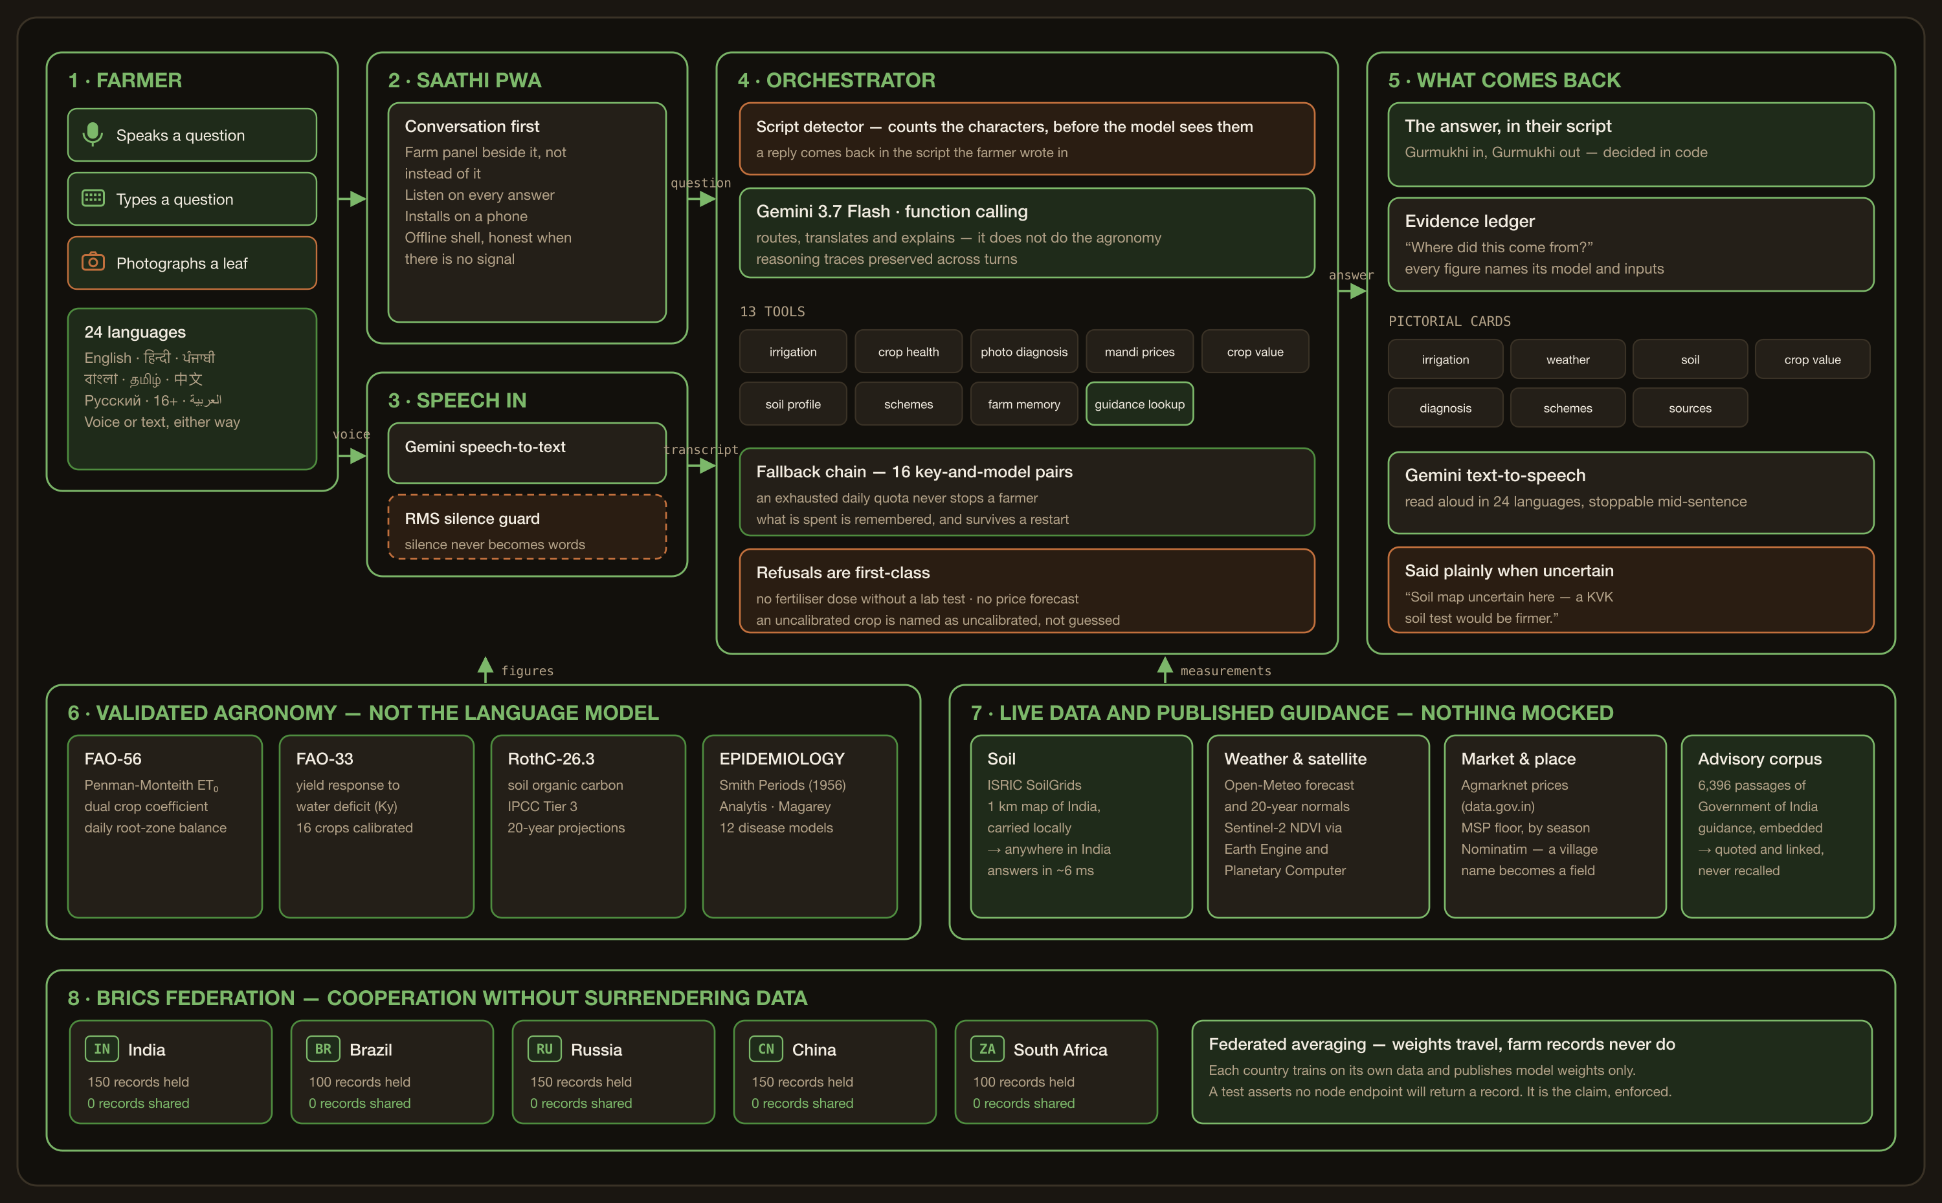
✳ SAATHI
06 · Architecture
ARCHITECTURE
How it fits together
github.com/japi3/agrin ↗

Slide 7
✳ SAATHI
07 · What we measured
EVIDENCE
What we measured
355
24
0
~6 ms
tests passing
languages
records shared
soil, anywhere
agronomy verified against FAO worked examples
interface and replies, 284 strings each
across five BRICS nodes, enforced by test
Car Nicobar to Ladakh, from a local map
VERIFIED END TO END
STATED PLAINLY, NOT HIDDEN
FAO-56 reproduces the published Example 18 exactly
Sentinel-2, soil, weather, prices — live, nothing mocked
Photo diagnosis refuses an unusable image rather than guessing
Replies checked by Unicode script, not by asking a model
Satellite verdicts are calibrated at population level, not per field
Federation training data is generated — there is no shared BRICS farm dataset yet
1 km soil is a regional estimate; every card says so and suggests a KVK test
github.com/japi3/agrin ↗
Notes:
The limitations slide is deliberate. A system that hides them cannot be trusted with a season's income.

