Slide 1
Saathi · ਸਾਥੀ 🌾
Regenerative agricultural intelligence,
in the farmer's own voice
A voice-first AI farming assistant for Indian farmers, where every actionable number comes from a validated agronomic model rather than the language model.
TRACK 4 · AGRIN & REGENERATIVE AGRICULTURAL INTELLIGENCE
BRICS theme: Cooperation
Harnoor Singh · Japleen Kaur
Thapar Institute of Engineering and Technology
github.com/japi3/agrin ↗

Slide 2
✳ SAATHI
02 · The problem
THE PROBLEM
The problem we're solving
86%
1.08 ha
22
of India's farmers work two hectares or less
(Agriculture Census 2015-16)
average holding — too small to absorb
one wrong decision
official languages; an assistant that reads
is no use to someone who does not
ADVICE DOES NOT REACH THE FIELD
THE FARMER MAY NOT READ
AN AI THAT GUESSES IS WORSE
Extension advice is general to a district, not specific to a farmer's field.
Saathi brings field context into the conversation.
Agricultural software often assumes literacy, smartphone habits and English.
Saathi is voice-first and multilingual.
A confident irrigation depth or pesticide dose can look correct to the person acting on it.
Saathi separates language-model reasoning from validated agronomy.
THE SAME QUESTION, TWO ANSWERS
“Should I irrigate my wheat today?”
A general chatbot: “Wheat usually needs irrigation every 20–25 days, around crown root initiation…”
Saathi: “No water this week. Your root zone holds 62 mm and the crop needs 41 mm before Friday's rain.”
github.com/japi3/agrin ↗
Notes:
The three problems were already here. The statistics size them and the contrast at the bottom is the pitch in three lines.

Slide 3
✳ SAATHI
03 · What we built
WHAT WE BUILT
What we built
Saathi is already structured around the farmer's question, field context, validated models and source-backed guidance.
SAATHI
A multilingual, voice-first farming assistant that accepts text, voice and crop photos and returns field-specific guidance in the farmer's language — running today against live soil, weather, satellite, market and published advisory sources.
24 LANGUAGES
13 TOOLS
484 TESTS
Voice in and out. Script detection is handled in code before the model sees the request.
Gemini function calling routes questions to agronomic, data and advisory tools.
≈250 agronomy · 80 API · 73 retrieval · 19 federation · 15 data-layer.
Not a prototype: one container serves the API and the app, every data source is open-licensed, and the whole system runs on free tiers.
github.com/japi3/agrin ↗

Slide 4
✳ SAATHI
04 · The product, working
ONE REAL EXCHANGE
A Punjabi question, answered from a source
WHAT THE FARMER SAID AND HEARD
WHAT HAPPENED IN BETWEEN
🎙 “ਕਣਕ ਦੀ ਬਿਜਾਈ ਤੋਂ ਪਹਿਲਾਂ ਬੀਜ ਦਾ ਇਲਾਜ ਕੀ ਹੈ?”
What seed treatment before sowing wheat?
🔊 “ਕਾਂਗਿਆਰੀ ਤੋਂ ਬਚਾਅ ਲਈ 40 ਕਿੱਲੋ ਬੀਜ ਨੂੰ 13 ਮਿਲੀਲੀਟਰ
ਟੈਬੂਕੋਨਾਜ਼ੋਲ 400 ਮਿਲੀਲੀਟਰ ਪਾਣੀ ਵਿੱਚ ਘੋਲ ਕੇ ਲਗਾਓ…”
Spoken back in Gurmukhi, with the source page linked beneath —
so the farmer, or the officer they show the phone to, can
open the original.
1. Speech → text, with a silence guard so an empty recording never becomes an invented sentence.
2. Script detected in code — Gurmukhi in, Gurmukhi out — before the model sees the question.
3. Gemini routes to the guidance tool: seed treatment is written down, not computed.
4. Retrieval searches 4,640 passages of government advisory material. Best match 0.77.
5. Every figure in the reply is checked back against the passage it came from.
6. The answer is read aloud in Punjabi.
The corpus is English. The question was Punjabi. Cross-language retrieval is what lets one corpus serve twenty-four languages — and it is the difference between an assistant that sounds knowledgeable and one that can show you where it got that.
github.com/japi3/agrin ↗
Notes:
A real exchange from the running app, not a mock-up.

Slide 5
✳ SAATHI
05 · How it works
TECHNICAL APPROACH
How it works
MODELS
VALIDATED AGRONOMY + DATA
Gemini 3.7 Flash routes, translates and explains.
Gemini multimodal handles crop photographs.
Gemini audio understanding handles speech-to-text.
Gemini TTS returns spoken answers.
gemini-embedding-001 supports retrieval.
FAO-56 Penman-Monteith and daily root-zone water balance.
FAO-33 yield response to water.
RothC-26.3 soil carbon model.
Disease epidemiology and NDVI-based crop assessment.
Soil, weather, satellite, market and published advisory sources.
THE RULE EVERYTHING FOLLOWS FROM
The language model never computes agronomy. It routes, translates and explains — every number a farmer acts on comes from a validated model running on real measurements. This is not architectural preference. An LLM asked for an irrigation depth returns a fluent, confident, unfalsifiable number, and it is indistinguishable from a correct one to the person standing in the field.
Gemini understands. · Tools calculate. · Validation decides what is shown.
github.com/japi3/agrin ↗

Slide 6
✳ SAATHI
06 · What Saathi does
KEY CAPABILITIES
What Saathi does
01
Ask in your language
Voice or text in the farmer's preferred language, with spoken output.
02
Irrigation guidance
FAO-56 daily root-zone water balance answers whether the field needs water.
03
Crop health
Sentinel-2 NDVI compared with expected crop stage; Gemini vision supports plant-photo analysis.
04
Soil & weather
Local SoilGrids data and live weather provide field context — anywhere in India in ~6 ms.
05
Market & schemes
Seasonal water-balance yield plus mandi data; government schemes with screening questions.
06
Published guidance
Varieties, seed rates, spacing and treatment quoted from government sources, with the link.
…and anything else. It is a capable assistant, not a crop bot.
github.com/japi3/agrin ↗

Slide 7
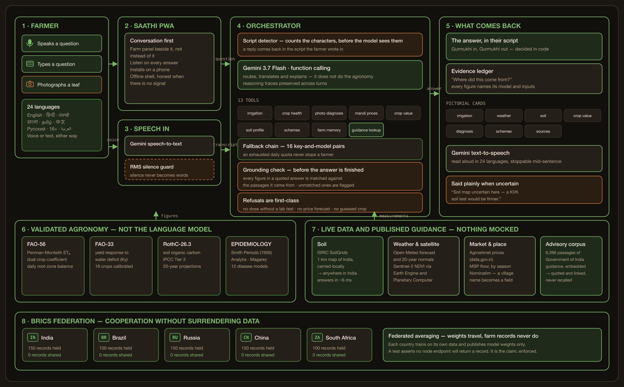
✳ SAATHI
07 · System architecture
SYSTEM ARCHITECTURE
How it fits together
READ IT THIS WAY
1
A farmer speaks, types or photographs a leaf, in any of 24 languages.
2
The script is decided in code before Gemini sees the question.
3
Gemini routes to tools. It never computes the answer itself.
4
Validated models run on live soil, weather, satellite and market data.
5
The answer is checked, then spoken back in the farmer's own script.
github.com/japi3/agrin ↗
Notes:
Do not read the diagram out. Walk the five numbers on the left and let the picture carry the rest.

Slide 8
✳ SAATHI
08 · Verification
VERIFICATION
How we verify it
REFERENCE ET
FAO-56 worked Example 18 reproduced, including every intermediate term → ET₀ = 3.9 mm/day.
→ the evapotranspiration is the published standard, not an approximation
LIVE REFERENCE ET
MAE 0.228 mm/day against an independent implementation, 264 station-days, five BRICS members.
→ it agrees with someone else's code on live weather
WATER BALANCE
Mass conservation closes to < 0.5 mm over a full season, irrigated and rainfed, sand to clay.
→ the water accounting invents nothing and loses nothing
RETRIEVAL
29/35 questions return the right subject first; 8/8 off-topic questions are refused.
→ the corpus answers what it knows and stays silent otherwise
NDVI CHECK
Verdict distribution checked against 22 real Punjab–Haryana wheat fields.
→ the satellite thresholds are calibrated at population level
484 AUTOMATED TESTS
≈250 agronomy · 80 API · 73 retrieval · 19 federation · 15 data-layer. No network needed.
→ the behaviour is pinned, and a reviewer can run it without a key
Every one of these is a command in the repository, not a claim in a slide.
github.com/japi3/agrin ↗

Slide 9
✳ SAATHI
09 · How we keep AI grounded
RAG + FEDERATION
How we keep AI grounded
SOURCE-BACKED GUIDANCE
BRICS FEDERATION
6,396 agriculture passages from Vikaspedia, published by C-DAC under MeitY.
A 0.62 similarity floor turns weak retrieval into abstention: on-topic questions score 0.65–0.80, off-topic 0.52–0.60.
Hindi and Punjabi questions retrieve English source passages and answer in the language asked.
Five country nodes train locally and publish weights only.
A local model on another country's fields: 212 mm RMSE. The federated model, anywhere: 59 mm. Federated then fine-tuned: 50 mm.
Field records transmitted: zero. What holds between five countries holds between five states.
THE CHECK THAT READS THE ANSWER BACK
Retrieval does not stop a model inventing — it lends the invention a citation. Asked how to deworm a buffalo calf, the assistant retrieved genuine ICAR passages giving Albendazole at 10 mg/kg, then added a dosing schedule and a second drug that appear in no passage, and said the government advisory recommended it. Two rounds of prompt-writing did not stop it. Every figure in a sourced answer is now matched against the passages it came from; unmatched figures raise a warning naming who to confirm with. It now refuses the question outright.
4,640
8/8
46
0
passages indexed so far, crop production first
off-topic questions correctly refused
banned pesticides named, from the CIBRC list
farm records ever transmitted between nodes
github.com/japi3/agrin ↗

Slide 10
✳ SAATHI
10 · Accessibility and safety
ACCESSIBILITY + SAFETY
Built for real farmers
BUILT FOR PEOPLE WHO MAY NOT READ
HONESTY IS A FEATURE
Voice in and out in 24 languages.
Named in each language — Saathi, ਸਾਥੀ, 农友, Parceiro, Umngane.
Pictogram grammar: state → duration → action → quantity.
Familiar units first; prices carry “per quintal”.
Decision-first cards; numbers sit underneath.
Unusable crop photographs are refused.
No pesticide dose is emitted by the system.
No price forecasting.
Urban-mask soil displacement is disclosed.
Satellite thresholds are not claimed to be per-field accurate.
WHAT IT REFUSES, AT EVERY LAYER
Microphone — silence never becomes words · Soil — a masked cell is “no data”, not a nearby guess
Water balance — an uncalibrated crop is named, not guessed · Diagnosis — an unusable photo is declined
Prices — today's rate and the MSP floor, never a forecast · Retrieval — below 0.62, nothing is quoted
Output — a figure absent from the source raises a warning · Schemes — navigation, never an eligibility ruling
“A farmer told ‘the soil map is uncertain here — a KVK soil test would be firmer’ has been served well. One given a confident wrong number has been harmed.”
github.com/japi3/agrin ↗

Slide 11
✳ SAATHI
11 · Reach across India
FROM ONE FIELD TO INDIA
What scales is the tools, not the model
PHASE 1 · PILOT
PHASE 2 · ZONES
PHASE 3 · NATIONAL
Punjab & Haryana
Five agro-climatic zones
India
Wheat and rice — already calibrated
A district's KVKs as the distribution channel
Punjabi, Hindi, English
Measure: is the advice acted on?
Each zone's crops added as tool modules
Each zone's language switched on
State agriculture departments and FPOs
Measure: does accuracy hold outside Punjab?
24 languages already built
Agronomy modules added independently
KVKs · FPOs · state departments · CSCs
States pool models, never records
WHY THIS IS CHEAP TO EXTEND
A new state does not need a new model. It needs its crops calibrated and its language switched on — and the language is already there. Adding a crop is a coefficient table; adding a district is a coordinate. The soil map, the satellite pipeline and the advisory corpus are national from day one.
The phases above are a plan, not traction. Saathi has no farmers yet — the engine is built and tested; the pilot is what we are asking for.
github.com/japi3/agrin ↗
Notes:
Say the caveat out loud. Judges trust a team that separates what it built from what it hopes for.

Slide 12
✳ SAATHI
12 · Deployment and impact
PILOT-READY BY DESIGN
What it would take, and what would change
A PILOT, IN FOUR WEEKS
WHAT IT DOES NOT NEED
Week 1 — deploy the container. No new infrastructure.
Week 2 — onboard a KVK or department; set the districts.
Week 3 — switch on the zone's languages and crop modules.
Week 4 — farmers onboard; monitor answers and refusals.
No custom model training — Gemini plus validated tools.
No new satellite or sensor infrastructure.
No per-state data agreement — sources are open-licensed.
No budget: every service runs on a free tier.
WHAT WE CAN ALREADY SHOW
WHAT A PILOT WOULD MEASURE
Irrigation tied to this field's measured water balance rather than a calendar. Soil for any coordinate in India in ~6 ms. Advice quoted from government sources with the link. A refusal when the evidence is thin.
Water saved against a district's usual practice. Whether advice is acted on. Yield and margin against a control group. None is claimed here, because none has been measured — and a number we invented would undo the point of the whole system.
github.com/japi3/agrin ↗
Notes:
Close on the right-hand box. Refusing to invent impact numbers is the same discipline the product is built on.

