Slide 1
TOOL1_FINAL_PROJECT
Compare 2020 State/Territory Deaths To 2020 Lockdown Measures

Slide 2
How/Why
The deaths dataset was collected from
https://data.cdc.gov/NCHS/Weekly-counts-of-death-by-jurisdiction-and-cause-o/u6jv-9ijr?fbclid=IwAR3oPM9rkxOVoZ4PRdfaGAvzLJy7kSPU3ymb1metm1R2vvAl6dAPE53OaKU
The state and local responses data was collected by webscraping https://en.wikipedia.org/wiki/U.S._state_and_local_government_responses_to_the_COVID-19_pandemic
The data was collected to analyze if the state and local responses to the COVID-19 pandemic helped reduce deaths.

Slide 3
About the dataset
Number of observations – 53
Number of variables – 13
Variables
State/territory – object
Masks required in public – object
Gatherings banned – object
2020 Deaths – object
Total Deaths – object

Slide 4
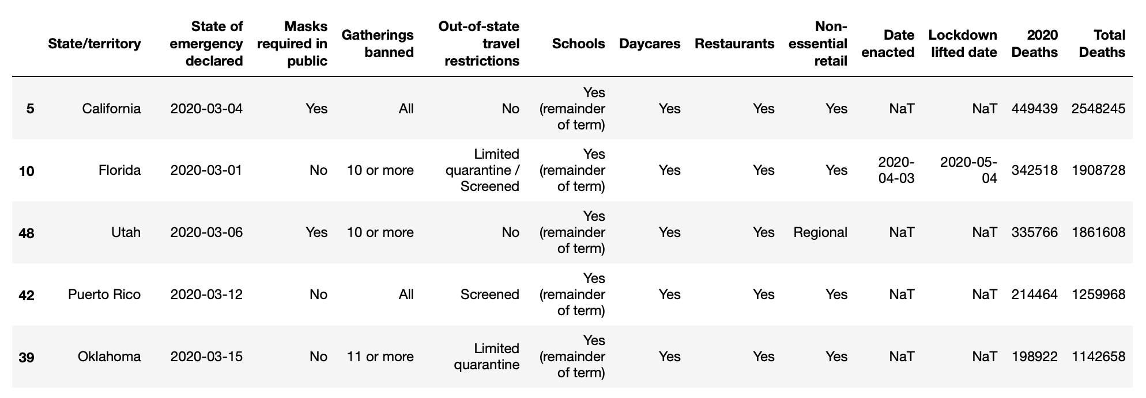
Dataset example

