Slide 1
Building a meta-driven near realtime ETL solution with BIML and SSIS
Rasmus Reinholdt

Slide 2



A word about me
Worked with BI and SQLServer for 12 years
  Primarily with ETL and relational datawarehousing
Individual contractor
  Spoken at various SQLSaturdays
  Co-organizer of SQLSaturday Copenhagen
Contact
  @RasmusReinholdt
  dk.linkedin.com/in/rasmusreinholdt/
  RasmusReinholdt.wordpress.com

Slide 3
What will this talk bring you!
Show what’s to gain from going metadriven and (near) real-time
It will show you the possibilities and point you in the right directions
It’s a talk that will bring you around the technologies needed for a modern ETL structure and give you something to think about
It is not a deep-dive
..or a 1-2-3 now you know BIML, talk

Slide 4
Agenda
Real time ETL- why and how
Meta-driven ETL - why and how
  The tools
  The metadata
A case story; Building a near real-time datawarehouse
  How
  The metadata
  Load strategy

Slide 5
Real time ETL- why
Yesterdays news – is no longer interesting
Nightly load windows – are not present when you operate around the globe or clock
Notes:
Your users will want to know what happend to day, what the last change to the ERP means for the MTD and YTD numbers
They require updates within minutes, not hours or days
What defines real time, we strive at half hourly updates and are committet to hourly, but that is for you to agree with your users about.

Slide 6
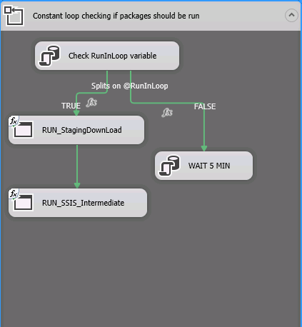
Real time ETL- how
Move as little data as possible
Move the data with as few dependencies as possible
Move the data as fast as possible
Notes:
Whats out for tempdb, all runs in one thread

Slide 7
Metadriven ETL - why
You need to be flexible
  Quickly incorporate changes to your source systems
You need to be responsive
  Implement new requirements faster
You do NOT want to be the bottleneck
Notes:
All in all your business users do not want to wait for you to go through a 100 ssis packages by hand to change a datatype or build a new dataflow to implement a new requirement – they will expect you to do this on the fly / in the meeting room

Slide 8
Metadriven ETL -how
We’ll see that in a second
Near-real-time ETL and relational datawarehousing – A case story
Notes:
Why relational and not cubes, well you can do cubes if you really have to, but you will need to have great control over your partitions and load stratefy to run this fast – and often an clustered columnstore index will be all you need, of corse dependent on what fancy mdx you are doing, but then consider ROLAP

Slide 9
Wrap up
Staging area with BIML/ MIST
  Use MIST to build your staging area and SSIS templates
  Meta data to control which tables to load and how
  CDC to do minimum load
MDS as metadata repository
  Advantages (versioning, relationships, check imposing via workflows etc)
The Datawarehouse
  Relational – no time for (MOLAP) cubes
  Metadriven flexible SSIS structure
Dependencies
  Use your metadata
  Use SP_depends
Beware of locks and latches.

Slide 10
What to take with you home
If you don’t remember anything else
– remember this ☺
  BIML is easy – takes but a few hours to learn the basics
    http://bimlscript.com is the place to start
    Build and (re-)use templates
    Mind your metadata – it’s your most valuable asset
  CDC for the win
    Load only the data that has changed
  Strive for a minimum interdependent structure

Slide 11
References
Anything BIML:
  http://bimlscript.com
Early Arriving facts:
  http://blogs.msdn.com/b/sqlcat/archive/2009/05/13/assigning-surrogate-keys-to-early-arriving-facts-using-integration-services.aspx
SSIS Tuning:
  http://davidpeterhansen.com/sql-server-integration-services-ssis-internals-performance/
  C#
  http://www.microsoftvirtualacademy.com/training-courses/developer-training-with-programming-in-c
  http://bimlscript.com/Develop/Resources

