Slide 1
Building a meta-driven near real-time ETL solution with BIML and SSIS
Rasmus Reinholdt

Slide 2



A word about me
Worked with BI and SQLServer for 12 years
Primarily with ETL and relational datawarehousing
Individual contractor
Presently with UNOPS
Before that as a consultant
Spoken at various SQLSaturdays
Co-organizer of SQLSaturday Copenhagen
Contact
@RasmusReinholdt
dk.linkedin.com/in/rasmusreinholdt/
RasmusReinholdt.wordpress.com

Slide 3
Agenda
Real time ETL- why and how
Meta-driven ETL - why and how
The tools
The metadata
A case story; Building a near real-time datawarehouse
How
The metadata
Load strategy

Slide 4
Real time ETL- why
Yesterdays news – is no longer interesting
Nightly load windows – are not present when you operate around the globe
Notes:
Your users will want to know what happend to day, what the last change to the ERP means for the MTD and YTD numbers
They require updates within minutes, not hours or days
What defines real time, we strive at half hourly updates and are committet to hourly, but that is for you to agree with your users about.

Slide 5
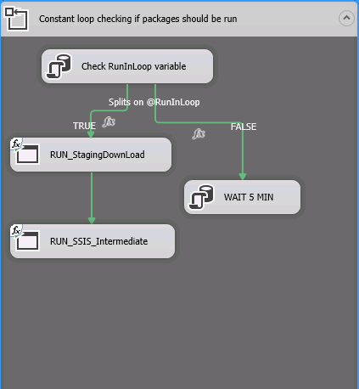
Real time ETL- how
Move as little data as possible
Move the data with as few dependencies as possible
Move the data as fast as possible

Slide 6
Metadriven ETL - why
You need to be flexible
Quickly incorporate changes to your source systems
You need to be responsive
Implement new requirements faster
You do NOT want to be the bottleneck
Notes:
All in all your business users do not want to wait for you to go through a 100 ssis packages by hand to change a datatype or build a new dataflow to implement a new requirement – they will expect you to do this on the fly / in the meeting room
And if you can’t – thy will hire somebody like me to do it for them ;)

Slide 7
Metadriven ETL -how
We’ll see that in a second
Near-real-time ETL and relational datawarehousing – A case story
Notes:
Why relational and not cubes, well you can do cubes if you really have to, but you will need to have great control over your partitions and load stratefy to run this fast – and often an clustered columnstore index will be all you need, of corse dependent on what fancy mdx you are doing, but then consider ROLAP

Slide 8
Wrap up
Staging area with BIML/ MIST
Use MIST to build your staging area and SSIS templates
Meta data to control which tables to load and how
CDC to do minimum load
MDS as metadata repository
Advantages (versioning, relationships, check imposing via workflows etc)
The Datawarehouse
Relational – no time for (MOLAP) cubes
Metadriven flexible SSIS structure
Dependencies
Use your metadata
Use SP_depends
Beware of locks and latches.

Slide 9
What to take with you home
If you don’t remember anything else
– remember this ☺
BIML is easy – takes but a few hours to learn the basics
http://bimlscript.com is the place to start
Build and (re-)use templates
Mind your metadata – it’s your most valuable asset
CDC for the win
Load only the data that has changed
Strive for a minimum interdependent structure

Slide 10











Thank you to all our SPONORS!

Slide 11
References
Anything BIML:
http://bimlscript.com
Early Arriving facts:
http://blogs.msdn.com/b/sqlcat/archive/2009/05/13/assigning-surrogate-keys-to-early-arriving-facts-using-integration-services.aspx
SSIS Tuning:
http://davidpeterhansen.com/sql-server-integration-services-ssis-internals-performance/

