Slide 1

Multithreading

Slide 2
Learning Objectives
What is a thread and why are they used?
What are the two techniques for creating threads in Java?
What are the four states that a thread passes through in its lifetime?
What are selfish threads?
Why do we need thread synchronization?
What is a mutex, and how are they implemented in Java?
What is deadlock and how do they occur?
What is the difference between sleep() and wait()?

Slide 3
What is a Thread?
A thread is formally defined as a “single sequential flow of control in a program”
a beginning
an execution sequence
and an end
A thread itself is not a program, but it runs within a Process
Threads are sometimes called lightweight processes. Both processes and threads provide an execution environment, but creating a new thread requires fewer resources than creating a new process.
Threads exist within a process — every process has at least one
A process has a self-contained execution environment. A process generally has a complete, private set of basic run-time resources; in particular, each process has its own memory space.

Slide 4
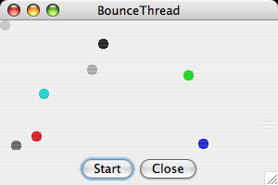
> The Problem with Single Threads
In a single-threaded program, a time-consuming computation can make a program seem unresponsive
Run the Bounce example….
why can’t we close the application?
why does only one ball bounce?
let’s look at Bounce.java...

Slide 5
> Multithreading to the Rescue
Let’s run a multithreaded sample to see what threads can do for us
Run BounceThread…
let’s look at BounceThread.java...
There are two ways to create threads in Java…

Slide 6
Threading Technique #1
In the BounceThread.java example
we subclass Thread
override the run() method
put our time-consuming code into run
When the user clicks the Start button, we call Bounce.start()
this tells the JVM to create a thread with the run() method as the entry point

Slide 7
Threading Technique #2
have your class implement the Runnable interface
in this case, a new thread would be created like this
see BounceRunnable.java
myRunnable = new MyRunnable();
Thread aThread = new Thread(myRunnable);
aThread.start();
biggest difference between Thread and Runnable is that Thread is a class and that Runnable is an interface

Slide 8
Creating Tasks and Threads
public class Task implements Runnable { ... public Task() { ... }
// implement the run method public void run() { // do something ... } ... }
public class Client {
...
public void runTask(...) {
...
// create an instance of Task
Task task = new Task();
// create a thread
Thread thread = new Thread(task);
// start the thread
thread.start();
...
}
...
}

Slide 9
Using the Runnable Interface to Create and Launch Threads
Create and run three threads:
The first thread prints the letter a 100 times.
The second thread prints the letter b 100 times.
The third thread prints the integers 1 through 100.
a 1bbbb 2aaaaaaaaaaaaaaaaaaaaaaaa
aaa 3 4 5 6 7 8 9bbbbbbbbbbbb 10 11 12 13aaaaa
aaaaaaaaaa 14bbbbbbbbbbbbbbbbbbbb
bbbbbbbbbbbbbbbbbbbbbbbbbbbbbbb
bbbbbbbbbbbbbbbbbbbb 15 16aaa 17bbbbb
bbb 18aaaaaaaaaaaaaaaaaaaaaaaaaaa
aaaaaaaaaaaaaaaaaaaaaaaaaaa 19 20 21b
bbbb 22 23 24 25 26 27 28 29 30 31 32 33 34 35 36 37 38 39 40 41 42 43 44 45 46 47 48
49 50 51 52 53 54 55 56 57 58 59 60 61 62 63 64 65 66 67 68 69 70 71 72 73 74 75 76 77 78 79
80 81 82 83 84 85 86 87 88 89 90 91 92 93 94 95 96 97 98 99 100
TaskThreadDemo

Slide 10
The Selfish Thread
what happens if a thread never relinquishes control?
it can take over the CPU and cause other threads to wait for a long time
such a “socially-impaired” thread is called a “selfish thread”
a thread should always call yield() or sleep() when it is executing a long loop to ensure it is not monopolizing the system

Slide 11
The static yield() Method
You can use the yield() method to temporarily release time for other threads
public void run() {
for (int i = 1; i <= lastNum; i++) {
System.out.print(" " + i);
Thread.yield();
}
}

Slide 12
The static sleep(ms) Method
The sleep(long milliseconds) method puts the thread to sleep for the specified time in milliseconds.
public void run() {
for (int i = 1; i <= lastNum; i++) {
System.out.print(" " + i);
try {
if (i >= 50) Thread.sleep(1);
}
catch (InterruptedException ex) {
}
}
}

Slide 13
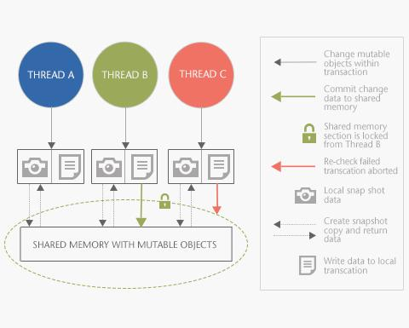
Synchronization

Slide 14
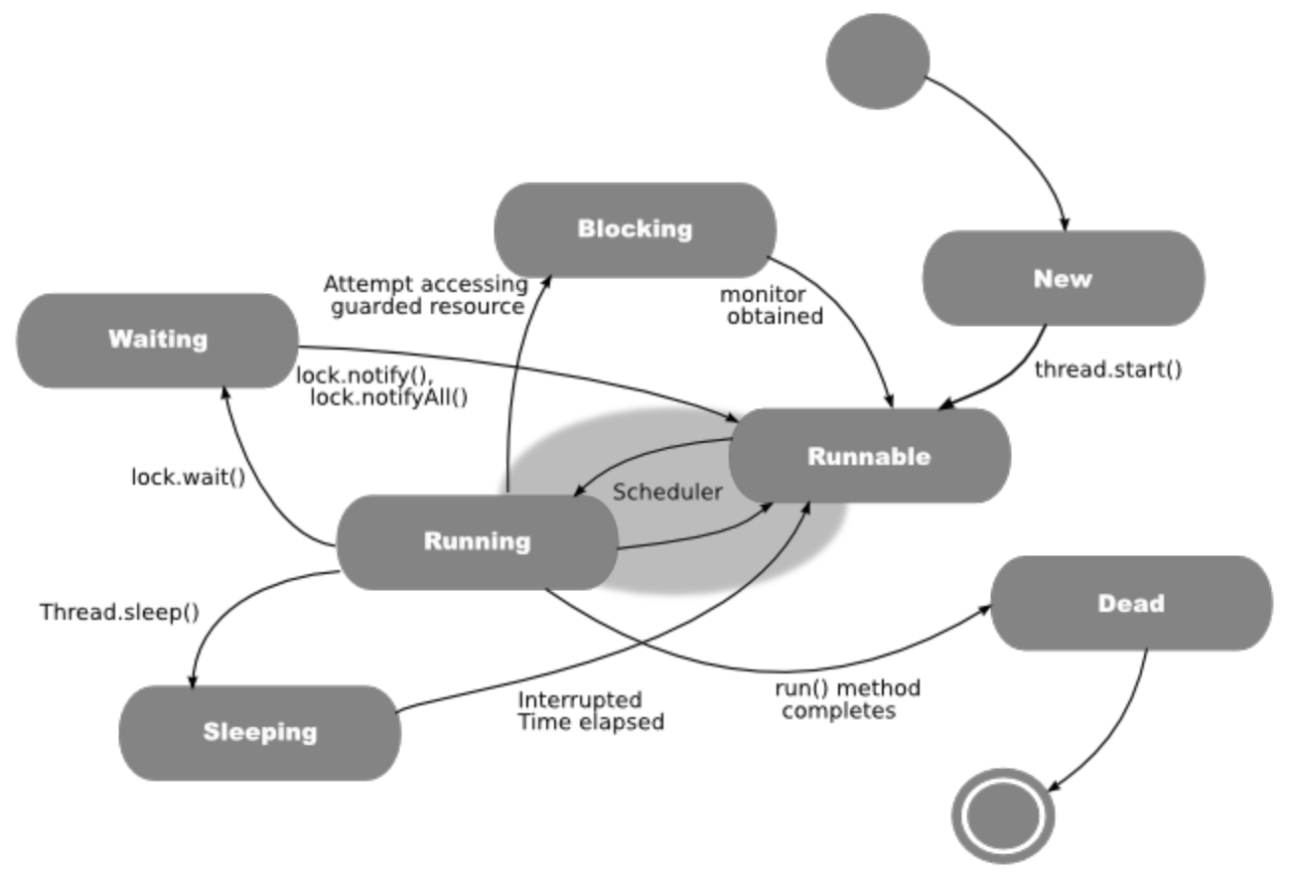
Thread States
A thread can be in one of five states: New, Ready, Running, Blocked, or Finished
4
1
4
2
3
5
4

Slide 15
Thread State #1 - New
when you create a thread with the new operator, it is not yet running and a physical thread does not exist yet
a certain amount of bookkeeping needs to be done before a thread can run (i.e. memory allocation, data structures, resources, etc.)
start() method performs this bookkeeping and creates a thread with the entry point at run()

Slide 16
Thread State #3 - Running
when a thread is running, it is executing code and using system resources

Slide 17
Thread State #4 - Not Runnable
A thread can enter the “Not Runnable” in several ways
the sleep() method is invoked
the wait() method is called to wait for a specific condition
the thread has invoked a blocking I/O call
a thread in this state will not run even when its turn comes up in the thread scheduler

Slide 18
Thread State #4 - Not Runnable
For every way into the “not Runnable” state, there is a specific way out of it
if sleep() was called, the thread will resume after the number of milliseconds has elapse
if wait() was called, then the the thread will start after notify() or notifyAll() are called
if the thread is blocking on I/O, then the the thread will start when the I/O has completed

Slide 19
Thread State #5 - Dead
A thread terminates when its run() method calls return or has finished its processing
Often a thread will go into an infinite loop and watch for some state to change as a signal to end the loop

Slide 20
Thread State #2 - Runnable
when a thread is runnable, the system thread has been created and the JVM can give it CPU cycles to execute
note that the state is called “runnable” and not “running” because it may not necessarily be running
JVM-dependent
a thread can surrender any remaining CPU cycles by calling yield()

Slide 21
isAlive(), interrupt(), and isInterrupted()
The isAlive() method is used to find out the state of a thread. It returns true if a thread is in the Ready, Blocked, or Running state; it returns false if a thread is new and has not started or if it is finished
The interrupt() method interrupts a thread in the following way: If a thread is currently in the Ready or Running state, its interrupted flag is set; if a thread is currently blocked, it is awakened and enters the Ready state, and an java.io.InterruptedException is thrown
The isInterrupt() method tests whether the thread is interrupted

Slide 22
stop(), suspend(), and resume() Methods
NOTE: The Thread class also contains the stop(), suspend(), and resume() methods
These methods are deprecated because they are known to be inherently unsafe
You should assign null to a thread variable to indicate that it is stopped rather than use the stop() method

Slide 23
Inter-Thread Communication
In many cases, threads don’t run in isolation
What if two threads are trying to update the same account balance?
If neither informs the other that the initial balance has changed then the result could be wrong
Information needs to flow from one thread to the other

Slide 24
Thread Synchronization
A shared resource may be corrupted if it is accessed simultaneously by multiple threads. For example, two unsynchronized threads accessing the same bank account may cause conflict.

Slide 25
Race Conditions
http://www.csci.csusb.edu/tongyu/courses/cs460/notes/interprocess.php
Time | William | Catherine
3:00 | Look in fridge - out of milk
3:05 | Leave for store
3:10 | Arrive at store – buy milk | Look in fridge - out of milk
3:15 | Leave store | Leave for store
3:20 | Arrive home - put milk away. | Arrive at store – buy milk
3:25 |  | Leave store
3:30 |  | Arrive home - OH NO!

Slide 26
Race Conditions
Race conditions arise from multiple threads trying to access the same data in an uncontrolled manner
In this example, there’s a race between threads to update the new balance
Neither thread is aware the other has added to the total
Thread 1
Thread 2
Load 10,000
Add 500 = 10,500
Load 10,000
Add 200 = 10,200
Store 10,200
Store 10,500

Slide 27
Sharing Data Between Threads
In the above scenario, the two threads access shared data
This is not a problem if the threads don’t attempt to access the data at the same time. But if they do…
let’s look at BankDemo.java…

Slide 28

BankDemo.java
Question: Why does the balance not equal $100,000 every time?
Run 1…
Transactions:0 Sum: 100000
Transactions:500 Sum: 15665
Transactions:1000 Sum: -3106
Transactions:1500 Sum: -20133
Transactions:2000 Sum: -39610
Transactions:2500 Sum: -46432
Transactions:3000 Sum: -74664
Transactions:3500 Sum: -138411
Transactions:4000 Sum: -135598
Transactions:4500 Sum: -200754
Transactions:5000 Sum: -178654
Run 2…
Transactions:0 Sum: 100000
Transactions:500 Sum: 57412
Transactions:1000 Sum: 45020
Transactions:1500 Sum: 20443
Transactions:2000 Sum: 42918
Transactions:2500 Sum: 35518
Transactions:3000 Sum: 40705
Transactions:3500 Sum: 25081
Transactions:4000 Sum: 17937
Transactions:4500 Sum: 23843
Transactions:5000 Sum: 9162

Slide 29
Mutexes
To prevent the race, we need to acquire and release a lock on the Bank (ex. To use a gas station bathroom, we need the key)
This lock is known as a mutex (short for mutual exclusion)
Only one thread at a time can own the mutex
If another thread wants the mutex, it must wait

Slide 30
Java Monitors
Every object has an associated monitor
This monitor is acquired by using the keyword synchronized
The synchronized keyword can be used to identify methods and objects that need to be guarded
Monitors are available on a per-class and per-object basis

Slide 31
Java’s Built-in Monitors
A monitor is an object with mutual exclusion and synchronization capabilities
Only one thread can execute a method at a time in the monitor
A thread enters the monitor by acquiring a lock on the monitor and exits by releasing the lock
Any object can be a monitor
An object becomes a monitor once a thread locks it
Locking is implemented using the synchronized keyword on a method or a block
A thread must acquire a lock before executing a synchronized method or block
A thread can wait in a monitor if the condition is not right for it to continue executing in the monitor

Slide 32
wait(), notify(), and notifyAll()
Use the wait(), notify(), and notifyAll() methods to facilitate communication among threads.
The wait(), notify(), and notifyAll() methods must be called in a synchronized method or a synchronized block on the calling object of these methods. Otherwise, an IllegalMonitorStateException would occur.
The wait() method lets the thread wait until some condition occurs.
When it occurs, you can use the notify() or notifyAll() methods to notify the waiting threads to resume normal execution.
The notifyAll() method wakes up all waiting threads, while notify() picks up only one thread from a waiting queue.

Slide 33
Using a Monitor
The wait(), notify(), and notifyAll() methods must be called in a synchronized method or a synchronized block on the receiving object of these methods. Otherwise, an IllegalMonitorStateException will occur.
When wait() is invoked, it pauses the thread and simultaneously releases the lock on the object. When the thread is restarted after being notified, the lock is automatically reacquired.
The wait(), notify(), and notifyAll() methods on an object are analogous to the await(), signal(), and signalAll() methods on a condition.
TASK 1:
synchronized (anObject) {
try {
// wait for condition to be true
while (!condition) {
anObject.wait();
}
// do something when condition is true
} catch {InterruptedException e) {
e.printStackTrace();
}
TASK 2:
synchronized (anObject) {
// when condition becomes true
anObject.notify() or anObject.notifyAll();
...
}
resume

Slide 34
Use of “synchronized” Keyword
There are two ways that we can guard our access to the bank balances
1) synchronize the method
2) synchronize access to the data source
Synchronizing a method:
Syntax would like like this:
public synchronized void myMethod(){…}
All code within the scope of this method will be locked

Slide 35
Use of “synchronized” Keyword cont…
Synchronizing a data source
Syntax would look similar to this:
public void myMethod() {
…//some code
synchronized (data) {
…//data access code
}
}
Only code inside the block is locked

Slide 36
Synchronizing BankDemo.java
Task:
Taking the BankDemo example let’s synchronize the transfer() method
Then change the code to synchronize only our data source (not the entire method)
A question:
Why are the synchronized versions slower to display results?

Slide 37
Deadlocks
In systems where monitors are acquired and released, deadlocks can occur (e.g. consider previous bathroom scenario and add another key to the mix)
Deadlocks occur when two or more threads wait on each other forever
Let’s look at BankDemoDeadlock.java...
STEP:
1
2
3
4
5
6
7
8
THREAD 1:
synchronized (object1) {
// do something
synchronized (object2) {
// do something
}
}
THREAD 2:
synchronized (object2) {
// do something
synchronized (object1) {
// do something
}
}
Wait for Thread 2 to release the lock on object2
Wait for Thread 1 to release the lock on object1

Slide 38
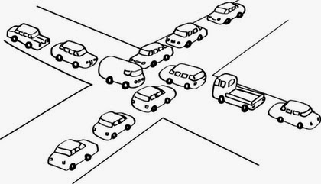
Deadlocks (cont.)
Why did the deadlock occur?
notice where the sleep() call was made: inside a synchronized method
The monitor that was acquired is not released (e.g. someone goes to the bathroom, locks the door and falls asleep)
No other threads can update the accounts in the bank

Slide 39
Fixing the Deadlock
Task:
Fix the code in BankDemoDeadlock by employing the wait() and notifyAll() methods
Remember, you must give up the monitor before sleep() is called
Try varying the sleep time to see what effect this has.

Slide 40
Avoiding Deadlock
Deadlock can be easily avoided by using a simple technique known as resource ordering
With this technique, you assign an order on all the objects whose locks must be acquired and ensure that each thread acquires the locks in that order

Slide 41
Synchronized Collections
The classes in the Java Collections Framework are not thread-safe, You can protect the data in a collection by locking the collection or using synchronized collections.
The Collections class provides six static methods for wrapping a collection into a synchronized version. The collections created using these methods are called synchronization wrappers
(next slide)

Slide 42
java.util.Collections
Collection synchronizedCollection(Collection c)
List synchronizedList(List list)
Map synchronizedMap(Map map)
Set synchronizedSet(Set set)
SortedMap synchronizedSortedMap(SortedMap map)
SortedSet synchronizedSortedSet(Sorted set)

Slide 43
Vector, Stack, and Hashtable
Invoking synchronizedCollection(Collection c) returns a new Collection object, in which all the methods that access and update the original collection c are synchronized. These methods are implemented using the synchronized keyword. For example, the add method is implemented like this:
public boolean add(E o) {
synchronized (this) { return c.add(o); }
}
The synchronized collections can be safely accessed and modified by multiple threads concurrently.
The methods in Vector, Stack, and Hashtable are already synchronized; these classes were introduced prior to the collections framework. You should use ArrayList to replace Vector, LinkedList to replace Stack, and Map to replace Hashtable.
If synchronization is needed, use a synchronization wrapper

Slide 44
Synchronization Summary
if a class has synchronized methods, each object of that class gets a queue to hold waiting threads
there are two ways onto that queue: calling a synchronized method when the monitor isn’t available or by calling wait
when a synchronized method returns or when wait is called, the monitor is released

Slide 45
Exceptions in multi-threaded Applications
If an exception occurs on a thread, the thread is terminated if the exception is not handled
However, the other threads in the application are not affected
Program
Thread 1
Thread 2

Slide 46
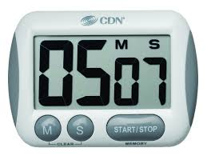
Timers
Examples of the user of timers:
updating the display every second in a clock application
play an alarm sound at a predetermined time
Java classes used to accomplish timer functionality:
java.util.Timer
java.util.TimerTask
Timer cannot guarantee the event will fire at the precise interval
ScheduleTest

Slide 47
schedule() variations
You can run tasks once, as in the previous example
You can run at recurring intervals with
Fixed Delay
a fixed amount of time elapses between the end of the task's execution and the beginning of the next execution
Fixed Rate
begin execution at fixed time intervals
more common
TickTockExample

Slide 48
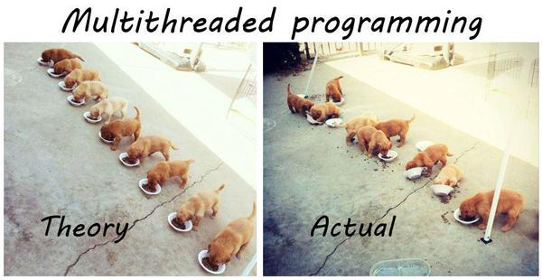
https://twitter.com/rundavidrun/status/543480950739308544

Slide 49
Read
http://javarevisited.blogspot.ca/2014/07/top-50-java-multithreading-interview-questions-answers.html

