Slide 1

Project Title -Seasonal Agriculture Performance Analysis
[Japji Johar
Graphic era deemed university, Dehradun]
AICTE STU ID: STU6a2e538b7bb701781420939

Slide 2

PROBLEM STATEMENT
Agricultural activities are influenced by seasonal variations in environmental conditions, farming practices, resource availability and market conditions. As a result, agricultural performance may differ from one season to another. However, raw agricultural data does not clearly explain how agricultural performance changes across seasons or what patterns can be observed in different seasonal conditions. The problem is to analyze the given agricultural dataset and investigate seasonal differences in agricultural performance by identifying meaningful patterns, trends, relationships and variations within the available data.

Slide 3
Project Description Seasonal Agriculture Performance Data Analytics is a data analysis project focused on understanding agricultural performance across different crops and seasons. The project analyses 4,000 farm records with 28 variables, including rainfall, temperature, soil conditions, fertilizer usage, irrigation methods, crop yield, production, revenue, profit, water usage, and disease/pest risk. The data is cleaned and explored using Python, Pandas, NumPy, Matplotlib, and Seaborn. Various techniques such as descriptive statistics, univariate analysis, bivariate analysis, correlation analysis, seasonal analysis, and outlier detection are used to identify patterns and relationships affecting agricultural performance. The project aims to generate meaningful data-driven insights that can help in better crop selection, resource management, productivity improvement, and agricultural decision-making.

Slide 4

WHO ARE THE END USERS?
Farmers – to make better decisions about crop selection, irrigation, fertilizers, and seasonal planning.
Agricultural Departments & Government Agencies – to understand agricultural trends and support policy planning.
Agricultural Researchers – to study factors affecting crop yield and productivity.
Agribusinesses & Cooperatives – to improve resource management and crop profitability.
Agricultural Consultants – to provide data-driven recommendations to farmers.
Students & Data Analysts – for studying agricultural trends and developing analytical models.

Slide 5

Technology Used
Tools & Technologies
Python — Programming Language
Jupyter Notebook — Development Environment
Pandas — Data manipulation and analysis
NumPy — Numerical calculations
Matplotlib — Data visualization
Seaborn — Statistical visualization

Slide 6
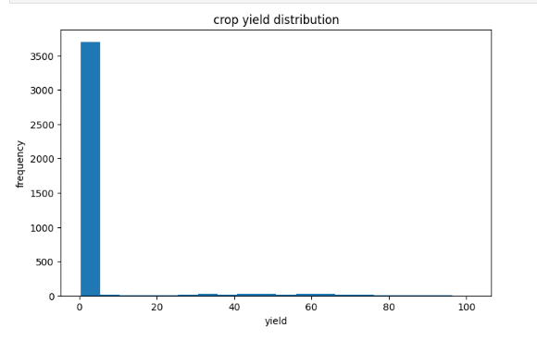
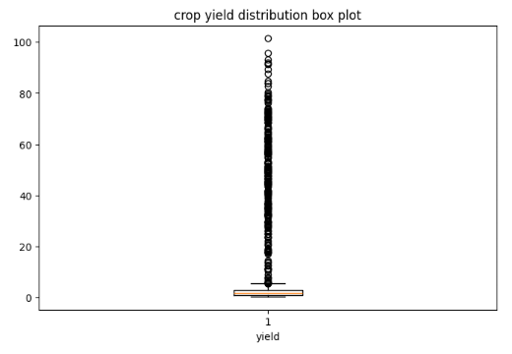
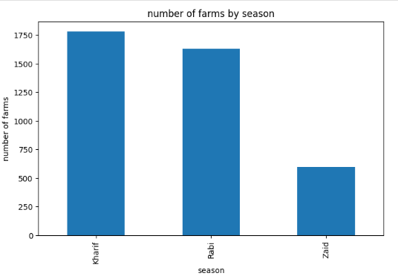
RESULTS:
Crop & Season Performance
The analysis compared crop performance across different agricultural seasons.
Average yield was calculated for each season.
Different crops showed variations in their average yield.
The best-performing crop and season were identified based on average yield.
This analysis helps understand seasonal and crop-wise productivity.

Slide 7
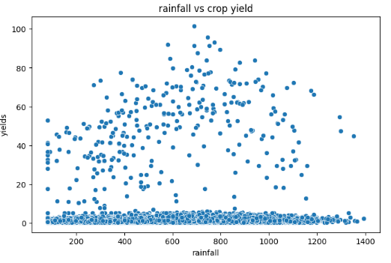
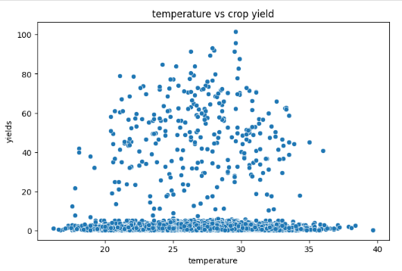
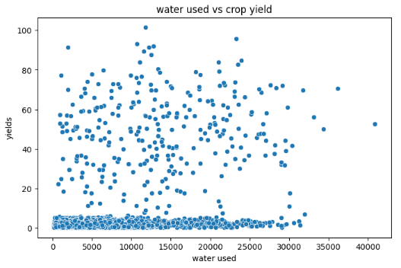
RESULTS:
Environmental Factors & Yield
The relationship between rainfall and crop yield was analysed.
The relationship between temperature and crop yield was examined.
Water usage and yield were also compared.
Scatter plots were used to visualize these relationships.
These results help identify environmental factors associated with agricultural productivity.

Slide 8
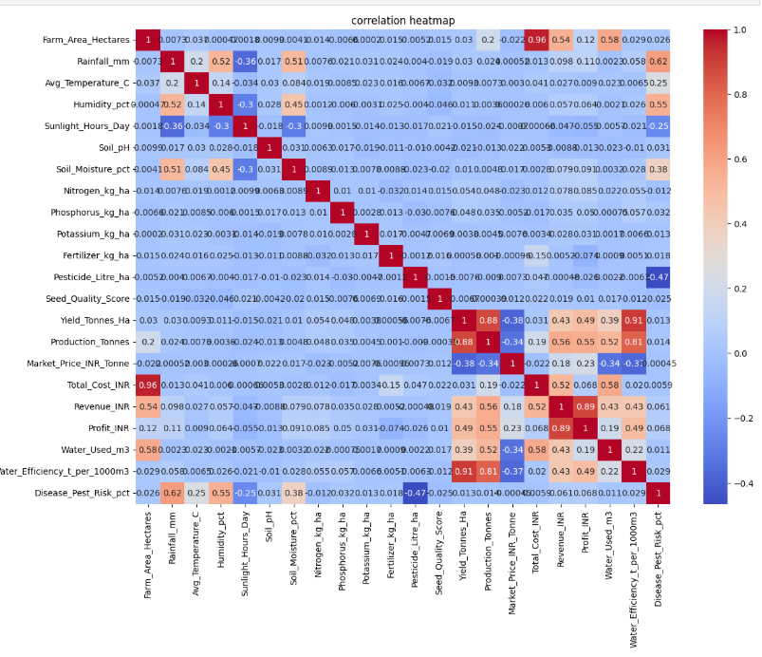
RESULTS
Correlation Analysis
A correlation matrix was created for the numerical variables.
The correlation heatmap helped identify positive and negative relationships.
Important relationships between environmental factors, agricultural inputs, yield, production and profit were examined.
Stronger correlations can help identify variables that deserve further investigation.
Correlation was interpreted as association, not proof of causation.

Slide 9
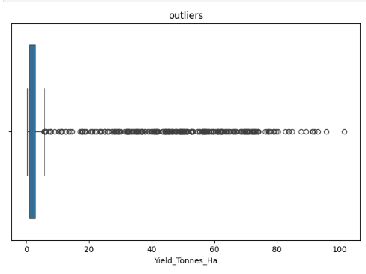
RESULTS
Outlier Analysis
Crop yield was analysed to identify unusual observations.
Box plots were used for visual identification of potential outliers.
Identified outliers were considered for further investigation rather than being automatically removed.
This analysis helps improve the reliability and understanding of the dataset.

Slide 10
RESULTS
Overall Findings
Agricultural performance varies across different crops and seasons.
Environmental conditions such as rainfall and temperature show relationships with crop yield.
Agricultural inputs and resource usage can be compared to understand their association with productivity.
Yield, production and profitability provide different perspectives on farm performance.
The analysis provides a foundation for data-driven crop planning, resource management and agricultural decision-making.

Slide 11
Future scope
Develop a Machine Learning model to predict crop yield based on environmental and agricultural factors.
Build a crop recommendation system that suggests suitable crops for different seasons and soil conditions.
Add real-time weather data to improve agricultural predictions.
Develop a dashboard or web application for farmers and agricultural departments.
Predict crop profitability using production costs, market prices, revenue and other factors.
Include disease and pest prediction to provide early warnings.
Improve water and fertilizer optimization for efficient resource management.
Expand the dataset with more regions, crops and years to improve the reliability of the analysis.

Slide 12
GitHub Link:
https://github.com/japjijohar/Seasonal-Agriculture-Performance-Analysis/tree/main
GitHub repository

Slide 13
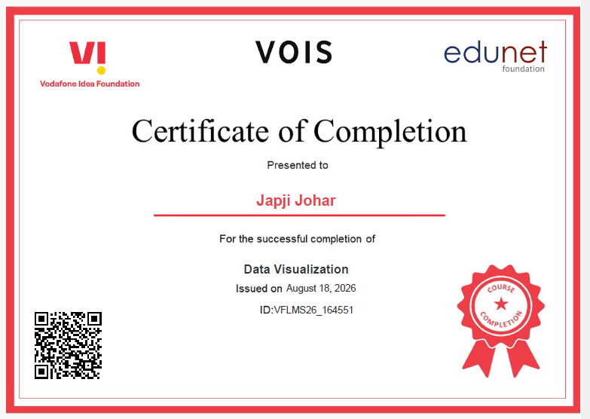
VOIS Course completion certificate - Course name- Data Visualization

Slide 14
Thank you
.
.

