Slide 1
React Testing Library (RTL)
David Armendáriz

Slide 2

What is RTL?
It was created by Kent C. Dodds. It is an alternative to Airbnb Enzyme.

Slide 3
React Testing Library
Enzyme gives React developers utilities to test internals of React components.
React Testing Library puts the developer in the shoes of an end user
RTL

Slide 4
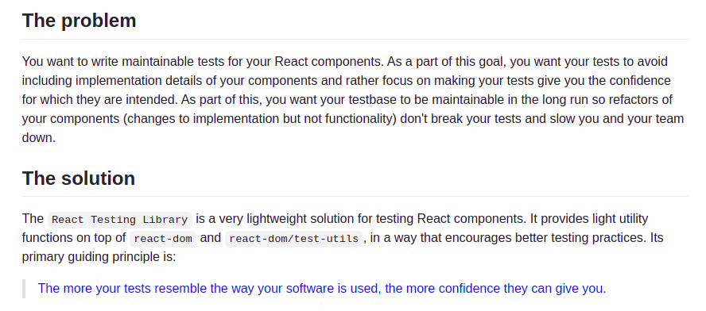

Slide 5
Jest
Beginners often confuse the tools for testing in React.
RTL is not an alternative to Jest
They need each other in order to work
Is it an alternative?

Slide 6
Jest
In modern React, developers will not get around Jest for testing
It is the most popular testing framework out there for JS
Is it an alternative?

