Slide 1
AI/ML Project
Submitted by : Japneet Singh (2210990434)
Submitted to : Dr. Shagun Sharma
Mr. Tushar Khitoliya
Chitkara University Institute of Engineering and Technology,
Chitkara University, Punjab

Slide 2
Table of Contents
Problem Statement
Technical Details
Key Features
Conclusion
References/Links used

Slide 3
Problem Statement
Creating a user-friendly calculator application using Python's Tkinter library to provide a simple yet effective tool for basic arithmetic calculations. The goal is to develop a responsive and intuitive interface that allows users to perform mathematical operations conveniently.

Slide 4
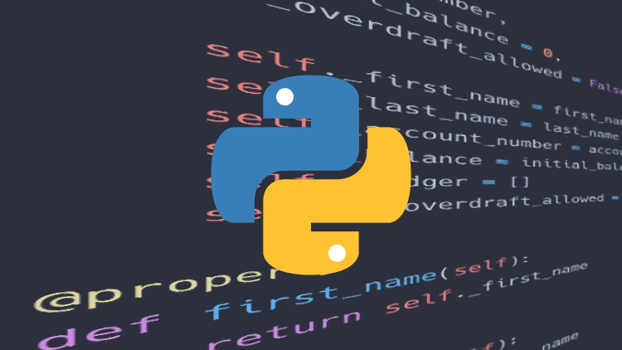

Technical Details
Programming Language : Python
GUI Library : Tkinter
Development Environment : Visual Studio Code

Slide 5
Key Features
Simple Interface : A clean and user-friendly design for easy navigation and operation.
Basic Arithmetic Operation : Support for addition, subtraction, multiplication and division.
Memory Function : Ability to store and recall previous results.
Error Handling : Proper error handling of invalid inputs and division by zero errors.
Keyboard Support : Option for users to input numbers and operations using both keyboard and mouse.

Slide 6
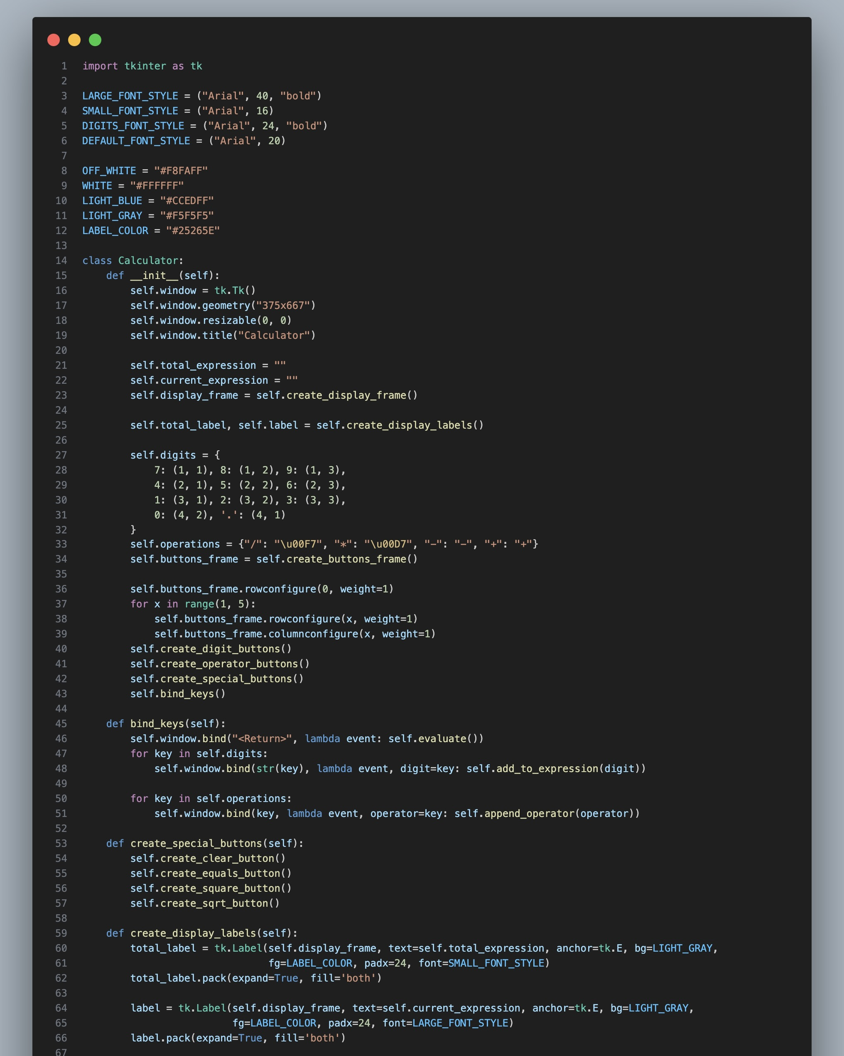
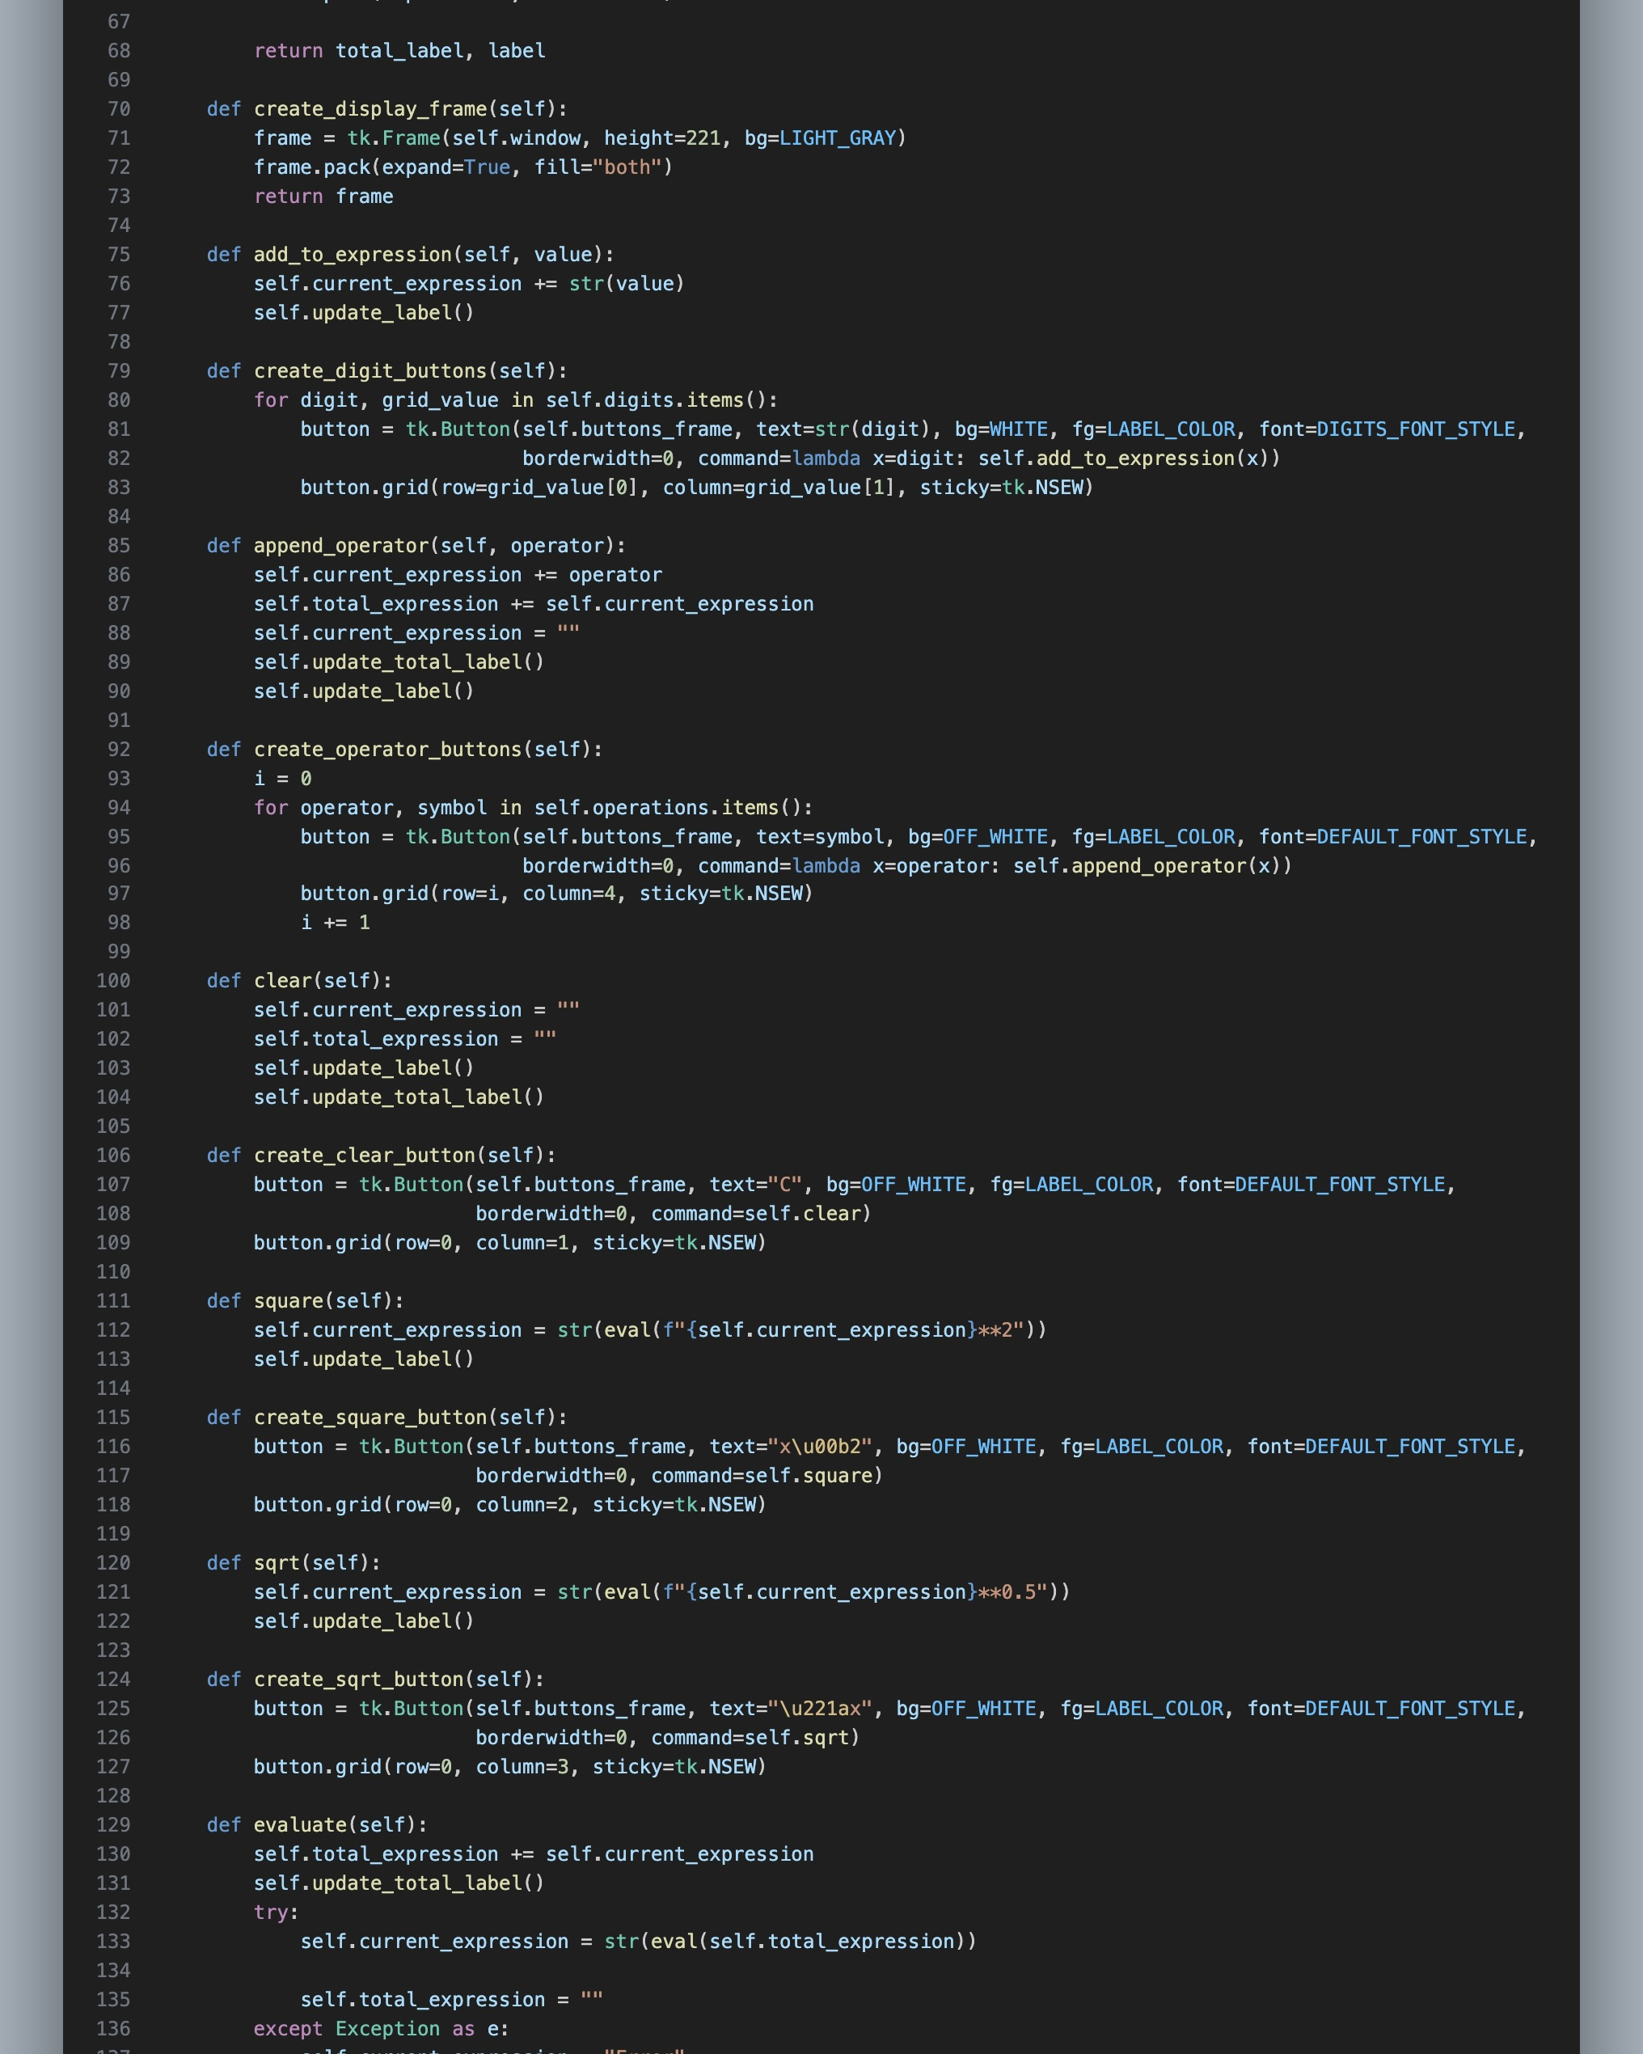
Code Snippets

Slide 7
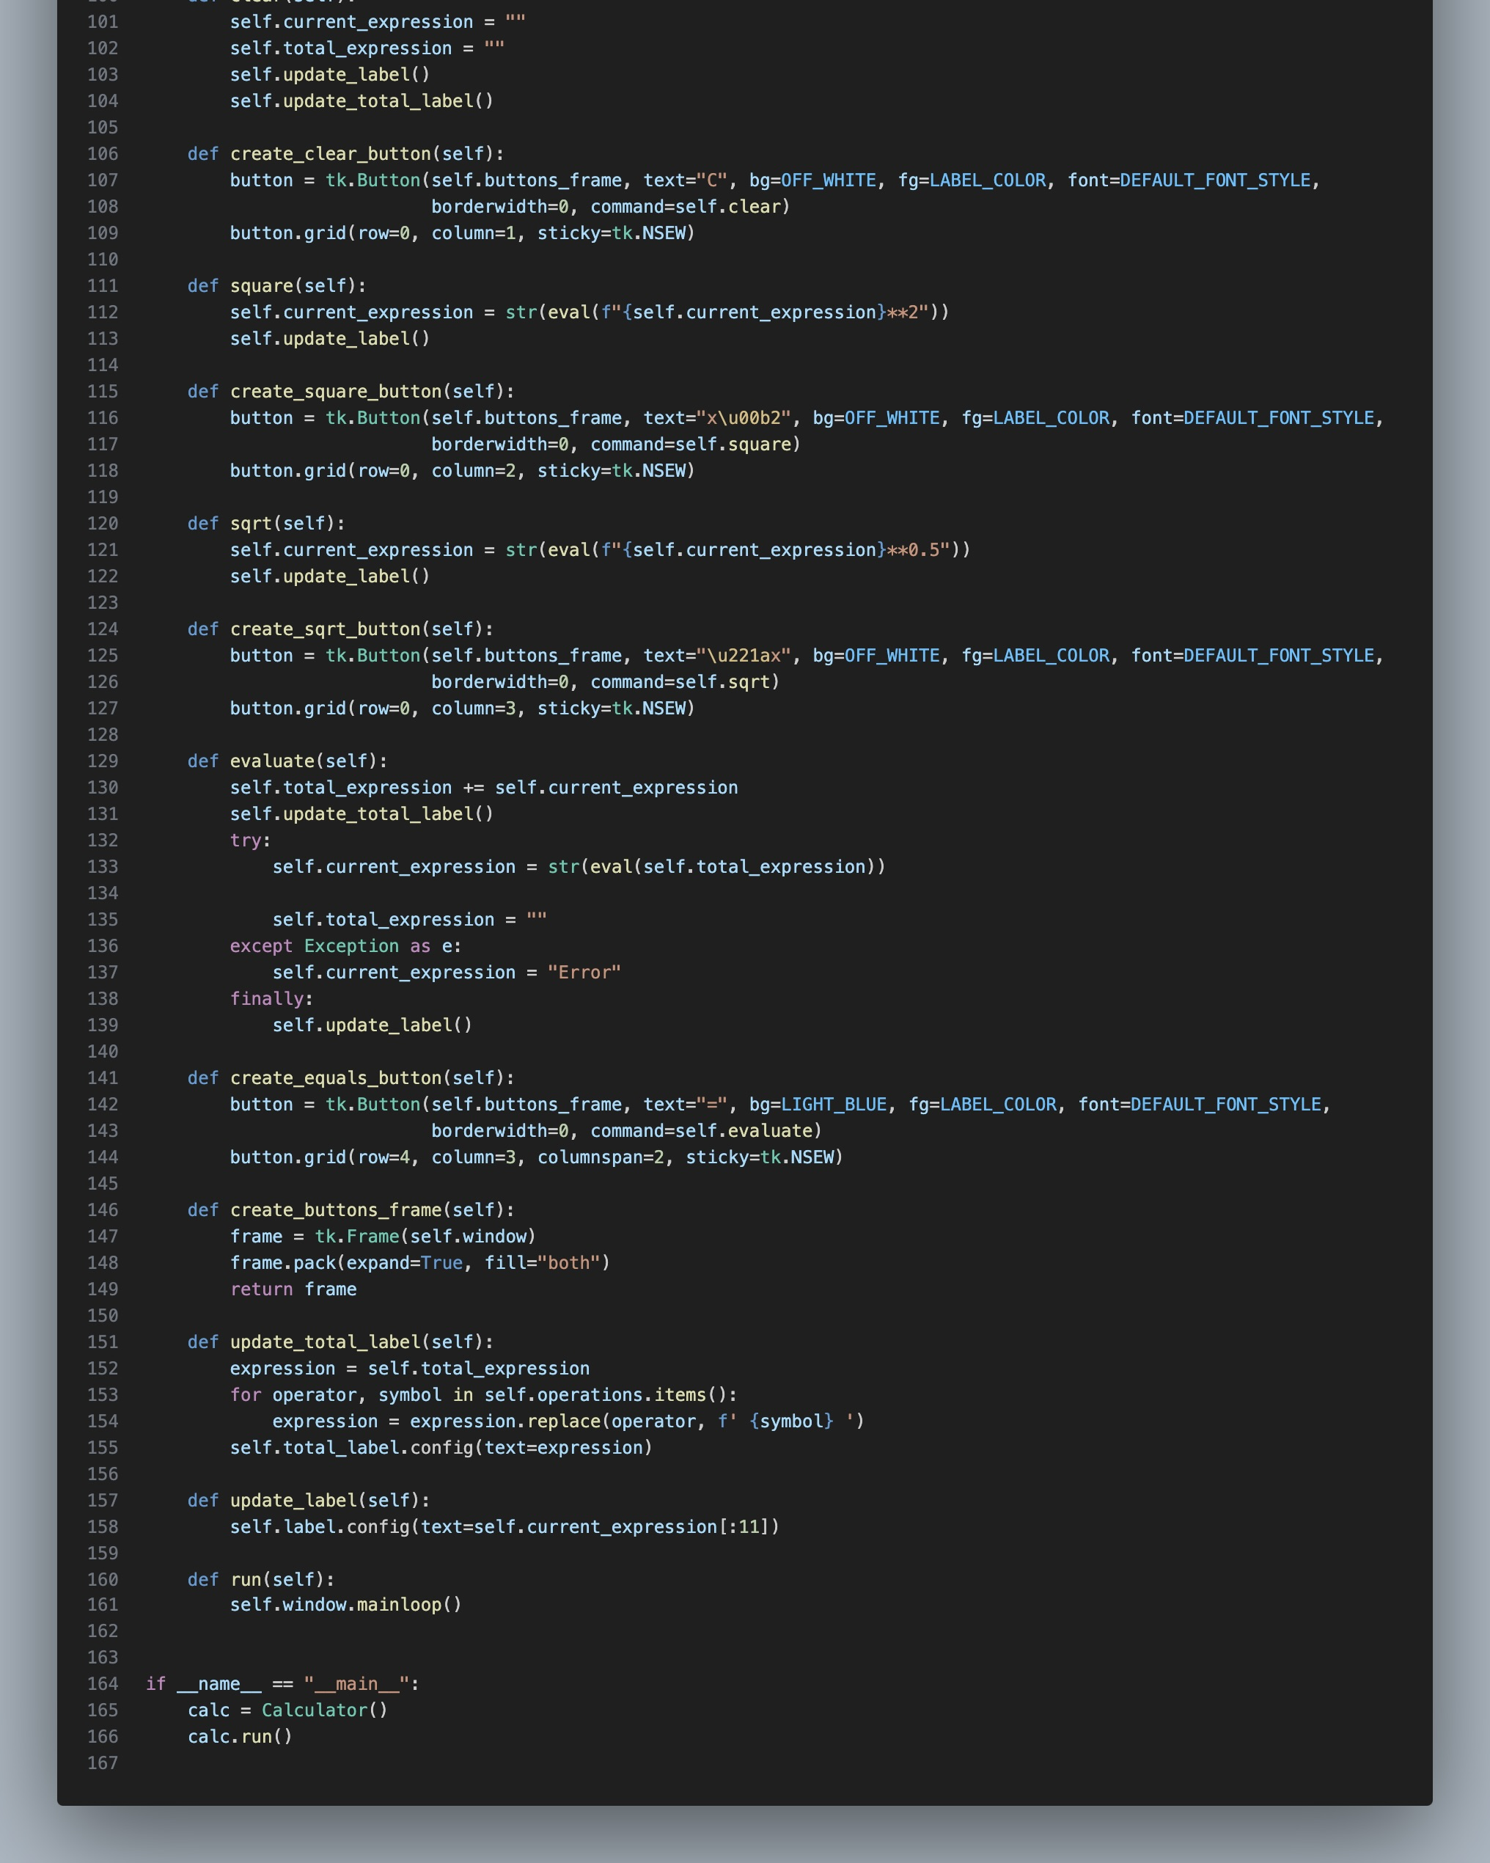
Code Snippets

Slide 8
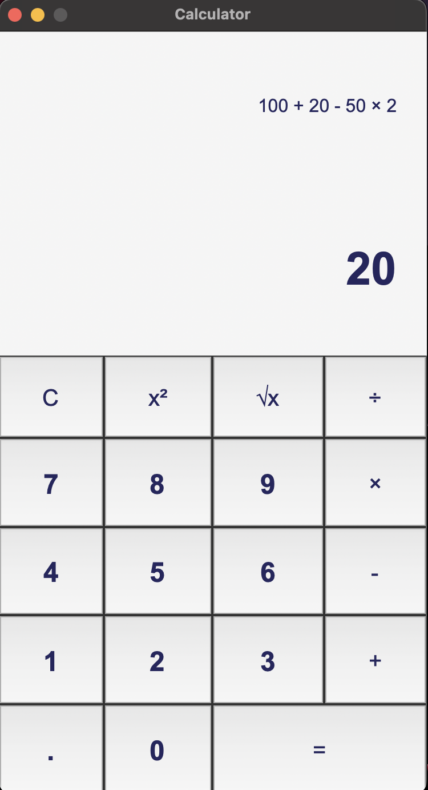
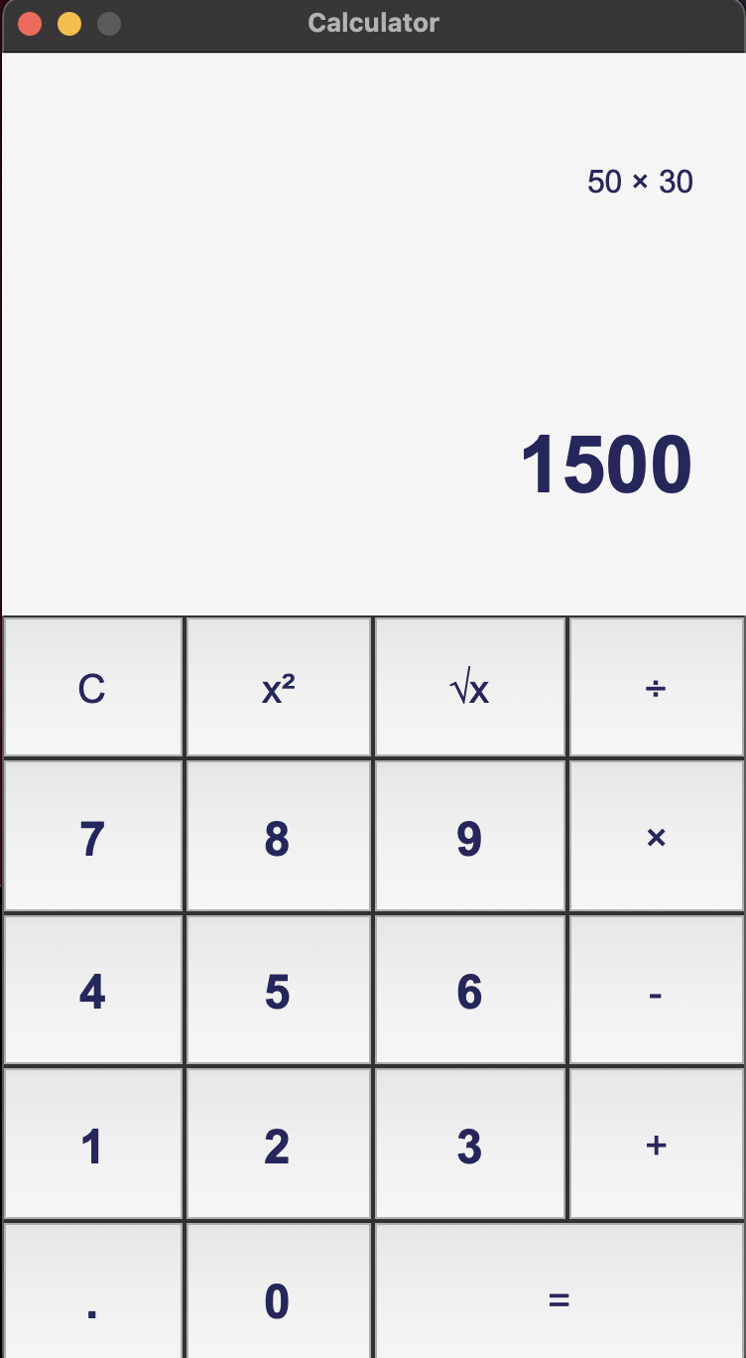
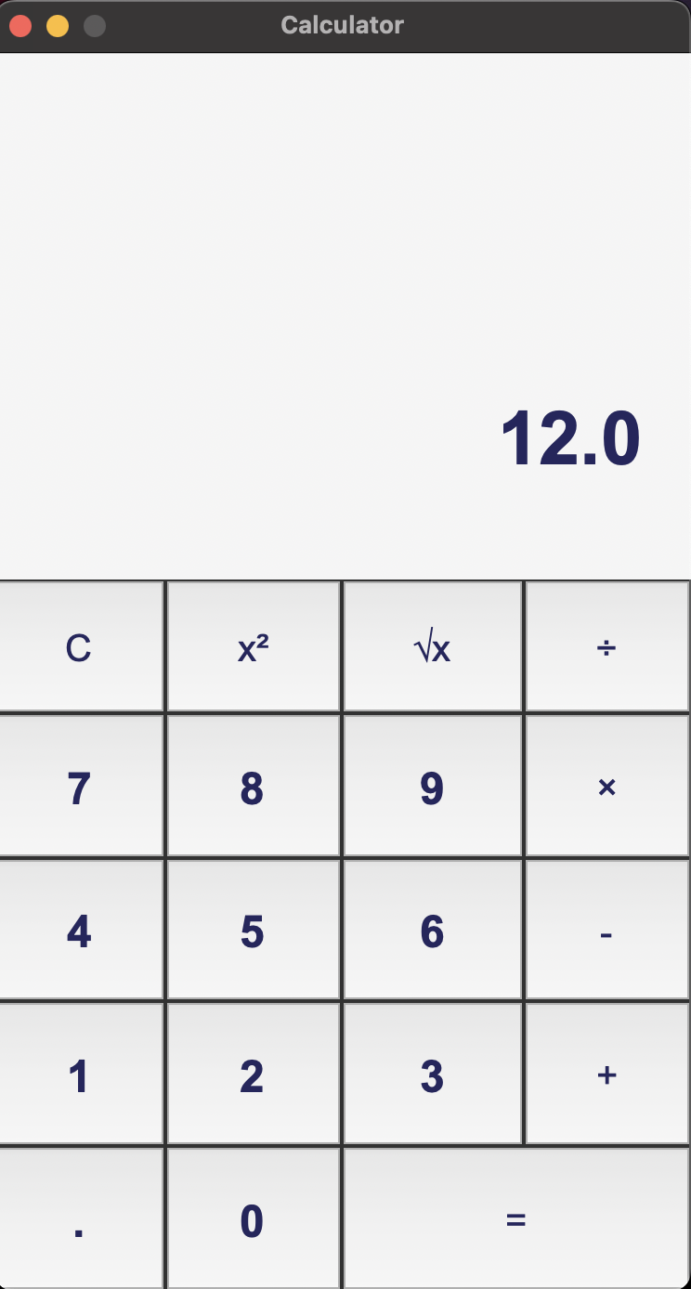
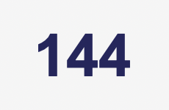
Calculator Interface

Slide 9
Conclusion
The Python Tkinter-based calculator project offers a practical solution for performing everyday arithmetic calculations. With its intuitive interface and essential features, it serves as a handy tool for users needing quick and accurate mathematical computations. Through effective development practices and attention to user experience, this project demonstrates the potential of Python and Tkinter in building desktop applications.

Slide 10
References/Links used
Tkinter Documentation : https://docs.python.org/3/library/tk.html
Python Installer : https://www.python.org/downloads/

Slide 11


